Slide 1
NDUBUISI JOSEPH CHUKWUMA
GITHUB PROFILE NAME: ndubuisijosephalx
Linkedin : Joseph Ndubuisi
Gmail: ndubuisijoseph47@gmail.com

Slide 2
BACKGROUND
In recent years Connecticut states are witnessing increasing drugs accidents cases that increase the death rate of their citizens on daily basis. There is no doubt that illicit drug usage in Connecticut poses a compelling threat to public health.
According to the National Survey on Drug Use, Connecticut ranks in the top 10 for dependence on illicit drugs for adults aged 18 to 25. Drug-related incidents claim more lives than motor vehicle accidents or incidents involving firearms. Opioids remain a primary concern, with heroin being the most commonly cited reason for treatment admissions in the Nutmeg State. Local and federal officials are committed to addressing the opioid epidemic, but public awareness plays a role in adopting legislation to curb the incidence and prevalence of drug overdose and drug-related death.
References:
Connecticut Saw 1,374 Deadly Drug Overdoses in 2020 – NBC Connecticut
Insights and Trends in Connecticut’s Drug Epidemic (theduneseasthampton.com)

Slide 3
Problem Statement
Connecticut wants to know the measures to take to control death rates as related to drug accidents across her states.

Slide 4
Project Goal
My approach to these problems is to analyze the dataset to gain meaningful insight and understanding of the following;
Trends and patterns in drug accident-related cases.
Associativity between features
The relationship between variables.
Upon completion of this project, I should be able to make professional recommendations to the Connecticut drug regulatory Agency on how to control the usage of illicit drugs by suggesting a policy that will help mitigate the problem.
My findings will be communicated to it drug regulatory agency to help reduce the use of hard drugs to the barest minimum in the future.

Slide 5
Analysis Questions
What is the association and relationship between drug usage and death rate?
What are the trends and patterns in drug accidents in recent years?
Who are the most affected age group?
Which state is most affected by drug usage?
What are the outcomes of illicit drugs after use?

Slide 6
Dataset Description
The analysis will be based on Accidental Drug Related Deaths 2012-2021. I downloaded the dataset from Accidental Drug Related Deaths 2012-2021 - Catalog (data.gov)
The dataset included data between 2012 and 2021.

Slide 7
Method
EDA and Data Cleaning
The drug accidents dataset is a categorical dataset that contains 42 columns and 9,202 rows, with 3,163 unique values. Some of the columns contain a large portion of missing values and do not communicate good information for our analysis, so I remove them and remodified the columns with 24 columns and 9,202 rows. Some of the columns that contain spaces that cannot be used by the dot method were renamed accordingly and some of the contents of the rows were modified to communicate a better understanding of what they stand for. The date datatype was converted to Date Time and the Age group was converted to the category data type for insightful analysis.
The columns containing 80 percent of missing values were dropped since it does not represent a good insight into the information we need.

Slide 8
Method Continuation
The columns and rows containing duplicate values were dropped as well. The heatmap visualization graph was also used to visualize the missing values in the dataset.

Slide 9
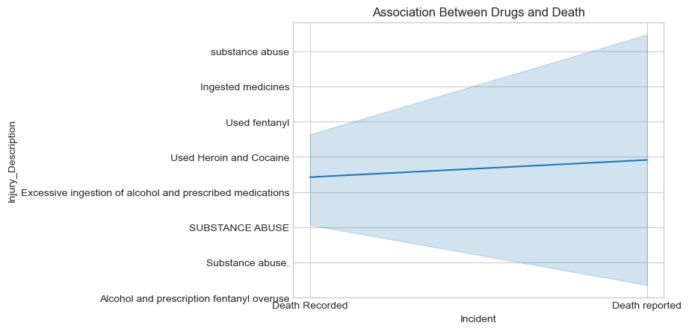
Data Analysis Associativity Between Drugs Accidents and Death
Ingested medicines, used fentanyl, used heroin and cocaine, excessive alcohol injection and prescribed medication in this order are also other victims killers
The most common drug usage that led to many recorded and reported of Connecticut citizens was substance abuse.

Slide 10
Data Analysis Interpretation
The reports shows that most people that died was a result of illicit drugs usage. Their deaths were associated with drug abuse , drug overdose etc. The report suggest that there is a strong relationship between drugs and death rate.

Slide 11
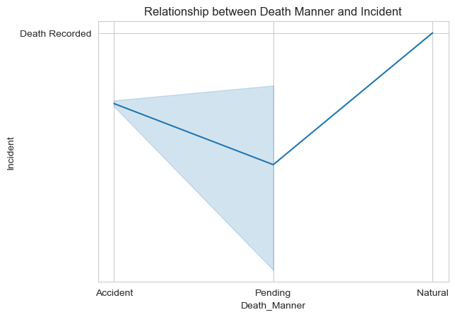
Relationship Between Manner of Death and Incident Cause

Slide 12
Analysis
The chart shows that most victims died as result drugs accidents. Thus, there is a strong relationship between the manner of death and the Incident cause

Slide 13
Associativity between drugs and death rates
Injury Description Percentage ACUTE AND CHRONIC SUBSTANCE USE DISORDER 0.333333 ALCOHOL MEDICATION ABUSE 0.333333 Abuse 0.333333 Abuse of Inhalants 0.333333 Abuse of Medication 1.333333 used Fentanyl 0.333333 used alcohol and prescription medications 0.333333 used heroin 0.333333 used methadone 0.333333 used multiple medications 0.333333

Slide 14
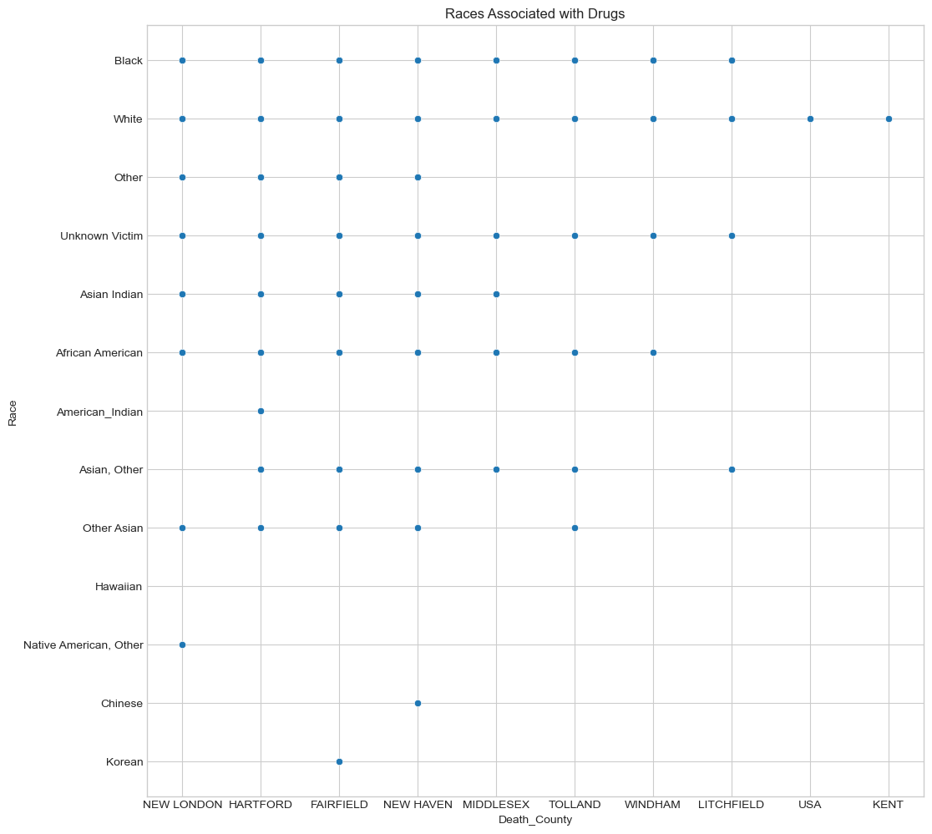
Races Associated with Drugs Visualization

Slide 15
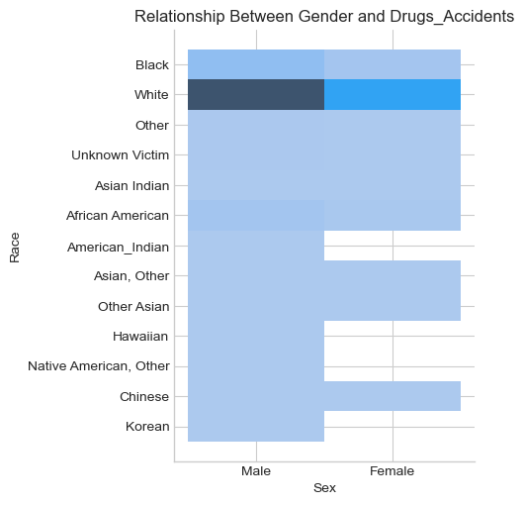
Relationship Between Gender and Drugs Accidents

Slide 16
Analysis
The white race is densely affected by drugs. The black are the next in the chart. Unknown affected victims also takes a significant percentage. Chinese, Korean and North America are the least in the chart.

Slide 17
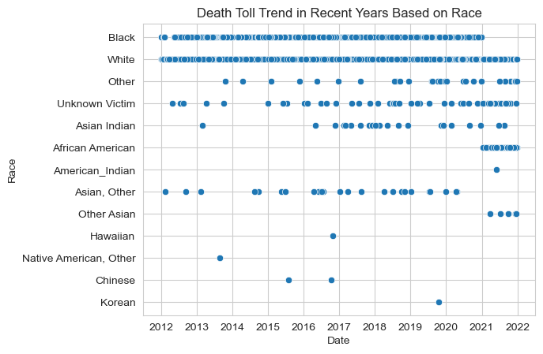
Trends and Patterns of Drugs Accidents In Recent Years
Drugs accidents is common among the white race than every other race with a continuous increase from 2012 to 2022 with a percentage of 63.40 death recorded and 0.01 death reported cases. The blacks are second in the top chart with 6.61 death recorded and 1.45 death reported cases in recent years

Slide 18
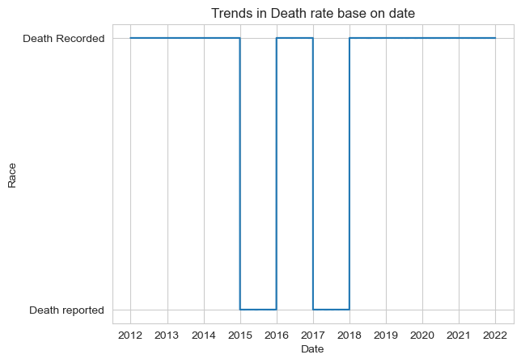
Date Rate Trends Based on date

Slide 19
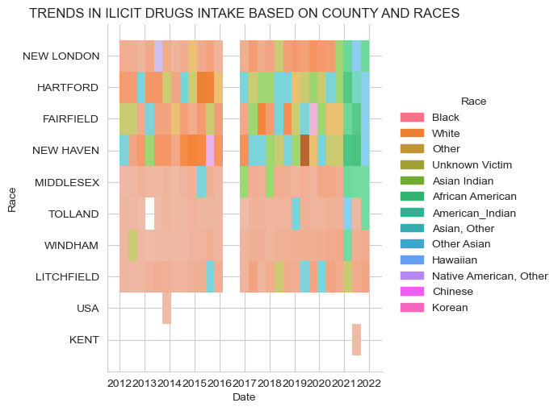
Trends in Illicit Drugs Intake Based on County and Races

Slide 20
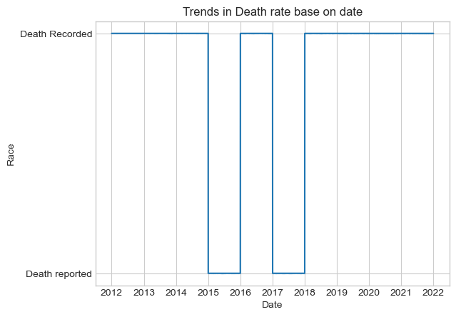
Trends in Death Rate Over the Years

Slide 21
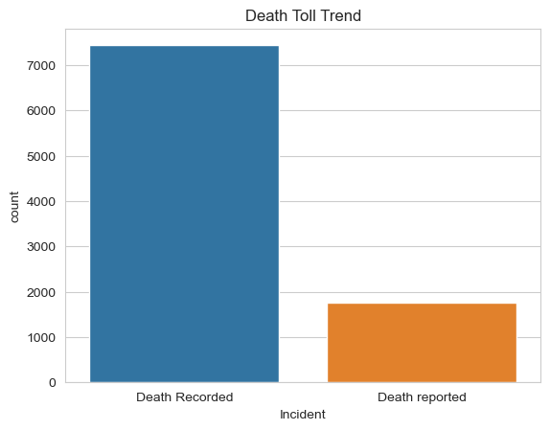
Death Frequency
Death Recorded: 7435
Death Reported: 1766

Slide 22
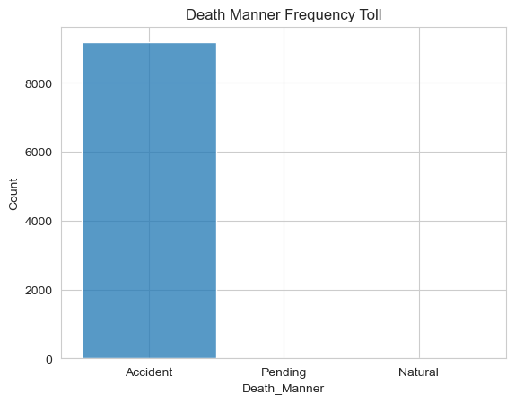
Death Manner Frequency

Slide 23
Date Race Death Manner Incident Percentage
20 12 -2022
African American Accident Death Recorded 2.84
American Indian Accident Death Recorded 0.01
Asian Indian Accident Death Recorded 0.15
Death reported 0.06
Asian, Accident Death Recorded 0.19
Death reported 0.05
Black Accident Death Recorded 6.61
Death reported 1.45
Pending Death Recorded 0.01
Chinese Accident Death Recorded 0.01
Death reported 0.01
Hawaiian Accident Death Recorded 0.01
Korean Accident Death Recorded 0.01
Native American, Other Accident Death Recorded 0. 01
Other Accident Death Recorded 0.25
Death reported 0.03
Pending Death Recorded 0.01
Other Asian Accident Death Recorded 0.06
Unknown Victim Accident Death Recorded 0.42
Death reported 0.06
White Accident Death Recorded 63.40
Natural Death Recorded 0.01
Pending Death Recorded 0.07
Natural Death reported 15.90
Death Recorded 0.01
Pending Death Recorded 0.07
Death reported 0.05
Trends in Death Rate Analysis Report

Slide 24
The top five major causes of death and the most affected citizens
Date Sex Race Age Death County Drugs Types 2015-06-16 White 61.0 NEW HAVEN oxycod, morphine, benzo 2013-10-23 Female Other 30.0 HARTFORD oxy benzo intox 2013-11-27 Female White 37.0 NEW HAVEN morphine, benzodiaz, trazadone buprop 2015-05-12 Male White 47.0 FAIRFIELD methadone, oxycod benzo 2015-06-24 Female White 60.0 NEW HAVEN methadone

Slide 25
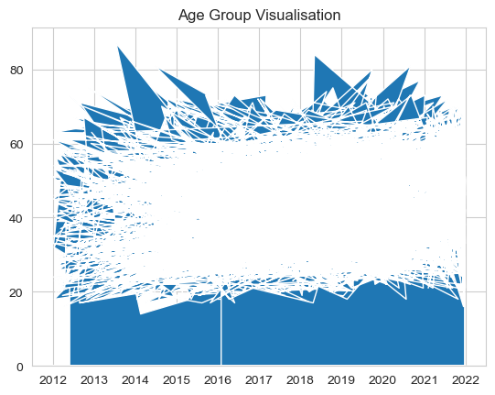
Affected Victims Age Groups Trends in Rescent Years
In 2015 the death of the oldest victim was recorded.
He died at the age of 87 as result of drug abused

Slide 26
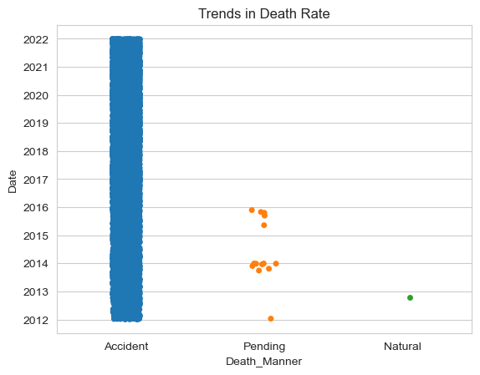
Death Toll In Recent Years
Highest Ranking Death Case Recorded
Date: 2021-12-31
Incident : Death Recorded
Age : 87
Cause of Death: The combined effects of Fentanyl, Heroin, Oxyc...

Slide 27
Trends in Death Rate Across Connecticut

Slide 28
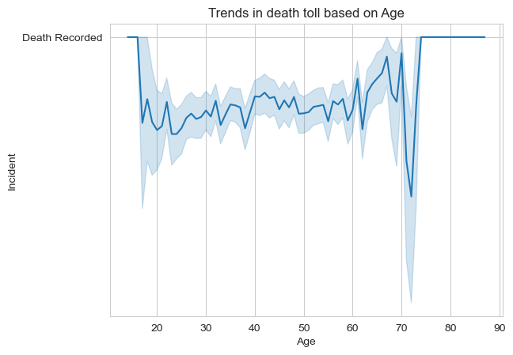
The Trend in Death Toll Based on Age

Slide 29
Outcome Analysis
From the plot, the age group of 17 and 70 are the most affected age group while there is a slight decline between the ages of 71 and 73 while from 73years and above there is an increase in the death toll

Slide 30

Affected Age Groups
The affected age group ranges from 17years to 87years respectively

Slide 31
Major addicted drugs victims and their respective traits
Sex Race Age Death County Percentage
Male White 41 NEW HAVEN 0.49
34 HARTFORD 0.49
54 HARTFORD 0.48
31 NEW HAVEN 0.48
40 NEW HAVEN 0.47
Asian Indian 27 HARTFORD 0.01
28 HARTFORD 0.01
30 NEW HAVEN 0.01
31 FAIRFIELD 0.01
White 87 NEW HAVEN 0.01

Slide 32
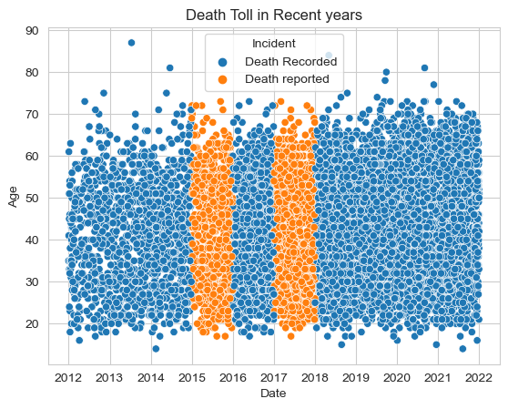
Age Range Death Toll In Recent Years

Slide 33
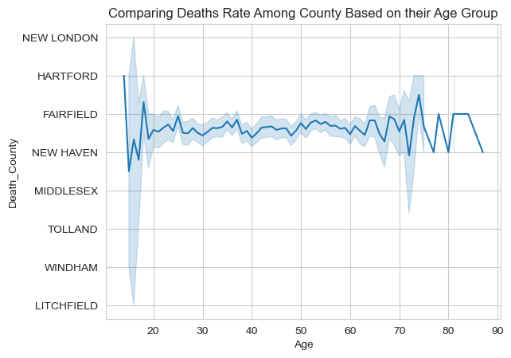
Death Rate Comparison Among County
There is death occurrence among all Age group except 17 below and 87 aboves

Slide 34
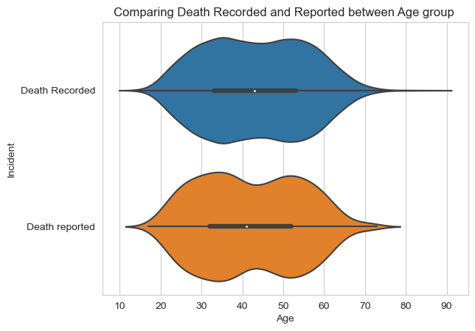
Incident Base on Age Comparison
There were many death cases recorded than reported

Slide 35
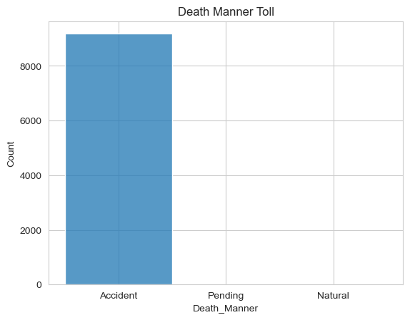
Death Manner Toll

Slide 36
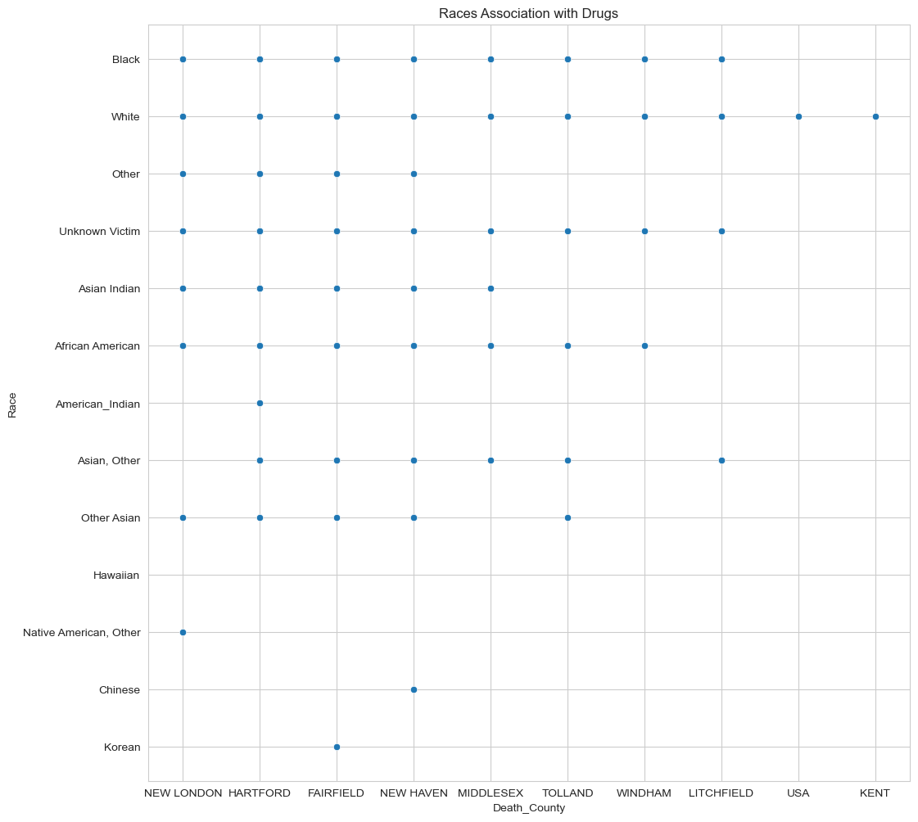
Races Association With Drugs

Slide 37
Top 5 locations where victims suffered injury as a result of ilicit drugs usage
Injury County Injury State Injury City Injury Place Injury Description Age HARTFORD CT HARTFORD Residence Substance Abuse 83 NEW HAVEN CT WATERBURY Residence Substance Abuse 78 FAIRFIELD CT BRIDGEPORT Residence Substance Abuse 64 NEW HAVEN CT NEW HAVEN Residence Substance Abuse 59 HARTFORD CT HARTFORD Residence Drug Use 43

Slide 38
The top five major causes of death and the most affected citizens
Date Sex Race Age Death County Drugs Descriptions
2015-06-16 Male White 61.0 NEW HAVEN oxycod, morphine, benzo
2013-10-23 Female Other 30.0 HARTFORD oxy benzo intox
2013-11-27 Female White 37.0 NEW HAVEN morphine, benzodiaz, trazadone, buprop
2015-05-12 Male White 47.0 FAIRFIELD methadone, oxycod benzo
2015-06-24 Female White 60.0 NEW HAVEN methadone

Slide 39
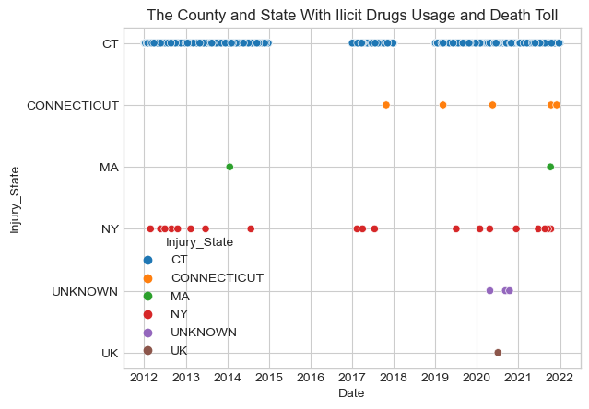
County and State Illicit Drugs Usage

Slide 40
The Injured Race
Race Frequency White 2487 Black 311 African American 85 Unknown Victim 19 Asian Indian 10 Asian, Other 9 Other 7 Other Asian 3 American Indian 1 Chinese 1 Hawaiian 1 Korean 1 Native American, Other 1

Slide 41
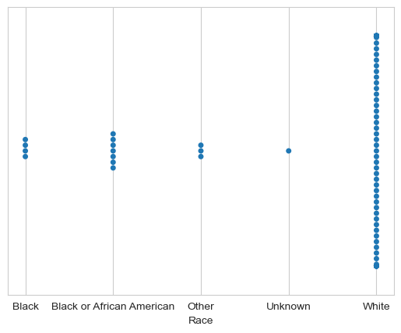
Top Five Affected Races
Hierarchy
White
African American
Black
Other Races
Other

Slide 42
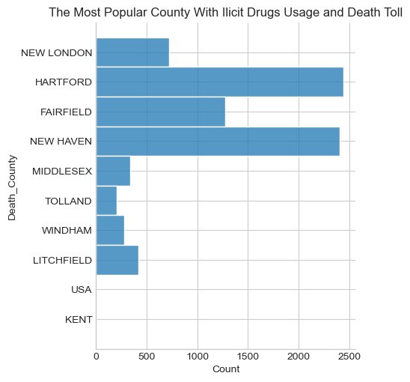
Popular County with Illicit Drugs Usage
Hierarchy
Hartford
New Haven
Fairfield
New London
Litchfield
Middlesex
Windham
Tolland

Slide 43
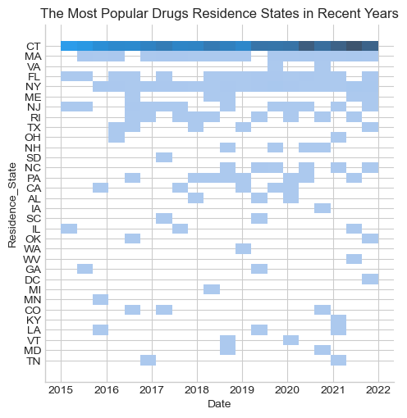
Popular Hard Drugs Residence in Recent Years

Slide 44
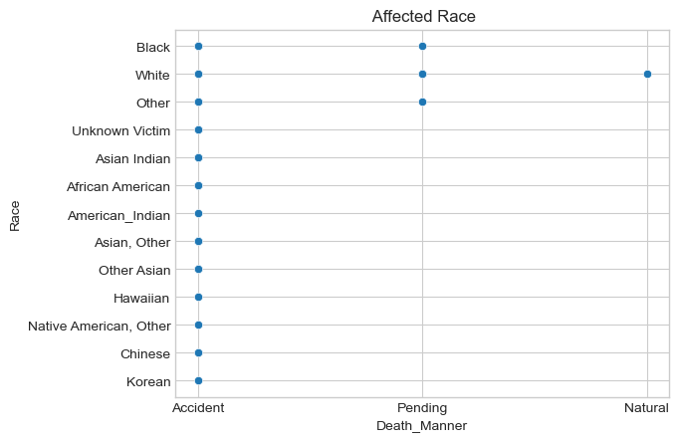
Affected Race

Slide 45
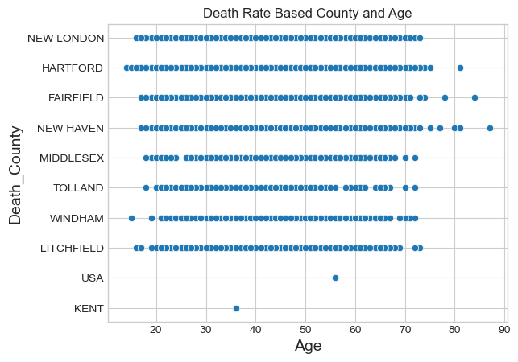
Death Rate Based County and Age

Slide 46
Highest Ranking Cases Report Analysis
In 2021/12/31, the highest-ranking age victim was reported dead at the age of 87 as a result of the combined effects of fentanyl, Heroin, Oxycodone, and diazepam. In recent years there is approximately 74.4% of death cases were recorded and 17.6% of death reported cases.
The white race is the most injured victim with a total number of 2,487 over the years while Chinese and American India have recorded 1 case respectively. 284 African Americans died as a result of drugs accidents, 661 Black died as a result of the accident,15 Asian Indian, American Indians, and 7 others

Slide 47
Percentage of injury sustained via illicit drugs
Injury Description Percentage ACUTE AND CHRONIC SUBSTANCE USE DISORDER 0.16 Substance sue 0.16 Substance use disorder 0.16 Substances Abuse 0.16 Took Drugs 0.16 Ingested medication 0.16 Ingested medications 0.16 Ingested medications and ethanol 0.16 Ingested medications, alcohol 0.16 substance abuse 0.16

Slide 48
Major addicted drugs victims and their respective traits
Sex Race Age Death County Percentage Male White 41.0 NEW HAVEN 0.49 34.0 HARTFORD 0.49 54.0 HARTFORD 0.48 31.0 NEW HAVEN 0.48 40.0 NEW HAVEN 0.47 Asian Indian 27.0 HARTFORD 0.01 28.0 HARTFORD 0.01 30.0 NEW HAVEN 0.01 31.0 FAIRFIELD 0.01 White 87.0 NEW HAVEN 0.01
Total average of addicted users 5.864

Slide 49
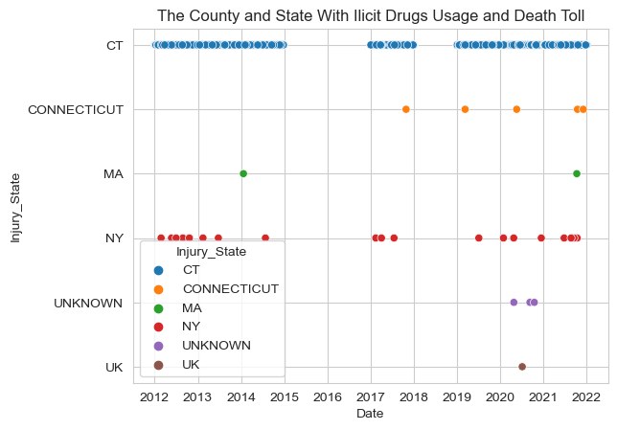
The County and State with Illicit Drugs usage and Death Toll

Slide 50
Percentage of Deaths Rates
Death County Death State Death City Death Place Death Manner Percentage FAIRFIELD CT BETHEL Other Accident 0.07 Residence Accident 0.04 BRIDGEPORT Decedent's Home Accident 0.04 Hospital Accident 1.68 Pending 0.01 WINDHAM CT WINDHAM Hospital Accident 0.04 Other Accident 0.06 Residence Accident 0.19 WOODSTOCK Decedent's Home Accident 0.01 Residence Accident 0.05

Slide 51
Death frequency based on Race
Death Manner Accident Natural Pending Race African American 284 0 0 American Indian 1 0 0 Asian Indian 21 0 0 Asian, Other 24 0 0 Black 806 0 1 Chinese 2 0 0 Hawaiian 1 0 0 Korean 1 0 0 Native American, Other 1 0 0 Other 28 0 1 Other Asian 6 0 0 Unknown Victim 48 0 0 White 7930 1 12

Slide 52
Frequency and the Average proportion of injury sustained by the different race based on drugs
Race Average African American 0.667453 American Indian 0.002358 Asian Indian 0.049528 Asian, Other 0.051887 Black 1.768868 Chinese 0.002358 Hawaiian 0.002358 Korean 0.002358 Chinese 0.002358 Hawaiian 0.002358 Korean 0.002358 Native American, Other 0.002358 Other 0.061321 Other Asian 0.014151 Unknown Victim 0.106132 White 17.049528

Slide 53
Injury Frequency Sustained Analysis Based on Races
Race White Black African American Unknown Victim Asian Indian Asian, Other Other Other Asian American Indian Chinese Hawaiian Korean Native American, Other | frequency 2487 311 85 19 10 9 7 3 1 1 1 1 1

Slide 54
Percentage of victims that died based on their race and the manner of death.
Race Death Manner Incident Average African American Accident Death Recorded 2.84 American Indian Accident Death Recorded 0.01 Asian Indian Accident Death Recorded 0.15 Death reported 0.06 Asian, Other Accident Death Recorded 0.19 Death reported 0.05 Black Accident Death Recorded 6.61 Death reported 1.45 Pending Death Recorded 0.01 Chinese Accident Death Recorded 0.01 Death reported 0.01 Hawaiian Accident Death Recorded 0.01 Korean Accident Death Recorded 0.01 Native American, Other Accident Death Recorded 0.01 Other Accident Death Recorded 0.25 Death reported 0.03 Pending Death Recorded 0.01 Other Asian Accident Death Recorded 0.06 Unknown Victim Accident Death Recorded 0.42 Death reported 0.06 White Accident Death Recorded 63.40 Death reported 15.90 Natural Death Recorded 0.01 Pending Death Recorded 0.07 Death reported 0.05

Slide 55
Examination of manner of death of drugs victims
Drugs Types Numbers of affected victims Acute Fentanyl Intoxication 416 Multiple Drug Toxicity 131 Heroin Intoxication 130 Acute Heroin Intoxication 121 Heroin Toxicity 97 Acute Methamphetamine Intoxication with Cardiac Hypertrophy 1 Intoxication due to the combined effects of Clonazepam, Cocaine, Venlafaxine, and Fentanyl 1 Acute Intoxication due to the Combined Effects of Cocaine, Heroin, Benzodiazepines and Ethanol 1 Acute Intoxication due to the Combined Effects of Heroin, Cocaine, Clonazepam, and Methylphenidate 1 Acute Intoxication by the Combined Effects of Fentanyl, Xylazine, and Methadone 1

Slide 56
The number of victims that died based on their race and the manner of death.
Race Death Manner Incident Numbers African American Accident Death Recorded 284 American Indian Accident Death Recorded 1 Asian Indian Accident Death Recorded 15 Death reported 6 Asian, Other Accident Death Recorded 19 Death reported 5 Black Accident Death Recorded 661 Death reported 145 Pending Death Recorded 1 Chinese Accident Death Recorded 1 Death reported 1 Hawaiian Accident Death Recorded 1 Korean Accident Death Recorded 1 Native American, Other Accident Death Recorded 1 Other Accident Death Recorded 25 Death reported 3 Pending Death Recorded 1 Other Asian Accident Death Recorded 6 Unknown Victim Accident Death Recorded 42 Death reported 6 White Accident Death Recorded 6340 Death reported Unknown Victim Accident Death Recorded 42 Death reported 6 White Accident Death Recorded 6340 Death reported 1590 Natural Death Recorded 1 Pending Death Recorded 7 Death reported

Slide 57
Outcomes Reported Cases and Death Rates
Our analysis shows that 74.28% death cases were recorded while 17.65% were reported as a result of hard drugs usage.
Illicit drugs has a chronic and deadly impact on the life of Connecticut citizens.

Slide 58
Proportion of Death Outcome
Death Manner Accident Natural Pending Race African American 0.030977 0.000000 0.000000 American Indian 0.000109 0.000000 0.000000 Asian Indian 0.002291 0.000000 0.000000 Asian, Other 0.002618 0.000000 0.000000 Black 0.087914 0.000000 0.000109 Chinese 0.000218 0.000000 0.000000 Hawaiian 0.000109 0.000000 0.000000 Korean 0.000109 0.000000 0.000000 Native American, Other 0.000109 0.000000 0.000000 Other 0.003054 0.000000 0.000000

Slide 59
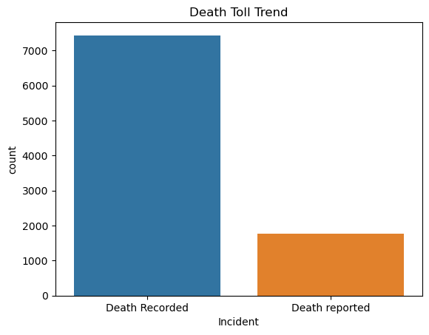
Outcomes Reported Cases and Death Rates
Sex Incident (%) Female Death Recorded 19.17 Death reported 4.51 Male Death Recorded 55.11 Death reported 13.14 Total Death Recorded 74.35 Total Death Reported 17.16
Death Cases (%) Female 23.68 Male 68.25 Total Cases =91.93

Slide 60
The oldest injured Victims that died in their residence due to hard drugs
Injury County Injury State Injury City Injury Place Injury Description Age
HARTFORD CT HARTFORD Residence Substance Abuse 83
NEW HAVEN CT WATERBURY Residence Substance Abuse 78
FAIRFIELD CT BRIDGEPORT Residence Substance Abuse 64
NEW HAVEN CT NEW HAVEN Residence Substance Abuse 59
HARTFORD CT HARTFORD Residence Drug Use 43

Slide 61
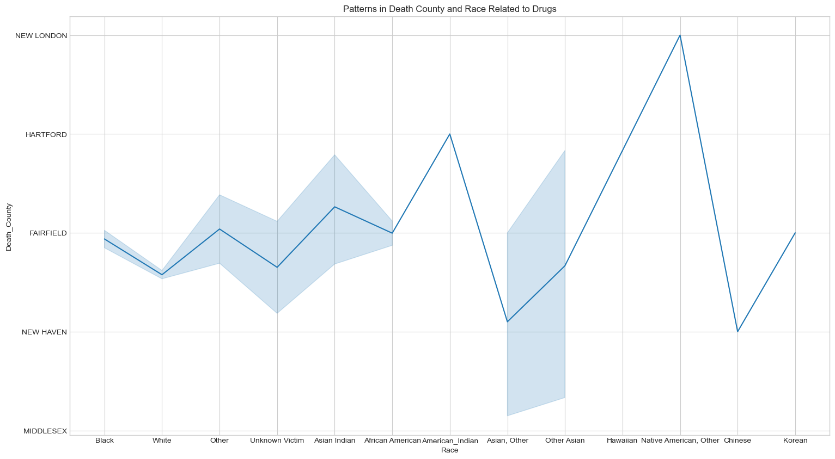
Patterns in Death County and Race Related to Drugs

Slide 62
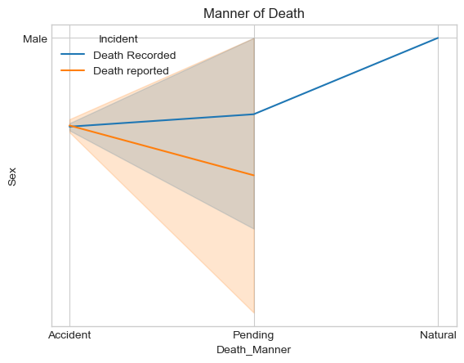
Manner of Death

Slide 63
Average of All features
Date 1.000000 Incident 1.000000 Age 0.999783 Sex 0.999131 Race 0.997392 Residence County 0.886751 Residence State 0.806978 Residence City 0.957722 Injury County 0.642756 Injury State 0.683621 Injury City 0.980654 Injury Place 0.988914 Injury Description 0.914140 Death County 0.879144 Death State 0.746875 Death City 0.999457 Death Place 0.997609 Cause of Death 1.000000 Death Manner 0.999022 Residence City Geopolitical zone 0.982067 Injury City Geopolitical zone 0.977068 Death City Geopolitical zone 0.999891

Slide 64
Outcome Summary
Features Percentage (%) Date 92.01 Incident 92.01 Age 91.99 Sex 91.93 Race 91.77 Residence County 81.59 Residence State 74.25 Residence City 88.12 Injury County 59.14 Injury State 62.90 Injury City 90.23 Injury Place 90.99

Slide 65
Race Death Manner Incident Percentage African American Accident Death Recorded 2.84 American Indian Accident Death Recorded 0.01 Asian Indian Accident Death Recorded 0.15 Death reported 0.06 Asian, Accident Death Recorded 0.19 Death reported 0.05 Black Accident Death Recorded 6.61 Death reported 1.45 Pending Death Recorded 0.01 Chinese Accident Death Recorded 0.01 Death reported 0.01 Hawaiian Accident Death Recorded 0.01 Korean Accident Death Recorded 0.01 Native American, Other Accident Death Recorded 0.01 Other Accident Death Recorded 0.25 Death reported 0.03 Pending Death Recorded 0.01 Other Asian Accident Death Recorded 0.06 Unknown Victim Accident Death Recorded 0.42 Death reported 0.06 White Accident Death Recorded 63.40 Death reported 15.90
Natural Death Recorded 0.01 Pending Death Recorded 0.07 Death reported 0.05
Incident Report based on Race

Slide 66
Conclusion
Upon completion of my analysis, I discovered that in recent years there is a drastic increase of drugs accidents in Connecticut that led to
74.35% death records and 17.16% death reports of illicit drug users.
The analysis reports also shows that the majority of the male gender was
reported to have a higher proportion of drugs addiction and death rate than the female gender, with a percentage of 68.25% for male and 16.18% for female gender respectively.
In addiction, the white race is the most addicted to illicit drugs and recorded and reported the highest numbers of death in Connecticut with a percentage of 63.40% death recorded and 15.90% reported death .
Tolland is the county with the maximum numbers of illicit drugs victims while Midllesex and Lichfield county has the lowest number of drugs victims.

Slide 67
Recommendation
Policy enhancement on drugs and other related offenses.
Public orientation and sensitization on the disadvantages of illicit drugs.
Adequate measures to restrict access to illicit drugs.

Slide 68
REFRENCES
Accidental drug related deaths 2012-2021. (2022, December 2). Dataset - Catalog. https://catalog.data.gov/dataset/accidental-drug-related-deaths-2012-2018
Framing an epidemic: Connecticut drug trends & statistics. (2019, August 22). The Dunes East Hampton Rehab. https://theduneseasthampton.com/framing-epidemic-connecticut-drug-trends-statistics/

