Slide 1
KAIROS
APWEN LASU
GIVE WITH PROOF, NOT FAITH
KAIROS
THE GIVING LOOP
01
Publish the need
Transparent giving for Nigeria
A story with a budget.
02
Pay the provider
A clear need. A named provider.
A receipt for every giver.
Spending tied to the bill.
03
Show each donor
Their share. Their receipt.
Sokenu Abigail · Omohuma Miracle
KAIROS · TRANSPARENT GIVING FOR NIGERIA
01 / 12
Notes:
SLIDE TIME: 0:23 · START: 0:00
LEAD PRESENTER: Abigail or Miracle. Choose the matching introduction; either person can present the whole deck.
As Abigail: Good day everyone. My name is Sokenu Abigail, presenting on behalf of Team Kairos.
As Miracle: Good day everyone. My name is Omohuma Miracle, presenting on behalf of Team Kairos.
We built Kairos, which is a transparent giving platform where helping is no longer an act of faith, because every naira you give can be watched until it reaches the need it was given for.
DELIVERY: Camera on. Say Kairos clearly. The deck is already shared.
IMPLEMENTATION NOTES: Kairos is a working web prototype for transparent giving. Its accounting, budget rules and donor updates run in code. Real payments and external verification integrations remain future work.

Slide 2
KAIROS
APWEN LASU
THE PROBLEM
A transfer succeeds. The doubt stays.
An appeal can move people without giving them a clear account of what happens next.
Is the appeal genuine?
A WhatsApp appeal
lands.
Similar stories and screenshots make real needs harder to judge.
What did the money pay for?
A hospital bill.
An account number.
A transfer confirms an account was credited, not that the bill was settled.
You want to help.
What happens after you send it?
How does an organiser show it?
Honest fundraisers need a clear record they can share with supporters.
Donors need a clear path from their contribution to the expense.
KAIROS · TRANSPARENT GIVING FOR NIGERIA
02 / 12
Notes:
SLIDE TIME: 0:32 · START: 0:23
LEAD PRESENTER: Abigail or Miracle. Choose the matching introduction; either person can present the whole deck.
Our school fees went up recently and a final year student who couldn't afford it posted an appeal so he wouldn't drop out. People gave. But then more posts appeared and my friends and I started to wonder if they were all real, because the screenshots looked identical and very easy to edit.
So donors hold back and real needs go unmet. The missing piece is not compassion. It's a trusted middle layer.
DELIVERY: Keep the school-fees story personal and familiar. Pause before 'The missing piece is not compassion.'
IMPLEMENTATION NOTES: The team first encountered this doubt around school-fee appeals, followed by similar posts with nearly identical screenshots. Avoid claims that every appeal is fraudulent or that transparency by itself establishes legitimacy.

Slide 3
KAIROS
APWEN LASU
THE SOLUTION
From a published budget to a personal receipt.
The story, the budget and the payment record stay connected throughout the cause.
01
02
03
Name the provider
Protect the purpose
Show every share
An AI interviewer helps organise
the story and costs into an
itemised budget. Each expense
names the hospital, school or
supplier to be paid.
At launch, donations would sit
with a licensed partner and go
directly to checked providers
against that budget. Organisers
cannot withdraw cash.
Each recorded payment creates
a public entry and a personal
update for every donor, showing
their proportional share with a
receipt.
Live custody and payments require a licensed partner. The prototype demonstrates the flow.
KAIROS · TRANSPARENT GIVING FOR NIGERIA
03 / 12
Notes:
SLIDE TIME: 0:38 · START: 0:55
LEAD PRESENTER: Abigail or Miracle. Choose the matching introduction; either person can present the whole deck.
Kairos is that trusted middle layer.
First, an AI interviewer helps the organizer explain the need and publish an itemised budget naming the school, hospital or supplier.
Second, the cause is shared as a link, so donors can see the story, budget and payment history. The plan is for a licensed partner to hold donations in escrow and pay only those verified providers, never the organizer's personal account.
Third, every donor gets a receipt showing their own share of each payment.
DELIVERY: The case, the provider payment, the receipt. Describe licensed custody as the intended live flow.
IMPLEMENTATION NOTES: The current prototype implements the accounting, payment constraints and donor notifications. It does not hold donations or initiate real bank payments. AI helps structure the intake; independent document verification is not implemented.

Slide 4
KAIROS
APWEN LASU
THE DONOR EXPERIENCE
Every giver sees their own part.
Illustrative example, with upkeep covered separately.
70%
YOUR DONATION WAS USED
₦4,900
of the cause's funds
paid to the hospital
of your ₦7,000
PAID TO
LUTH · Surgery
A ₦7,000 contribution has ₦4,900 attributed to
this payment.
YOUR SHARE
70% of your contribution
Example invoice #0042
The payment is shared proportionally across the donors who funded it.
KAIROS · TRANSPARENT GIVING FOR NIGERIA
04 / 12
Notes:
SLIDE TIME: 0:16 · START: 1:33
LEAD PRESENTER: Abigail or Miracle. Choose the matching introduction; either person can present the whole deck.
A donor doesn't just get a thank-you. They get a receipt: four thousand nine hundred naira of their seven thousand, paid to LUTH for surgery.
DELIVERY: Point at the receipt. Read the numbers slowly. This example allocates seventy percent to the bill, with upkeep covered separately.
IMPLEMENTATION NOTES: This is a native, editable illustration, not a receipt for a real payment. Assume the donor covers upkeep separately, so the full ₦7,000 reaches the cause. When 70% of the contributed funds are spent, ₦4,900 is attributed to this donor. The prototype calculates attribution from net contributions after any upkeep.

Slide 5
KAIROS
APWEN LASU
WORKING PROTOTYPE
What runs today.
Real application logic, demonstrated with simulated money movement.
Cause creation
BEFORE LIVE DONATIONS
AI-guided story, named providers and an itemised budget
Simulated
Escrow accounting
Bank transfers, Remita settlement
and NIN lookup
Balances and payments against published budget items
Donor receipts
Proportional shares and automatic personal updates
Still to connect
Public records
CAC and account-name checks;
licensed custody and live payments
The donations and payments behind each cause
Built with Next.js, TypeScript, MongoDB and Claude. No real donations have moved yet.
KAIROS · TRANSPARENT GIVING FOR NIGERIA
05 / 12
Notes:
SLIDE TIME: 0:20 · START: 1:49
LEAD PRESENTER: Abigail or Miracle. Choose the matching introduction; either person can present the whole deck.
The accounting, donor shares, notifications and public ledger are running.
Bank transfer, Remita settlement and NIN lookup are simulated. CAC and account-name checks are not built. No real donations have moved, and no custody partner is signed.
DELIVERY: Say all three simulated parts. A seeded balance is not a bank balance.
IMPLEMENTATION NOTES: Bank transfer, Remita settlement and NIN lookup are simulated. CAC and bank account-name verification are unbuilt. General file uploads and automated document verification should not be claimed as implemented. The Claude integration has a scripted fallback when unavailable. This deck makes no claim of live donors or a completed pilot.

Slide 6
KAIROS
APWEN LASU
THE PEOPLE & THE MODEL
Useful to give. Sustainable to run.
A clearer account for supporters and the people organising help.
People with a real need
PROPOSED UPKEEP MODEL
Help with a hospital bill, school fees or an emergency.
2%
capped at ₦5,000
per cause
Community organisers
A shared record for churches, NGOs and informal groups.
Shown in naira before confirmation. Donors can cover
the charge so the cause receives the full gift.
Donors
A clear account of what their own gift helped pay for.
Tentative rate; pilot economics will be tested.
Intended surplus supports small causes. Grants, credits and sponsorship cover shared costs.
KAIROS · TRANSPARENT GIVING FOR NIGERIA
06 / 12
Notes:
SLIDE TIME: 0:23 · START: 2:09
LEAD PRESENTER: Abigail or Miracle. Choose the matching introduction; either person can present the whole deck.
Kairos is built to be run, not sold.
We aim to cover running costs through donations and grants from NGOs. Without that support, we'd tentatively take two percent per donation, capped at five thousand naira per cause. Donors see the fee before confirming.
DELIVERY: NGO donations and grants are intended support, not secured funding. The upkeep is a tentative fallback; its cap is per cause. The prototype's fee flow does not implement a grant-dependent switch.
IMPLEMENTATION NOTES: The cost-recovery model is proposed, not proven unit economics. The prototype shows the upkeep amount before confirmation and allows the donor to cover it. The 2% rate and ₦5,000 cap are tentative. Grants, credits and sponsorship are intended sources for shared operating costs, not confirmed awards or partnerships.

Slide 7
KAIROS
APWEN LASU
WHERE WE START
Start with a bill that can be checked.
A launch plan that builds on the same giving flow.
FIRST
NEXT
LATER
School fees
Hospital bills
Community support
Connect school fee references
so contributions can settle a
named student's bill directly with
the institution.
Work with a small list of
hospitals, checking registration,
accreditation and payout
accounts before pilot use.
Extend to church and alumni
welfare, NGO programmes and
workplace collections once the
first flow is proven.
Prove the full loop on a few real causes, then widen it.
KAIROS · TRANSPARENT GIVING FOR NIGERIA
07 / 12
Notes:
SLIDE TIME: 0:10 · START: 2:32
LEAD PRESENTER: Abigail or Miracle. Choose the matching introduction; either person can present the whole deck.
We start with school fees because they're easy to verify in Nigeria.
Then we plan to move to hospitals and other service providers.
DELIVERY: This is the launch sequence, not a completed pilot or signed partnership.
IMPLEMENTATION NOTES: These are launch plans. A pilot handling real donations has not been run. School fees would use institutional payment references such as Remita; hospital payouts require provider checks and a licensed partner.

Slide 8
KAIROS
APWEN LASU
WHY IT MATTERS
Clearer giving. Real needs met.
For willing donors, honest organisers and the people waiting for help.
01 DONORS
02 ORGANISERS
03 BENEFICIARIES
A reason to give
An account to share
The right bill paid
See what your contribution helped pay.
A clear record as bills are paid.
Support reaches the named provider.
THE FIRST TEST
Bills settled. Receipts understood. Donors giving again.
These are intended outcomes. A pilot with real donations has not yet been run.
A clear need. A named provider. A receipt for every giver.
KAIROS · TRANSPARENT GIVING FOR NIGERIA
08 / 12
Notes:
SLIDE TIME: 0:10 · START: 2:42
LEAD PRESENTER: Abigail or Miracle. Choose the matching introduction; either person can present the whole deck.
Nigerians already give. Kairos helps people with genuine need get help with less hesitation, and honest organizers account for it.
DELIVERY: Connect the receipt to the people it serves. These are intended outcomes, not pilot results.
IMPLEMENTATION NOTES: These are intended social outcomes, not measured pilot results. The first live pilot would test settled bills, donor understanding and repeat giving.

Slide 9
KAIROS
APWEN LASU
SAFEGUARDS
Accountability has rules.
Spending limits run in code. Live identity, provider checks and custody remain integration work.
BUILT
BUILT
BUILT
Spend within the budget
Keep spending visible
Keep ID numbers private
Payments cannot exceed the available
balance or the expense's remaining budget.
The cause page shows donations and
recorded payments in a public history.
The prototype stores the ID-check result,
never the NIN number itself.
SIMULATED
PLANNED
PLANNED
Verify the organiser
Check the provider
Use licensed custody
The identity flow is present; the NIN lookup is
simulated.
CAC and account-name checks before live
payments to providers.
A licensed partner would hold donations and
settle the payments.
The aim is to make each payment easier to check, with a clear record for every donor.
KAIROS · TRANSPARENT GIVING FOR NIGERIA
09 / 12
Notes:
SLIDE TIME: 0:12 · START: 2:52
LEAD PRESENTER: Abigail or Miracle. Choose the matching introduction; either person can present the whole deck.
We don't claim fraud is impossible. We're building Kairos to make it visible, traceable, capped and unprofitable.
DELIVERY: The prototype enforces payment permissions, balances and budget limits. A receipt alone does not prove delivery. Keep launch requirements distinct from working checks.
IMPLEMENTATION NOTES: No safeguard makes fraud impossible. Provider checks and licensed custody must be operational before real payments. The prototype stores the result of the simulated identity check rather than a NIN, but this is not a claim that the wider launch privacy and security work is complete.

Slide 10
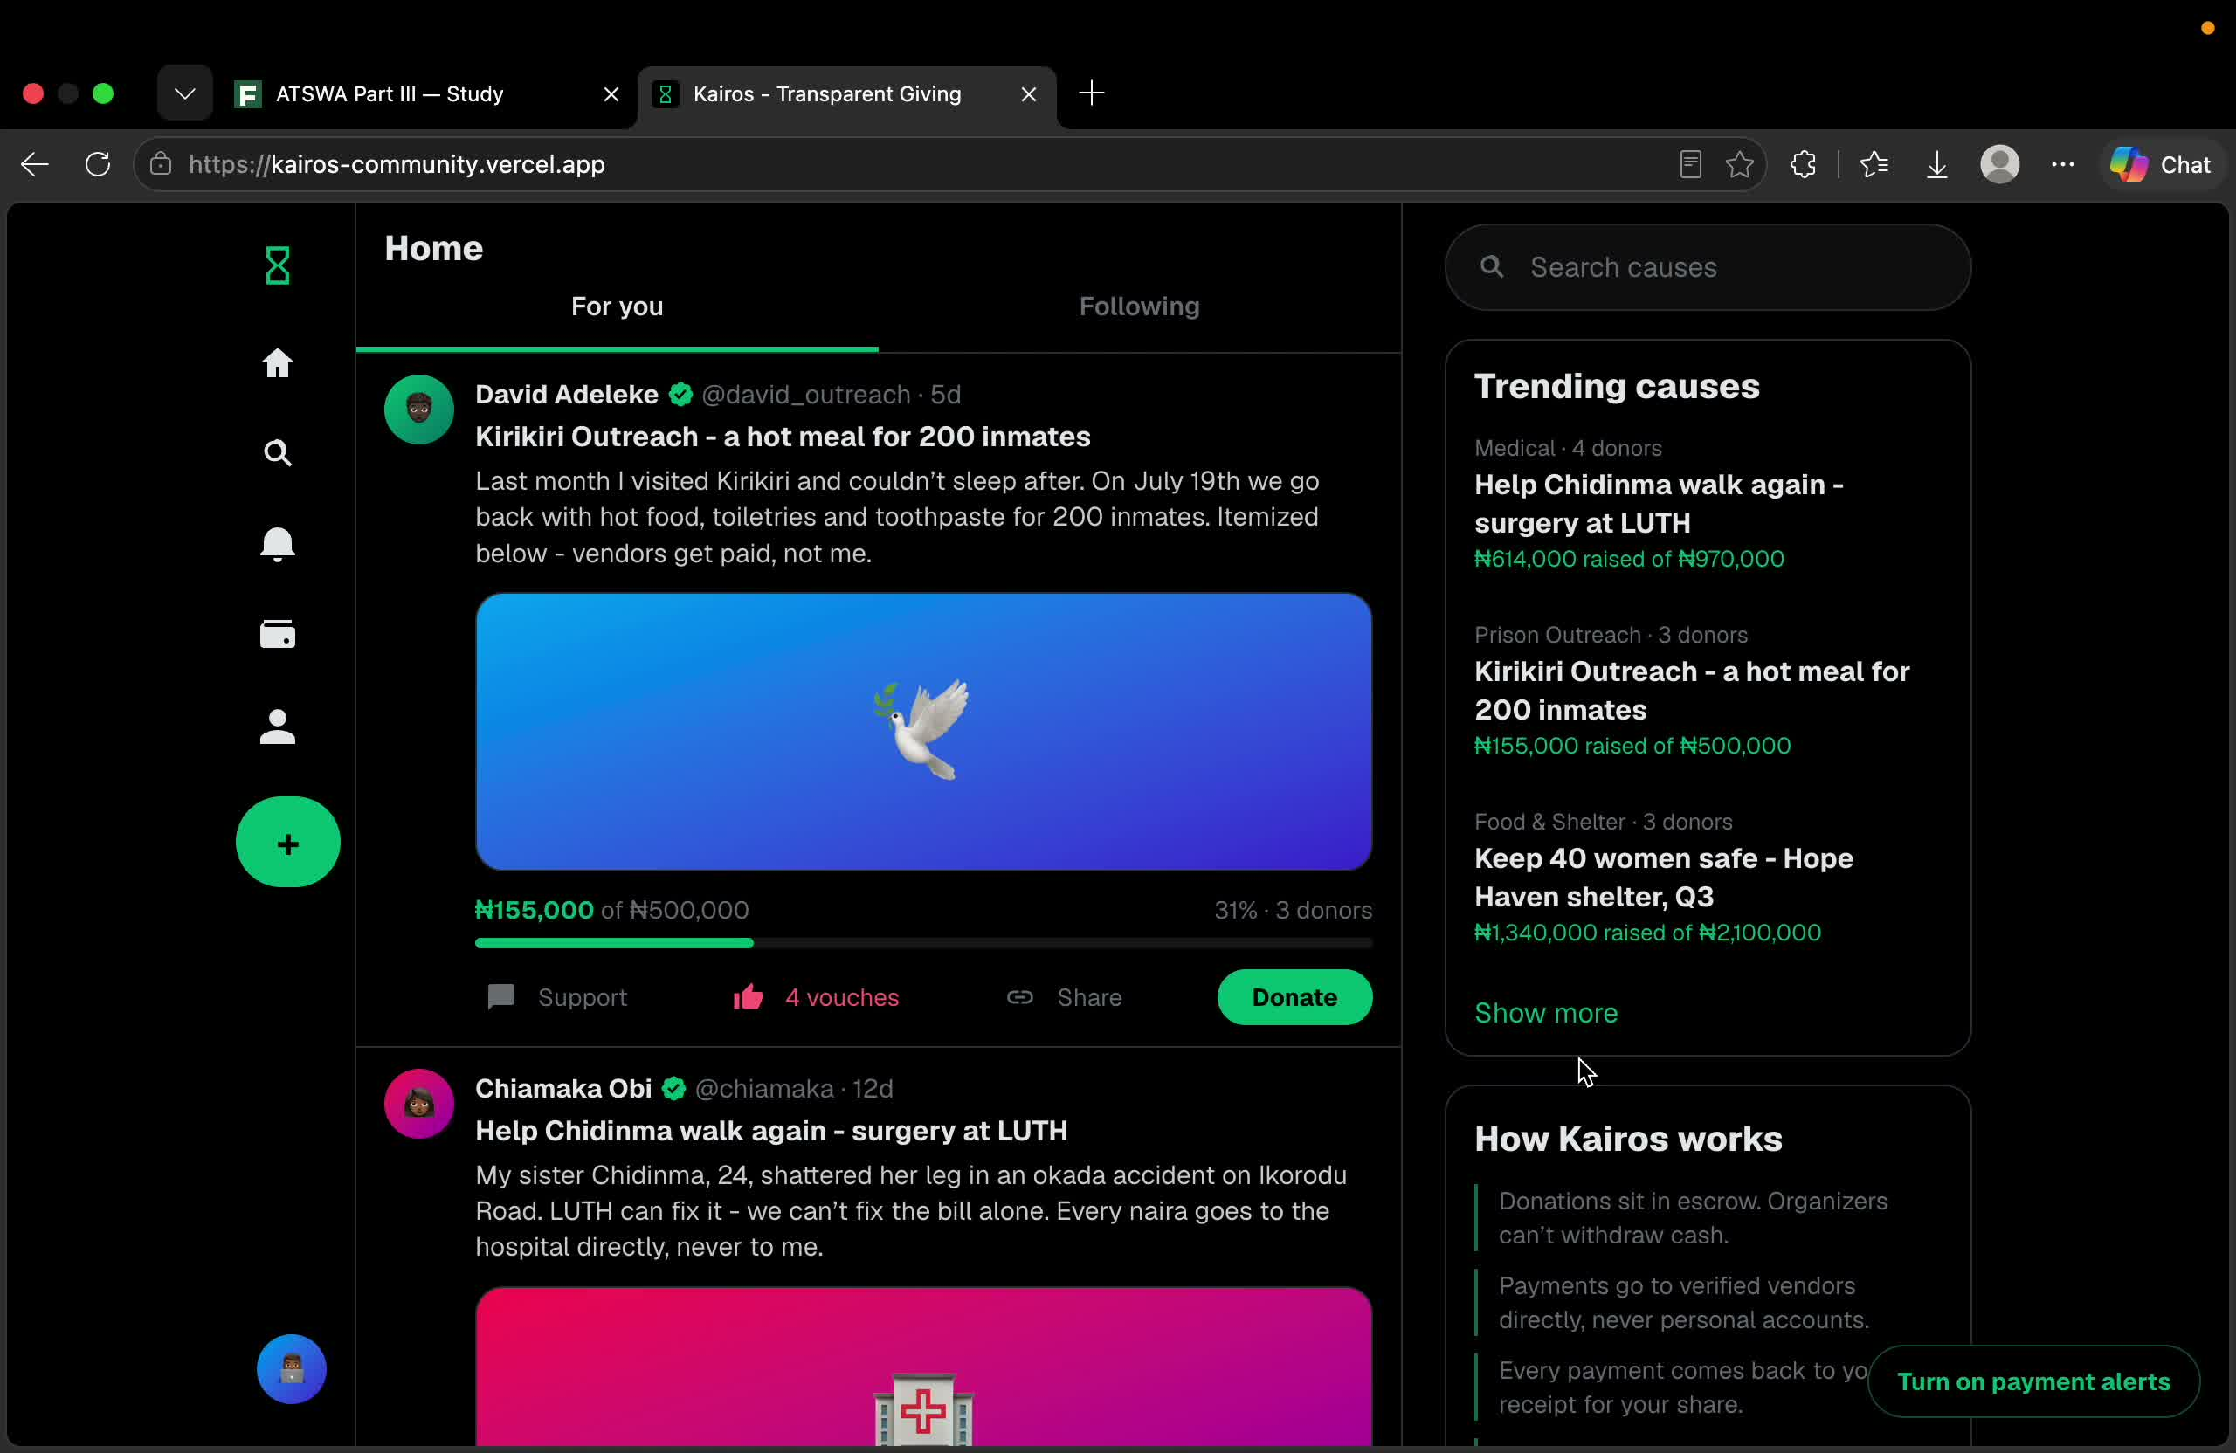
KAIROS
APWEN LASU
WORKING DEMO
Watch the
payment become
a receipt.
3:47 · RECORDED WALKTHROUGH
The prototype flow,
with simulated money
movement.
POWERPOINT
Click the video to play.
PDF: play the supplied demo.mp4
separately. Video does not play inside
this PDF.
KAIROS · TRANSPARENT GIVING FOR NIGERIA
10 / 12
Notes:
SLIDE TIME: 4:10 · START: 3:04
LEAD PRESENTER: Abigail or Miracle. Choose the matching introduction; either person can present the whole deck.
Let me show you the prototype. The accounting and donor receipts are running. This earlier recording also describes checks we plan to add. Bank transfer, Remita settlement and NIN lookup are simulated; independent provider and image checks and licensed custody are not live.
DELIVERY: Share computer sound. Play the embedded 3:47 recording once, then move to Team and Thank You. The original recording mentions planned checks; it is not evidence of live settlement or independent verification.
IMPLEMENTATION NOTES: The unchanged existing recording lasts 3:47 (227.033 seconds). The MP4 is embedded in this PPTX. In PowerPoint Slide Show, click the video once to start playback. Test audio and playback in the actual presentation application. PDF is a static poster: play the supplied ../demo.mp4 separately, then continue to the team and closing slides. The recording demonstrates a prototype, not evidence of live payments or an operating custody arrangement.

Slide 11
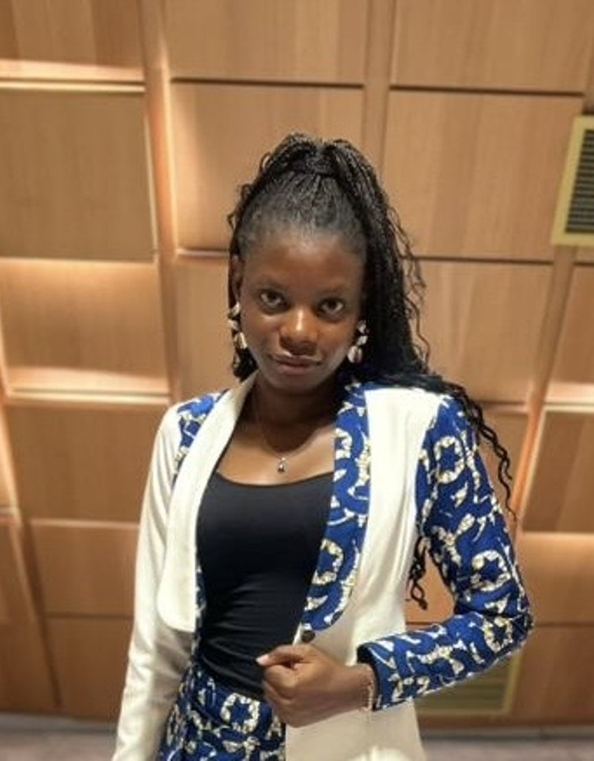
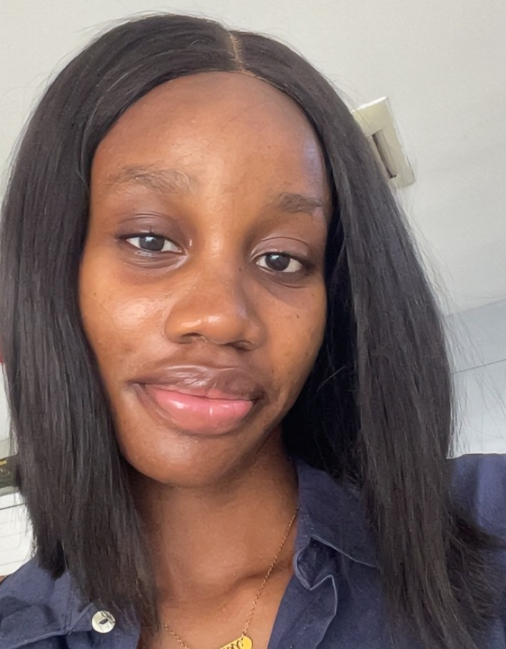
KAIROS
APWEN LASU
THE TEAM
Abigail and Miracle.
A shared focus on making giving easier to account for.
Sokenu
Abigail
Omohuma
Miracle
Team Lead &
Product Manager
Product
Designer
Built around a simple question: what did my gift help pay for?
KAIROS · TRANSPARENT GIVING FOR NIGERIA
11 / 12
Notes:
SLIDE TIME: 0:10 · START: 7:14
LEAD PRESENTER: Abigail or Miracle. Choose the matching introduction; either person can present the whole deck.
As Abigail: And this is the team. I'm Abigail, the team lead and product manager. Miracle is our product designer.
As Miracle: And this is the team. I'm Miracle, the product designer. Abigail is our team lead and product manager.
DELIVERY: Introduce both people on the slide. Either Abigail or Miracle can lead this presentation.
IMPLEMENTATION NOTES: This presentation features only Sokenu Abigail and Omohuma Miracle, using their existing portraits.

Slide 12
KAIROS
APWEN LASU
Make generosity
visible.
GIVE WITH PROOF
A clear need.
A named provider.
A clear record for every giver.
Your own receipt.
Thank you.
Sokenu Abigail · Omohuma Miracle
KAIROS · TRANSPARENT GIVING FOR NIGERIA
12 / 12
Notes:
SLIDE TIME: 0:13 · START: 7:24
LEAD PRESENTER: Abigail or Miracle. Choose the matching introduction; either person can present the whole deck.
In short, Kairos turns charitable giving from an act of blind trust into one of complete transparency. Thank you so much. We're Team Kairos.
DELIVERY: Thank them, then stop. The demo has already played.
IMPLEMENTATION NOTES: The next step is to connect licensed custody, live payments and verification, then test the full flow with a small pilot. These are needs and plans, not signed partnerships or completed pilot results.

