Slide 1
KAIROS
CLEVA × TETHER
GIVE WITH PROOF, NOT FAITH
KAIROS
THE GIVING LOOP
01
Publish the need
Transparent giving for Nigeria
A story with a budget.
02
Pay the provider
A clear need. A named provider.
A receipt for every giver.
Spending tied to the bill.
03
Show each donor
Their share. Their receipt.
Sokenu Abigail · Omohuma Miracle
KAIROS · TRANSPARENT GIVING FOR NIGERIA
01 / 08
Notes:
SLIDE TIME: 0:21 · START: 0:00
LEAD PRESENTER: Abigail or Miracle. Choose the matching introduction; either person can present the whole deck.
As Abigail: Good day everyone. My name is Sokenu Abigail, presenting on behalf of Team Kairos.
As Miracle: Good day everyone. My name is Omohuma Miracle, presenting on behalf of Team Kairos.
We built Kairos, which is a transparent giving platform where helping is no longer an act of faith, because every naira you give can be watched until it reaches the need it was given for.
DELIVERY: Camera on. Say Kairos clearly. The deck is already shared.
IMPLEMENTATION NOTES: Kairos is a working web prototype for transparent giving. Its accounting, budget rules and donor updates run in code. Real payments and external verification integrations remain future work.

Slide 2
KAIROS
CLEVA × TETHER
THE PAYMENT CHALLENGE
A transfer succeeds. The bill may still be unpaid.
The missing link is between money collected and the bill it was meant to pay.
01
02
03
A real need
A transfer succeeds
The bill is still unclear
A school fee or hospital bill is
shared with supporters.
The money reaches the
fundraiser's account.
Funds can be diverted before the
intended provider is paid.
A successful transfer is not proof that the need was met.
KAIROS · TRANSPARENT GIVING FOR NIGERIA
02 / 08
Notes:
SLIDE TIME: 0:51 · START: 0:21
LEAD PRESENTER: Abigail or Miracle. Choose the matching introduction; either person can present the whole deck.
Our school fees went up recently and a final year student who couldn't afford it posted an appeal so he wouldn't drop out. People gave. But then more posts appeared and my friends and I started to wonder if they were all real, because the screenshots looked identical and very easy to edit.
People wanted to help, but transferring to the fundraiser only proved that an account was credited. It didn't prove the school fee was paid. That is the payment gap; how do we manage to keep money tied to the need it was given for, instead of risking it getting pocketed along the way?
DELIVERY: Use the school-fees story, then name the payment gap plainly. The problem is money reaching an account without proof it paid the intended bill.
IMPLEMENTATION NOTES: Event-specific native slide. Its spoken script and delivery limits are supplied in the notes below.

Slide 3
KAIROS
CLEVA × TETHER
THE SOLUTION
Our solution.
Connect the contribution, the provider payment and each donor's own proof.
01
02
03
Check the cause
Share one clear link
Pay verified vendors
Identity, AI-assisted intake and
an itemised budget naming
suppliers.
Story, budget and public ledger.
Donations are intended to stay in
escrow.
Release funds to named
providers, with a receipt for every
donor.
The prototype demonstrates the flow. Live custody and settlement remain to be integrated.
KAIROS · TRANSPARENT GIVING FOR NIGERIA
03 / 08
Notes:
SLIDE TIME: 0:55 · START: 1:12
LEAD PRESENTER: Abigail or Miracle. Choose the matching introduction; either person can present the whole deck.
Kairos is that trusted middle layer.
Here is how it's designed to work.
First, the cause gets checked. The person raising money proves who they are with their BVN or NIN. Then an AI interviewer takes them through it. What happened, when, which hospital. It builds an itemised budget naming real suppliers, and screens the evidence for reused photos and mismatched dates.
Second, every cause is just an ordinary link shared on social media. Anyone who opens it sees the story, the budget, and the ledger. The money lands in escrow, never a personal account.
Third, funds leave escrow only toward named, verified vendors.
DELIVERY: Need and budget, controlled provider payment, personal receipt. Licensed custody and live settlement are planned; today's demo shows the accounting and rules.
IMPLEMENTATION NOTES: Event-specific native slide. Its spoken script and delivery limits are supplied in the notes below.

Slide 4
KAIROS
CLEVA × TETHER
THE DONOR EXPERIENCE
Every giver sees their own part.
Illustrative example, with upkeep covered separately.
70%
YOUR DONATION WAS USED
₦4,900
of the cause's funds
paid to the hospital
of your ₦7,000
PAID TO
LUTH · Surgery
A ₦7,000 contribution has ₦4,900 attributed to
this payment.
YOUR SHARE
70% of your contribution
Example invoice #0042
The payment is shared proportionally across the donors who funded it.
KAIROS · TRANSPARENT GIVING FOR NIGERIA
04 / 08
Notes:
SLIDE TIME: 0:24 · START: 2:07
LEAD PRESENTER: Abigail or Miracle. Choose the matching introduction; either person can present the whole deck.
A donor doesn't just get a thank-you. They get a receipt: four thousand nine hundred naira of their seven thousand, paid to LUTH for surgery.
That is what makes Kairos different: every giver can follow their own part of the payment, even when many people funded the bill.
DELIVERY: Point at the receipt. Read the numbers slowly. This example allocates seventy percent to the bill, with upkeep covered separately.
IMPLEMENTATION NOTES: This is a native, editable illustration, not a receipt for a real payment. Assume the donor covers upkeep separately, so the full ₦7,000 reaches the cause. When 70% of the contributed funds are spent, ₦4,900 is attributed to this donor. The prototype calculates attribution from net contributions after any upkeep.

Slide 5
KAIROS
CLEVA × TETHER
DEMO & PROGRESS
What we can show you today.
We can show the accounting, payment controls and personal receipts today.
WORKING
SIMULATED
NEXT
Application logic
Money and identity
Live integrations
Accounting, budget checks,
donor shares, notifications and
public history.
Bank transfer, Remita settlement
and NIN lookup.
Independent provider and
evidence checks, licensed
custody and settlement.
The demo uses seeded data. No real donations have moved.
KAIROS · TRANSPARENT GIVING FOR NIGERIA
05 / 08
Notes:
SLIDE TIME: 0:59 · START: 2:31
LEAD PRESENTER: Abigail or Miracle. Choose the matching introduction; either person can present the whole deck.
Here is where we are today. The accounting, budget checks, donor shares, notifications and public history are running in the app.
Bank transfer, Remita settlement and NIN lookup are simulated. CAC, account-name and automated evidence checks are not built, and no real donations have moved.
With Cleva's approval, we could also explore funding from supporters abroad, linking a contribution in dollars or USDT to the same bill and receipt.
We aim to cover running costs through donations and NGO grants. Without that support, our tentative fallback is two percent upkeep, capped at five thousand naira per cause.
We don't claim fraud is impossible. We're building Kairos to make it visible, traceable, capped and unprofitable.
DELIVERY: Show the working app next. The Cleva connection is proposed, not built. NGO support is not secured; the upkeep policy remains tentative. Say all three simulated parts clearly.
IMPLEMENTATION NOTES: Event-specific native slide. Its spoken script and delivery limits are supplied in the notes below.

Slide 6
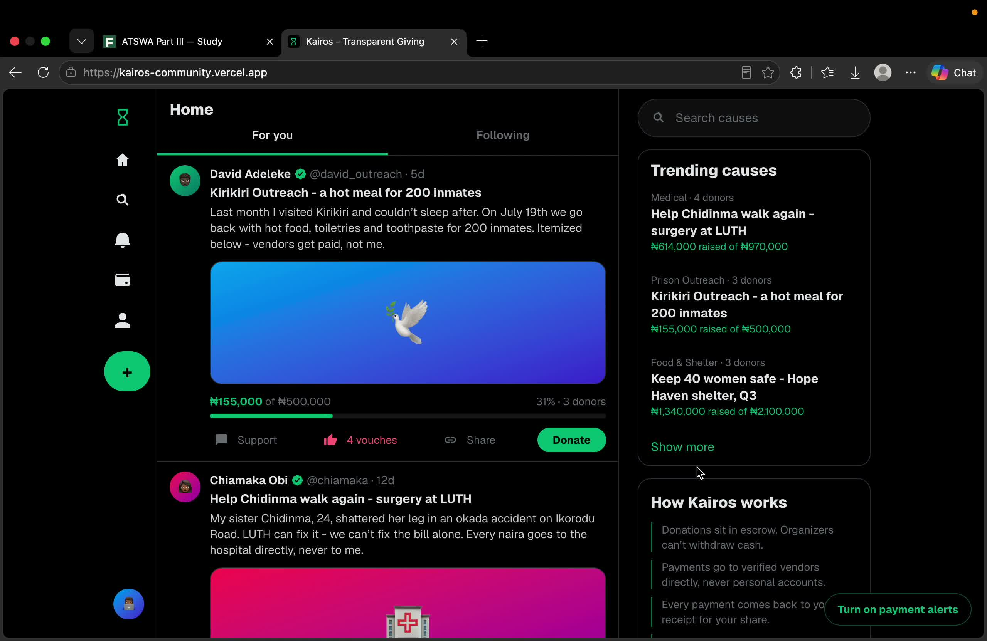
Notes:
SLIDE TIME: 3:59 · START: 3:30
LEAD PRESENTER: Abigail or Miracle. Choose the matching introduction; either person can present the whole deck.
Now let us watch a demonstration of how the app works.
DELIVERY: Share computer sound. Play the embedded 3:47 recording once. The Progress section distinguishes working code from the intended checks in the recording. After it ends, move to Team, then Thank You. Do not narrate over the recording.
IMPLEMENTATION NOTES: The unchanged existing recording lasts 3:47 (227.033 seconds). The MP4 is embedded in this PPTX. In PowerPoint Slide Show, click the video once to start playback. Test audio and playback in the actual presentation application. PDF is a static poster: play the supplied ../demo.mp4 separately, then continue to the team and closing slides. The recording demonstrates a prototype, not evidence of live payments or an operating custody arrangement.

Slide 7
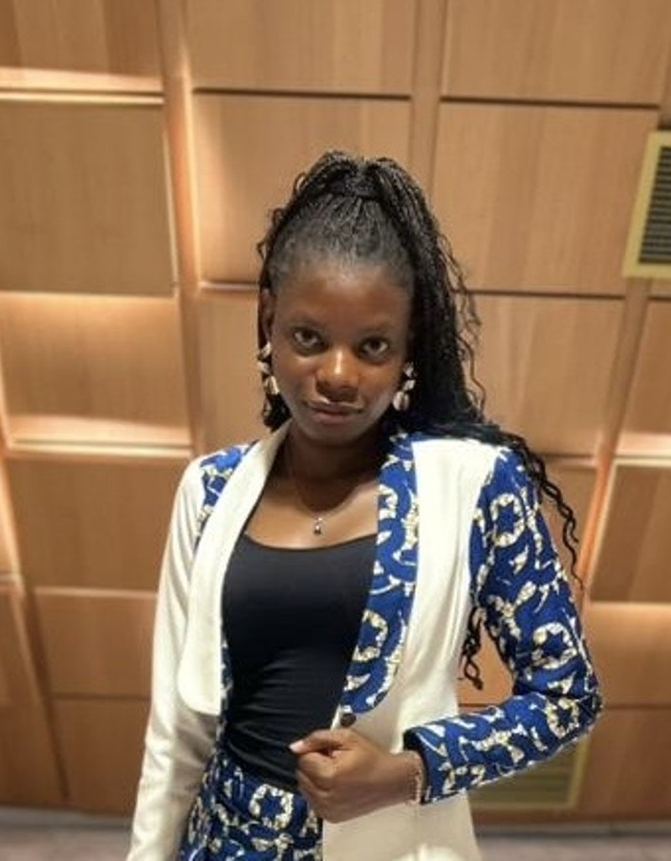

KAIROS
CLEVA × TETHER
THE TEAM
Abigail and Miracle.
A shared focus on making giving easier to account for.
Sokenu
Abigail
Omohuma
Miracle
Team Lead &
Product Manager
Product
Designer
Built around a simple question: what did my gift help pay for?
KAIROS · TRANSPARENT GIVING FOR NIGERIA
07 / 08
Notes:
SLIDE TIME: 0:09 · START: 7:29
LEAD PRESENTER: Abigail or Miracle. Choose the matching introduction; either person can present the whole deck.
As Abigail: And this is the team. I'm Abigail, the team lead and product manager. Miracle is our product designer.
As Miracle: And this is the team. I'm Miracle, the product designer. Abigail is our team lead and product manager.
DELIVERY: Introduce both people on the slide. Either Abigail or Miracle can lead this presentation.
IMPLEMENTATION NOTES: This presentation features only Sokenu Abigail and Omohuma Miracle, using their existing portraits.

Slide 8
KAIROS
CLEVA × TETHER
Make generosity
visible.
GIVE WITH PROOF
A clear need.
A named provider.
A clear record for every giver.
Your own receipt.
Thank you.
Sokenu Abigail · Omohuma Miracle
KAIROS · TRANSPARENT GIVING FOR NIGERIA
08 / 08
Notes:
SLIDE TIME: 0:12 · START: 7:38
LEAD PRESENTER: Abigail or Miracle. Choose the matching introduction; either person can present the whole deck.
In short, Kairos turns charitable giving from an act of blind trust into one of complete transparency. Thank you so much. We're Team Kairos.
DELIVERY: Thank them, then stop. The demo has already played.
IMPLEMENTATION NOTES: The next step is to connect licensed custody, live payments and verification, then test the full flow with a small pilot. These are needs and plans, not signed partnerships or completed pilot results.

