Slide 1

AI
Workplace
Productivity
4,500
Employees
6 Job Roles · 15 Features
Kaggle Dataset
AI Workplace Study
Data Analysis & Machine Learning
Presented by WINNIE NDUVA

Slide 2
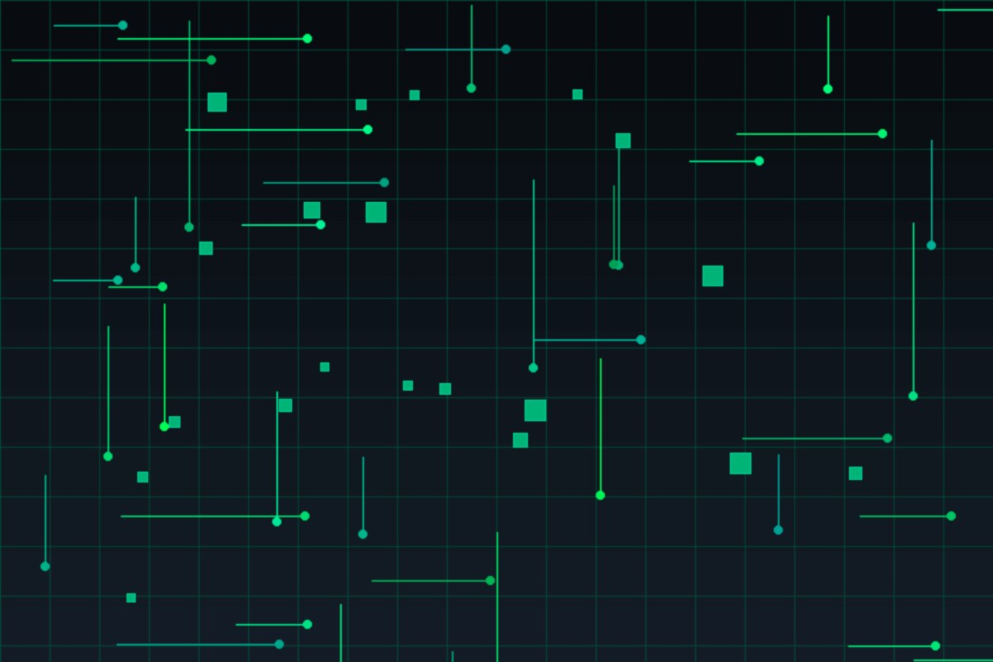
Dataset Overview
Key Variables
ai_tool_usage_hours_per_week
4,500
6
tasks_automated_percent
Employees
Job Roles
manual_work_hours_per_week
15
0
work_life_balance_score
Features
Null Values
burnout_risk_score
focus_hours_per_day
deadline_pressure_level
→ productivity_score (target)
→ burnout_risk_level (target)

Slide 3
FINDING 1
Higher AI Usage → Fewer Manual Work Hours
Key Insight
54%
reduction in manual
work hours (Low→High AI)
Recommendation
Scale AI adoption
across all roles

Slide 4

FINDING 2
AI Adoption Varies Significantly Across Job Roles
HIGH ADOPTERS
Developer, Writer
~15 hrs/wk
LOW ADOPTERS
Manager, Designer
~5 hrs/wk
Prioritize AI training for
Managers & Designers

Slide 5
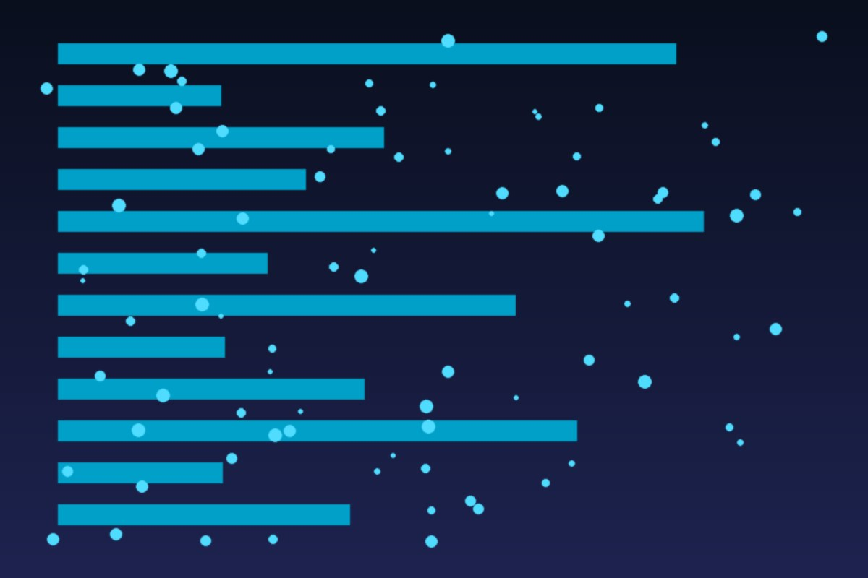
FINDING 3
AI & Work-Life Balance: A Nuanced Picture
What This Means
✓
Low & Medium AI users
show similar WLB scores (~4.77)
!
High AI users score
noticeably lower (~4.05)
→
May reflect heavier workloads
or over-reliance on AI tools
Encourage balanced AI usage,
not maximization.

Slide 6
Burnout Risk & Deadline Pressure
Burnout Risk by Job Role
Deadline Pressure vs. Error Rate

Slide 7
MACHINE LEARNING
Predictive Models: Productivity & Burnout
Regression · Random Forest
Classification · Random Forest
Target: productivity_score
Target: burnout_risk_level (Low / Medium / High)
Algorithm:
Random Forest
Algorithm:
Random Forest
Train / Test:
80% / 20%
Train / Test:
80% / 20%
MAE (error):
~4.2 pts
Class Weights:
Balanced
R² Score:
~0.87
Accuracy:
~82%
Top predictors:
focus_hours_per_day
tasks_automated_percent
ai_tool_usage_hours_per_week
Top predictors:
burnout_risk_score
work_life_balance_score
manual_work_hours_per_week

Slide 8
Recommendations
Scale AI Adoption
Reduce Deadline Pressure
1
Prioritize training & tooling for low-adoption roles (Designers, Managers) to close the efficiency gap.
4
Realistic project planning protects output quality — high pressure increases error rates by ~47%.
Balance AI Usage
Protect Focus Time
2
Encourage moderate AI usage — very high usage may signal overload. Monitor work-life balance as adoption grows.
5
focus_hours_per_day is a top driver of productivity. Preserve deep-work time through organizational norms.
Deploy Burnout Predictor
3
Use the ML classification model as an HR early-warning system to identify and support at-risk employees proactively.

Slide 9
Conclusion
AI adoption delivers measurable efficiency gains — up to 54% fewer manual work hours
Adoption is uneven: Developers & Writers lead; Managers & Designers lag behind
Balanced AI usage correlates with better work-life balance; over-use may indicate strain
ML models can predict productivity (R²≈0.87) and burnout risk (~82% accuracy)
Data-driven HR decisions can drive both productivity and employee well-being
Presented by WINNIE NDUVA · AI Workplace Productivity

