Slide 1
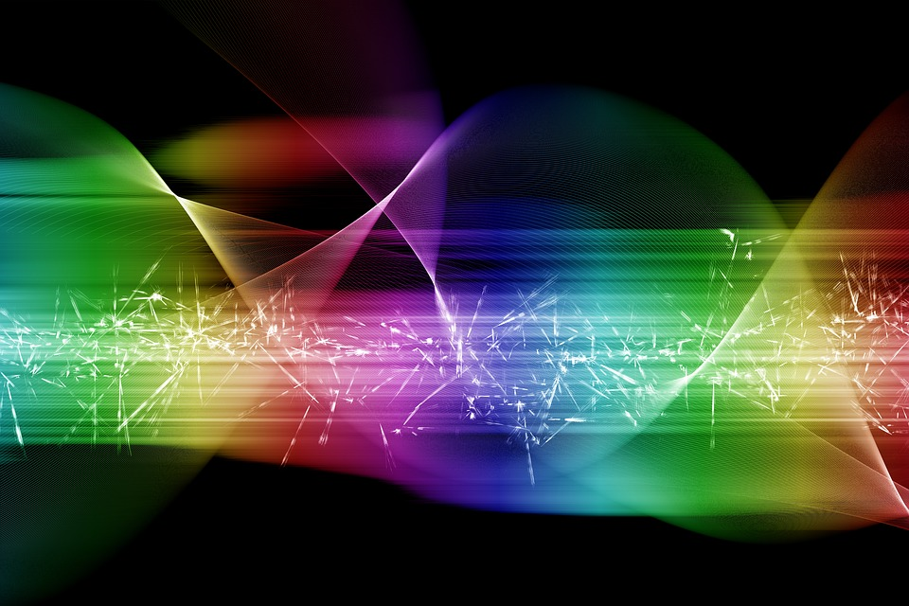
Models of Light and the experiment that birthed Quantum Physics

Slide 2
Goals?

Slide 3
Goals?
To review how we came to
understand light scientifically
Over the last 2600 years.

Slide 4
Goals?
To review how we came to
understand light scientifically
Over the last 2600 years.
To help participants come
to greater comprehension
of the experiment
that birthed
quantum physics:
The Photo-electric Effect

Slide 5
Goals?
To review how we came to
understand light scientifically
Over the last 2600 years.
To help participants come
to a greater comprehension
of the experiment
that birthed
modern quantum physics:
The Photo-Electric Effect

Slide 6
Team Discussion & Report:
How could one describe
“light” and “seeing”
to a person born blind?
(3-6 minutes!)

Slide 7
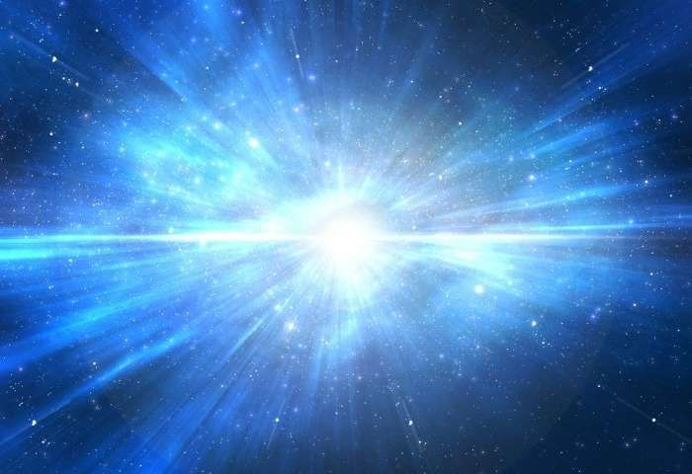
What is Light?
How could one describe
“light” and “seeing”
to a person born blind?
To predict and explain
the behavior of light
requires analogies and metaphors.....

Slide 8
What is Light?
What could be the reasons
a physical model fails to make
predictions that match
observed experimental data?

Slide 9
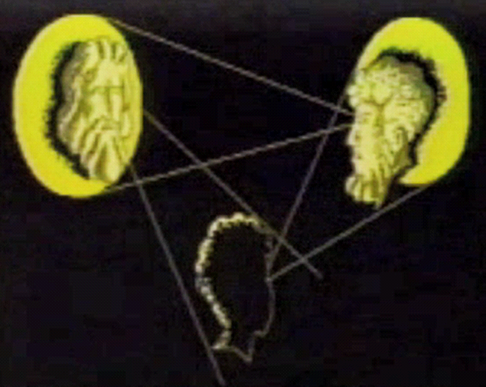
Ancient View of Light?

Slide 10
Ancient View of Light?
Ptomley (100-170 CE)
read Euclid’s “Optica” (300 BCE)
and agreed with Pre-Socratics that
“visual-flux” came from the eye.

Slide 11
Does “light” instantaneously fill space or does it take time to travel from one place to another? The first known person to question the idea that“speed of light is infinite”was the 5th century BC philosopher Empedocles. Less than a century later, Aristotle would disagree with Empedocles and the argument continued for more than 2,000 years.

Slide 12
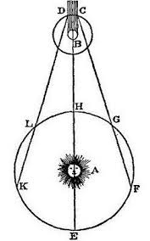
Incredible Speed of Light?
Ole Roemer in 1676 (announced by Cassini) Io eclipsed by Jupiter every 2,457.6 minutes at “H”

Slide 13
Incredible Speed of Light?
Ole Roemer in 1676 (announced by Cassini) Io eclipsed by Jupiter every 2,457.6 minutes at “H”

Slide 14
Incredible Speed of Light?
Ole Roemer in 1676 (announced by Cassini) Io eclipsed by Jupiter every 2,457.6 minutes at “H”
Eclipse was 10 minutes later at “K” and at “F” (compared to Jupiter in opposition at “H”)

Slide 15
Incredible Speed of Light?
Ole Roemer in 1676 (announced by Cassini) Io eclipsed by Jupiter every 2,457.6 minutes at “H”
Roemer Reasoned: Eclipse was 10 minutes later at “K” and at “F” (compared to Jupiter in opposition at “H”) because the speed of light was constant and additional distance across the earth’s orbit was significant. (DK > BH and CF>BH)

Slide 16
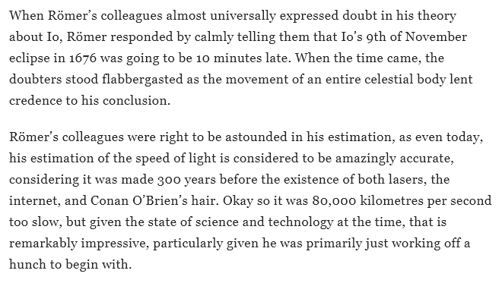
Incredible Speed of Light?
Ole Roemer in 1676 (announced by Cassini) Io eclipsed by Jupiter every 2,457.6 minutes at “H”
https://gizmodo.com/how-the-speed-of-light-was-first-measured-1138348467

Slide 17
Incredible Speed of Light?
Ole Roemer in 1676 (announced by Cassini) Io eclipsed by Jupiter every 2,457.6 minutes at “H”
Eclipse was 10 minutes later at “K” and at “F” (compared to Jupiter in opposition at “H”)
In 1729 James Bradley used Roemer’s explanation for time delay due to speed but revised the speed estimate based on better data on Jupiter’s distance. [His estimate was within 2%]

Slide 18
What is Light?
If light has a speed
Could it be a particle?
This particle would be…..
Very Fast
Very Small
Perfectly Elastic

Slide 19
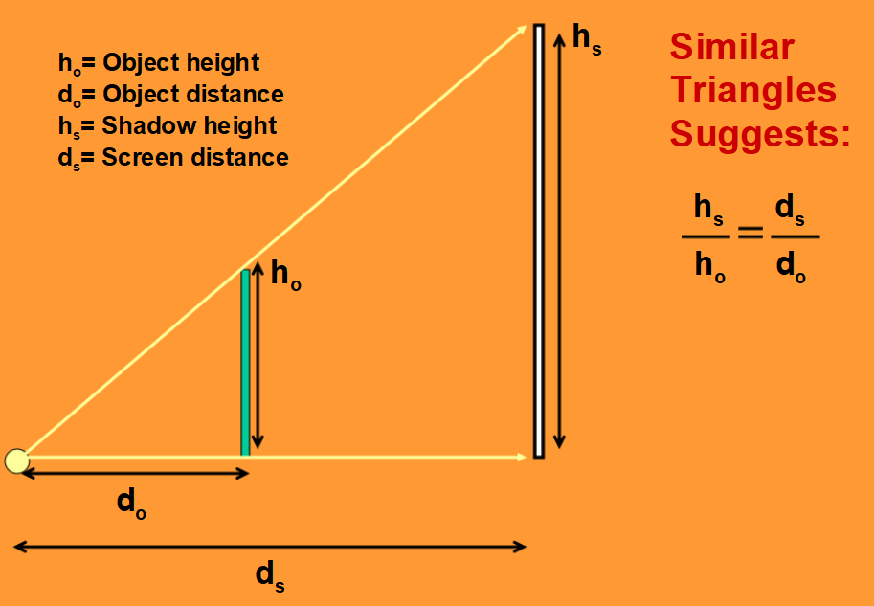
Newtons Particle Model
“Corpuscular Theory of Light” in “Opticks” (1704)
Very Fast: evidenced by rectilinear propagation (explaining behavior of shadows)

Slide 20
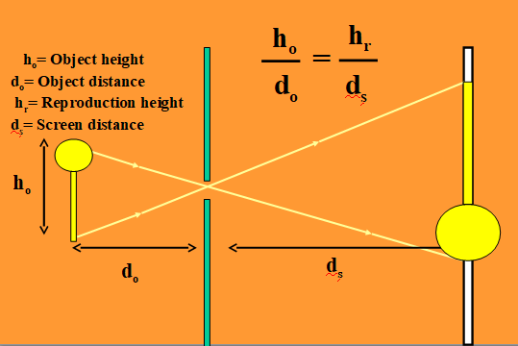
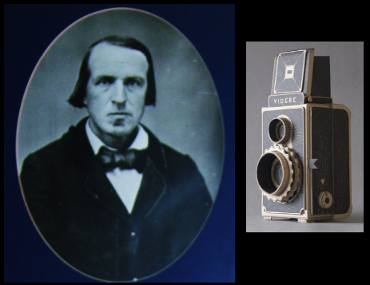
Newtons Particle Model
“Corpuscular Theory of Light” in “Opticks”
Very Fast: evidenced by rectilinear propagation (explaining behavior of pinhole cameras)

Slide 21
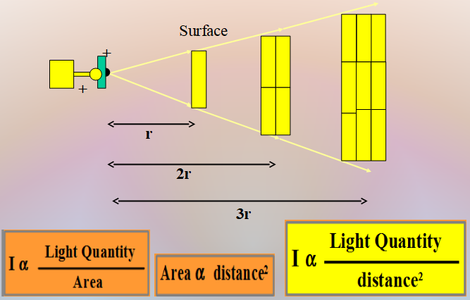
Newtons Particle Model
“Corpuscular Theory of Light” in “Opticks”
Very Fast: evidenced by rectilinear propagation (explaining inverse square law)

Slide 22

Newtons Particle Model
“Corpuscular Theory of Light” in “Opticks”
Very Small: rare or no interactions if light beams crossing same areas of space

Slide 23
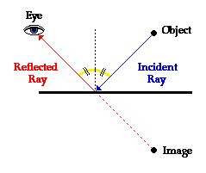
Newtons Particle Model
“Corpuscular Theory of Light” in “Opticks”
Very Fast & very Elastic: evidenced by rectilinear propagation and predictable bouncing

Slide 24
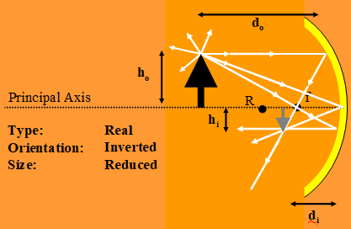
Newtons Particle Model
“Corpuscular Theory of Light” in “Opticks”
Very Fast & very Elastic: evidenced by rectilinear propagation and predictable bouncing (explaining light in mirrors of all types)

Slide 25
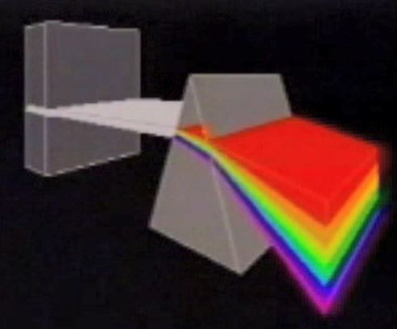
Newtons Particle Model
“Corpuscular Theory of Light” in “Opticks” explains dispersion….
Speed Changes: Refraction of light when traveling through objects of different densities

Slide 26
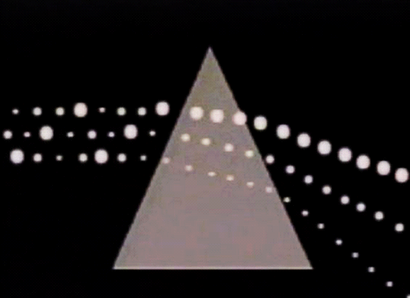
Newtons Particle Model
“Corpuscular Theory of Light” in “Opticks” explains dispersion….
Colors: Result from differences in size of the corpuscles
Speed Changes: Difference due to sizes refract light traveling through objects of different densities

Slide 27
Newtons Particle Model
“Corpuscular Theory of Light” in “Opticks”
Very Fast: evidenced by rectilinear propagation (& estimated by Roemer)
Very Small: rare or no interactions if light beams crossing same areas of space
Perfectly Elastic: No loss of speed when bouncing off objects
Speed Changes: Refraction of light when traveling through objects of different densities
Colors: Different colors were result of differences in size of the corpuscles

Slide 28
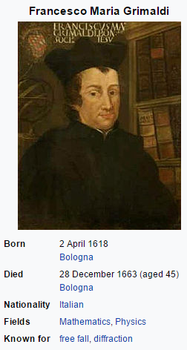

Particle Model Challenged
“Corpuscular Theory of Light”
Challenge: Fr. Grimaldi Jesuit Scientist Priest (1) The first to make accurate observations on the diffraction of light.

Slide 29
Particle Model Challenged
“Corpuscular Theory of Light”
?????
Challenge: Fr. Grimaldi Jesuit Scientist Priest (1) The first to make accurate observations on the diffraction of light. (2) Demonstrated that the observed passage of light could not be reconciled with the idea that it moved in a rectilinear path.

Slide 30
Particle Model Challenged
“Corpuscular Theory of Light”
?????
Challenge: Fr. Grimaldi Jesuit Scientist Priest (1) The first to make accurate observations on the diffraction of light. (2) Demonstrated that the observed passage of light could not be reconciled with the idea that it moved in a rectilinear path. (3) Discovered what are now known as “diffraction bands”.

Slide 31
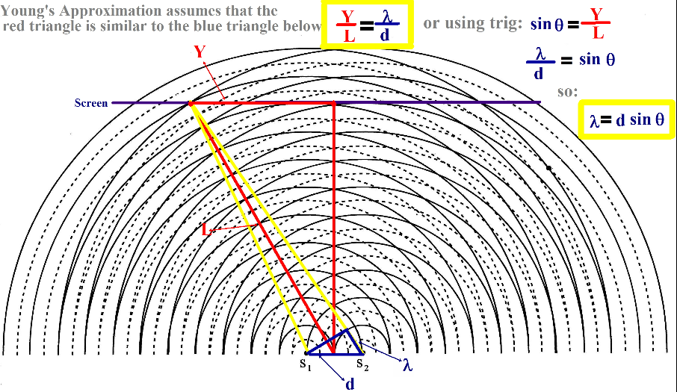
Huygens Wave Model
“Young’s Approximation” (1817) explains Diffraction full using the Wave Model of Light

Slide 32
Newtons Particle Model
“Corpuscular Theory of Light” in “Opticks” 1670-72
Prediction Tested in Future: Speed of light particles were suppose to be faster in denser substances (like water)

Slide 33
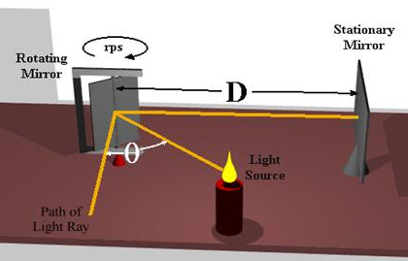
Particle Model Challenged
“Corpuscular Theory of Light” (1670-2)
?????
Findings in the Future: Speed of light particles faster in denser substances (like water)
slower!
Leon Foucault found light SLOWER in water than air! (1850)

Slide 34
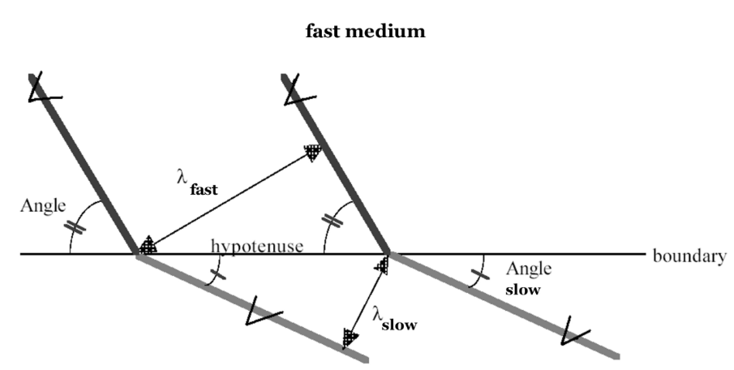
Huygens Wave Model
“Snells Law” is fully explained refraction the Wave Model of Light (1678)

Slide 35
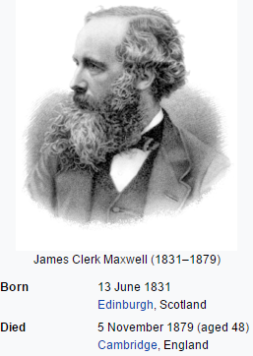
Huygens Wave Model
Diffraction is fully explained by the wave model Refraction is fully explained by the wave model Colors behavior consistent with wavelength Waves pass through without altering propagation Speed changes based on medium and predictable Reflection of waves predictable Maxwell’s calculations exactly predict electromagnetic disturbance and yields wave propagation at Roemer’s speed! Increased energy delivered with increase in intensity

Slide 36
Huygens Wave Model
Challenge? Waves require a medium.
Consensus: Ether is the medium for light.
J. Maxwell (in Encyclopedia Britannica)
“There can be no doubt that the interplanetary and interstellar spaces are not empty, but are occupied by a material substance….certainly the largest, and most uniform body of which we have any knowledge.”
H. Hertz (discovered radio waves)
“Remove from the world luminous ether and electric and magnetic actions can no longer traverse space.”

Slide 37
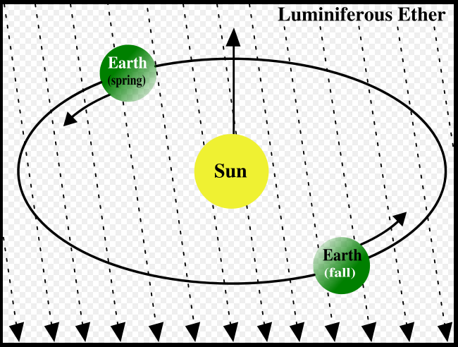
Huygens Wave Model
Challenge? Waves require a medium.
Is Ether a medium for light?
A. Michelson and E. Morley (1887)
Carefully measured the speed of light with extreme accuracy while the earth moving. Small changes of speed were not observed. Ether not supported by observations.
A. Einstein (1899)
Senior thesis Einstein proposed “studying light’s speed through the ether” but learned, by reading about the Michelson-Morley experiment that this had already been done. Einstein accepted the results.

Slide 38
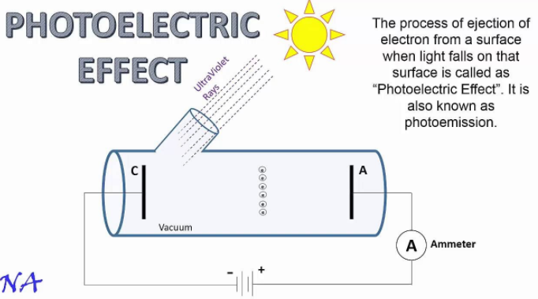
THEN CONFUSION!

Slide 39
Wave Model
Fails to predict Photoelectric effect! Light incident on a surface ejects negative charges.
Increasing light intensity fails to increase energy of electrons ejected as the wave model would predict!

Slide 40
Particle Model
Fails to predict Photoelectric effect! Light incident on a surface ejects negative charges.
Light at a too long a wavelength fails to eject any electron no matter what the intensity is!

Slide 41
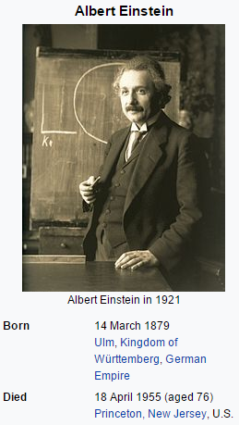
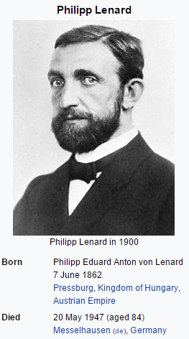
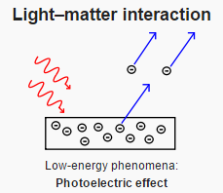
What is Light?
The photoelectric effect
fails to be explained as a wave
and
fails to be explained as a particle!

Slide 42
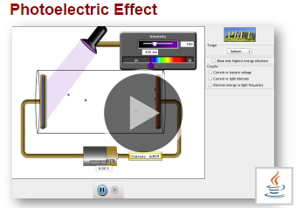
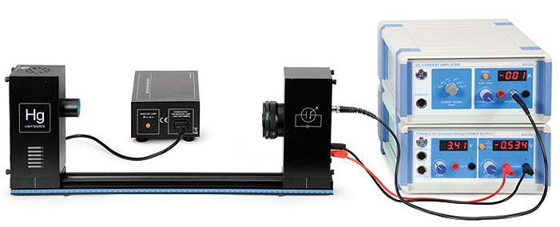
What is Light?
Experiencing Data Collection
and Reasoning as a Scientist!
GOALS
(1) Participants gather data concerning the behavior of the photoelectric effect using simulations
(2) Participants operate high quality photoelectric effect apparatus to gather data.
(3) Participants share data and patterns found and discuss if the explanation proposed by Einstein of light quanta is consistent with the findings.

Slide 43
Our Take Aways?
During this grueling 2600 year review:
* Physics explains the world
using analogies, metaphors, imagination, speculation, logical consistency and refines these explanations based on both observations and predictions
that are BOTH qualitative and quantitative.
* Modern Physics (quantum Mechanics)
emerged as a result of coming to see
particles we will never really see (photons).
These photons interact with the smallest of atomic and
subatomic particles (which we also can not see) allowing us to probe the universe in ways that extend our ability to observe (and measure)
* The dual nature of light provides a unique analogy
for other disciplines where two simultaneous and
seemingly contradictory properties may co-exist.

