Slide 1
Kinetic
Energy of
Ejected electron
E_{k} = hf - Φ
Work function of the metal
Energy contained
In single light quanta
Einstein proposed that PE effect is fully explained IF:
(1) Light is thought of as discontinuous rather than continuous
(2) an individual quanta of light has an energy consisting of the product of frequency and Planck’s constant
(3) all the energy in the quanta is delivered to a single electron
(4) “the simplest conception is that a light quantum [lichtquanten] transfers its entire energy to a single electron”. When greater than the work function of the metal that electron is liberated with the observed kinetic energy (in eV)
Notes:
1

Slide 2
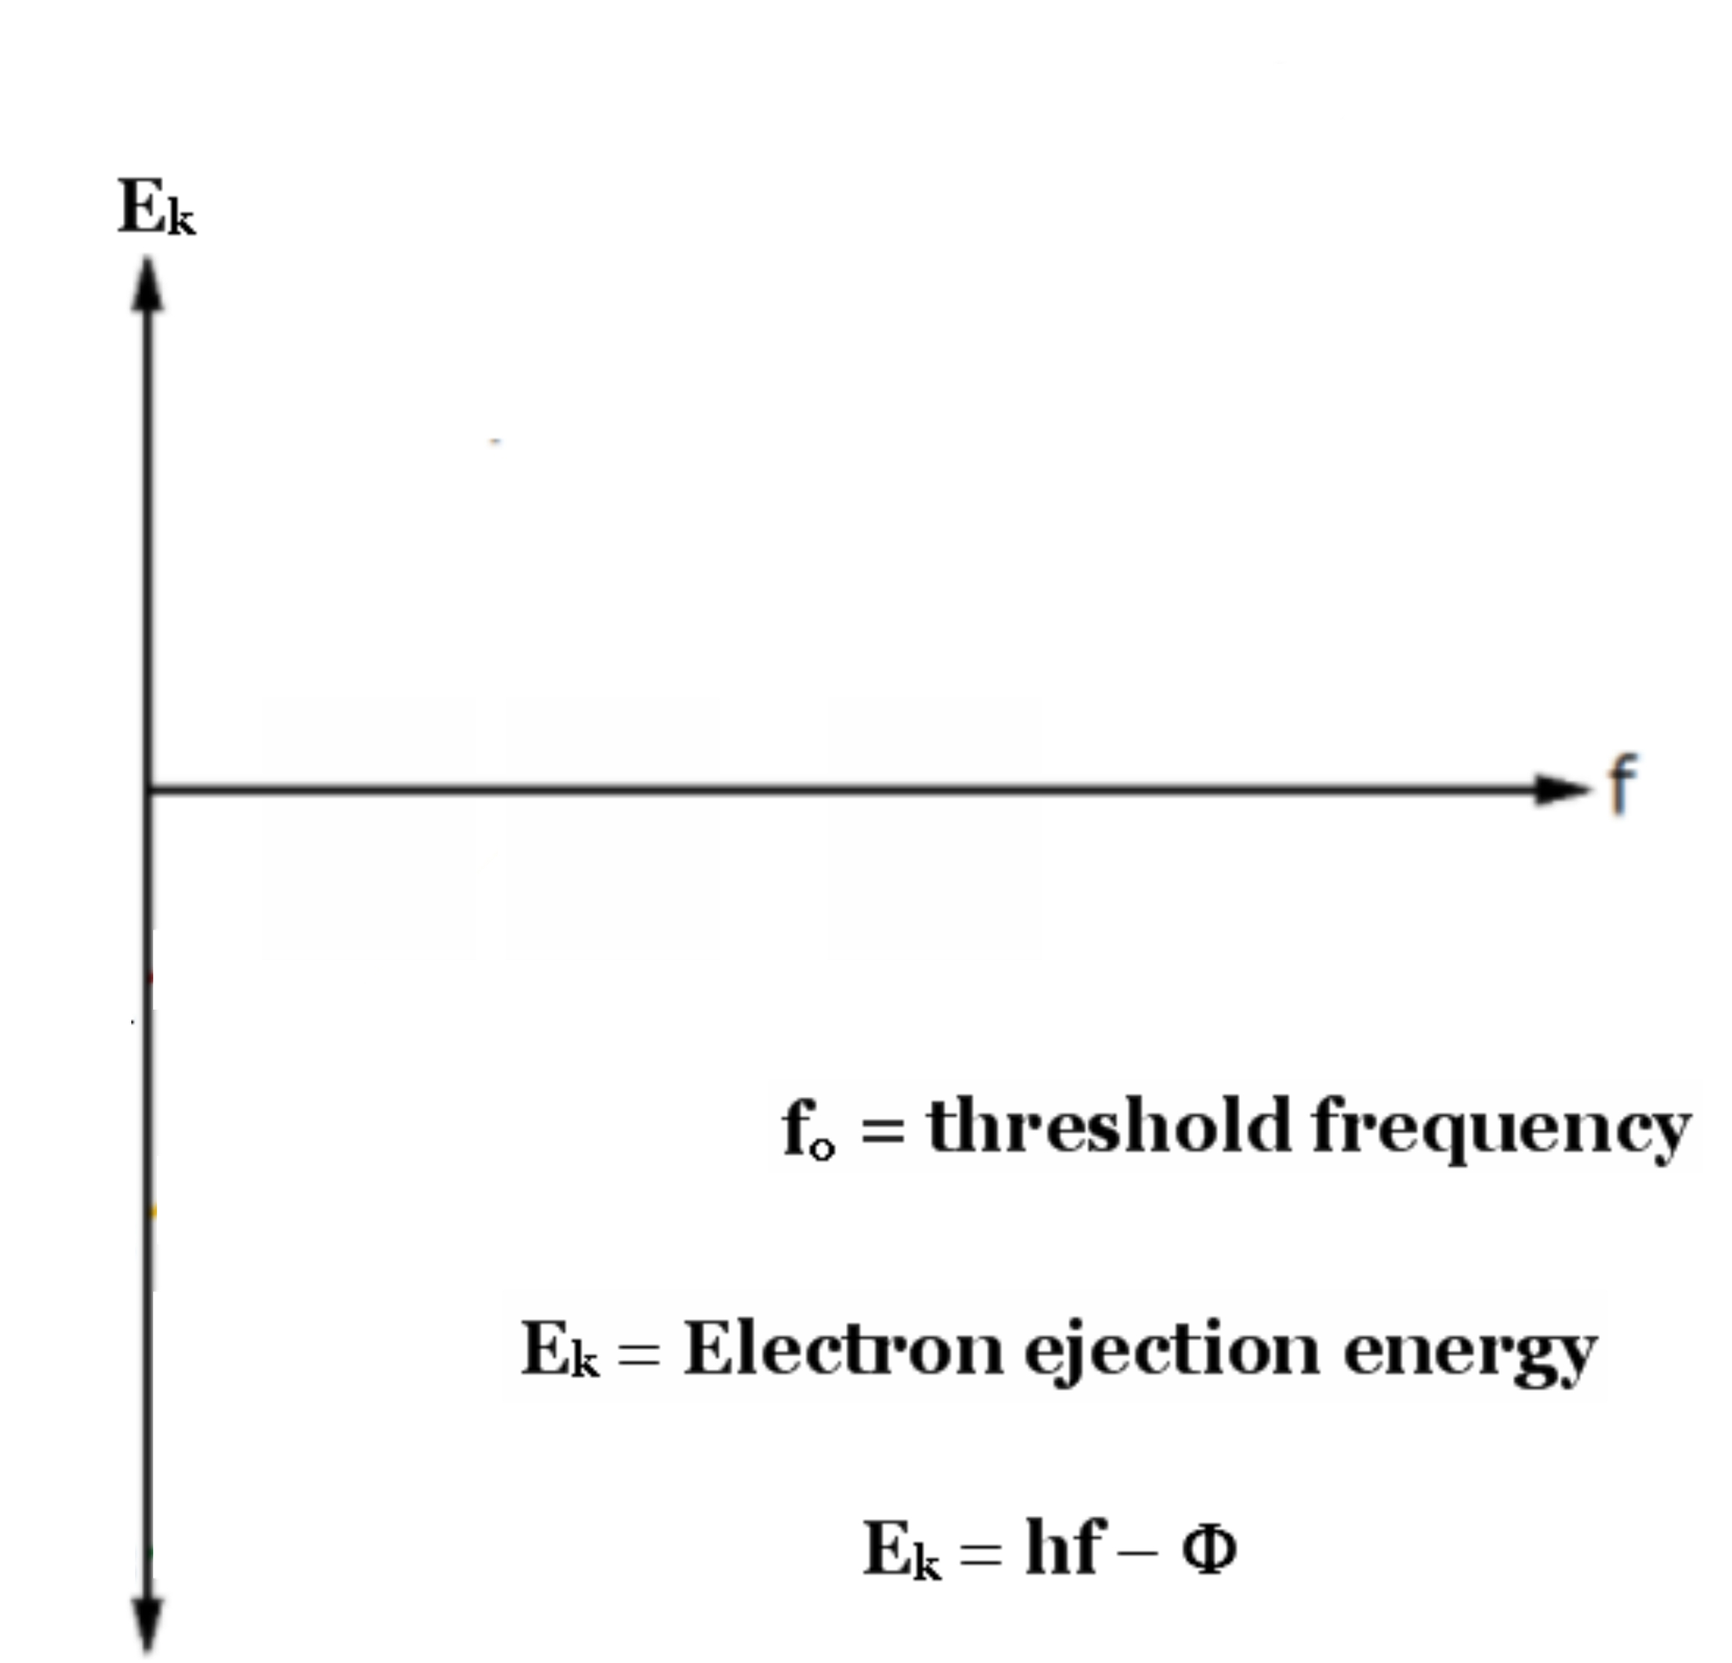
Notes:
2

Slide 3
Notes:
3

Slide 4
Notes:
4

Slide 5
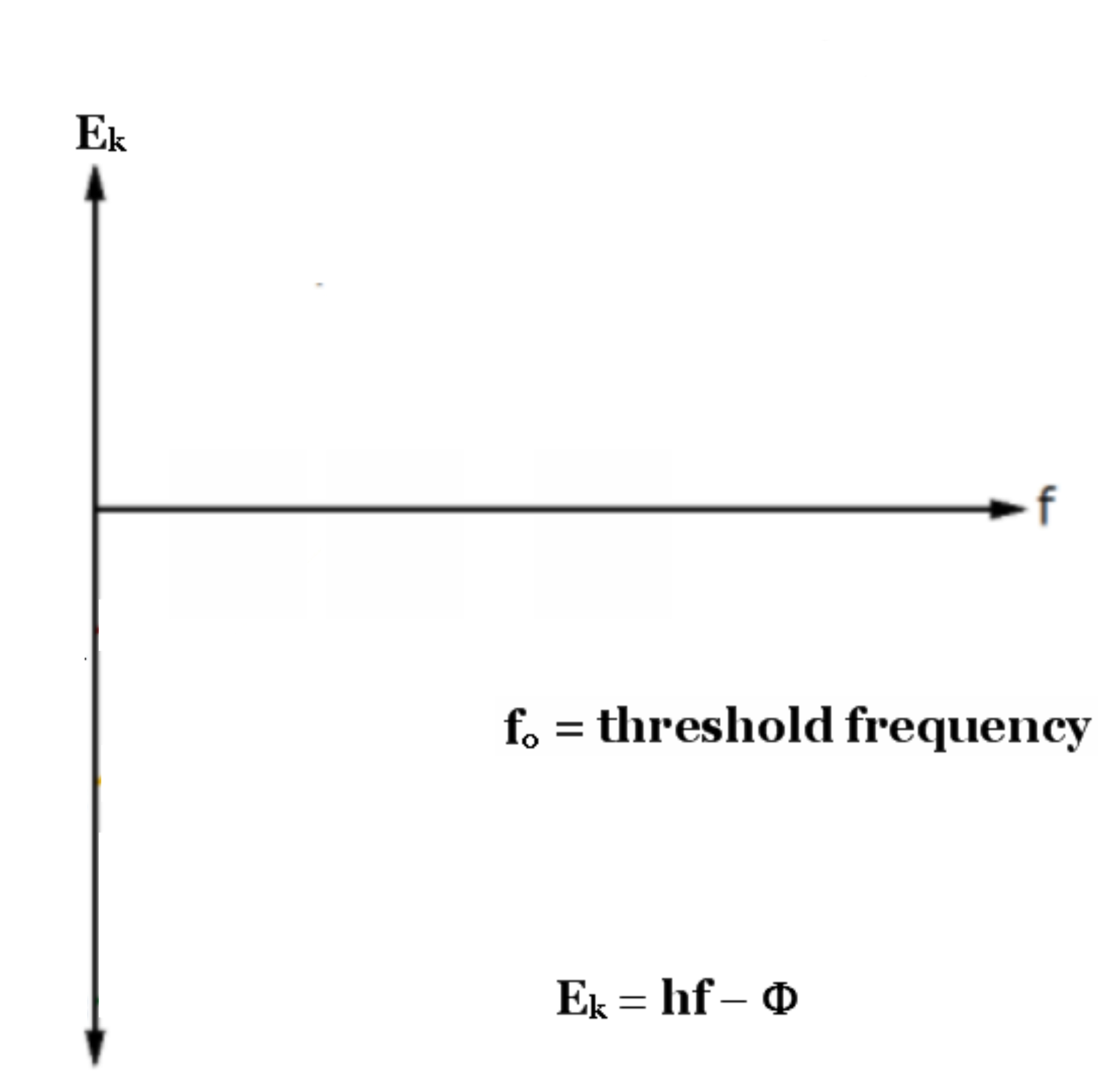
Notes:
5

Slide 6
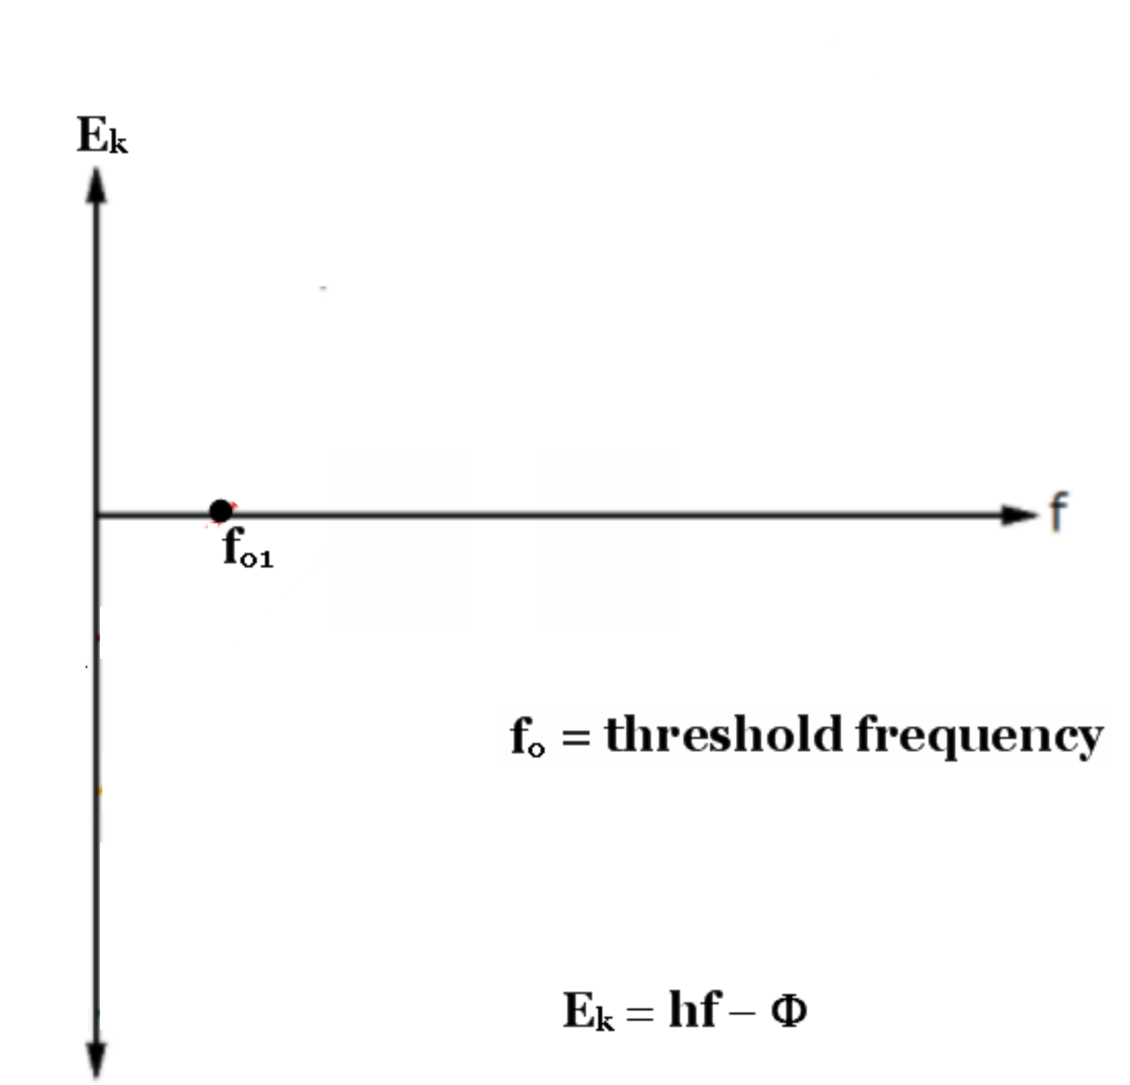
Notes:
6

Slide 7
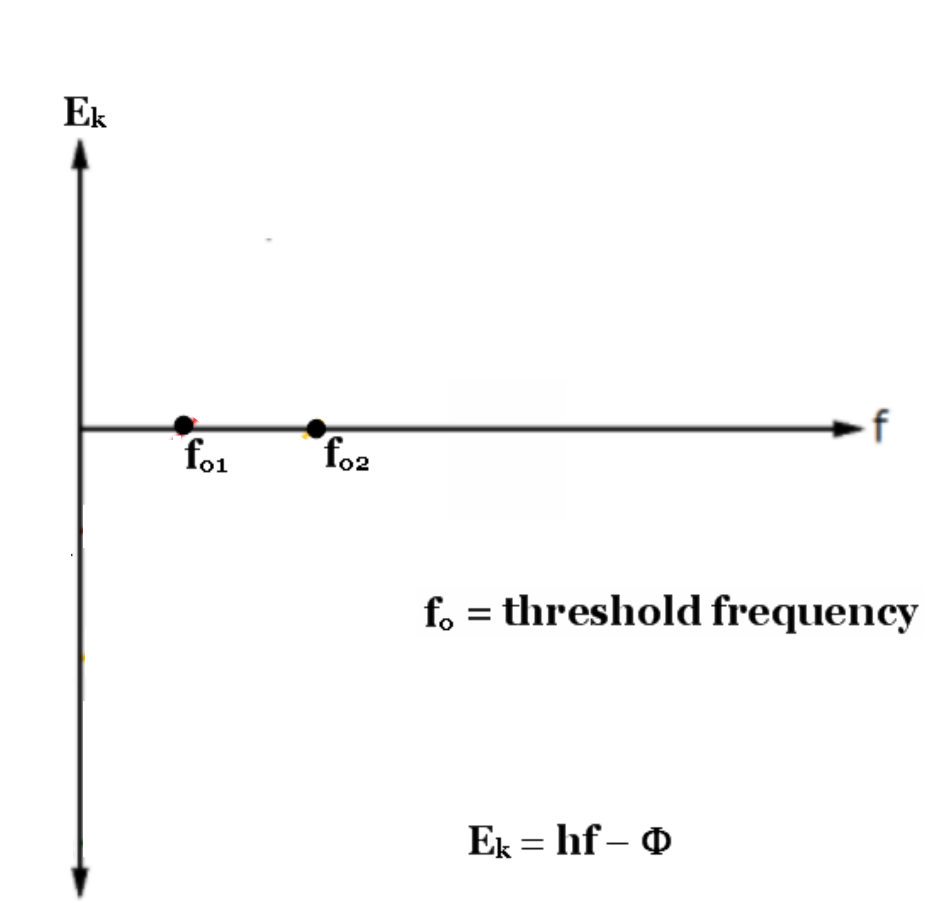
Notes:
7

Slide 8
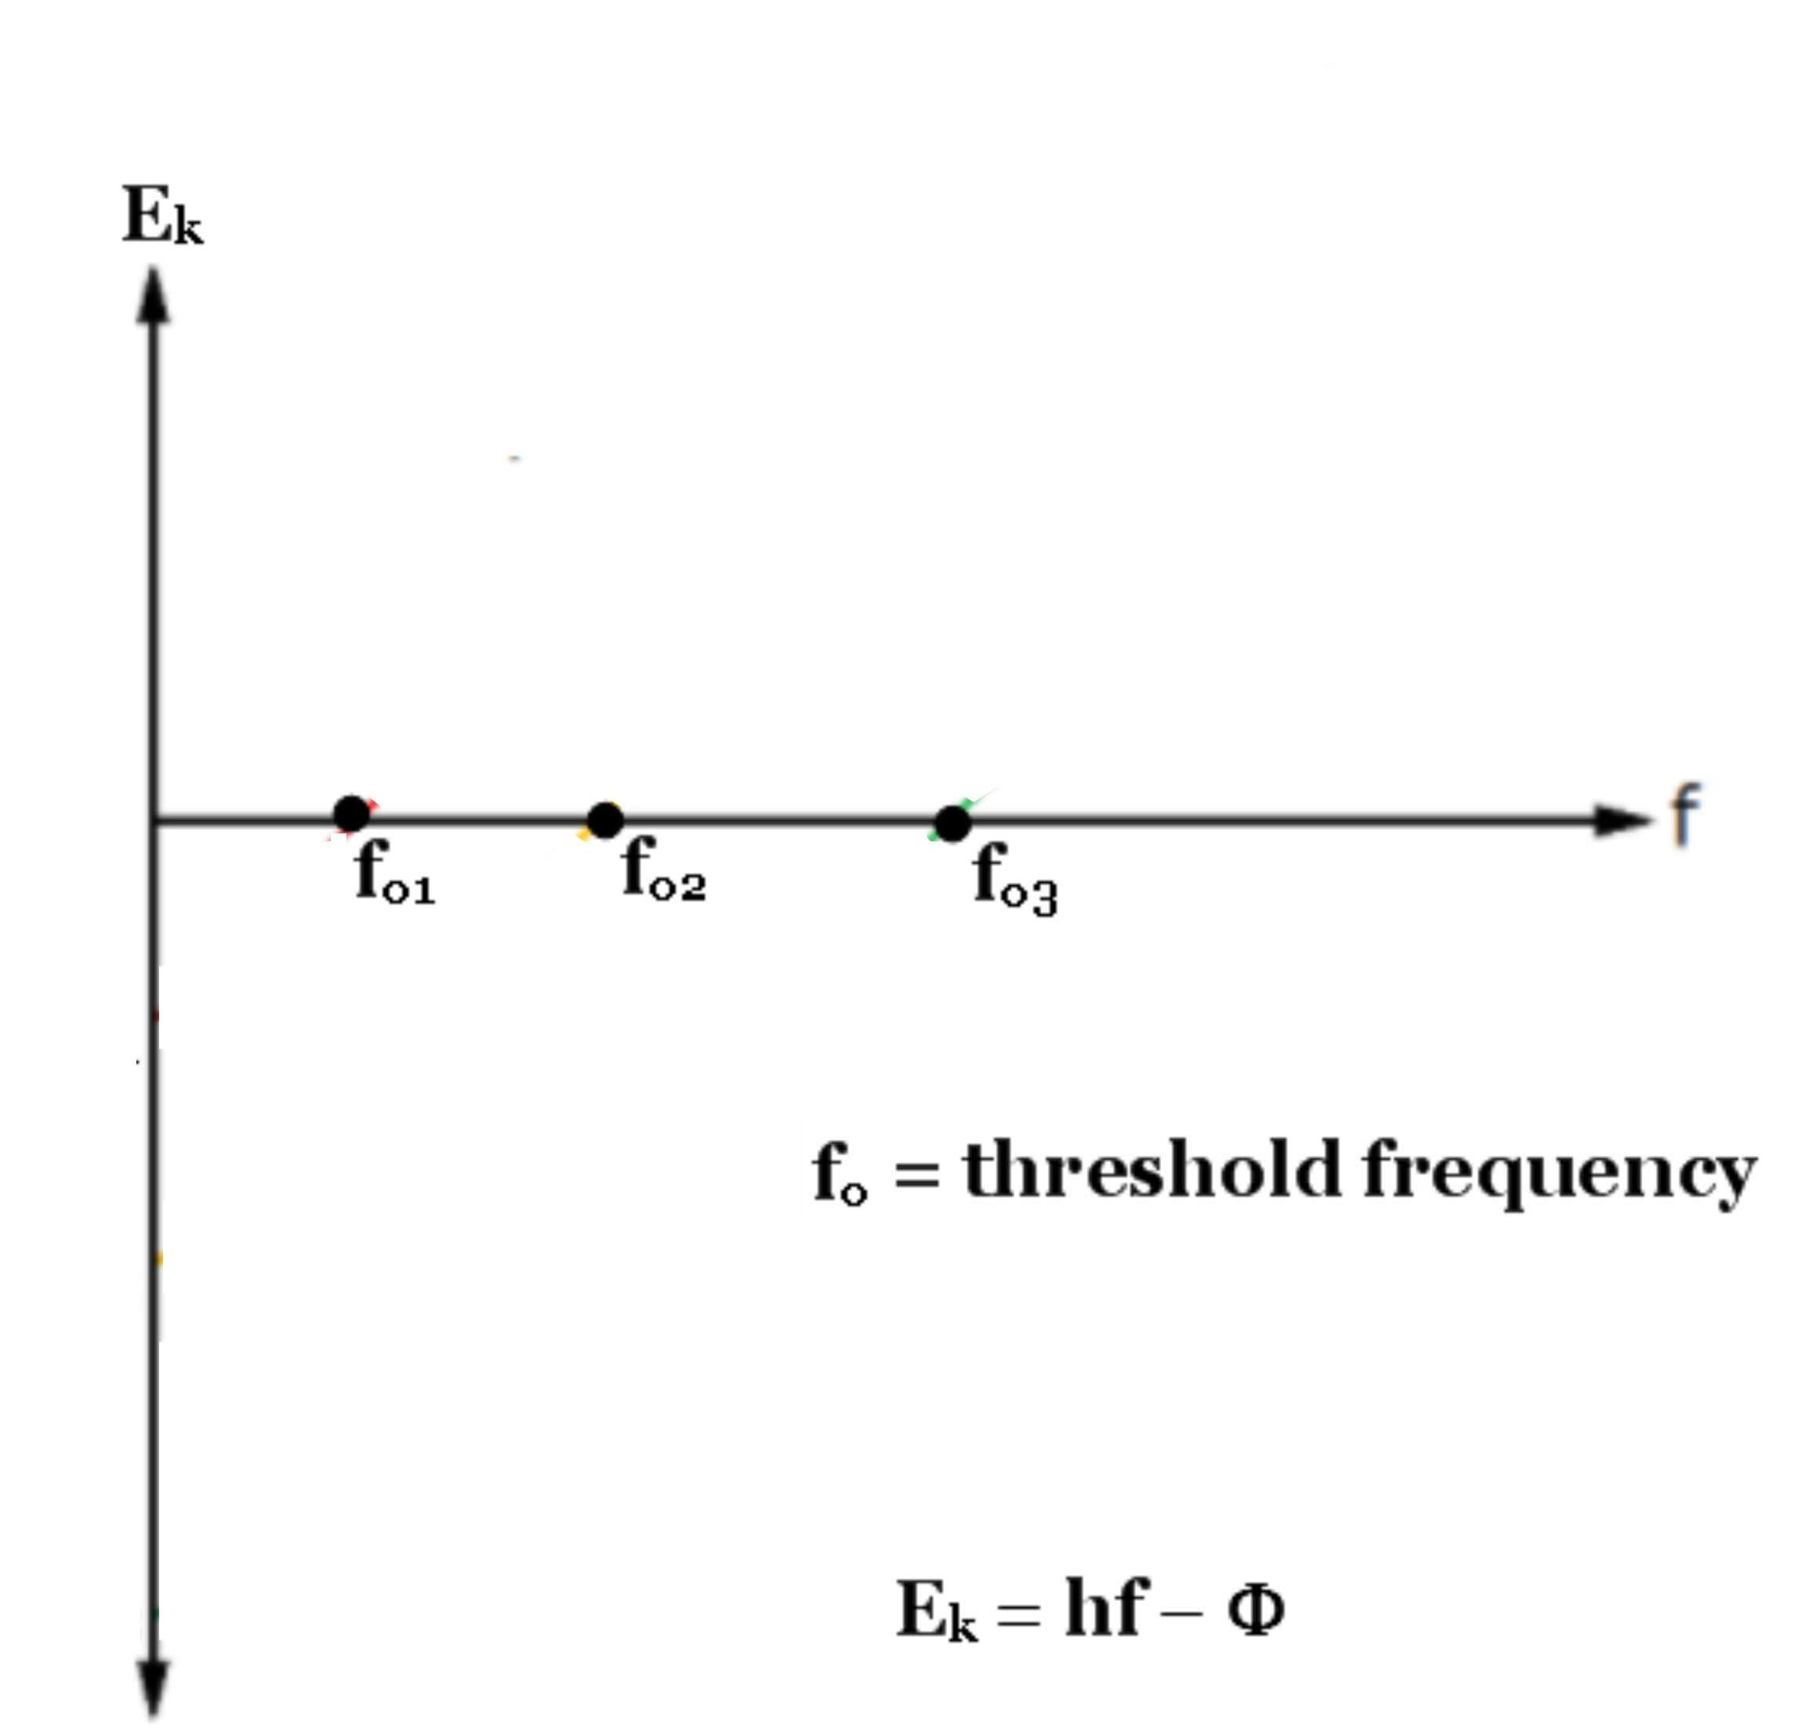
Notes:
8

Slide 9
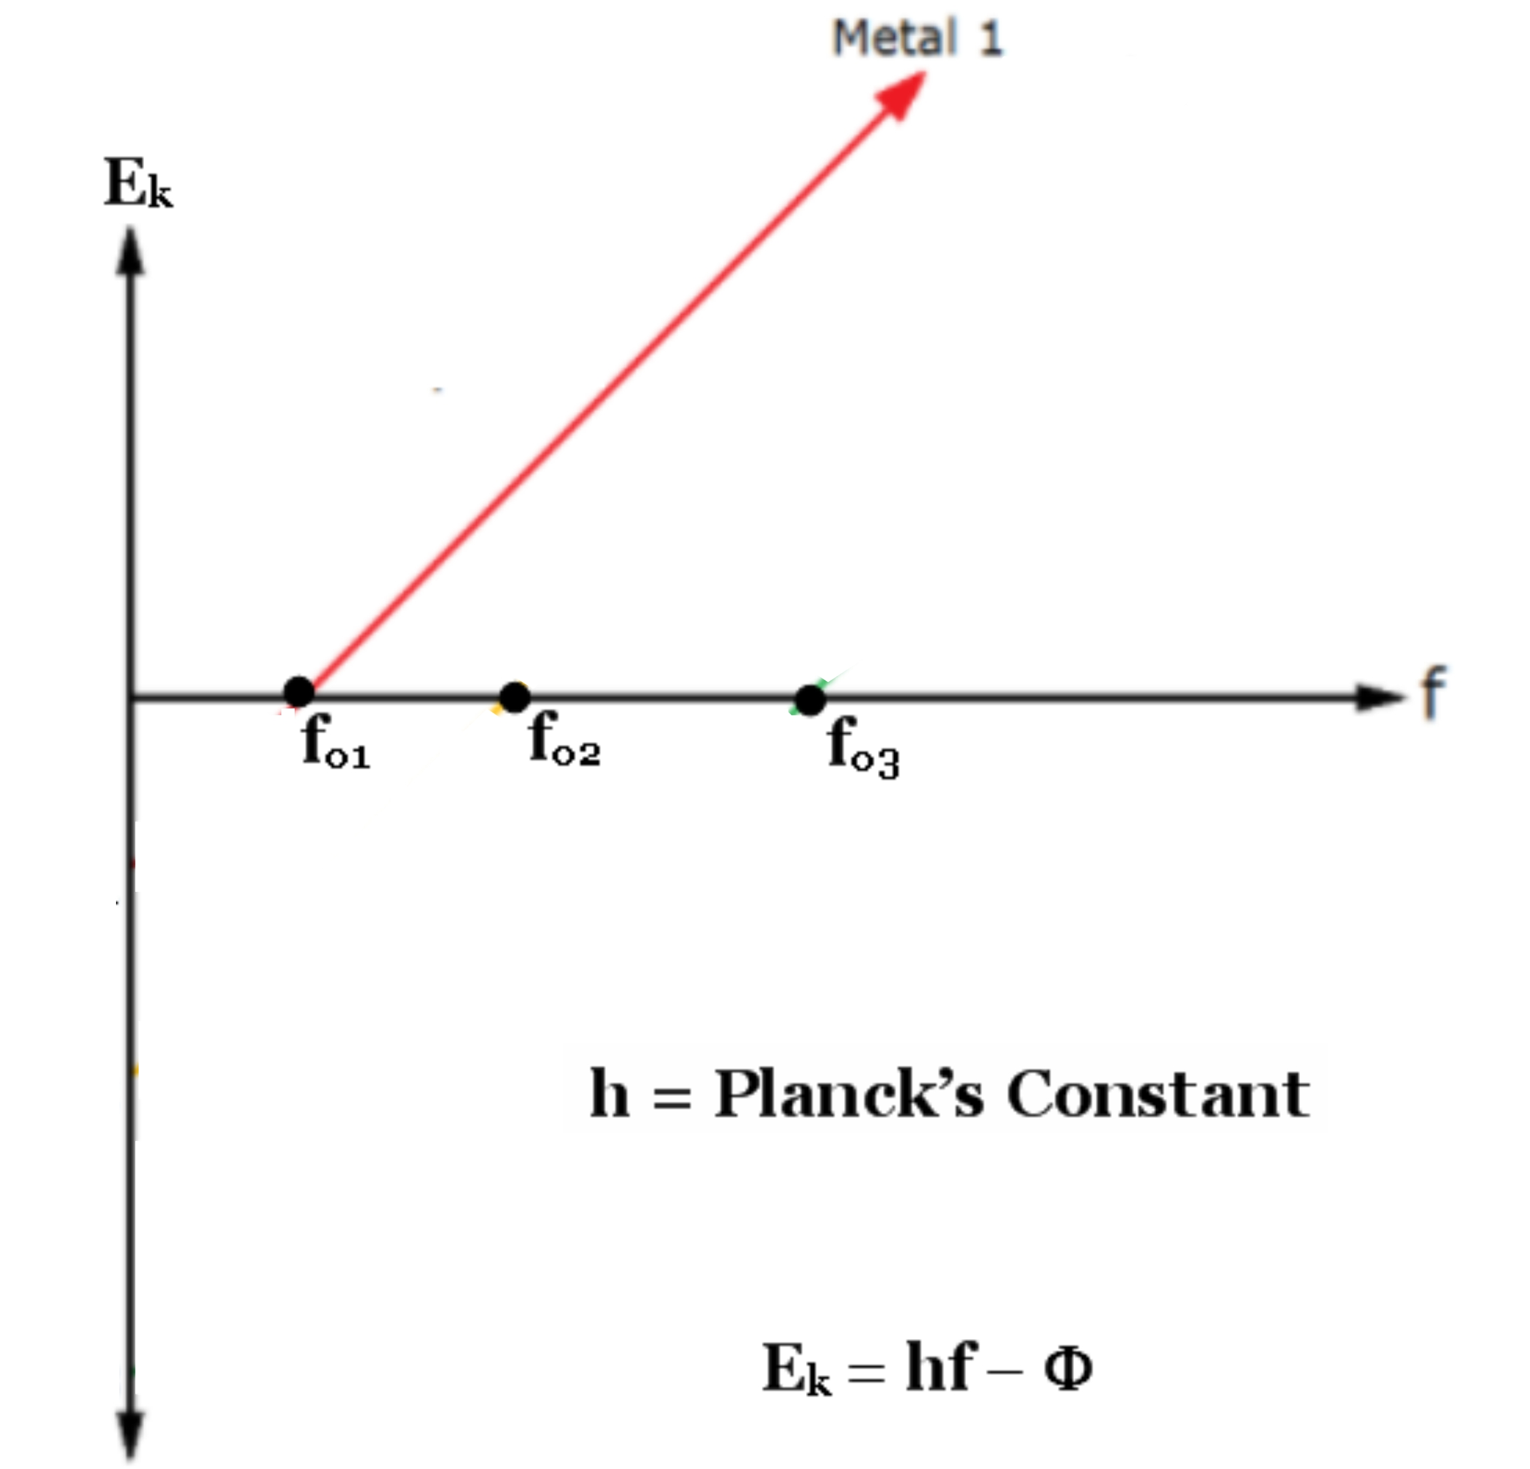
Notes:
9

Slide 10
H
h
Notes:
10

Slide 11
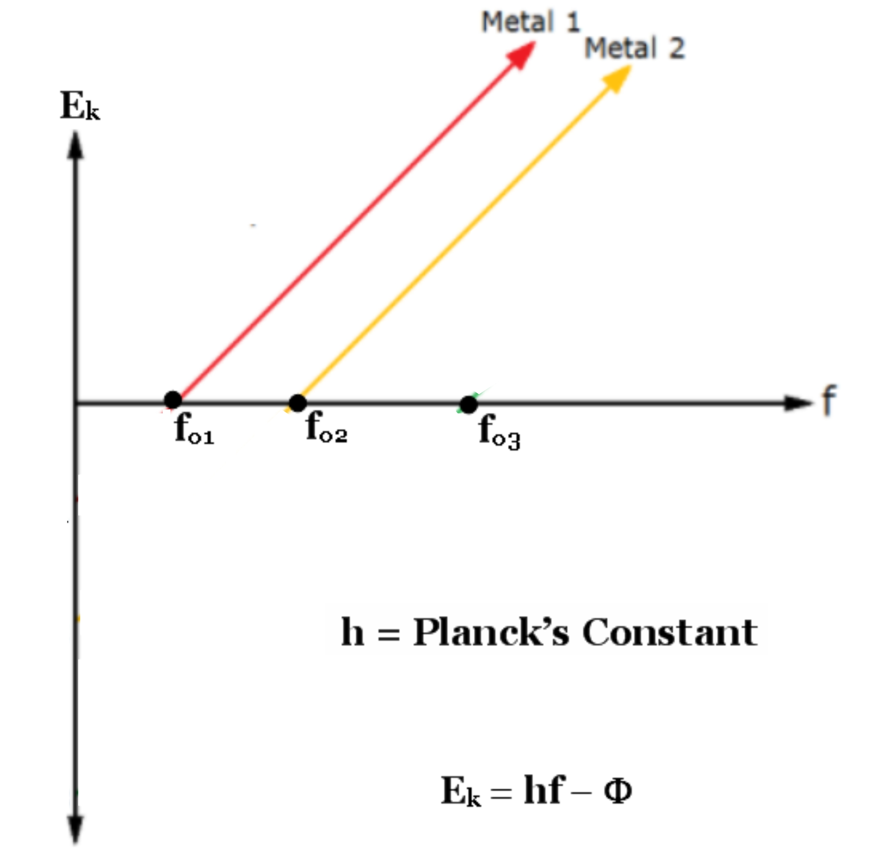
Notes:
11

Slide 12
h
Notes:
12

Slide 13
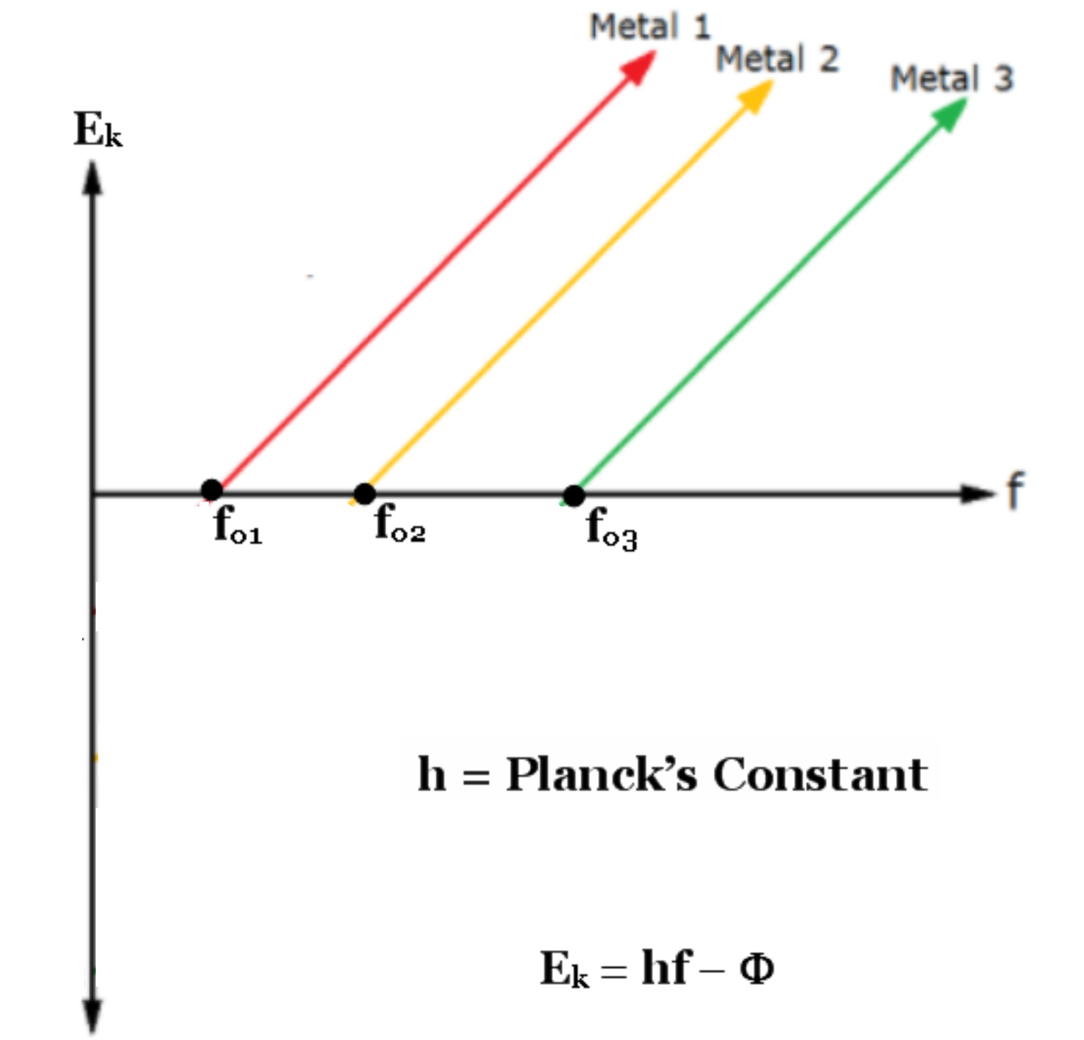
Notes:
13

Slide 14
h
Notes:
14

Slide 15
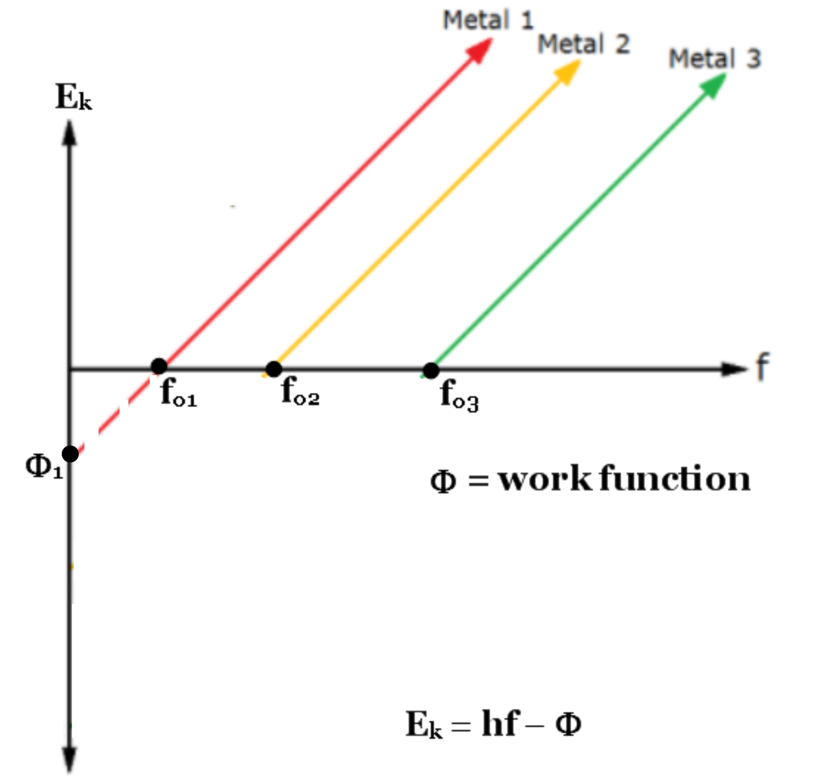
Notes:
15

Slide 16
Notes:
16

Slide 17
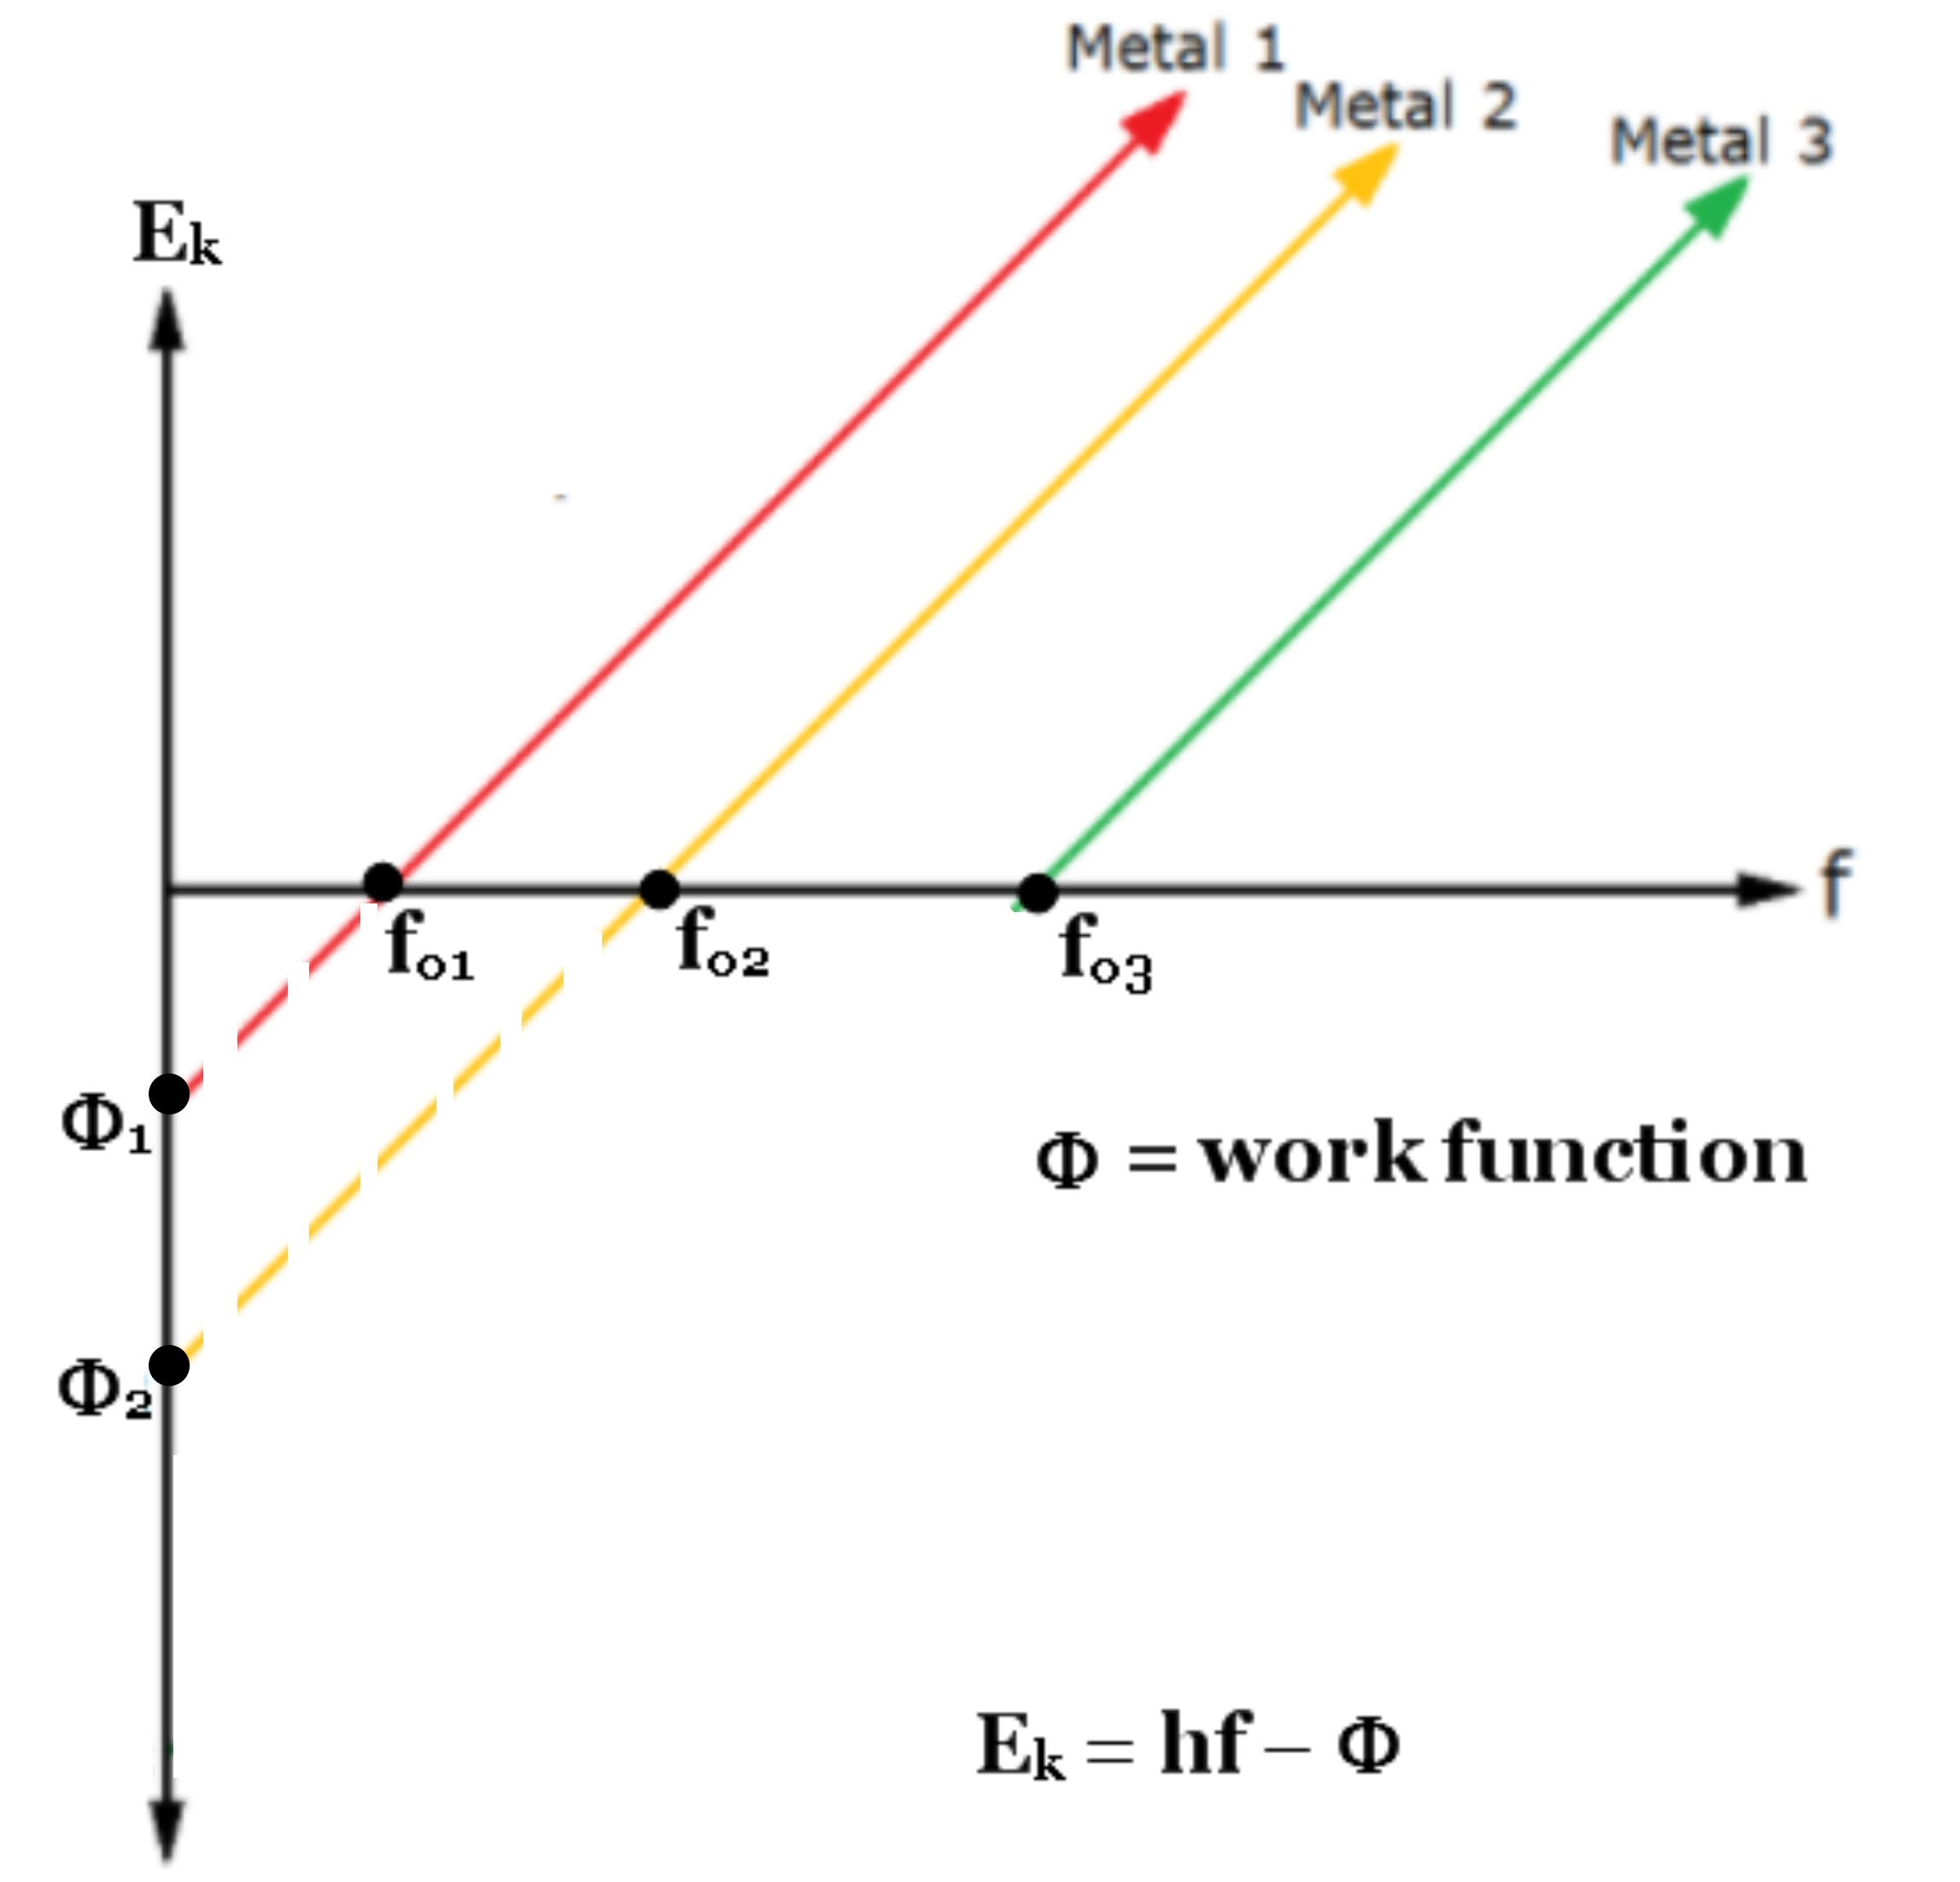
Notes:
17

Slide 18
Notes:
18

Slide 19
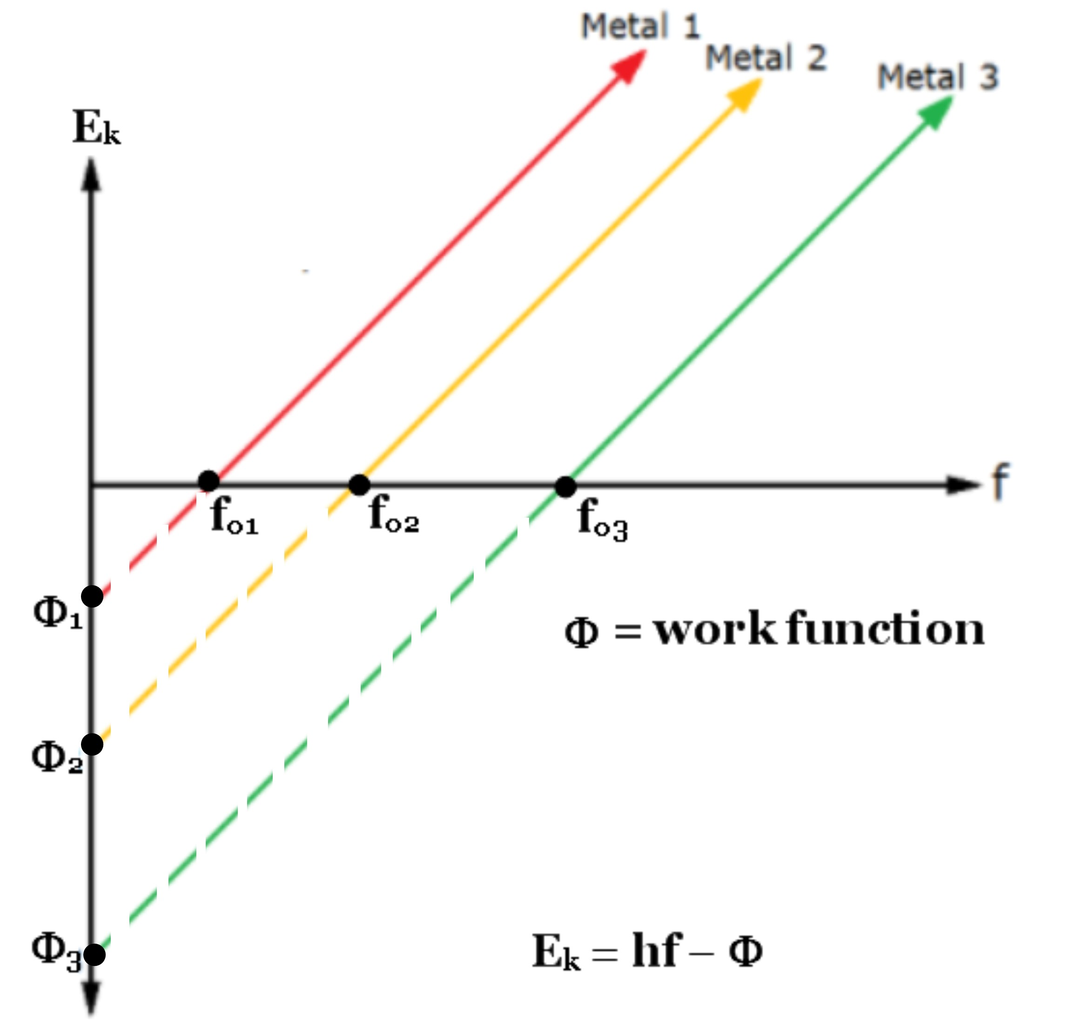
Notes:
19

Slide 20
Notes:
20

Slide 21
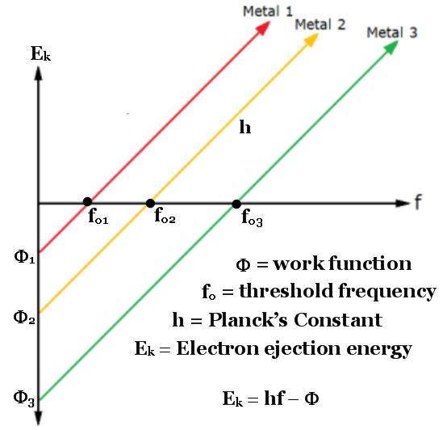
Notes:
21

Slide 22

Faith and Reason
Photo Electric Data
2019
Accepted value for Planck’s Constant:
4.135667662 ×10−15 eV⋅s
Our value for Planck’s Constant:
4.135667662 ×10−15 eV⋅s
Notes:
22

Slide 23
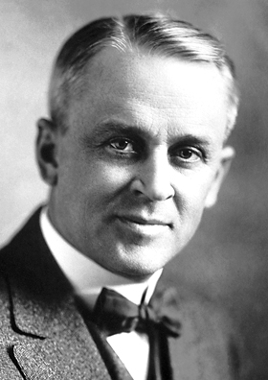
Robert Millikan was totally convinced
that light was a wave and intended to
disprove the thesis that Albert
Einstein had proposed for a light
quantum (“das Lichtquant”). He
thought if the experiment was done
carefully in a vacuum there would be
no ejection of electrons.
Seven years later and after many repeated trials
and recorded experiments Dr. Millikan
concluded that Einstein’s proposed “light
quantum” was a better explanation for the effect.
Notes:
23

Slide 24
SUMMARY!
Einstein was nominated by Emil Warburg in 1917 and was awarded the Nobel Prize in 1921 a paper written in 1905:
“Einstein's law of the photo-electrical effect has been extremely rigorously tested by the American Millikan and his pupils and passed the test brilliantly. Owing to these studies by Einstein the quantum theory has been perfected to a high degree and an extensive literature grew up in this field whereby the extraordinary value of this theory was proved. “
We now look at the work compiled by Robert Millikan from 1907-14....
Notes:
24

Slide 25
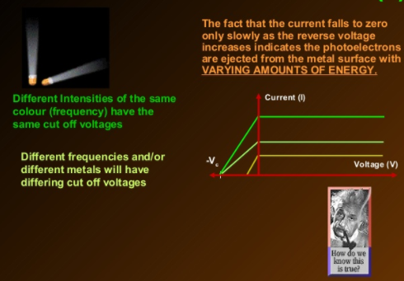
Notes:
25

Slide 26
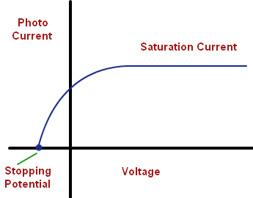
Notes:
26

Slide 27
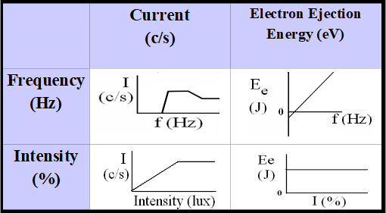
Photoelectric Effect Analysis & Explanation
using Albert Einstein’s Quanta (photon) model
A good theoretical model explains the results of multiple
experiments involving a phenomenon (like PE effect).
Notes:
27

Slide 28
SURPRISE!
Wikipedia 01/04/17:
Einstein's work predicted that the energy of individual ejected electrons increases linearly with the frequency of the light. Perhaps surprisingly, the precise relationship had not at that time been tested. By 1905 it was known that the energy of photo electrons increases with increasing frequency of incident light and is independent of the intensity of the light. However, the manner of the increase was not experimentally determined until 1914 when Robert Andrews Millikan showed that Einstein's prediction was correct.
A Direct Determination of "h"
Millikan, R. (1914). Physical Review. 4 (1): 73–75.
Millikan presented results but was unconvinced...
Notes:
28

Slide 29
Take Aways?
During this grueling 2600 year review:
* Physics explains the world
using analogies, metaphors, imagination, speculation, logical consistency and refines these explanations based on both observations and predictions
that are BOTH qualitative and quantitative.
* Modern Physics (quantum Mechanics)
emerged as a result of coming to see
particles we will never really see (photons).
These photons interact with the smallest of atomic and
subatomic particles (which we also can not see) allowing us to probe the universe in ways that extend our ability to observe (and measure)
* The dual nature of light provides a unique analogy
for other disciplines where simultaneous and seemingly
contradictory properties may surprisingly co-exist.
Notes:
29

