Slide 1


Docker Security
Calico Project
Instructor: Nguyen Duy

Slide 2




ABOUT US
01
03
NGUYEN DOAN XUAN BINH
TRAN HOANG KHANG
02
NGUYEN MY QUYNH (PHA PHA)

Slide 3

TABLES OF CONTENT
Kubernetes (K8s) environment (Minikube, MicroK8s)
Pod, Service, Secret
Deployment (YAML Files)
Calico
Demo
1
2
3
4
5

Slide 4

Kubernetes

Slide 5
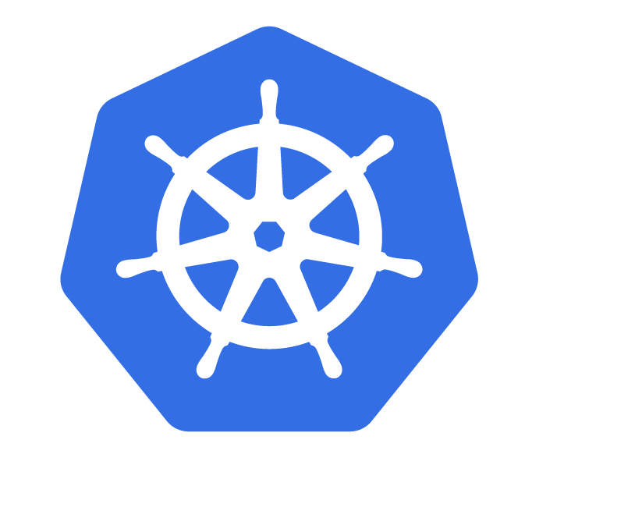
01
Kubernetes
Automated rollouts and rollbacks
Secret and configuration management
04
Service discovery and load balancing
IPv4/IPv6 dual-stack
02
05
Storage orchestration
Self-healing
03
06

Slide 6

Tools
Run commands against Kubernetes clusters (deploy, inspect, cluster resources, and view logs
kubectl
kind
Run Kubernetes on your local computer
Run Kubernetes locally, only run a single node on PC (Win, Mac, Linux)
minikube
kubeadm
Create and manage Kubernetes clusters

Slide 7

K8s Architecture

Slide 8
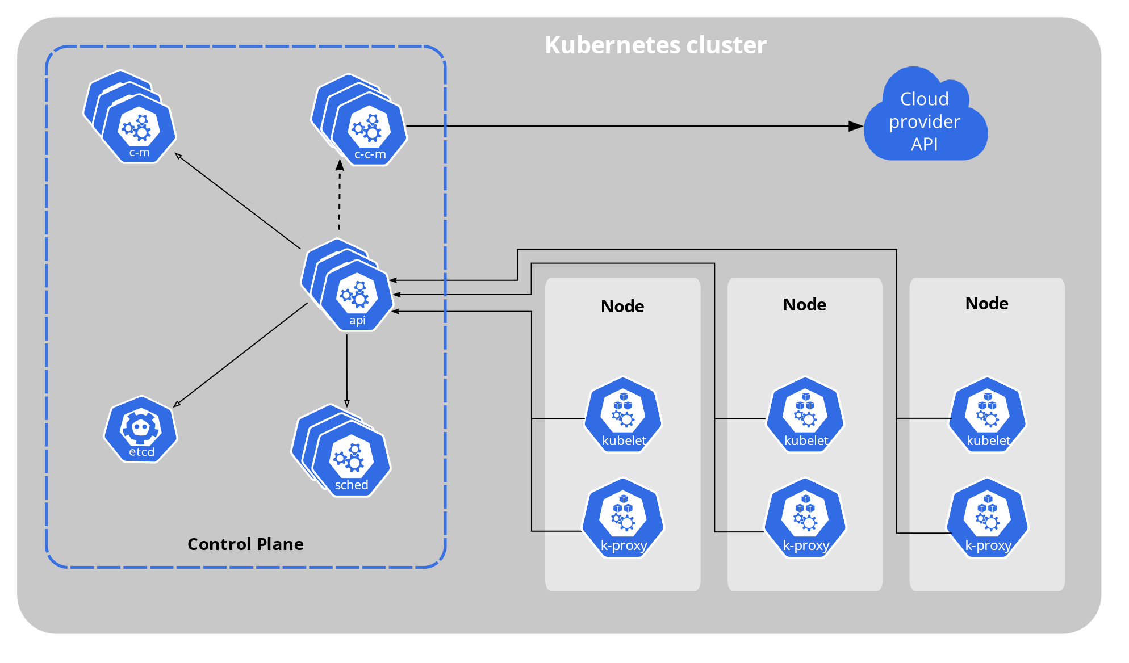
Architect Overview

Slide 9
Deployment

Slide 10
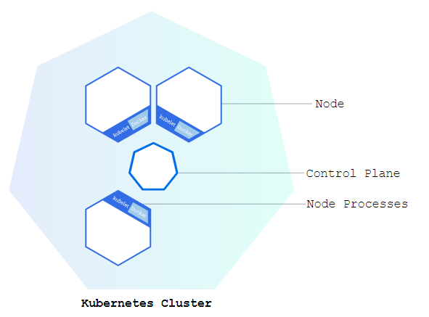
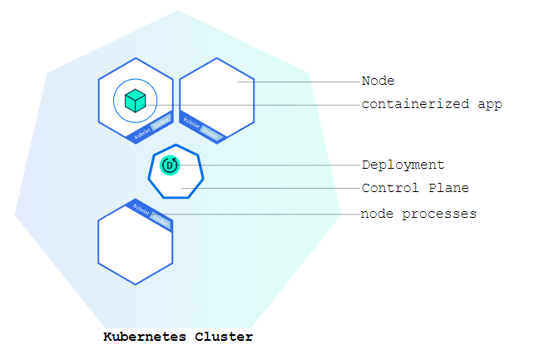
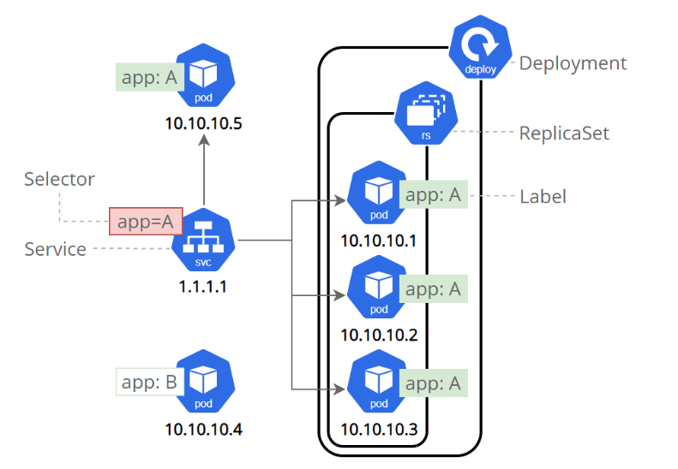
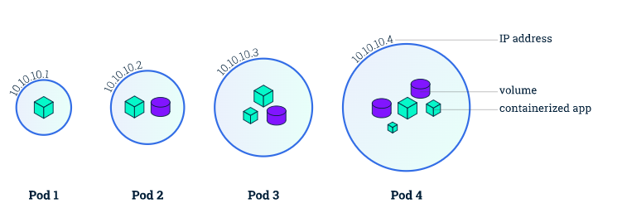
Deploy

Slide 11
Deployment

Slide 12
Service

Slide 13
Secret

Slide 14
ConfigMap

Slide 15






NetworkPolicies

Slide 16
Calico

Slide 17
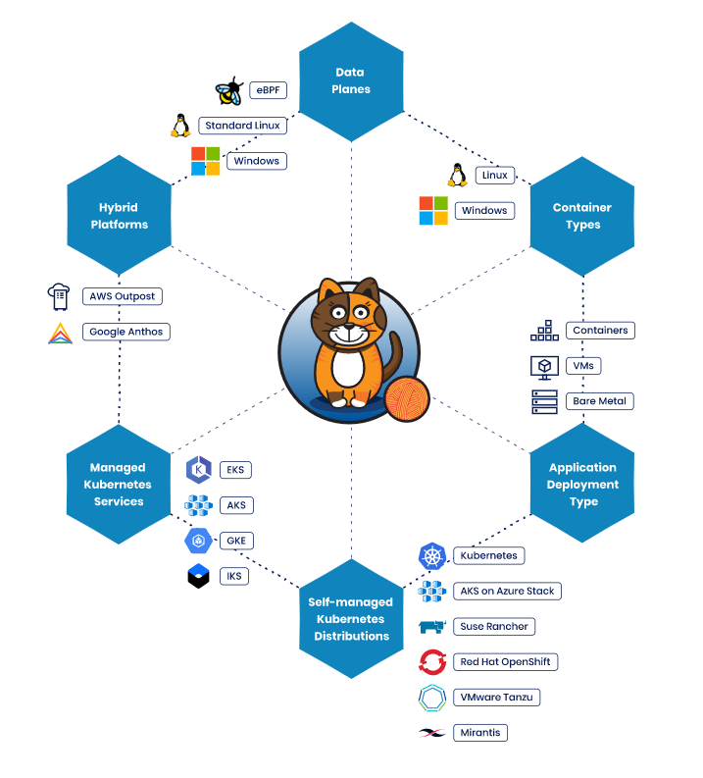

Slide 18
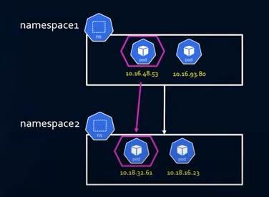
RESOURCES
KUBERNETES NETWORK MODEL
Every pod has its own IP address
Containers inside a pod share the Pod's IP address
and can communicate freely with each other
Pods can communicate with other pods in the cluster using the Pod's IP address (no NAT required)

Slide 19
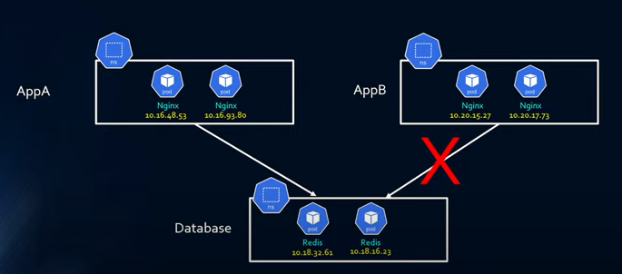
RESOURCES
NETWORK POLICY
Is the main tool for securing the kubernetes network. It allows you to easily limit network traffic in the cluster to allow only the traffic you want to pass through.

Slide 20

CALICO NETWORK POLICY
Calico is an open source networking and network security solution for containers, virtual machines, and native host-based workloads. Calico supports a broad range of platforms including Kubernetes, OpenShift, Mirantis Kubernetes Engine (MKE), OpenStack, and bare metal services.

Slide 21
OUR CLIENTS
Full Kubernetes network policy support
Extends Kubernetes network
Policy write once, works everywhere
Host and VM protection capabilities

Slide 22
FEATURES
Policies can be applied to any kind of endpoint: pods/containers, VMs, and/or to host interfaces and can communicate freely with each other
Optional packet handling controls: disable connection tracking, apply before DNAT, apply to forwarded traffic and/or locally terminated traffic
Policy rules support:
Actions: allow, deny, log, pass
Source and destination match criteria
Ports: numbered, ports in a range, and Kubernetes named ports
Protocols: TCP, UDP, ICMP, SCTP, UDPlite, ICMPv6, protocol numbers (1-255)
HTTP attributes (if using Istio service mesh)
ICMP attributes
IP version (IPv4, IPv6)
IP or CIDR
Endpoint selectors (using label expression to select pods, VMs, host interfaces, and/or network sets)
Namespace selectors
Service account selectors

Slide 23
Demo

Slide 24

THANKS FOR YOUR ATTENTIONS

