Slide 1
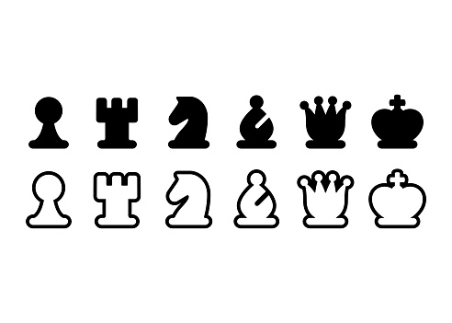
PGN Viewer program
2016310703 남득윤

Slide 2

Introduction
After I watch Netflix “The Queen's gambit” I felt so much interest in chess.
I learn many thing about JAVA as well as some tips for programming on board game
In this project, I will develop my own PGN viewer
Netflix “The Queen’s Gambit”

Slide 3
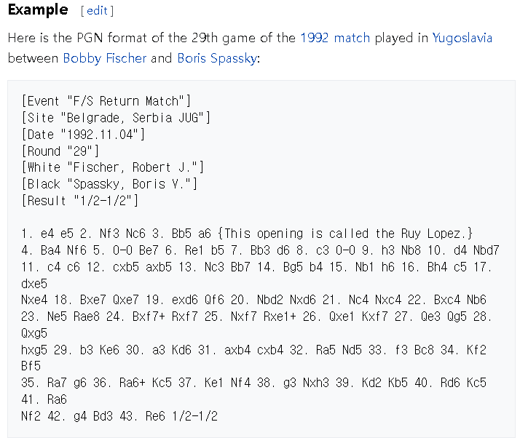
Pgn is a notation for chess game. It contains the match information and the move orders
PGN – potable game notation
Pgn example capture from wikipidia

Slide 4
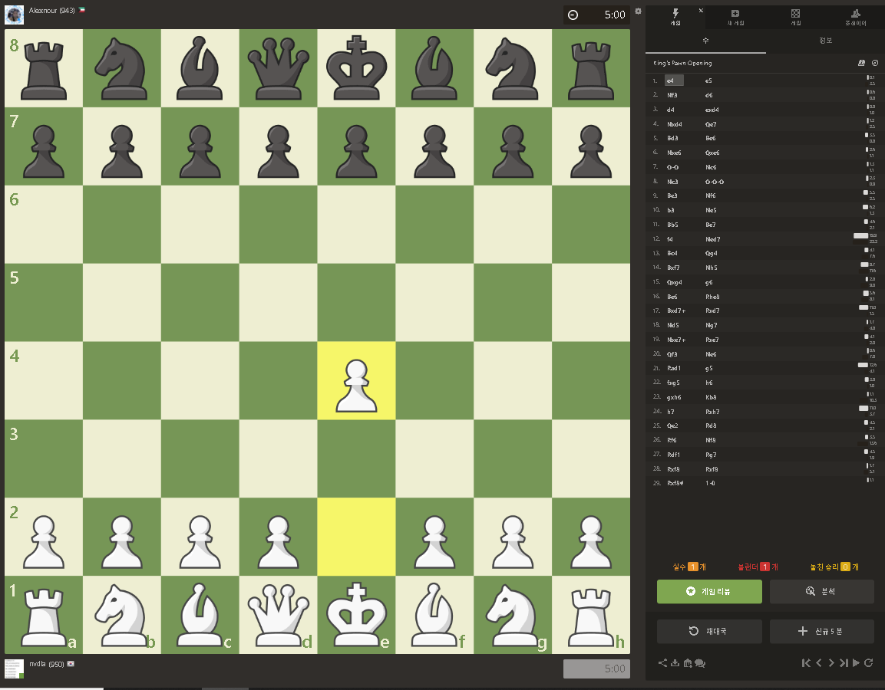
Goals - requirement
Develop a pgn viewer that can simulate an ended chess game.
Consider only valid pgn files of Chess.com.
That is there are no invalid move.
Chess.com is one of most favorite chess web site.
Set white down-side.
Consider special moves (EnPassant, Promotion, Castling)
Simulate chess with gui
Load game
Next move
Chess.com

Slide 5
Goals - development
Clean code
Separate the game and gui part.
Separate the piece move logic for each piece

Slide 6
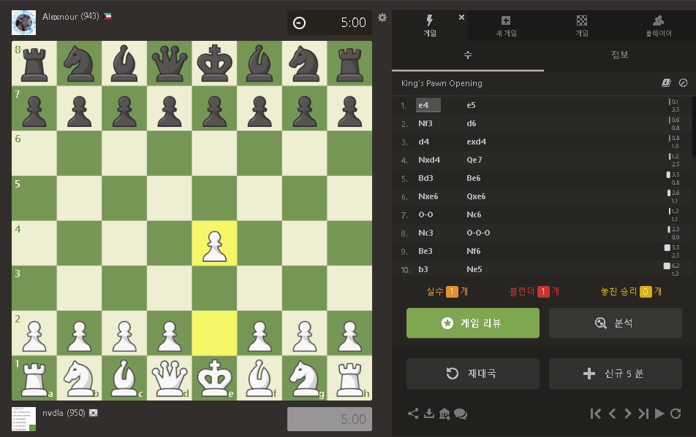
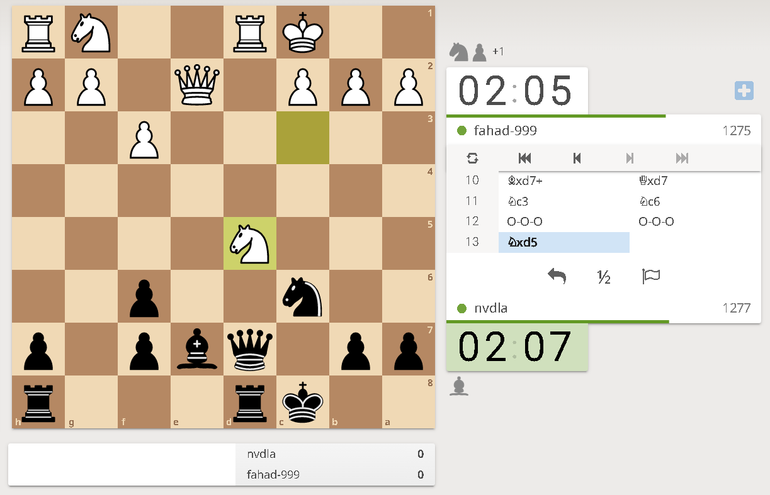
Ideas
Need str.replace(regex,””) for removing unnecessary bracket info in move orders
Since chess is based on grid, gridbaglayout would be useful for label placement
Refer design of chess website
Chess.com
Lichess.org

Slide 7
Plan
week13
Design and specify what to implement and not
Design gui
Develop laod pgn
week14
Implement next move
week15
Bug fix, refactoring
Final Presentation

