Slide 1


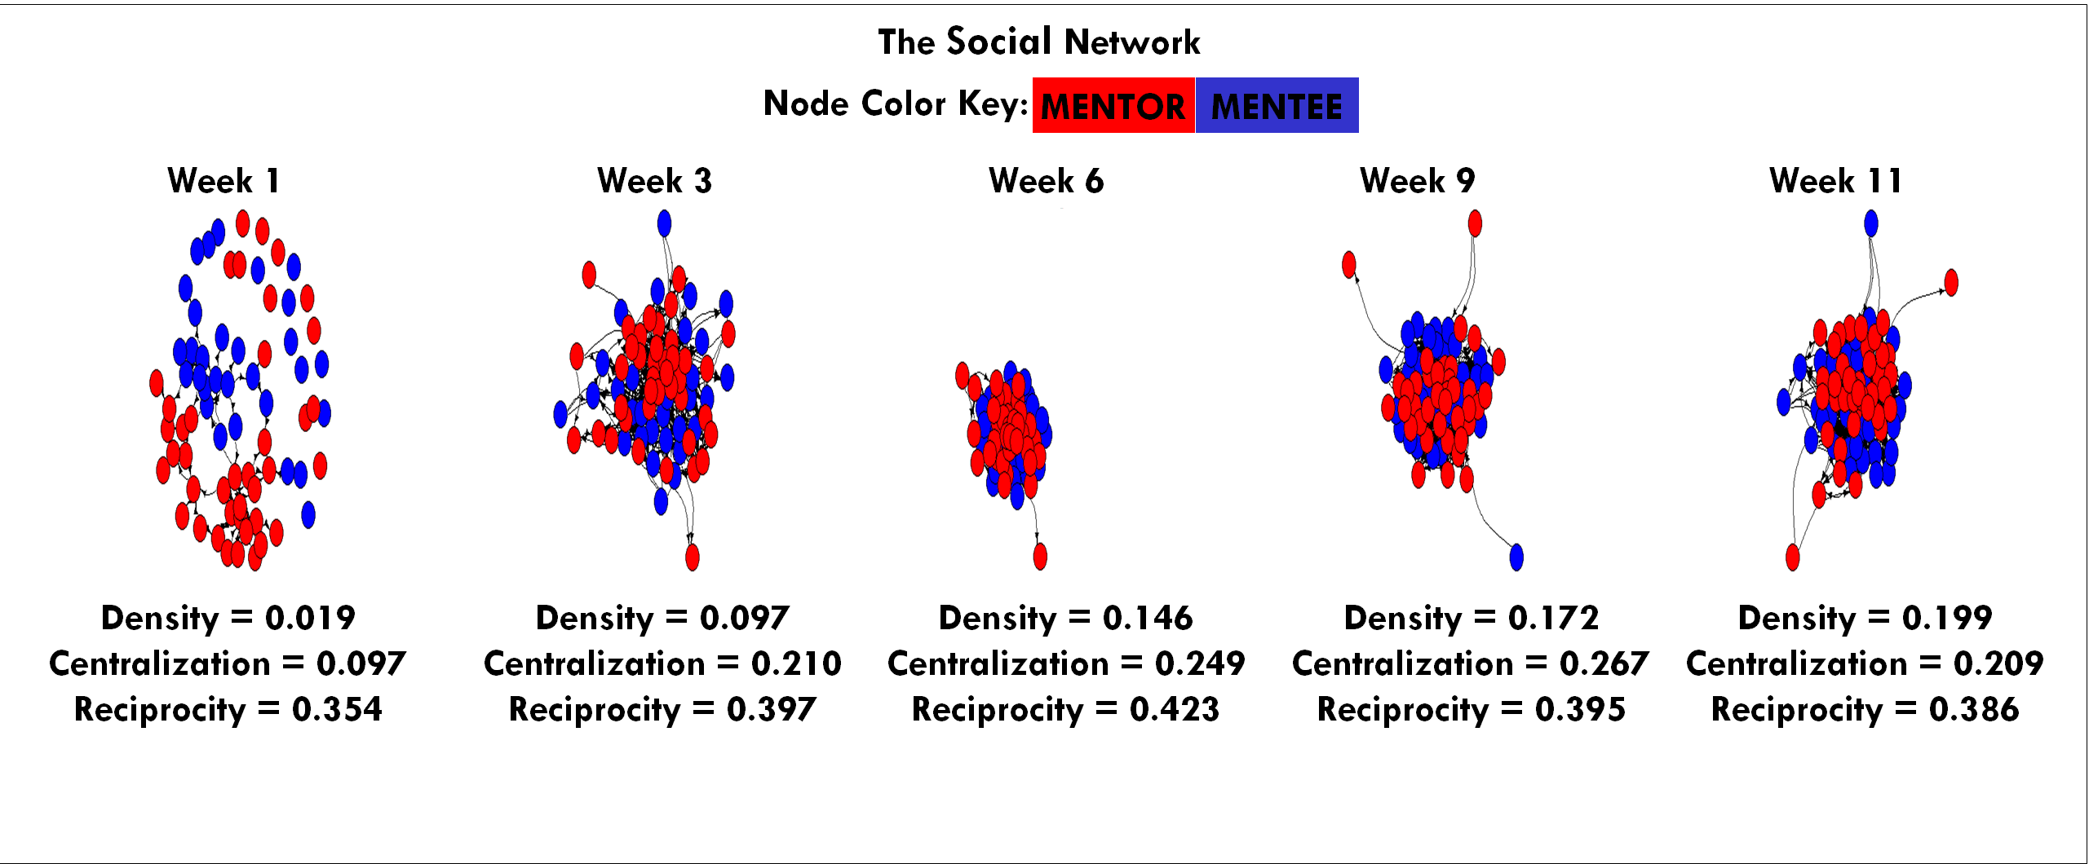
Extraversion Correlations
An Analysis of the Social Network of Campus Connections and its Relationship to Youth Outcomes
Neil Yetz, MPH Candidate^{1,2}
1. Colorado School of Public Health
2. Colorado State University Department of Psychology
Introduction
Methods
Summary
Campus Connections is a multidisciplinary service learning course at CSU where undergraduate students serve as mentors to youth. Students from over 65 different majors work one on one with youth ranging in age from 11-18 who are referred to Campus Connections from our community partners (juvenile justice system of Larimer County, local schools, social service agencies) and directly from families. Student mentors spend four hours once a week with their mentee in a group setting to provide academic support and career planning, encourage positive social skill development, assist with goal setting, and implement wellness programming. Strong bonds are developed over the 12 week program between mentors and mentees
The evolution of the social network of mentors and mentees is tracked as part of the evaluation of Campus Connections. Here, we chart the network over the course of the intervention, and examine the extent to which mentor extraversion is associated with the number of social network nominations that they receive.
Hypothesis 1: An increase in social bonds would be seen across the 12-week program.
Hypothesis 2: Higher scores in extraversion would be associated with a higher number of relationships among mentors.
Methods
Results
Hypotheses

