Slide 1

Neil Yetz, MPH Candidate Colorado School Of Public Health
An Analysis of the Social Network of Campus Connections and its Relationship to Youth Outcomes

Slide 2
Outline [DRAFT]
Campus Connections Program
Social Network Analysis
Background Literature
Methods
Results
Discussion
Conclusions
Implications

Slide 3
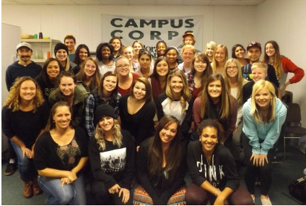
Campus Connections
Highly structured multidisciplinary mentoring program for at-risk youth
Mentorship program open to all majors/years at Colorado State University (CSU).
CSU Students mentor at-risk youth (11-18 yrs) referred from the juvenile justice system, schools, human services.
Mentors are paired 1:1 with youth and work both individually and in multidisciplinary teams.
Past evaluation research has shown positive outcomes in youth that attend the Campus Connections program. (Weiler et al, 2005)

Slide 4
Mentoring At-Risk Youth
Past met-analytic reviews show evidence for better outcomes for youth that partake in mentorship programs (Dubois et al, 2011; Tolan et al, 2013)
Mentored at-risk youth are 55% more likely to attend college than their non-mentored at-risk peers (Thurlow, Sinclair & Johnson, 2002)
Group based mentoring programs have the added benefit of serving more at-risk youth and saving costs in comparison to one on one programs (Dubois et al, 2011)

Slide 5

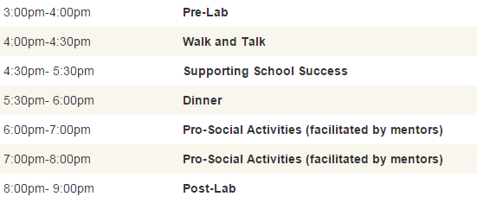
Campus Connections Schedule

Slide 6
Social Network Analysis (SNA)
The investigation of social structures and bonds within a population.
Key terms:
Density – A proportion of connections as compared to the theoretical max in that specific network
Centralization – an identifier of influence and position in the graph through inbound and outbound relationships
Reciprocity – a measure of reciprocated links in a directed network
Measures can be assessed at the group and individual level

Slide 7
SNA, Mentorship, and Adolescents
Adolescent social groups tied with peer deviance and substance use (Ryzin & Dishion, 2014)
Adolescents that reported having a mentoring relationship reported more favorable life outcomes (National Longitudinal study of Adolescents; Dubois & Silverthorn, 2005)
Previous research suggest positive relationships serve as a protective factor for youth (Kawachi & Berkman, 2001)

Slide 8
Hypotheses
Social network measures will serve as significant predictors of program outcomes such as depression.
Youth participants in the Campus Connections Program who have higher degrees of centrality, inbound relationships, and outbound relationships will demonstrate more improvement in measured outcomes from program start to program end.

Slide 9
Methods
5 surveys distributed across 11 week program period
Surveys distributed at week 1 (Baseline), Week 3, Week 6, Week 9, & Week 11
Contained various outcome measures and an indicator of social ties within the program
Data Collected using Qualtrics Survey Software
Outcome measures of depression (Center for Epidemiologic Studies Depression Scale [CES-D]; Haroz, Ybarra & Eaton, 2014)
Controlled for: Baseline depression, attendance night, gender, & ethnicity.
Social network measures of inbound/outbound individual centrality and individual reciprocity scores at week 9 used to predict program end depression outcome

Slide 10

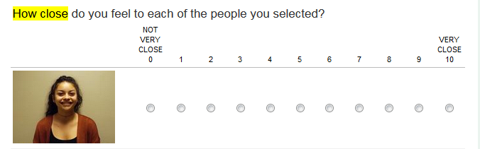


Assessing network ties and bonds
Participants shown pictures of all other individuals in the program of their night
Participants choose individuals they know in the program
Then asked to rate their closeness with individual at all survey time periods

Slide 11
Analysis Methods
Linear Regression was used to assess the association between network connections and youth outcomes
All network measures were standardized to be compared across different time periods.
Hierarchical modeling used to assess social network measures as more significant predictive models.
Partial F-tests compared reduced and full model to assess social network measures as significant predictors.
Analysis performed using R-Studio, SAS, & UCINet

Slide 12
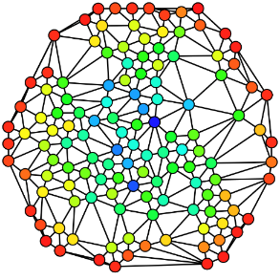
The Campus Connections Social Network

Slide 13
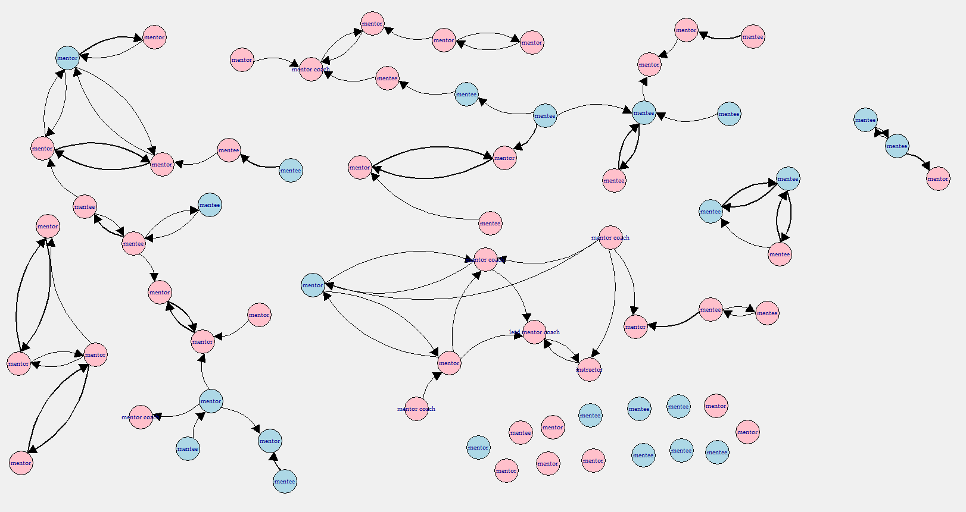
The Growing Social Network
Week 1 (Baseline)
Density: 0.02
Centrality: 0.05
Reciprocity: 0.43
= Staff(when pres complete)

Slide 14
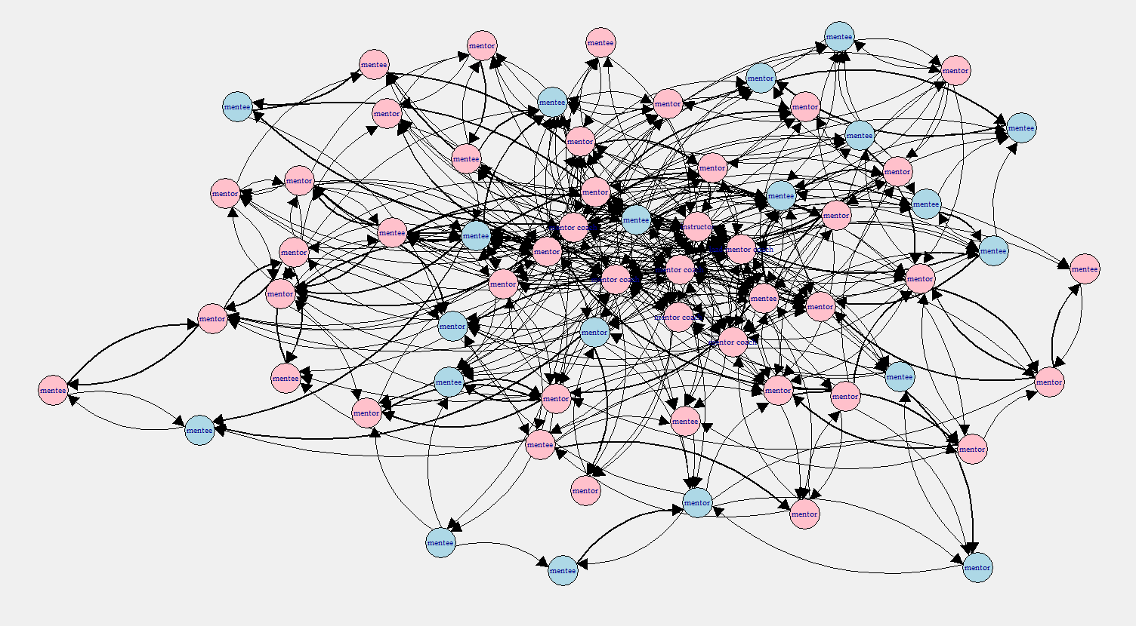
The Growing Social Network
Week 3
Density: 0.11
Centrality: 0.16
Reciprocity: 0.44
= Staff(when pres complete)

Slide 15
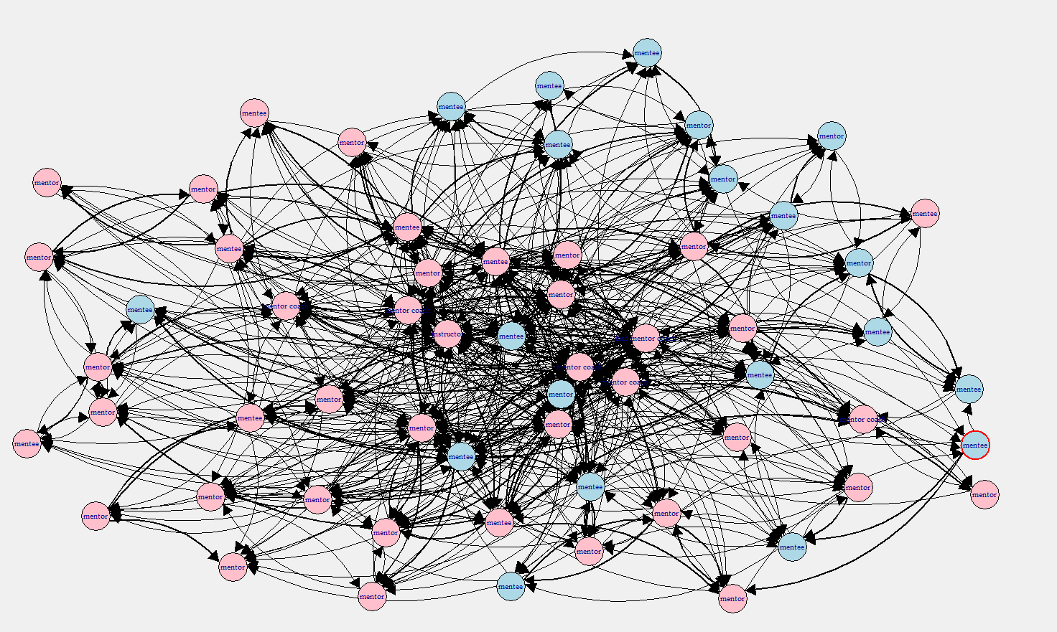
The Growing Social Network
Week 6
Density: 0.18
Centrality: 0.17
Reciprocity: 0.50
= Staff(when pres complete)

Slide 16
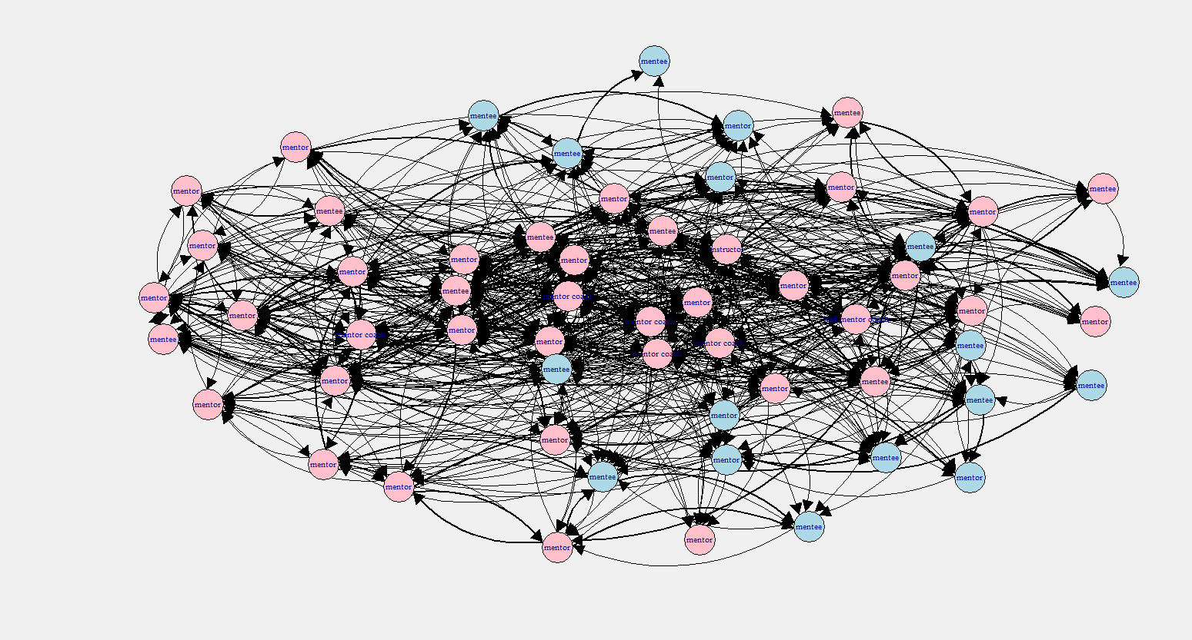
The Growing Social Network
Week 9
Density: 0.18
Cenrality: 0.17
Reciprocity: 0.50
= Staff(when pres complete)

Slide 17
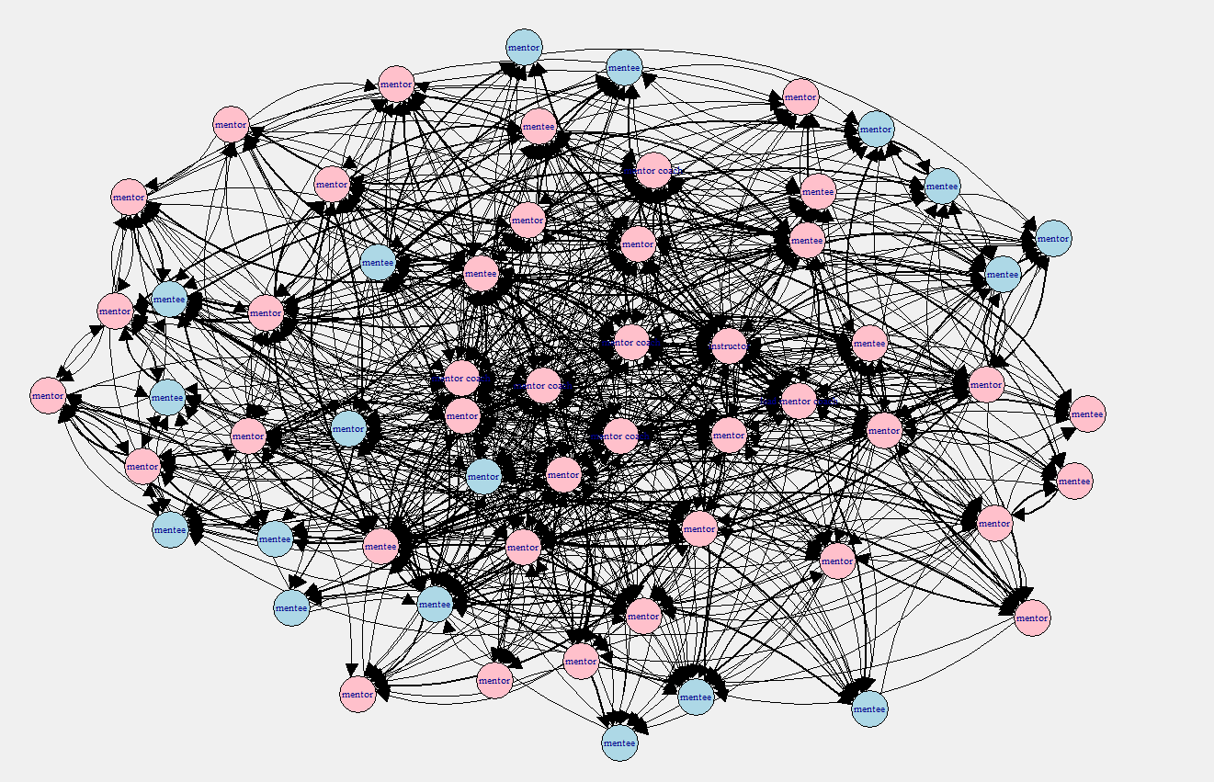
The Growing Social Network
Week 11
Density: 0.25
Centrality: 0.20
Reciprocity: 0.49
= Staff(when pres complete)

Slide 18
Results
N= 83
Reduced model:
Post-Depression = Standard Control explanatory variables: Age, sex, attendance night, baseline depression, ethnicity
R² = 0.51
Full Model:
Post-Depression = Reduced model with the addition measures of individual level inbound/outbound centrality and individual reciprocity.
R² = 0.59

Slide 19
Partial F-Test results
Partial F(4,72) = 2.71, p = 0.036.
The Full model including our social network measures serve as a more significantly predictive model.

Slide 20
Conclusions
In sum, social network measures of inbound & outbound centrality, and reciprocity serve as significant explanatory variables in a regression model when compared to a reduced model with basic predictors.
Social bonds and friendships may serve as important factors understanding in program success.

Slide 21
Implications
Providing a better understanding of social network connections in a youth mentoring program
Encouraging a more and stronger relationships within Campus Connections
Findings contribute to the literature that social ties and bonds are related to positive outcomes

Slide 22
Limitations and Future Research
Limitations
Program attrition and drop out
Presence of “Homophily” in the network
Peer selection vs peer influence (Berten & Van Rossem, 2015)
Limited sample size
Future Research
Assess more youth outcomes and their relation to social network bonds and ties
Understanding the role of youth-mentor based relationships
Incorporating measures of “homophily” in future research

Slide 23
THANK YOU!
Campus Connections program staff
Gereon Fredrickson, Mackenzie Miller
HDFS Faculty
Dr. Shelly Haddock, Dr. Jen Krafchick
Capstone Academic Advisor
Dr. Tracy Nelson
Capstone Preceptor
Dr. Kimberly Henry
All CSPH Faculty, Staff, and Peers

Slide 24
REFERENCES

Slide 25
EXTRA SLIDES
Do not go past this

Slide 26
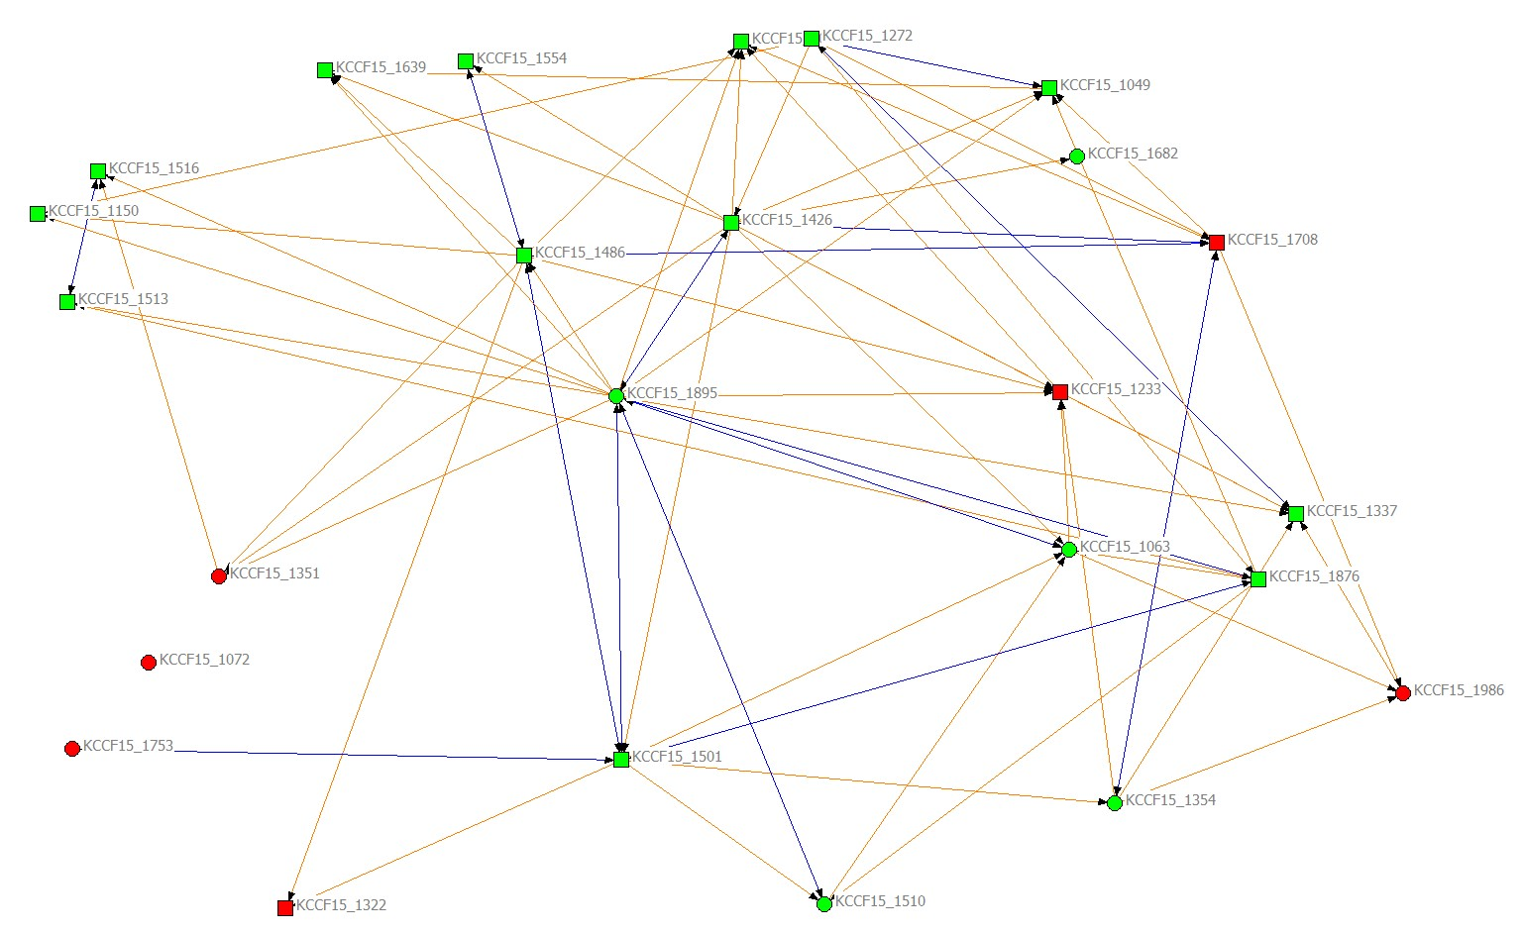
Adolescent Specific Social Network

Slide 27
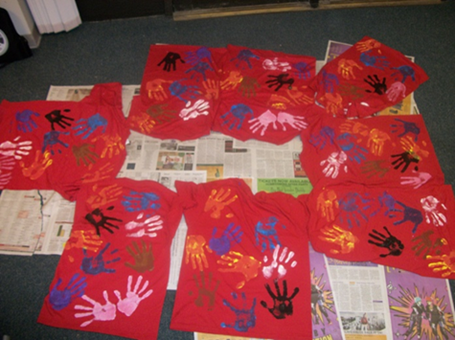
Program Evaluation Findings
Participation in Campus Corps accounted for significant changes:
Community Service Self-Efficacy
Service Learning Benefit
Self-Esteem
Civic Attitudes
Political Awareness
Civic Action
Interpersonal Social Skills

Slide 28
Student experiences
“I was ready to drop out of college before joining Campus Corps and now, because of my time spent with the youth, I am excited about the possibility of pursuing an education degree.”
“I graduated over a year ago and Campus Corps was the most meaningful and rewarding part of my college career.”
“[In Campus Corps] I gained a whole family and a place to belong at CSU.”

Slide 29
Background
2009:
Rates of youth involved in the juvenile justice system increased dramatically during the economic recession
District Attorney & Juvenile Magistrate asked for creative solutions
Research based design – best practices in mentoring
Federal funding to launch program ($500,000 - CNCS grant)
2010:
Launched two sections – Spring 2010
Mentors from only four majors (HDFS, HES, Psych, Spanish)
Expanded to include students from all major and all years at CSU due to student demand

Slide 30
For more information, please contact:
Jen Krafchick, PhD, CFLE
Assistant Professor
Human Development and Family Studies
jen.krafchick@colostate.edu
970-491-2171
Visit us online:
http://www.hdfs.chhs.colostate.edu/students/undergraduate/campuscorps/

Slide 31
Campus Connections
2010-2015:
Four sections every fall/spring + two summers
Approximately 32 mentoring pairs per section
Over 2,000 CSU students have participated
Over 1,700 at-risk youth have participated
CSU students from over 90 different majors
William T. Grant Foundation 3 year funding ($580,000)
Notes:
The coefficients and odds ratios for all of the model’s covariates are provided in Appendix B. Odds ratios can be difficult to interpret in a practical sense; therefore, figures 1 and 2 graph the model’s predicted probability of graduating for a CC new freshman and transfer student compared to a non-CC peer assuming all other things are equal over six years of enrollment.

