Slide 1


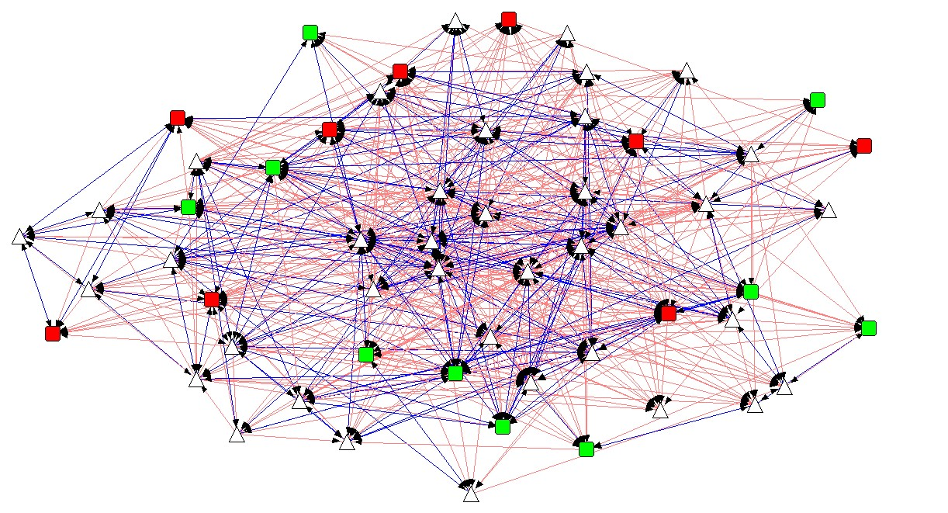
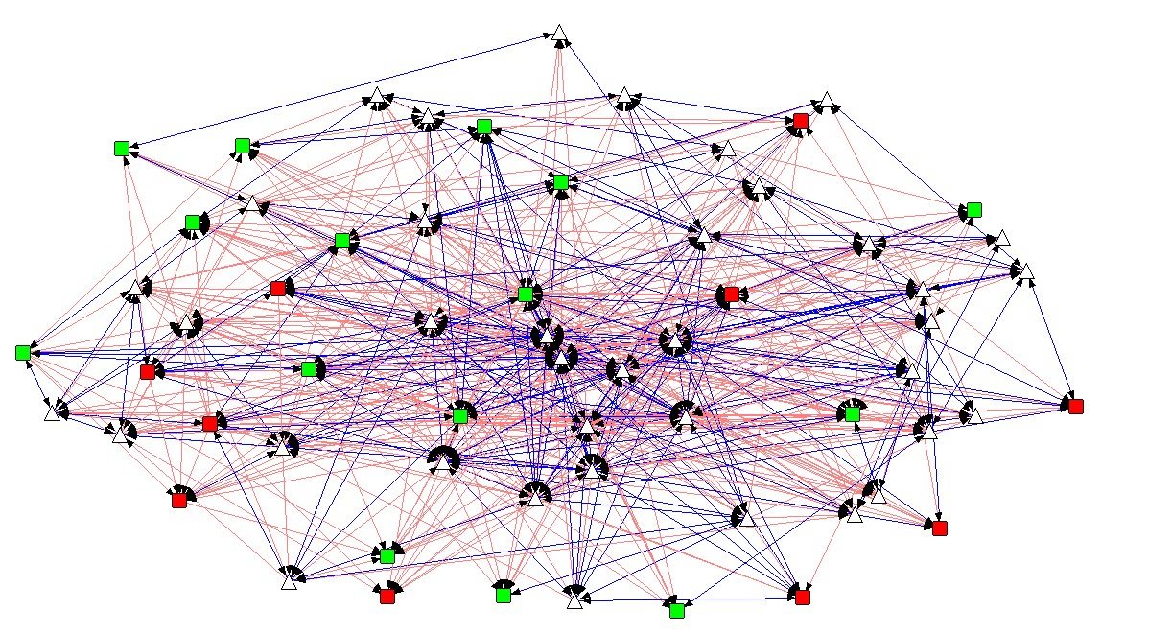
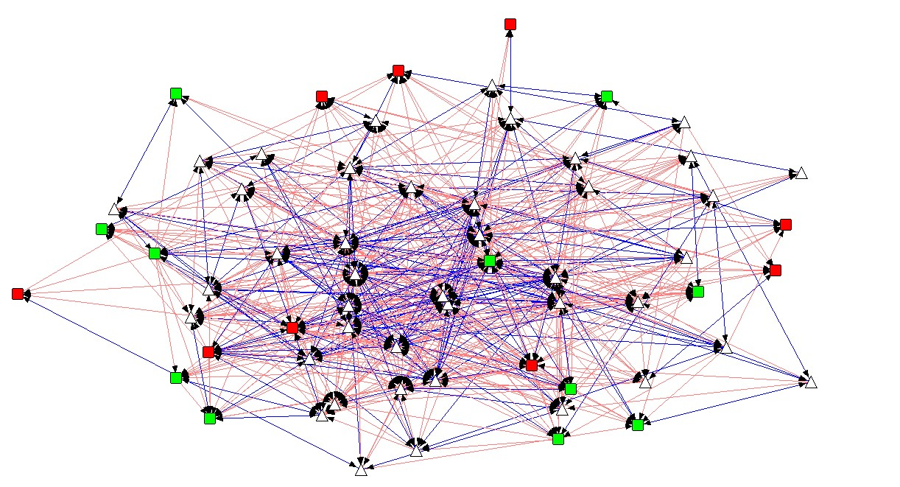
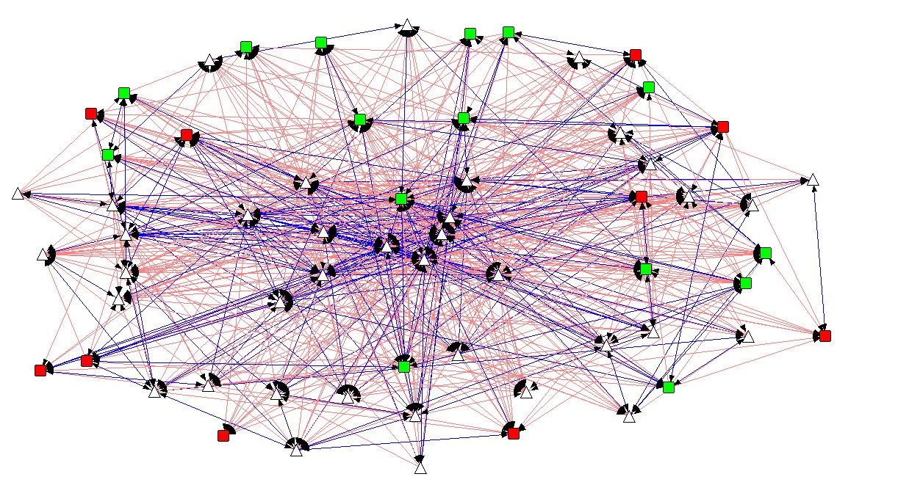
An Analysis of the Social Network of Campus Connections and its Relationship to Youth Outcomes
Neil Yetz
Master of Public Health
Background
Methods
Results
Campus Connections is a multidisciplinary service learning course at CSU where undergraduate students serve as mentors to adolescent mentees. Students from over 65 different majors work one on one with at-risk adolescents ranging in age from 11-18. Strong bonds are developed over the 12 week program between mentors and mentees.
The evolution of the social network of mentors and mentees is tracked as part of the evaluation of Campus Connections. Here, we chart the network over the course of the intervention, and examine the extent to which social network measures serve as predictors of adolescent depression at the program’s end.
Social network data was collected during the Fall 2015 and Spring 2016 semester for four Campus Connections sessions. Mentees and mentors were asked to choose individuals on a survey that they felt a connection with and then asked to rate the strength of the corresponding relationship. The social network data was assessed for the Campus Connections program at weeks 1, 3, 6, 9, and 11. For each week, measures of density, centralization & reciprocity were normalized and assessed across four social network groups.
Measures of mentee depression were assessed prior to the Campus Connections program and at week 11 of the program. Controlling for baseline depression and important control variables, this study used hierarchical regression modeling to assess the addition of the social network measures at week 9 in a predictive model for mentee depression at week 11.
Mentee depression was measured using the Center for Epidemiologic Studies Depression Scale (CES-D; Ybarra & Eaton, 2014).
Reduced Model |  |  |  |  |  |  | Full Model
Variable | Estimate |  |  | p-value |  |  | Variable | Estimate |  |  | p-value
Baseline Depression | 0.54 |  |  | <0.001 |  |  | Baseline Depression | 0.54 |  |  | <0.001
Age | 0.17 |  |  | 0.01 |  |  | Age | 0.15 |  |  | 0.06
Sex | -0.41 |  |  | 0.11 |  |  | Sex | -0.40 |  |  | 0.14
Race: W|H|O | - | -0.66 | -0.06 | R | 0.07 | 0.85 | Race: W|H|O | - | -0.76 | 0.05 | R | 0.03 | 0.09
Night: M|T|W | - | 0.43 | 0.03 | R | 0.27 | 0.93 | Night: M|T|W | - | 0.51 | 0.16 | R | 0.17 | 0.63
 |  |  |  |  |  |  | Inbound Centrality | -0.16 |  |  | 0.35
 |  |  |  |  |  |  | Outbound Centrality | -0.10 |  |  | 0.43
 |  |  |  |  |  |  | Reciprocity | -0.91 |  |  | <0.01
 |  |  |  |  |  |  | Inbound Centrality * Reciprocity | 1.04 |  |  | <0.01
Reduced Model R² = 0.55 |  |  |  |  |  |  | 12% increase in explained variance in post intervention depression
Full Model R² = 0.62
Partial F(4, 71) = 2.89, p = 0.028
Mentee Characteristics
Total Mentees | 83
% Male | 65%
Mean Age (SD) [Range 11-18] | 14 (1.89)
Depression Mean (SD) [CES-D; Score 0-7] | Baseline: 1.63 (1.70)
 | Post: 1.42 (1.58)
Race % | White = 62.07%
 | Hispanic = 18.39%
 | Other = 19.54%
Discussion
Hypothesis
Social network measures of inbound & outbound centrality, and reciprocity serve as significant explanatory variables in a regression model when compared to a reduced model with basic predictors. Social bonds and friendships may provide a better understanding of program success in adolescents. Limitations include a small sample size and program attrition due to mentee drop out from program start to program end.
Study findings help to provide a better understanding of social network connections in a youth mentoring program. Additionally, encouraging more and stronger relationships within Campus Connections may serve to improve program outcomes. Future Research interests should include further understanding of which aspects of a mentor-mentee relationship are most important (e.g., mentee-mentee or mentor-mentee relationships).
Adolescent mentee participants in the Campus Connections Program who have higher degrees of inbound centrality, outbound centrality, and reciprocity will demonstrate more improvement in measured depression outcomes from program start to program end.
The Four Assessed Sessions
Legend
= Depressed Mentee
= Non-Depressed Mentee
= Staff Member
= Reciprocated Tie
= Non-Reciprocated Tie
Density = 0.23 | Reciprocity = 0.47
Density = 0.21 | Reciprocity = 0.53
Density = 0.21 | Reciprocity = 0.50
Density = 0.18 | Reciprocity = 0.48

