Slide 1

Neil Yetz, MPH Candidate Colorado School Of Public Health
An Analysis of the Social Network of Campus Connections and its Relationship to Youth Outcomes

Slide 2
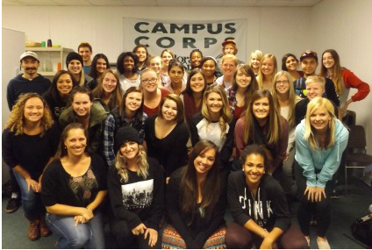
The Campus Connections Program
12 week Mentorship program open to all majors/years at Colorado State University (CSU).
CSU students mentor at-risk adolescents (11-18 years old) referred from the juvenile justice system, schools, human services.
Facilitated my experienced program staff and Marriage & Family Therapist graduate students.
Mentors are paired 1:1 with mentees and work both individually and in multidisciplinary teams.

Slide 3
Mentoring At-Risk adolescents
Past meta-analytic reviews show evidence of better outcomes for adolescents that partake in mentorship programs^{1,2}
Mentored at-risk youth are 55% more likely to attend college than their non-mentored at-risk peers³
Group based mentoring programs have the added benefit of serving more at-risk adolescents and saving costs in comparison to one on one programs¹
1 - Dubois et al, 2011
2 - Tolan et al, 2013
3 - Thurlow, Sinclair & Johnson, 2002

Slide 4
Objective
To understand the role of social bonds in the Campus Connections program and its relationship to adolescent depression

Slide 5
Social Bonds, Mentorship, and Adolescents Background
Adolescent social groups tied with peer deviance and negative outcomes¹
Adolescents that reported having a mentoring relationship have more favorable life outcomes^{2,3}
Previous research suggest positive relationships serve as a protective factor for adolescents⁴
1 - Van Ryzin & Dishion, 2014
2 - Harris & Udry, 2016
3 - Dubois & Silverthorn, 2005
4 - Kawachi & Berkman, 2001

Slide 6
Hypothesis
Adolescent mentee participants that have more social bonds with staff, mentors, and other mentees in the Campus Connections program will demonstrate more improvement in measured depression outcomes from program start to program end.

Slide 7
Methods
5 surveys distributed across 12 week program period
Surveys distributed to Campus Connections mentees at weeks 1, 3, 6, 9, & 11
Assessed mentee bonds, friendships, and relationships with staff, mentors, and other mentees at all time points
Mentee demographic information assessed
Outcome measures of mentee depression assessed using the Center for Epidemiologic Studies Depression Scale (CES-D) ¹
Assessed at prior to Campus Connections and at Week 11
Reliability: α = 0.92
1 - Haroz, Ybarra & Eaton, 2014

Slide 8
Mentee Characteristics
Total Mentees | 83
% Male | 65%
Mean Age (SD) [Range 11-18] | 14 (1.89)
Depression Mean (SD) [CES-D; Score 0-7] | Baseline: 1.63 (1.70)
 | Post: 1.42 (1.58)
Race % | White = 62.07%
 | Hispanic = 18.39%
 | Other = 19.54%

Slide 9




Assessing friendships and bonds

Slide 10

Assessing friendships and bonds

Slide 11
Assessing friendships and bonds

Slide 12

Assessing friendships and bonds

Slide 13
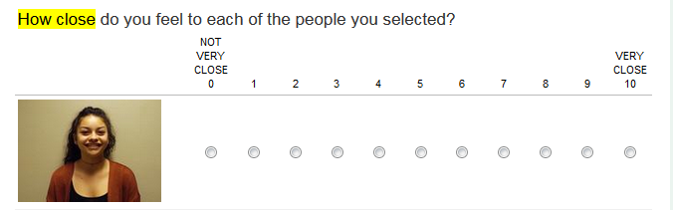

Assessing friendships and bonds

Slide 14
Assessing friendships and bonds

Slide 15
Social Network Analysis: A Quick Overview

Slide 16
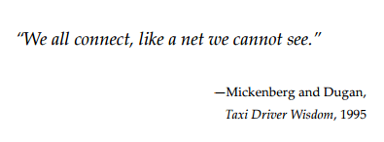
Social Network Analysis (SNA)
The investigation of social relationships and bonds through quantifiable measures

Slide 17
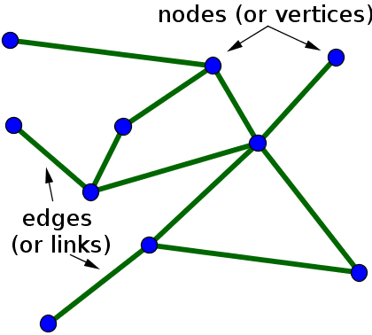
Social Network Analysis (SNA)
Quantifying social networks and bonds
Key terms:
Density
Centralization
Reciprocity
Image: http://katychuang.com/PyData2013-SNATutorial/#/step-1

Slide 18
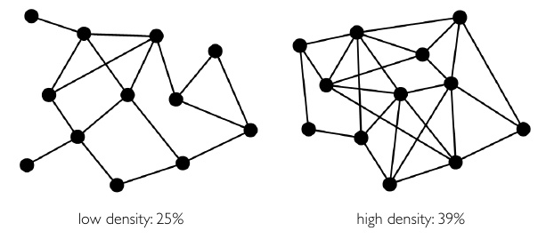
Social Network Analysis (SNA)
Density – A proportion of bonds formed over the max number of possible connections
Density = 25%
Density = 39%
Image: https://www.slideshare.net/plotti/social-network-analysis-intro-part-i

Slide 19
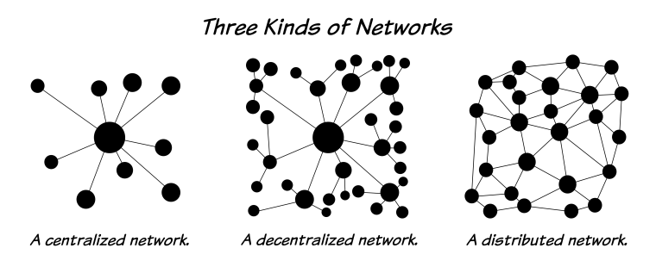
Social Network Analysis (SNA)
Centralization – An identifier position in the graph through inbound and outbound relationships
Image: http://bluenetworks.weebly.com/syngeneia-in-the-history-of-pergamon.html

Slide 20
Social Network Analysis (SNA)
Reciprocity – A measure of the proportion of Returned relationships within a network
Not
Reciprocated
Reciprocated

Slide 21
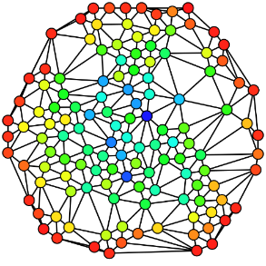
The Campus Connections Social Network
Image:
http://www.assignmentpoint.com/arts/sociology/social-networks-analysis.html

Slide 22
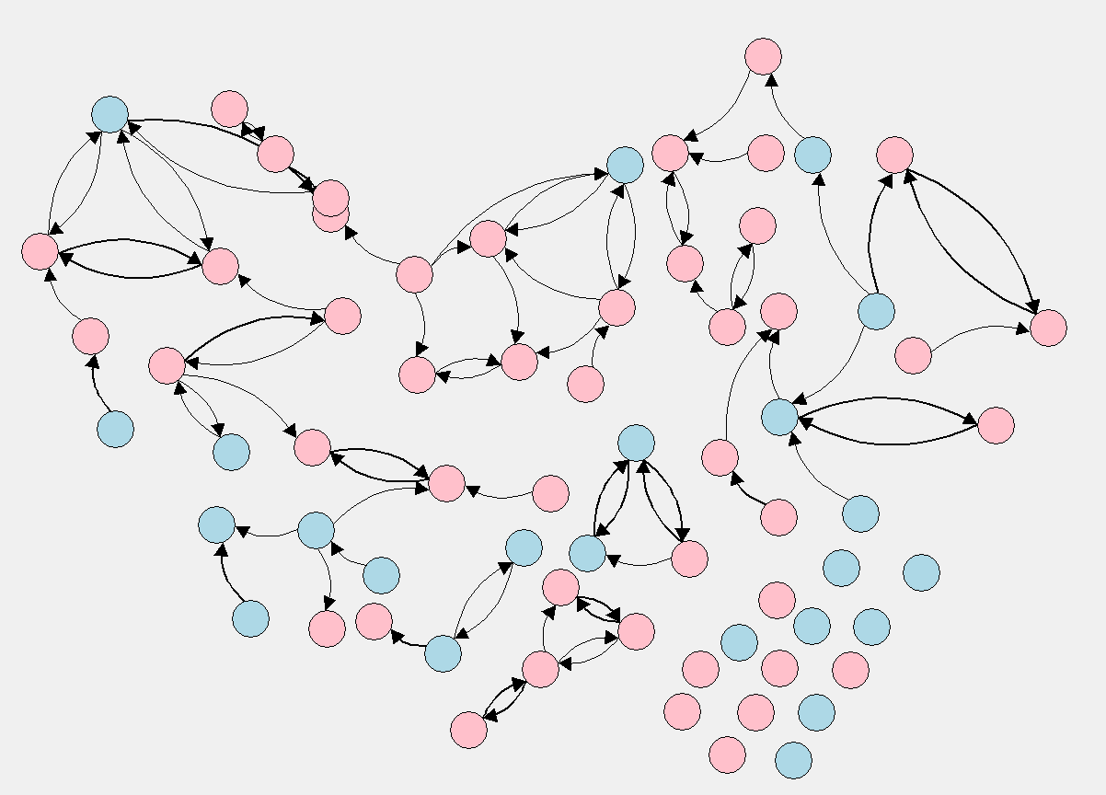
The Growing Social Network
Week | Density | Centrality | Reciprocity
1 (Baseline) | 0.02 | 0.05 | 0.43
N = 68

Slide 23
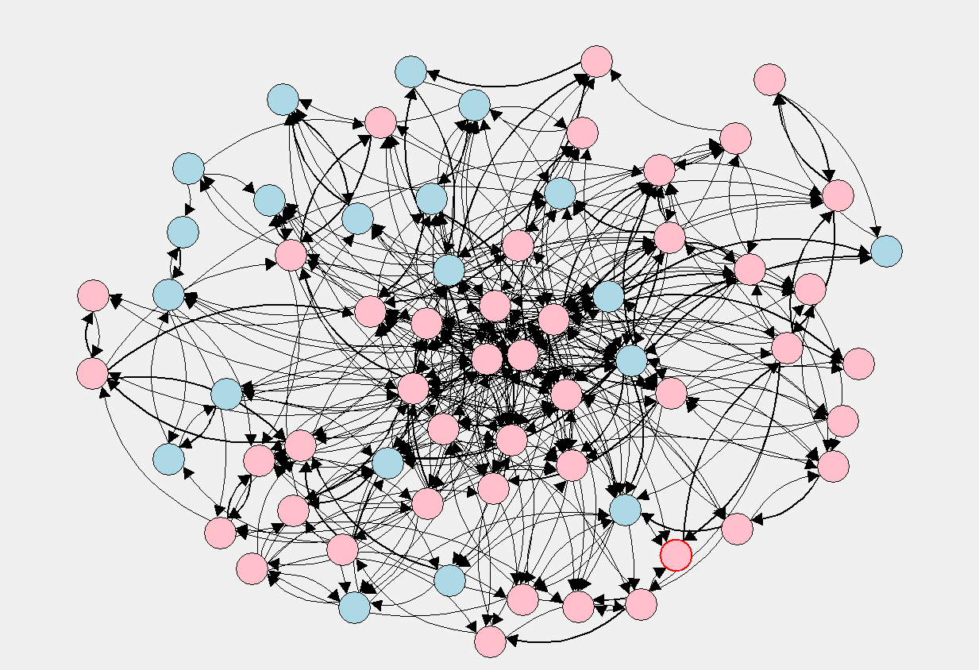
The Growing Social Network
Week | Density | Centrality | Reciprocity
1 (Baseline) | 0.02 | 0.05 | 0.43
3 | 0.11 | 0.16 | 0.44
N = 64

Slide 24
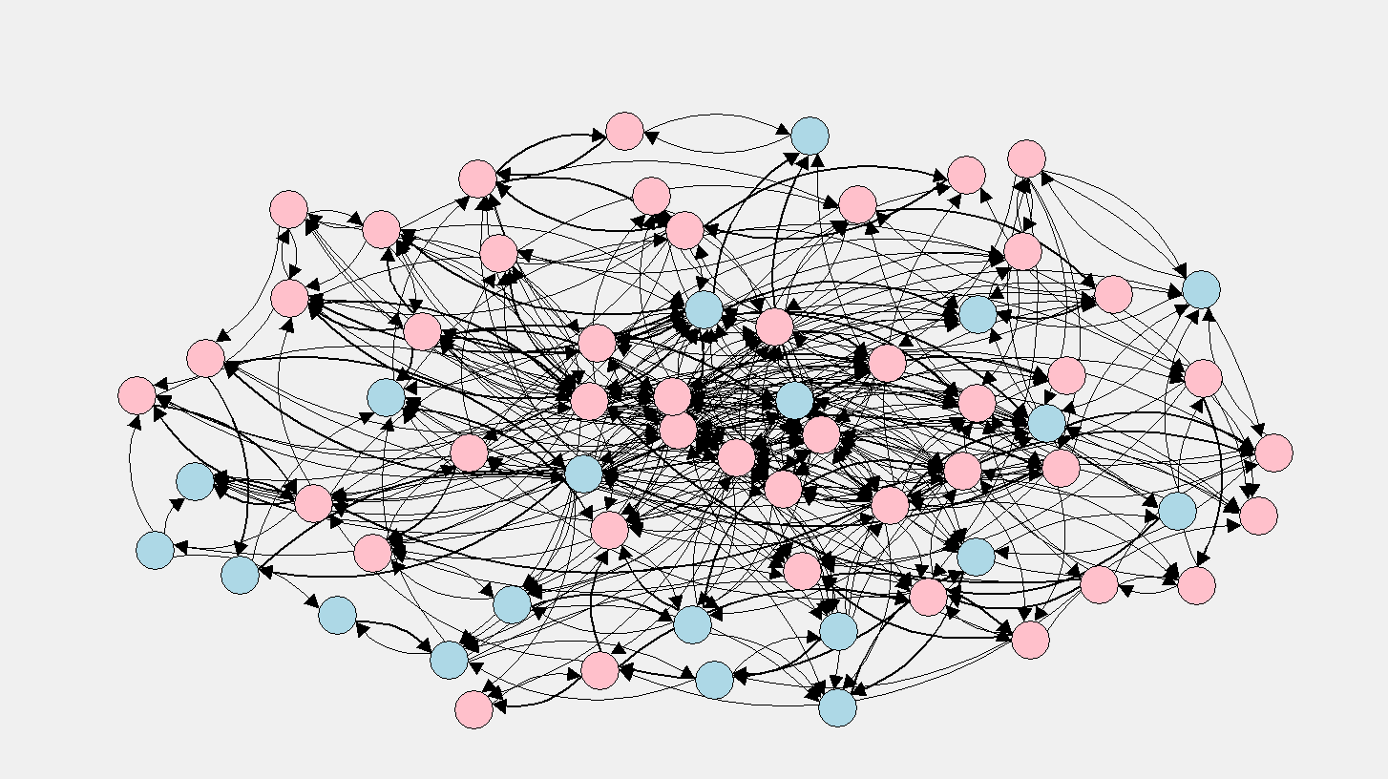
The Growing Social Network
Week | Density | Centrality | Reciprocity
1 (Baseline) | 0.02 | 0.05 | 0.43
3 | 0.11 | 0.16 | 0.44
6 | 0.18 | 0.17 | 0.50
N = 61

Slide 25
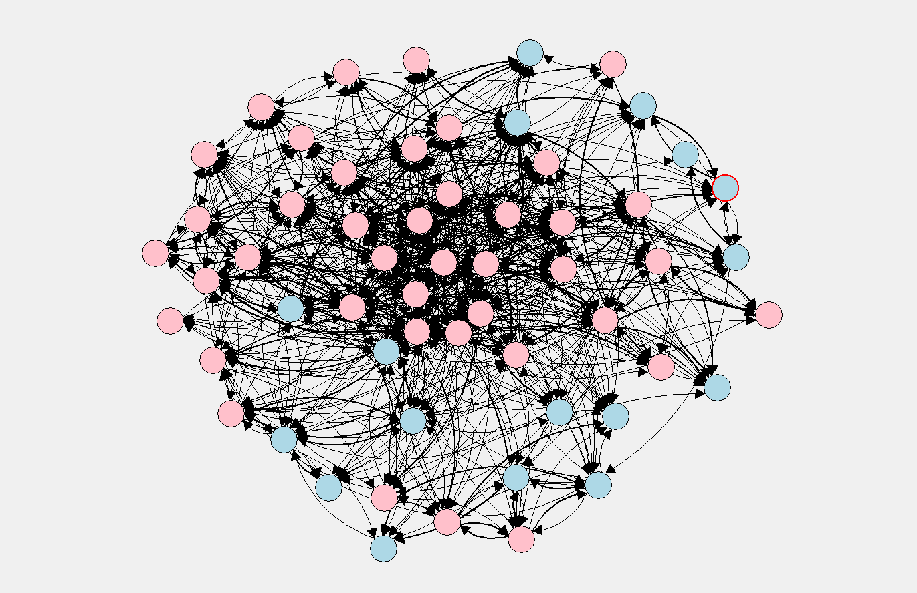
The Growing Social Network
Week | Density | Centrality | Reciprocity
1 (Baseline) | 0.02 | 0.05 | 0.43
3 | 0.11 | 0.16 | 0.44
6 | 0.18 | 0.17 | 0.50
9 | 0.23 | 0.17 | 0.47
N = 58

Slide 26
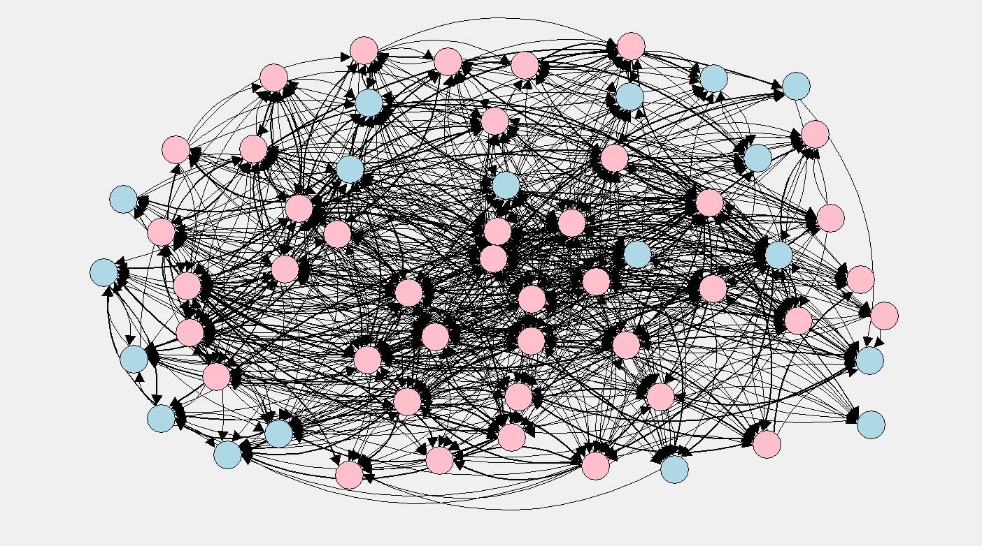
The Growing Social Network
Week | Density | Centrality | Reciprocity
1 (Baseline) | 0.02 | 0.05 | 0.43
3 | 0.11 | 0.16 | 0.44
6 | 0.18 | 0.17 | 0.50
9 | 0.23 | 0.17 | 0.47
11 | 0.25 | 0.20 | 0.49
N = 59

Slide 27
Welcome to the world of social networks!
You’re an expert!
Well… At least good enough to reframe our hypothesis

Slide 28
Quantified Hypothesis
Adolescent mentee participants in the Campus Connections program who have higher degrees of inbound centrality, outbound centrality, and reciprocity will demonstrate more improvement in measured depression outcomes from program start to program end.

Slide 29
Analysis Methods
Linear Regression was used to assess the association between network connections and youth depression across four sessions during the Fall 2015 and Spring 2016 Campus Connections sessions.
Controlled for baseline depression and important control variables.
All network measures were standardized to be compared across different the four assessed sessions.
This study used hierarchical regression modeling to assess the addition of the social network measures at week 9 in a predictive model for mentee depression at week 11.

Slide 30
Results

Slide 31
Model Comparison (N=83)
Reduced Model |  |  |  | Full Model
Variable | Estimate | 95% CI |  | Variable | Estimate | 95% CI
Baseline Depression* | 0.54 | [0.39 – 0.69] |  | Baseline Depression* | 0.54 | [0.39 - 0.69]
Age* | 0.17 | [0.04 – 0.30] |  | Age* | 0.15 | [0.03 - 0.29]
Sex | -0.41 | [-0.91 – 0.09] |  | Sex | -0.40 | [-0.92 - 0.13]
Race |  |  |  | Race
White | Reference | Reference |  | White | Reference | Reference
Hispanic | -0.57 | [-1.25 – 0.11] |  | Hispanic | -0.76 | [-1.45 - 0.08]
Other | -0.03 | [-0.55 – 0.71] |  | Other | 0.05 | [-0.58 - 0.68]
Night |  |  |  | Night
Monday | Reference |  | Reference | Monday | Reference | Reference
Tuesday | 0.50 |  | [-0.24 – 1.24] | Tuesday | 0.52 | [-0.24 - 1.28]
Wednesday | 0.08 |  | [-0.66 – 0.60] | Wednesday | 0.16 | [-0.51 - 0.84]
 |  |  |  | Inbound Centrality | -4.42 | [-13.78 - 4.95]
 |  |  |  | Outbound Centrality | -0.93 | [-3.27 - 1.41]
 |  |  |  | Reciprocity* | -19.33 | [-32.54 - -6.11]
 |  |  |  | Inbound Centrality x Reciprocity* | 251.25 | [90.20 - 412.3]
Reduced Model R² = 0.55 |  |  |  | 12% increase in explained variance in post intervention depression
Full Model R² = 0.62

Slide 32
Model Comparison (N=83)
Reduced Model |  |  |  | Full Model
Variable | Estimate | 95% CI |  | Variable | Estimate | 95% CI
Baseline Depression* | 0.54 | [0.39 – 0.69] |  | Baseline Depression* | 0.54 | [0.39 - 0.69]
Age* | 0.17 | [0.04 – 0.30] |  | Age* | 0.15 | [0.03 - 0.29]
Sex | -0.41 | [-0.91 – 0.09] |  | Sex | -0.40 | [-0.92 - 0.13]
Race |  |  |  | Race
White | Reference | Reference |  | White | Reference | Reference
Hispanic | -0.57 | [-1.25 – 0.11] |  | Hispanic | -0.76 | [-1.45 - 0.08]
Other | -0.03 | [-0.55 – 0.71] |  | Other | 0.05 | [-0.58 - 0.68]
Night |  |  |  | Night
Monday | Reference |  | Reference | Monday | Reference | Reference
Tuesday | 0.50 |  | [-0.24 – 1.24] | Tuesday | 0.52 | [-0.24 - 1.28]
Wednesday | 0.08 |  | [-0.66 – 0.60] | Wednesday | 0.16 | [-0.51 - 0.84]
 |  |  |  | Inbound Centrality | -4.42 | [-13.78 - 4.95]
 |  |  |  | Outbound Centrality | -0.93 | [-3.27 - 1.41]
 |  |  |  | Reciprocity* | -19.33 | [-32.54 - -6.11]
 |  |  |  | Inbound Centrality x Reciprocity* | 251.25 | [90.20 - 412.3]
Reduced Model R² = 0.55 |  |  |  | 12% increase in explained variance in post intervention depression
Full Model R² = 0.62

Slide 33
Model Comparison (N=83)
Reduced Model |  |  |  | Full Model
Variable | Estimate | 95% CI |  | Variable | Estimate | 95% CI
Baseline Depression* | 0.54 | [0.39 – 0.69] |  | Baseline Depression* | 0.54 | [0.39 - 0.69]
Age* | 0.17 | [0.04 – 0.30] |  | Age* | 0.15 | [0.03 - 0.29]
Sex | -0.41 | [-0.91 – 0.09] |  | Sex | -0.40 | [-0.92 - 0.13]
Race |  |  |  | Race
White | Reference | Reference |  | White | Reference | Reference
Hispanic | -0.57 | [-1.25 – 0.11] |  | Hispanic | -0.76 | [-1.45 - 0.08]
Other | -0.03 | [-0.55 – 0.71] |  | Other | 0.05 | [-0.58 - 0.68]
Night |  |  |  | Night
Monday | Reference |  | Reference | Monday | Reference | Reference
Tuesday | 0.50 |  | [-0.24 – 1.24] | Tuesday | 0.52 | [-0.24 - 1.28]
Wednesday | 0.08 |  | [-0.66 – 0.60] | Wednesday | 0.16 | [-0.51 - 0.84]
 |  |  |  | Inbound Centrality | -4.42 | [-13.78 - 4.95]
 |  |  |  | Outbound Centrality | -0.93 | [-3.27 - 1.41]
 |  |  |  | Reciprocity* | -19.33 | [-32.54 - -6.11]
 |  |  |  | Inbound Centrality x Reciprocity* | 251.25 | [90.20 - 412.3]
Reduced Model R² = 0.55 |  |  |  | 12% increase in explained variance in post intervention depression
Full Model R² = 0.62

Slide 34
Model Comparison (N=83)
Reduced Model |  |  |  | Full Model
Variable | Estimate | 95% CI |  | Variable | Estimate | 95% CI
Baseline Depression* | 0.54 | [0.39 – 0.69] |  | Baseline Depression* | 0.54 | [0.39 - 0.69]
Age* | 0.17 | [0.04 – 0.30] |  | Age* | 0.15 | [0.03 - 0.29]
Sex | -0.41 | [-0.91 – 0.09] |  | Sex | -0.40 | [-0.92 - 0.13]
Race |  |  |  | Race
White | Reference | Reference |  | White | Reference | Reference
Hispanic | -0.57 | [-1.25 – 0.11] |  | Hispanic | -0.76 | [-1.45 - 0.08]
Other | -0.03 | [-0.55 – 0.71] |  | Other | 0.05 | [-0.58 - 0.68]
Night |  |  |  | Night
Monday | Reference |  | Reference | Monday | Reference | Reference
Tuesday | 0.50 |  | [-0.24 – 1.24] | Tuesday | 0.52 | [-0.24 - 1.28]
Wednesday | 0.08 |  | [-0.66 – 0.60] | Wednesday | 0.16 | [-0.51 - 0.84]
 |  |  |  | Inbound Centrality | -4.42 | [-13.78 - 4.95]
 |  |  |  | Outbound Centrality | -0.93 | [-3.27 - 1.41]
 |  |  |  | Reciprocity* | -19.33 | [-32.54 - -6.11]
 |  |  |  | Inbound Centrality x Reciprocity* | 251.25 | [90.20 - 412.3]
Reduced Model R² = 0.55 |  |  |  | 12% increase in explained variance in post intervention depression
Full Model R² = 0.62

Slide 35
Results Main Findings
Hierarchical Regression Modeling Results
Partial F(4, 71) = 2.89, p = 0.028
The full model including the social network measures explains statistically significantly more variability in depression scores than the reduced model.

Slide 36
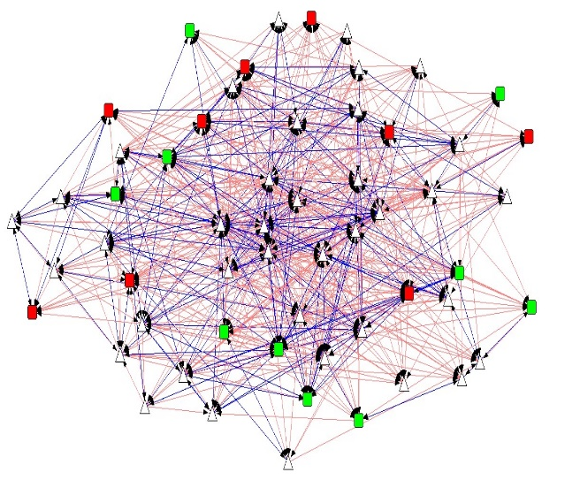
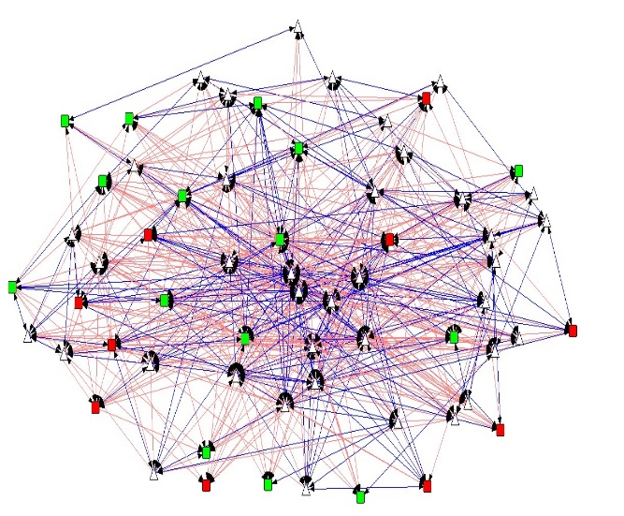
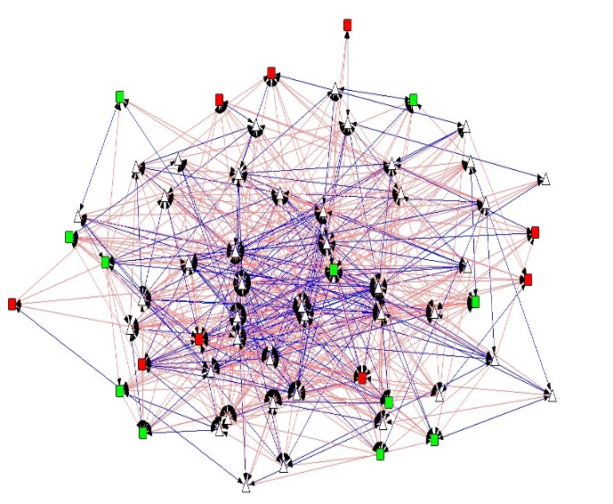
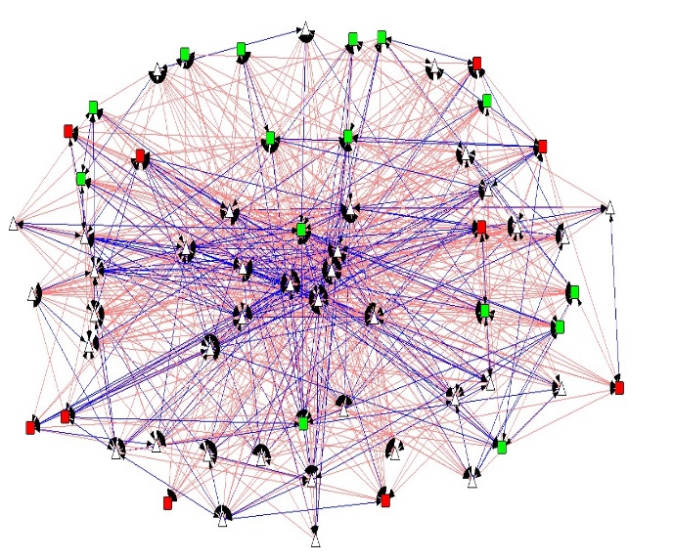
The Four Assessed Networks
Legend
= Depressed Mentee
= Non-Depressed Mentee
Density = 0.23 | Reciprocity = 0.47
Density = 0.21 | Reciprocity = 0.53
= Staff Member
= Reciprocated Tie
= Non-Reciprocated Tie
Density = 0.21 | Reciprocity = 0.50
Density = 0.18 | Reciprocity = 0.48

Slide 37
Legend
= Depressed Mentee
= Non-Depressed Mentee
= Staff Member
= Reciprocated Tie
= Non-Reciprocated Tie

Slide 38
Conclusions
Social bonds and friendships may serve as important factors understanding in adolescent depression in the Campus Connections program
Reciprocity is heavily related post depression in the Campus Connections program

Slide 39
Implications
These results help to provide better understanding of social network connections in an adolescent mentoring program
Encouraging a more (and stronger) relationships within Campus Connections may promote more positive outcomes in mentees

Slide 40
Limitations and Future Research
Limitations
Program attrition
Small sample size
Future Research
Further understanding of which aspects of a mentor-mentee relationship are most important
E.g, mentee-mentee relationship vs. mentor-mentee relationships.

Slide 41
THANK YOU!
Campus Connections program staff
Stacy Biggerstaff, MS
Gereon Fredrickson, BS
Mackenzie Miller, MS
HDFS Faculty
Shelly Haddock, PhD
Capstone Academic Advisor
Tracy Nelson, PhD, MPH
Capstone Preceptor & Mentor
Kimberly Henry, PhD
All CSPH Faculty, Staff, and Peers

Slide 42
REFERENCES
DuBois DL, Portillo N, Rhodes JE, Silverthorn N & Valentine (2011). How effective are mentoring programs for youth? A systematic assessment of the evidence. Psychological Sciences in the Public Interest 12(2), 57-91. DOI: 10.1177/1529100611414806
Dubois DL & Silverthorn N (2005). Natural mentoring relationships and adolescent health: Evidence from a national study. American Journal of Public Health 95(3) 518-524. doi:10.2105/AJPH.2003.031476
Harris KM & Udry RJ (2016) National Longitudinal Study of Adolescent to Adult Health (Add Health), 1994-2008 [Public Use]. Consortium for Political and Social Research [distributors]. http://doi.org/10.3886/ICPSR21600.v17
Haroz EE, Ybarra ML & Eaton WW (2014). Psychometric evaluation of a self-report scale to measure adolescent depression: The CESDR-10 in two representative adolescent samples in the United States. Journal of Affective Disorders, 158, 154-160.
Kawachi I & Berkman (2001). Social ties and mental health. Journal of Urban Health 78(3) 458-467.
Thurlow ML, Sinclair MF & Johnson DR (2002). Students with disabilities who drop out of school – Implications for policy and practice. National Center on secondary education and transition, 1(2) 1-8.
Tolan P, Henry D, Schoeny M, Bass A, Lovegrove P & Nichols E (2013). Mentoring interventions to affect juvenile delinquency and associated problems. Campbell Systematic Reviews 10. DOI: 10.4073/csr.2013.10
Van Ryzin MJ & Dishion TJ (2014). Adolescent deviant peer clustering as an amplifying mechanism underlying the progression from early substance use to late adolescent dependence. Journal of Child Psychology & Psychiatry. 55(10): 1153–1161. doi:10.1111/jcpp.12211.

Slide 43
Questions?

