Slide 1

Stats Crash Course
Neil Yetz, M.P.H.
Psy 652
09/30/2020

Slide 2
Objectives
Learn stats!
We will learn about:
Levels of measurement
Descriptive statistics
Common stats terminology

Slide 3
Part 1: Variables

Slide 4
Scales of Measurement
Categorical variables: They take on categories. However, none of these categories take an order
Gender identity
Sex
Race/Ethnicity
Quantitative variables: Variables have differing levels. One is less than 2. Two is less than 3, and so on…
Income
Age
Height

Slide 5
Variables can take on FOUR forms
Categorical Variables
Nominal: Completely categorical… But not ordered. (i.e. bird species)
Quantitative Variables
Ordinal: Numbers are ordered… But the order is not equal (i.e. marathon race rankings)
Interval: Numbers are ordered AND equal… But there is no true zero point (i.e. Likert scales)
Ratio: Numbers are ordered AND equal AND there is a true zero point (i.e. height)

Slide 6
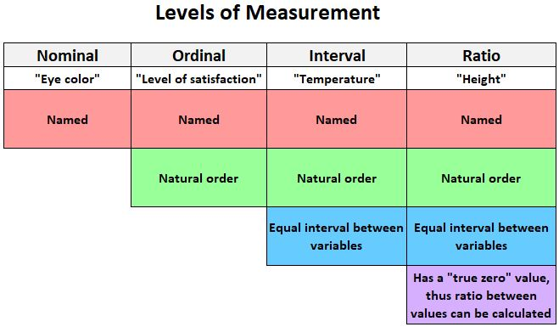
“Race Ranking”

Slide 7
Part 2: Descriptive Statistics

Slide 8
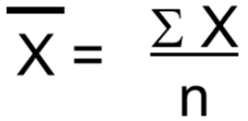
Measures of Central tendency
Mode: Most common score
Median: The middlemost score of a distribution of scores
Mean: AKA average, it the sum of the scores divided by the number of scores.

Slide 9
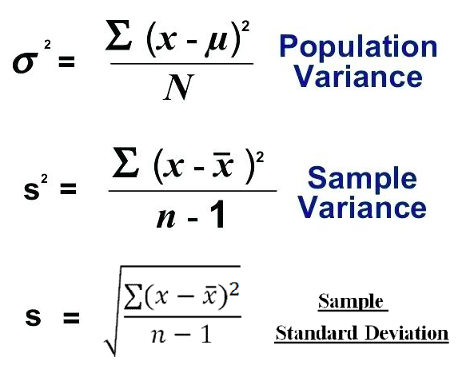
Measures of Variability
Variance: A computation that quantifies how spread out the data is from the mean
However, it is in “Squared deviations” meaning it is hard to interpret
Standard Deviation: The square root of the variance. It captures how far, on average, each score is from the mean value
We use this because it is more interpretable (However, we need the variance for many calculations)

Slide 10
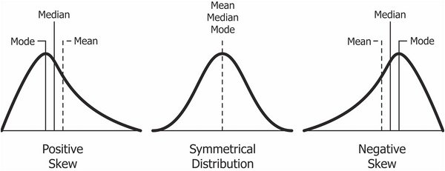
What is skew?
o When extreme values “pull” the shape of the distribution

Slide 11

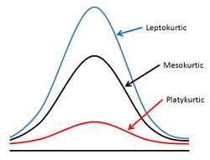

Kurtosis & interpretation

Slide 12
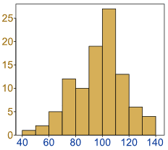
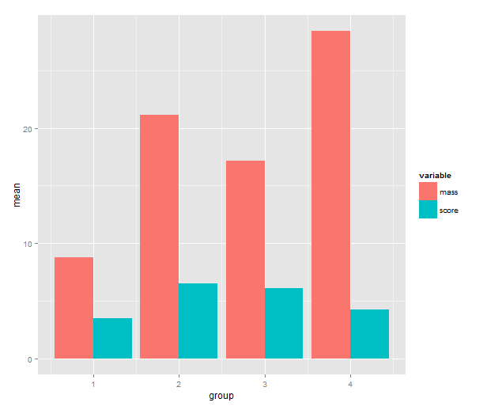
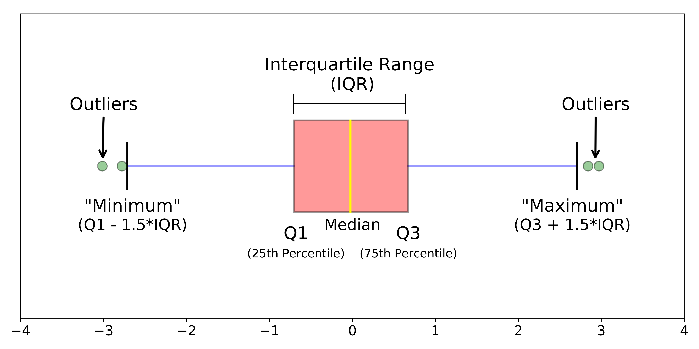
Visualizing descriptive statistics
Histograms
Bar plots
Boxplots
geom_histogram()
geom_bar()
geom_boxplot()

Slide 13
Part 3: Common terminology used in statistics

Slide 14
Common terms in statistics
Standard error
Confidence intervals
Test statistics (i.e. χ² test , t-test, F-test, etc.)
Degrees of freedom (df)

Slide 15
Degrees of freedom (df)
The number of observations (or groups) that are free to vary in your sample.
For example: We have a of a sample of 3 with a sample mean of 10
In our sample we the following values: 5, 10, 15.
Because we know the mean, we only need 2 out of 3 of those values. Thus, 2 values are allowed to “vary” as much as possible – the “ minus 1” is the only value we need to manipulate to get the mean value (or whatever your parameter of interest is).
It conveniently makes our sample less variable than the population when we subtract that 1.
Here’s a great video explaining the concept (Starting at 7:08): https://youtu.be/nlm9gfso4mw?t=428

Slide 16
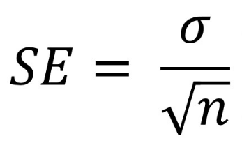
Standard error
Derived from the sampling distribution
Sampling distribution = If we got an infinite number of the same size samples of from a population, we would estimate the population parameter
Used to understand the statistical accuracy of an estimate
It is inferential
Inferential = making assumptions about the population from our sample
If we continuously sample from the same population, the SD of the sampling distribution will be approximately equivalent to the SE.
Simulation:
http://onlinestatbook.com/stat_sim/sampling_dist/index.html

Slide 17
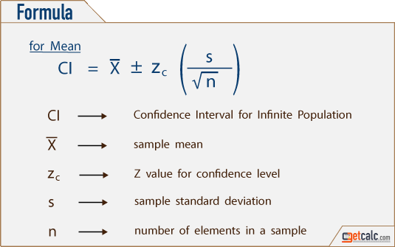
Confidence intervals
Derived from the SE
A 95% Confidence interval means: If we ran this study 100 times, 95 of our confidence intervals will contain the parameter value

Slide 18
Confidence intervals
SE equation
Derived from the SE
A 95% Confidence interval means: If we ran this study 100 times, 95 of our confidence intervals will contain the parameter value
*Pictured on the next slide*

Slide 19
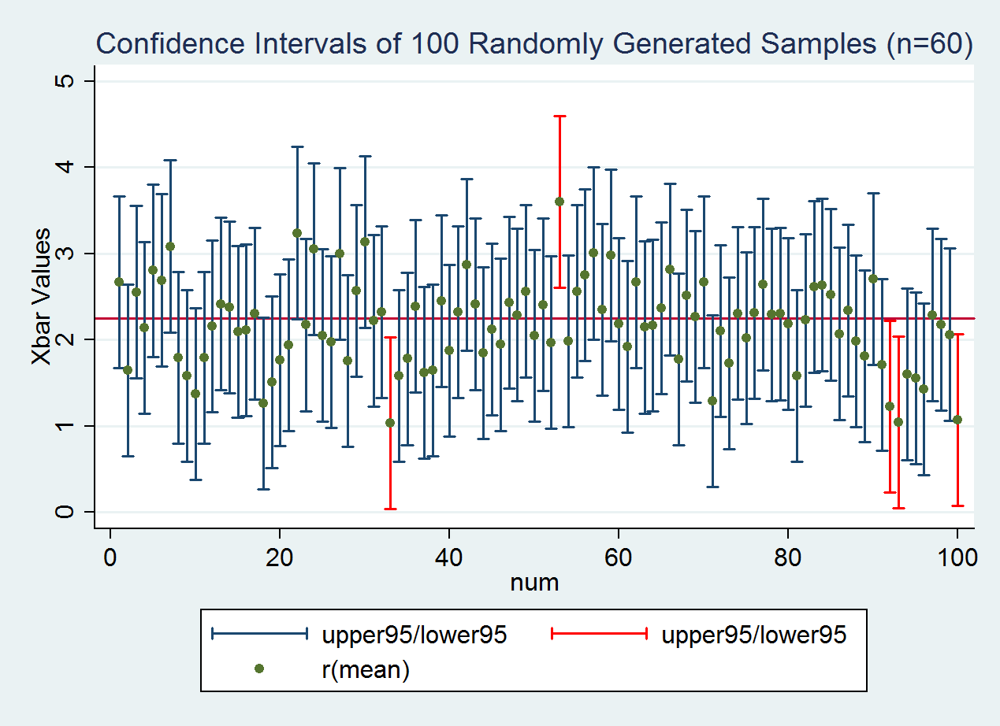
* Notice how 5 of the 100 confidence intervals do NOT capture the true population value.
True population value

Slide 20
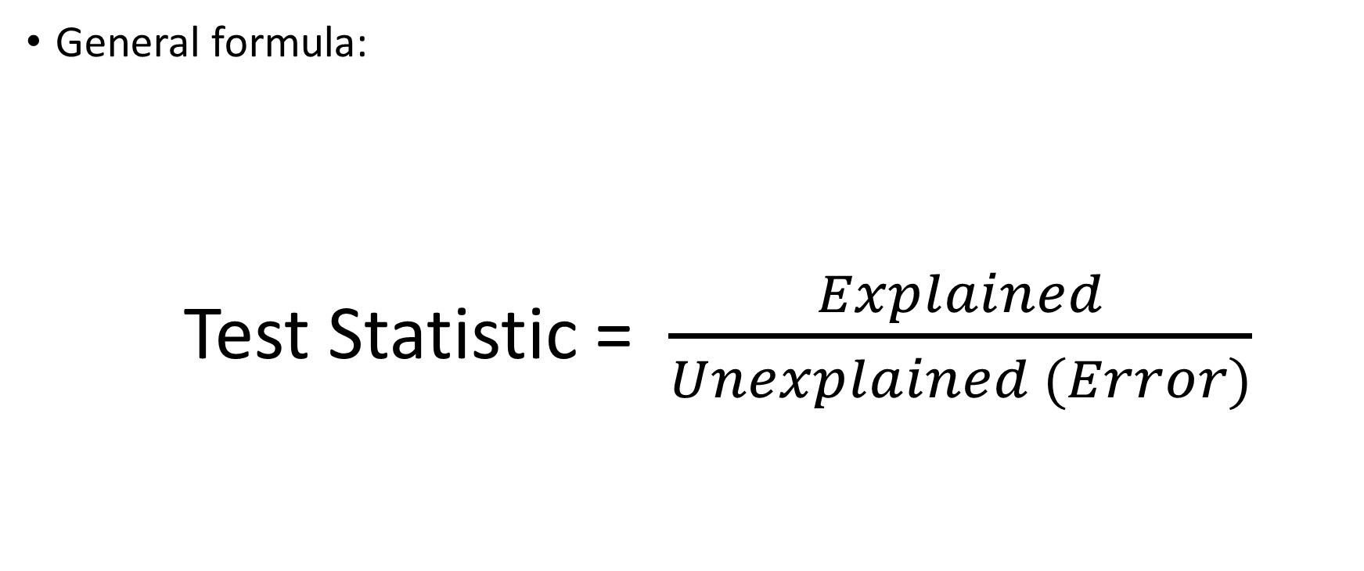
Test Statistics
General formula:
Test Statistic = $\frac{Explained}{Unexplained (Error)}$

Slide 21

Test Statistics
More specific formulas:
t statistic = $\frac{Observed value −Null Value}{error}$
OR
F statistic = $\frac{Explained variation}{Unexplained variation (Error)}$

Slide 22
Test Statistics
More specific formulas:
t statistic = $\frac{Observed value −Null Value}{error}$
OR
F statistic = $\frac{Explained variation}{Unexplained variation (Error)}$
This asks, “How different is our point estimate (i.e. mean) from zero?”
This asks, “How different from zero is the proportion of variance we are explaining (i.e. R²)?”

Slide 23
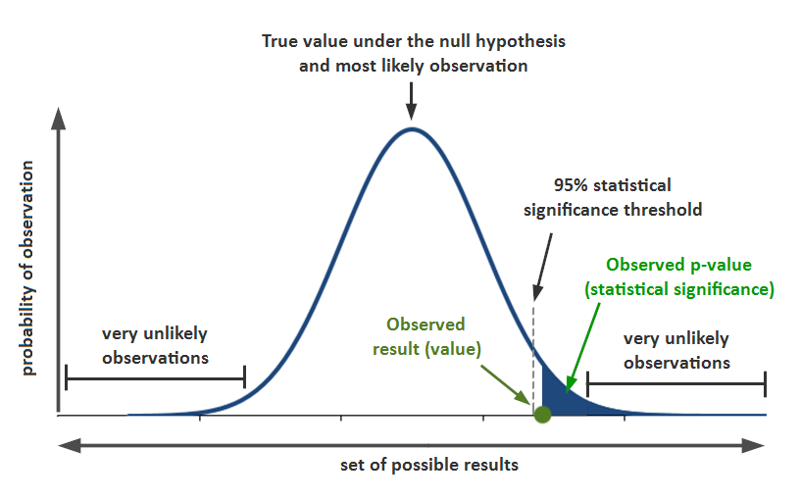
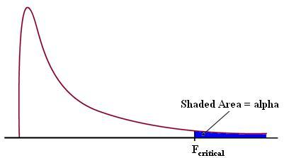
Test statistics and p-values
F-Distribution

