Slide 1

Welcome to Psy 653 Lab!
Module 02:
Orthogonal contrasts, Polynomial contrasts and moderated regression
*Thanks to Gemma Wallace for her help with these slides

Slide 2
Objectives
Part 1: Orthogonal contrasts
Part 2: Polynomial contrasts
Part 3: Moderated regression

Slide 3
Part 1: Orthogonal Contrasts

Slide 4
A Quick Review of Planned Contrasts
Contrasts test a specific hypothesis related to group means based upon some prior information about the groups.
Contrasts assign a weight to each of the groups in your predictor variable
Weights should add up to zero
Assigning a weight of zero means that group will not be included in the contrast
Order of the weights corresponds to order of groups in predictor variable

Slide 5
An example of a planned contrast set-up:
 | Control | Drug A | Drug B
Contrast 1 | -1 | 1/2 | 1/2
Contrast 2 | 0 | -1 | 1
o Contrast 1 tests whether or not the control group differs from the groups that received a drug treatment
o Contrast 2 tests whether or not the two drugs differ in their effect.

Slide 6
Orthogonal Contrasts
A set of contrasts is orthogonal if:
o The number of contrasts = df (number of groups -1)
o You have at least 3 groups to compare
o Two contrasts are orthogonal if the pairwise products of the corresponding coefficients for each term sum to zero:
 | Control | Drug A | Drug B
Contrast 1 | -1 | 1/2 | 1/2
Contrast 2 | 0 | -1 | 1
These contrasts are orthogonal because: (-1 *0) + (1/2 * -1) + (1/2 * 1) = 0

Slide 7
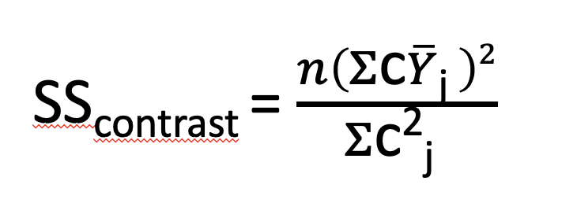
Relevant formulas
We can use orthogonal contrasts to get a lot of information about a dataset, even if we don’t have a full ANOVA table!
Sums of Squares for each contrast:
n = n/cell
cj is a set of contrast weights
Ŷj is the mean of the DV in group j
Sum of Squares Treatments:
SS_{treatments} = SS_{contrast1} + SS_{contrast2} + …SS_{contrastk}
Sum of Squares Total:
SS_{total} = SS_{contrast1} + SS_{contrast2} + …SS_{contrastk} + SS_{error}
Notes:
Make note: you can go through these steps just for SStreatments too! (Doesn’t need to only by the contrasts themselves)

Slide 8
 | Mean | Contrast 1 | Contrast 2
Group 1 | 35 | -1 | 1
Group 2 | 40 | -1 | -1
Group 3 | 45 | 2 | 0
Note: We could use different contrast weights, depending on our specific research question and a priori information.
N for this study was 90 (i.e., 30 subjects/cell in this design)
SS_{total} = 5000

Slide 9
 | Mean | Contrast 1 | Contrast 2
Group 1 | 35 | -1 | 1
Group 2 | 40 | -1 | -1
Group 3 | 45 | 2 | 0
Contrast 1 tests whether the mean of Y for treatment group 3 was significantly different than the means of the other two groups.
Contrast 2 tests the hypothesis that the mean of group 1 was significantly different than the mean of group 2.

Slide 10
 | Mean | Contrast 1 | Contrast 2
Group 1 | 35 | -1 | 1
Group 2 | 40 | -1 | -1
Group 3 | 45 | 2 | 0
In this demo we walk through how to test the hypothesis that the mean of group 3 was significantly different from the mean of participants in groups 1 and 2 (i.e., testing the significance of Contrast 1)
You will calculate contrast 2 by yourself on the practice activity ☺

Slide 11
Calculate Sums of Squares for the contrast
 | Mean | Contrast 1
Group 1 | 35 | -1
Group 2 | 40 | -1
Group 3 | 45 | 2
N/cell = 30
SS_{contrast1} = (30 * ((35 * -1) + (40 * -1) + (45 * 2))^2) / ((-1)^2 + (-1)^2 + (2)^2)
SS_{contrast1} = (30 * (15)^2 )/6
SS_{contrast1} = (30 * 225)/6
SS_{contrast1} = 6750/6 = 1125

Slide 12
2) Calculate eta-squared for contrast
Note: if you are not given SS_{total} you can calculate this from the SD and mean of Y!
Eta²_{contrast}= SS_{contrast}/SS_{total}
SS_{total} = SS_{contrast1} + SS_{contrast2} + SS_{error} = 5000 (this was given to us)
Eta²_{contrast1} = 1125/5000 = 0.225
22.5% variance in Y explained by this contrast

Slide 13
2) Calculate eta-squared for contrast
Eta²_{contrast}= SS_{contrast}/SS_{total}
SS_{total} = SS_{contrast1} + SS_{contrast2} + SS_{error}
Eta²_{contrast1} = 1125/5000 = 0.225
22.5% variance in Y explained by this contrast
1125 is the SS_{contrast} from the previous slide
5000 is the SS_{total} that was given to us beforehand

Slide 14
Resources on Orthogonal Contrasts
http://www.jds-online.com/files/JDS-563.pdf

Slide 15
Part 2: Polynomial Contrasts

Slide 16
What are orthogonal polynomial contrasts (aka trend contrasts) and why use them?
Allow us to evaluate non-linear relations between a categorical predictor and an outcome
With continuous predictors we can model these by squaring X to test a quadratic effect, cubing X to test a cubic effect, etc.
With categorical predictors, we can use specific polynomial contrasts to test different effects. These contrast levels can be found online, or in the table on slide 23!
This type of coding system should be used only with an ordinal variable in which the levels are equally spaced

Slide 17
Effects we can evaluate with more than 3 levels of a categorical predictor:
Linear: If we increase the dose level the Y values will increase, and we can select the best level based on the highest dose. Y = a + bX
Quadratic: If we increase the dose level the Y values will be increased until certain dose after that the level of dosage will have a negative effect. Y = a + b₁X + b₂X²
Cubic: The dosage would increase Y values after certain dosage and then decrease and if we increase more the dosage level, the Y values will increase. Y = a + b₁X + b₂X² + b₃X³
Notes:
Stack exchange
https://www.researchgate.net/post/Linear_quadratic_and_cubic_polynomial_contrasts

Slide 18

Create a new R-Project and r-notebook!
Download the “cogtest.csv” file from Canvas and save it into your R-project file

Slide 19
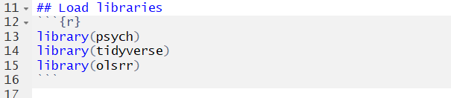
Load libraries

Slide 20
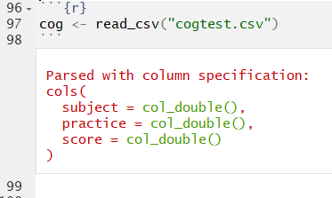
New dataset description
Researchers were interested in the effect of time spent in practice on the performance of a visual discrimination task. Subjects were randomly assigned to different levels of practice, following which a test of visual discrimination is administered, and the number of correct responses is recorded for each subject. 40 subjects were randomly assigned to practice 0 minutes, 2 minutes, 4 minutes, 6 minutes, 8 minutes, 10 minutes, 12 minutes, or 14 minutes.
There are two variables:
practice = minutes spent practicing, this was assigned by the experimenter
score = the number of correct answers on the test

Slide 21
Filter practice to only 4 conditions
We selected four evenly spaced conditions to test non-linear effects between practice and score
We could include more than four levels of practice if we wanted to, but we use four levels in this example for a simpler interpretation

Slide 22
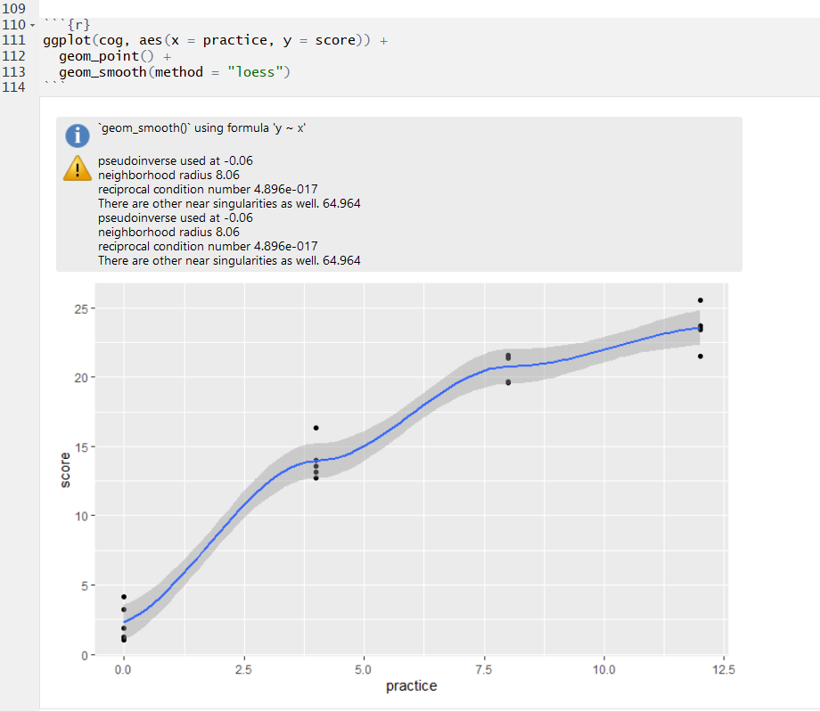
Visualize the relation between X and Y
The slope appears to become less steep as practice time increases. Since there may be a curve to the regression line, we should test for more than a linear effect. Since we have four levels of our categorical variable, we can test both a quadratic and cubic effect.

Slide 23
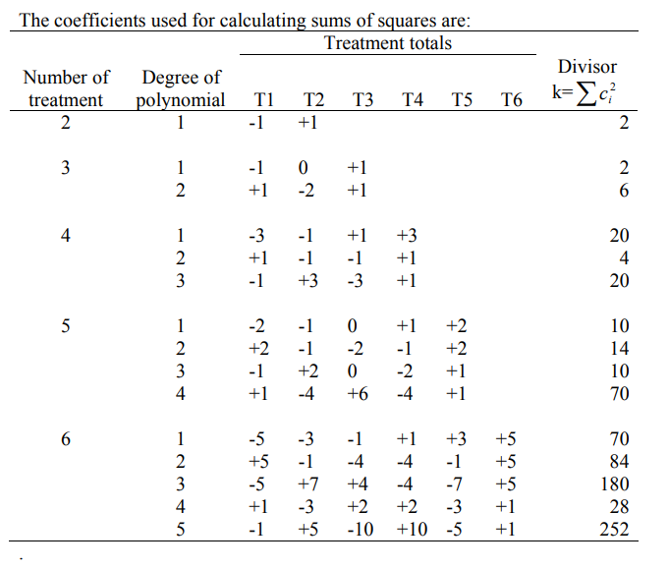
We have 4 treatment levels
https://www.ndsu.edu/faculty/horsley/Polycnst.pdf

Slide 24
Linear Contrasts
Quadratic contrasts
Cubic contrasts
https://www.ndsu.edu/faculty/horsley/Polycnst.pdf

Slide 25
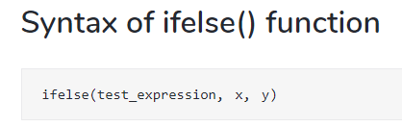
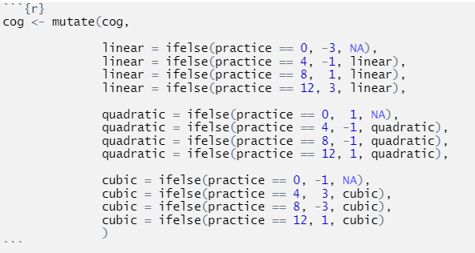
Specify the polynomial contrasts
TRUE
FALSE
All of these contrasts come from the table on the previous slide!
We created three new variables:
linear specifies contrasts for testing a linear effect
quadratic specifies contrasts for testing a quadratic effect
cubic specifies contrasts for testing a cubic effect

Slide 26
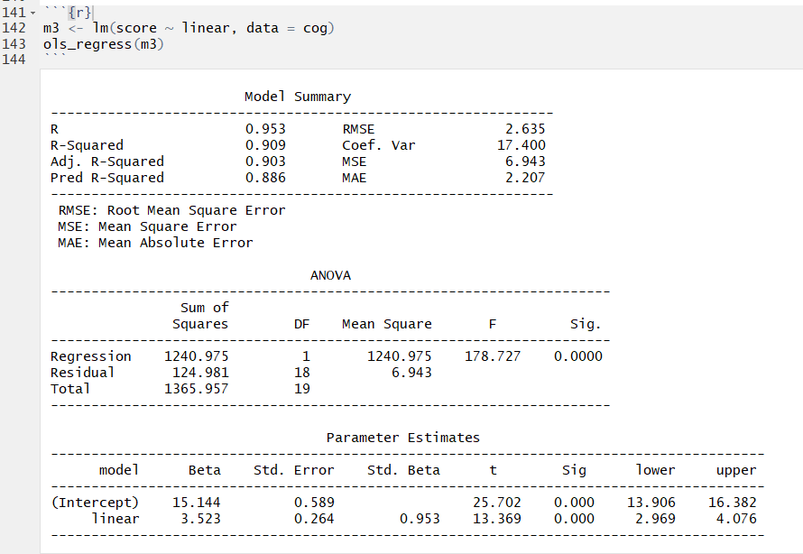
Step 1: Regress score on linear effect
The model testing the linear effect between practice and score explained 90.9% of the variance in score, and the linear trend was statistically significant at p<0.001.
This model fits the data pretty well, but since we observed a potential curved relationship when we plotted the data, there could be a better way to examine this relationship.
Evidence of linear effect

Slide 27
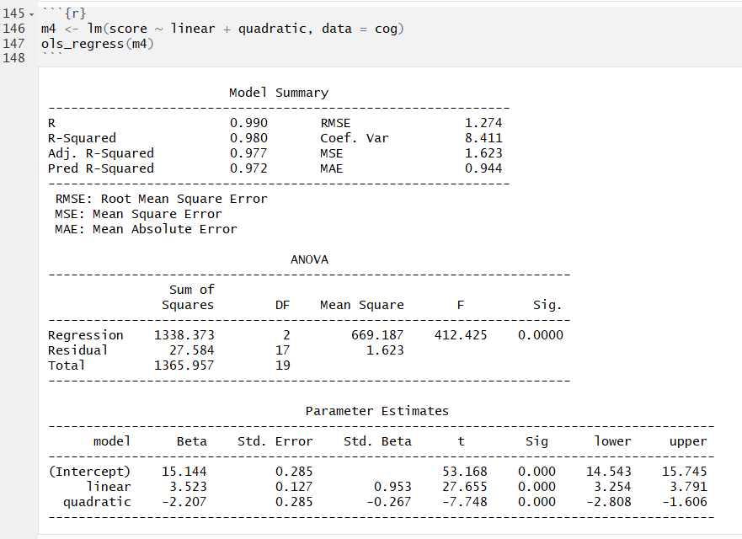
Step 2: Regress score on linear & quadratic effect
The model testing the linear and quadratic effects between practice and score explained 98.0% of the variance in score, which is 7.1% higher than the model that only tested the linear relation.
The quadratic term is statistically significant, indicating that there is a substantial curve to the relation between practice and score (i.e., it's not linear). We need to maintain the quadratic term in the model.
Evidence of quadratic effect

Slide 28
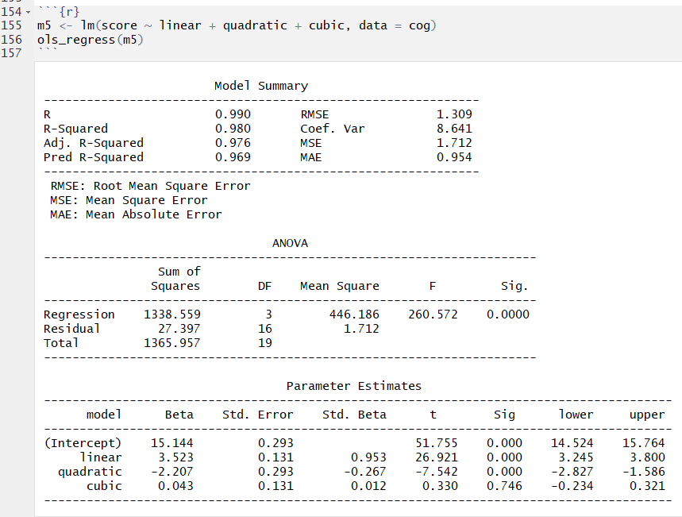
Step 3: Regress score on linear, quadratic & cubic effect
We tested the cubic term to determine if there is a second bend to the relationship between practice and score. Since we have at least four levels of our categorical predictor, we can test the cubic effect.
This model explains the same amount of variance in score as the previous model that only included the linear and quadratic effects (i.e., adding the cubic effect does not increase the explanatory power of the model).
The cubic term is not significant, indicating that there is not a second bend to the relationship. Therefore, the quadratic model is the best fit for these data.
No evidence of cubic effect

Slide 29
Additional resources on categorical variable coding systems:
https://www.researchgate.net/post/Linear_quadratic_and_cubic_polynomial_contrasts
https://www.ndsu.edu/faculty/horsley/Polycnst.pdf

Slide 30
Part 3: Moderated regression

Slide 31
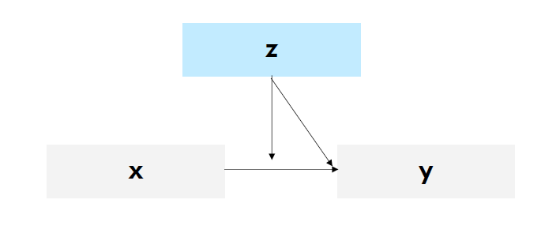
What is Moderation?
A moderator is a variable that changes (i.e., moderates) the relationship between two (or more) other variables
Moderation models are used to determine if the magnitude and/or direction of a certain regression slope varies as a function of some third variable
©Kimberly Henry

Slide 32
What is moderation?
An interaction term = the predicted difference in the effect of x on y for a one-unit increase in z
(i.e., how the simple slope of x on y changes as z increases)
©Kimberly Henry

Slide 33
What does an interaction (aka moderation) effect look like?
No interaction observed:
Interaction observed:
High level of Z
Low level of Z
Y
Y
X
X
Note: crossed lines would also indicate an interaction

Slide 34
Create a new r-notebook!
Download the “moderation_demo.csv” file from Canvas and save it into your R-project file

Slide 35
Load libraries

Slide 36
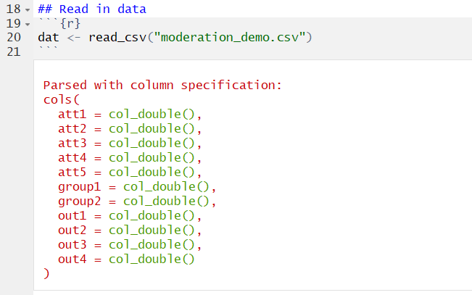
Read in Data

Slide 37
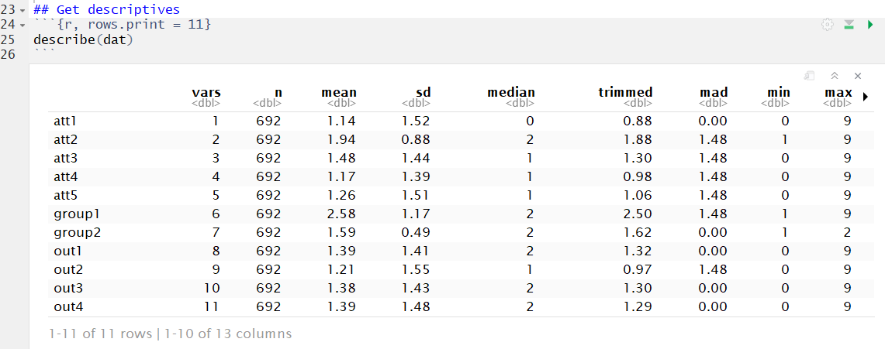
Calculate descriptives
This is a simulated dataset (i.e., the variables don’t have specific meaning)

Slide 38
Our variables of interest
Predictors
Outcome

Slide 39

Create the cross-product of the two predictors
The cross-product is the interaction term. We’ll include this as an additional predictor in the regression model.

Slide 40
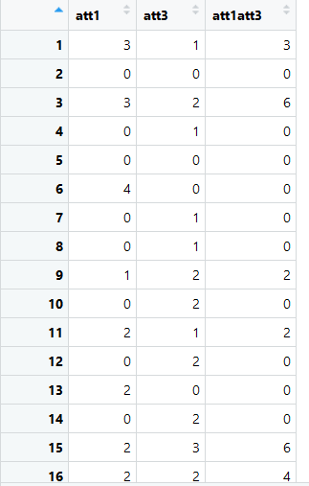
Create the cross product

Slide 41
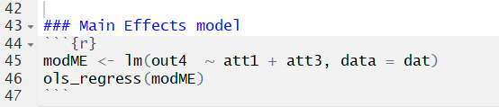
Run the main effects model
This is just a regular multiple linear regression.
We first want to examine the main effects between each predictor and the outcome before adding the interaction term.

Slide 42
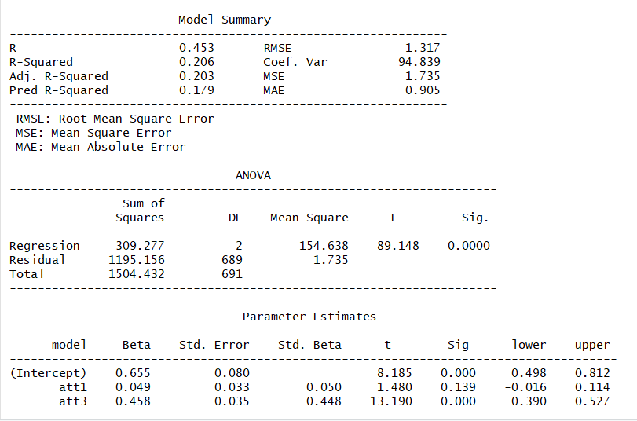
Main effects model results

Slide 43
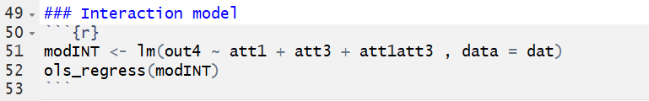
Run the same model with the interaction term
(aka a Moderated Regression)
att1att3 is the cross-product variable we made earlier
It represents att1*att3

Slide 44
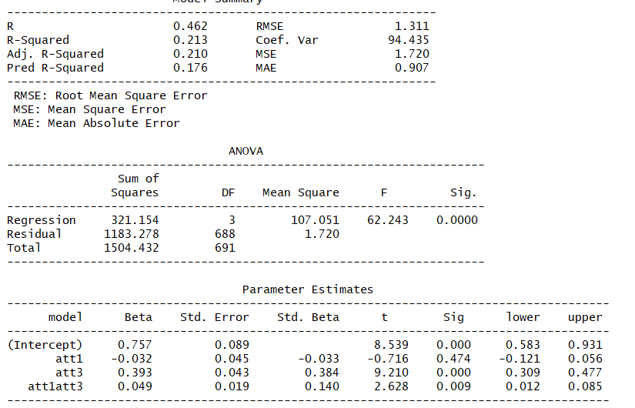
Model
results with interaction term
Simple Slopes
Interaction

Slide 45
Interpreting the moderated regression
att1: This is the predicted change in our outcome for every 1 unit increase in att1 when att3 is 0.
att3: This is the predicted change in our outcome for every 1 unit increase in att3 when att1 is 0.
att1att3: This is the predicted change in the effect of att1 on our outcome for every one unit increase in att3.

Slide 46
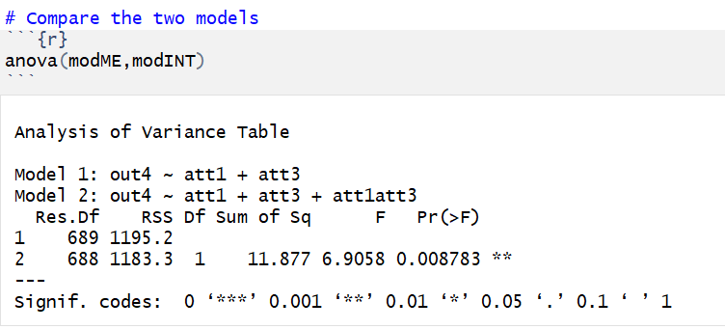
Compare the two models via hierarchical regression
Does including the interaction term significantly improve the amount of variance our model explains in out4?

Slide 47
Compare the two models via hierarchical regression
At p<0.05, the moderated regression model explained significantly more variance in out4 than the main effects model

Slide 48
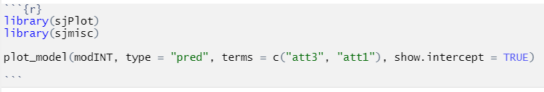
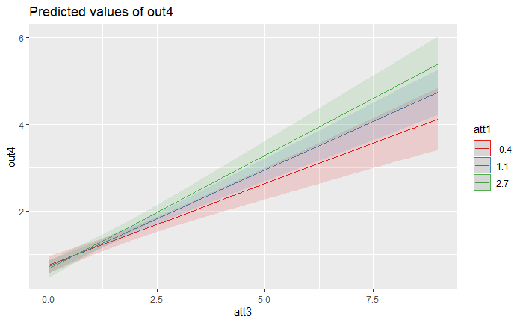
Our interaction - Visualized
1 SD below
Mean
1 SD Above

Slide 49
Our interaction - Visualized
Slopes differ
Lines cross
1 SD below
Mean
1 SD Above

Slide 50
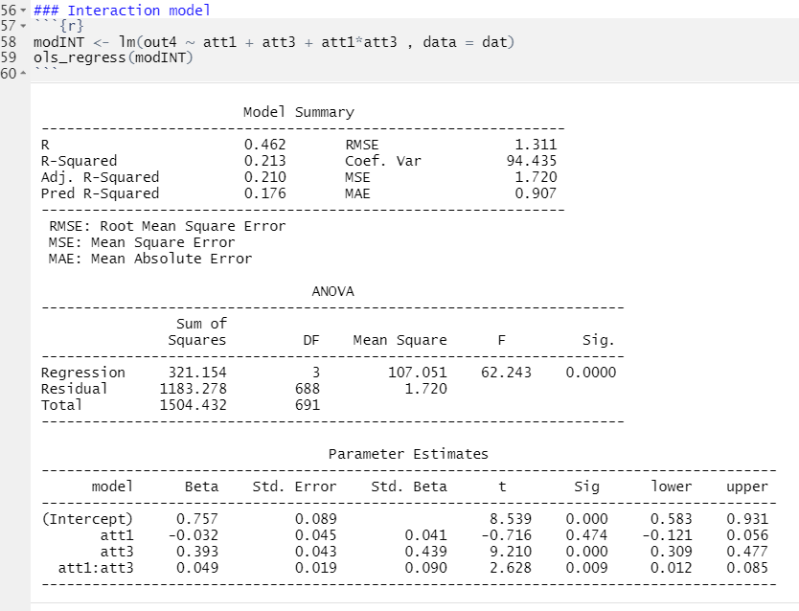
Alternative way to specify interactions: Specify the interaction in the regression equation using a “*”

Slide 51
Example APA write up
The differential effect of att1 on out4, using att3 as a moderator, was examined among 692 participants. A moderation model was estimated, out4 was regressed on att1, att3, and the interaction between the two. The simple slope of att1 was not statistically significant (b = -0.03, 95%CI -0.12, 0.06) and the simple slope of att3 (b = 0.39, 95%CI 0.31, 0.48) was statistically significant. The interaction term is statistically significant (b = 0.05, 95%CI 0.01, 0.09), indicating that the effect of att1 on out4 is larger as att3 increases.

Slide 52
Additional considerations for moderation
Power is important!
N needed to detect interaction effect can be up to 9x larger than for detecting main effects (e.g., Wahlsten, 1991)
For every interaction term you add, N needed to detect effect increases
You can examine interactions between more than two variables
E.g., 3-way interactions
Interpretation is easier with categorical predictors
E.g. You can turn continuous variables into categorical by using cut-off scores

