Slide 1

Welcome to Psy 653 Lab!
Module 03:
Mediation
*Thanks to Gemma Wallace for her help with these slides

Slide 2
Objectives
Explain mediation
Discuss the Baron & Kenny Criteria for testing mediation
Coding tutorial

Slide 3
Mediation
A mediator variable is a variable that helps to explain the relationship between X & Y
A mediated relationship occurs when a third variable plays an important role in governing the relationship between the two other variables
We can have a full mediation (not likely in psychology) or a partial mediation model (more likely in psychology)

Slide 4
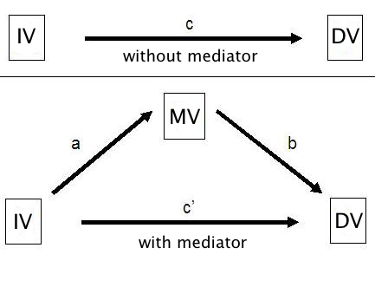
The “paths” in mediation

Slide 5
Baron & Kenny criteria for testing mediation
Show X is related to Y (c path)
Show X is related to M (a path)
Show Y is related to M (b path)
Show that M explains the relationship between X and Y (c’ path)
One way to do this is to show that controlling for M will cause r_{xy} to go toward zero
*Must meet all criteria to run a mediation model

Slide 6

Create a new R-Project and r-notebook!
Download the “mediate2.csv” file from Canvas and save it into your R-project file

Slide 7
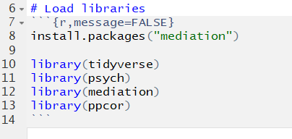
Load Libraries

Slide 8

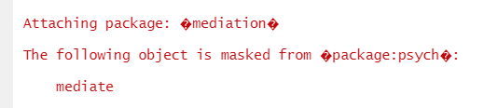
STOP!
New R concept:
We will be experiencing “Package conflicts” during this lab
In short, both the psych package and the mediation package have a function called “mediate()”
Therefore, we need to tell R which package to call the mediate() function from
To do this we use the package name followed by two colons and then the name of the function: “package_name::function()”
Every time we use the mediate() function we will have to tell R which package it comes from.
Continue on…

Slide 9
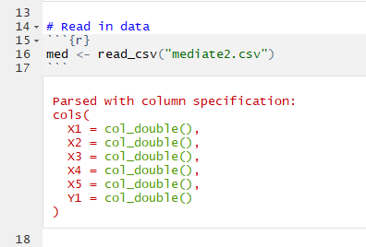
Read in data
This is a simulated dataset with four predictor variables (X1-X5) and one outcome variable (Y1)
Note: though not shown here, don’t forget to do your data management “best practices” by examining descriptives and visualizing data before conducting analyses!

Slide 10
Analysis 1: Test the hypothesis that X4 mediates the relationship between X1 and Y1

Slide 11
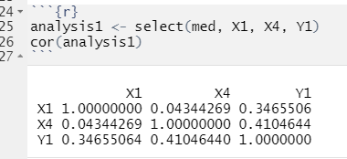
Step 1: Determine if mediation is plausible, based on the Baron & Kenny Criteria
Examine correlations between variables
rxy = .3466 (c path)
rxm = .0434 (a path)
rmy = .4105 (b path)

Slide 12
Do we have justification to test the mediation hypothesis? (Baron & Kenny criteria)
rxy = .3466 (c path)
rxm = .0434 (a path)
rmy = .4105 (b path)

Slide 13
Do we have justification to test the mediation hypothesis? (Baron & Kenny criteria)
NO!
rxy = .3466 (c path)
rxm = .0434 (a path)
rmy = .4105 (b path)
Negligible correlation

Slide 14
Analysis 2: Test the hypothesis that X4 mediates the relationship between X3 and Y1

Slide 15
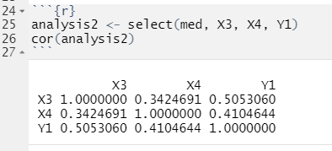
Step 1: Determine if mediation is plausible, based on the Baron & Kenny Criteria
rxy = .5053 (c path)
rxm = .3425 (a path)
rmy = .4105 (b path)

Slide 16
Do we have justification to test the mediation hypothesis? (Baron & Kenny criteria)
rxy = .5053 (c path)
rxm = .3425 (a path)
rmy = .4105 (b path)

Slide 17
Do we have justification to test the mediation hypothesis? (Baron & Kenny criteria)
YES!
rxy = .5053 (c path)
rxm = .3425 (a path)
rmy = .4105 (b path)
All paths have moderate correlations

Slide 18
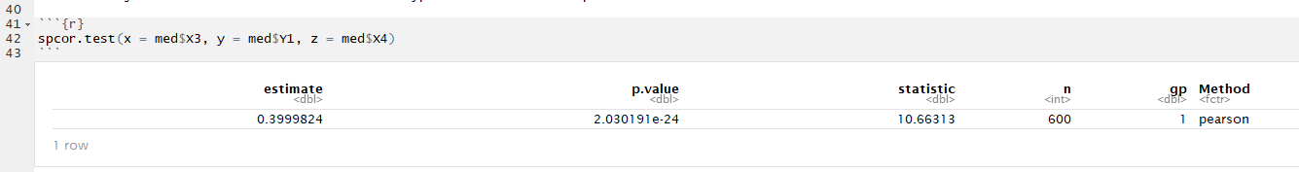
Step 2: Use semi-partial correlation to examine correlation between X and Y when partialling out the effect of the mediator
(Baron & Kenny Criteria, continued)

Slide 19
Step 2.1: Compare semi-partial correlation to rxy
(Baron & Kenny criteria)
Compare to rxy = .5053 (from previous slide)
r y(x.m) = 0.3999. This is 0.11 smaller than rxy (0.5053), indicating that partial mediation is plausible. In other words, there is a portion of the relation between x and y that involves m.

Slide 20
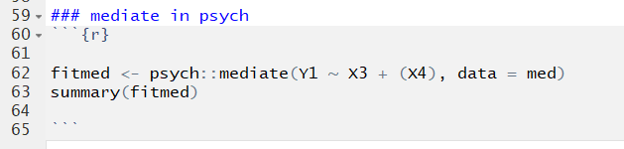
Step 3: Test mediation model via psych::mediate
psych::mediate: mediate function (via psych package)
Y1: Outcome variable
X3: Predictor variable
(X4): Mediator variable (keep it enclosed in parentheses)
data = med: dataset

Slide 21
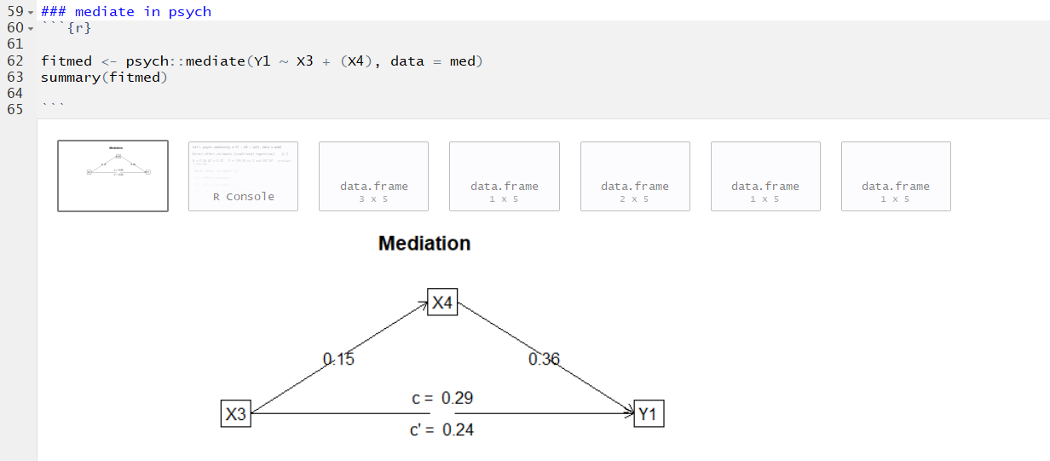
1
2
3
4
5
6
7
WINDOWS
Model diagram with paths
Function call
c’ path
c path
a path
b path
ab bootstrapped results (indirect effect)

Slide 22
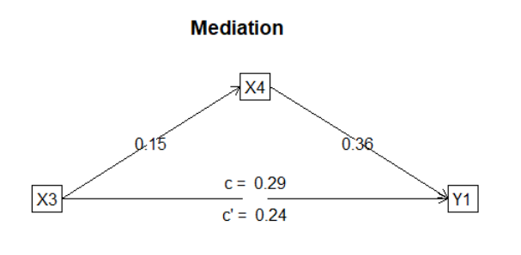
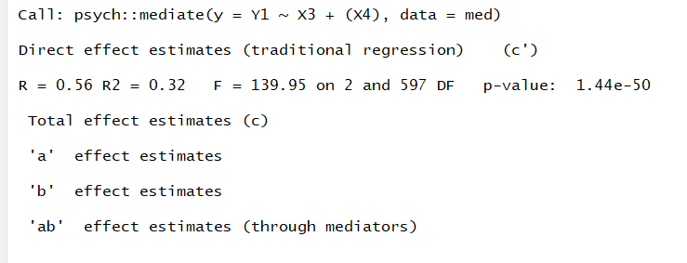
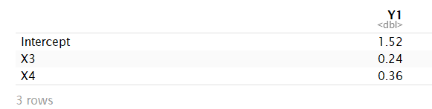
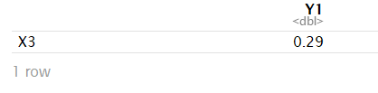
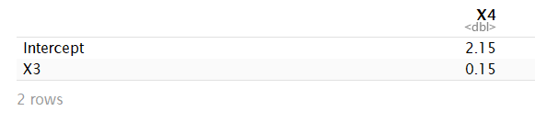
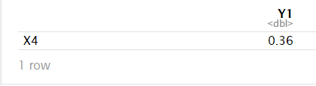
psych::mediate output windows
1: Diagram
2: Function Call
3: c’ path
4: c path
5: a path
6: b path
7: a*b path bootstrapped analysis (indirect effect)

Slide 23
psych::mediate output windows
1: Diagram
2: Function Call
3: c’ path
4: c path
5: a path
6: b path
7: a*b path bootstrapped analysis
(indirect effect)
Bootstrapped estimate
Evidence of partial mediation

Slide 24
psych::mediate a*b interpretation
To evaluate if the indirect effect is significant:
Output Window 7: a*b path bootstrapped analysis (indirect effect)
Does the bootstrapped confidence interval for the indirect effect (aka a path estimate * b path estimate) contain zero?
In this case it does not, indicating that X4 partially mediates the relation between X3 and Y1.
You can calculate the proportion of the relation of Y1 on X3 that is mediated by X4 by dividing the indirect effect by the total effect:
Proportion mediated = (a*b)/c
Proportion mediated = 0.054/0.29 = .1862. 18.6% of the effect is mediated.
Notes:
Make sure to talk about necessity of using boostrapped confidence intervals to evaluate significance of a*b (not p values!)

Slide 25
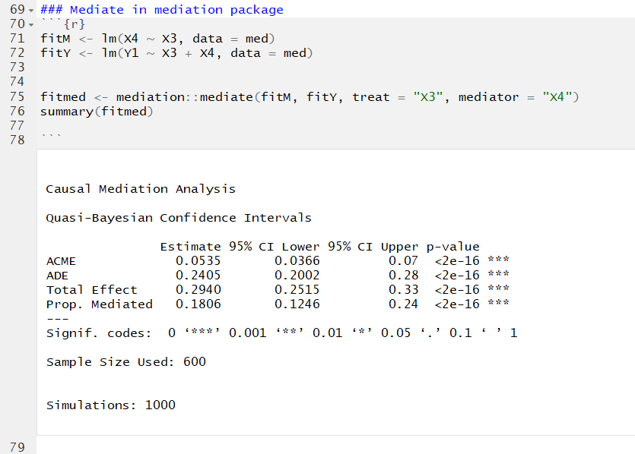
Step 4: Test mediation via mediation::mediate
Regress mediator variable (X4) on predictor variable (X3)
Regress outcome variable (Y1) on predictor (X3) and mediator (X4)
Use mediation::mediate to test models for mediation. Indicate predictor variable (treat = “X3”) and mediator variable (mediator = “X4”)
This is an alternative function for testing mediation. Both work!

Slide 26
Step 4: Test mediation via mediation::mediate
ACME: “Average Causal Mediated Effect.” This is the effect of the mediator alone (ab bootstrapped; equivalent to window 7 via psych::mediate)
ADE: “Average Direct Effect” (c’ path; equivalent to window 3 via psych::mediate)
Total Effect: c path (equivalent to window 4 via psych::mediate)
Prop. Mediated: Proportion of variance explained by the mediator. (a path*b path)/c path

