Slide 1

Welcome to Psy 653 Lab!
Module 04:
Categorical Predictors in regression & nonlinear regression
* Thanks to Gemma Wallace for her help with these slides

Slide 2
Objectives
Part 1: Categorical predictors in regression models
Part 2: Nonlinear regression with continuous variables

Slide 3
Part 1: Categorical variables in regression models

Slide 4
Demo Overview
We are practicing three different ways of examining categorical predictors in a regression framework:
Dummy coding
Effect coding
Contrast coding
Note: our outcome variables are continuous in each of these examples

Slide 5

Create a new R-Project and r-notebook!
Download the “slpdata.csv” file from Canvas and save it into your R-project file

Slide 6
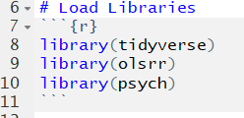
Load Libraries

Slide 7
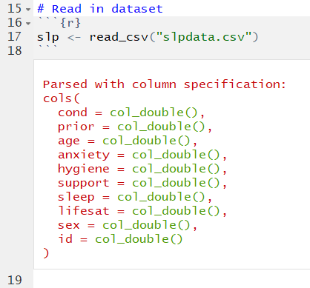
Read in Data
This is the same slpdata we’ve used in previous lab activities.

Slide 8
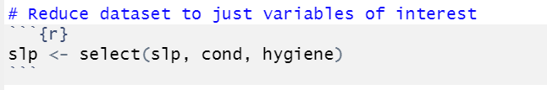
Reduce dataset to just variables of interest

Slide 9
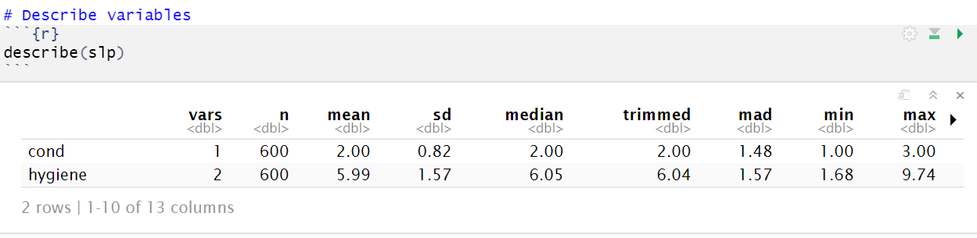
Describe the variables

Slide 10
Our research question for parts 1-3:
To what extent do treatment condition predict sleep hygiene?
We will show three different ways to approach this question using different coding methods for the categorical predictor variables: dummy coding, effect coding, and contrats coding
These methods are similar, but the coding and interpretations are slightly different.

Slide 11
Part 1: Dummy coding

Slide 12
What is dummy coding and why use it?
It is one of the most common and simplest approaches to evaluating categorical predictors in psychology
Dummy coding allows you to compare the mean difference between two levels of a categorical variable: the level that is coded as a 1 versus the level that is coded as 0
You can specify any level of the variable to be the reference group (i.e., the level coded as 0)
Create a new “dummy coded” binary variable for every comparison you want to make between two groups

Slide 13
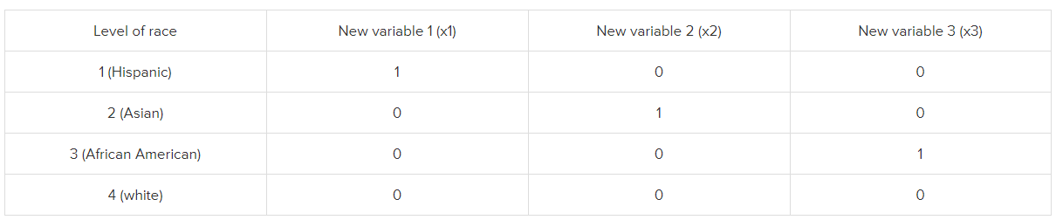
Dummy coding
For dummy coding, we will be converting categorical variables into a series of binary variables.
For all but one of the levels of the categorical variable, a new variable will be created that has a value of 1 for each observation at that level and 0 for all others.
Reference category
https://stats.idre.ucla.edu/spss/faq/coding-systems-for-categorical-variables-in-regression-analysis/

Slide 14
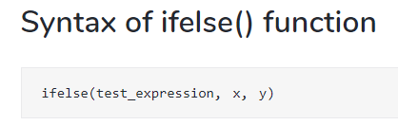
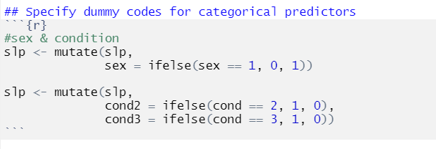
Specify dummy codes
TRUE
FALSE
We created two new variables:
cond2 is a dummy coded binary variable in which condition 2 is coded as 1 and condition 1 is coded as 0. This variable allows us to compare the mean difference in Y between conditions 2 and 1.
cond3 is a is a dummy coded binary variable in which condition 3 is coded as 1 and condition 1 is coded as 0. This variable allows us to compare the mean difference in Y between conditions 3 and 1.

Slide 15

Run model with dummy coded condition variable

Slide 16
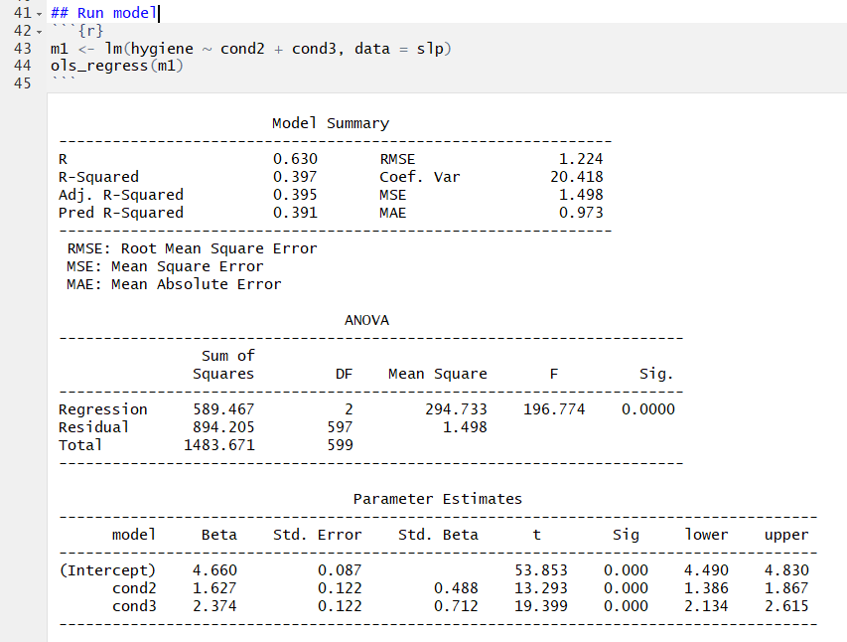
Intercept: The predicted sleep hygiene score when all x variables are zero, so participants in Condition 1.
cond2: the predicted difference in sleep hygiene score between participants in condition 2 compared to condition 1.
cond3: the predicted difference in sleep hygiene score between participants in condition 3 compared to condition 1.
Interpretations

Slide 17
Part 2: Effect Coding

Slide 18
What is effect coding and why use it?
Similar to dummy coding, except here, you are comparing one level of a categorical predictor to the mean of all of the levels.
Instead of asking “are two conditions different from each other?” using dummy coding, effect coding asks “is this condition different from average?”
While the "rule" in dummy coding is that only values of 0 and 1 are valid, the "rule" in effect coding is that all of the values in any new variable must sum to zero.
Notes:
If you have several categorical variables in a model it often doesn’t make much difference whether you use effect coding or dummy coding.

Slide 19
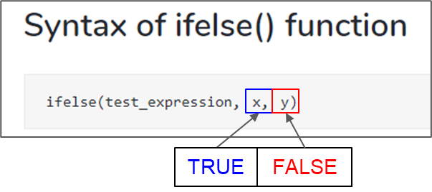
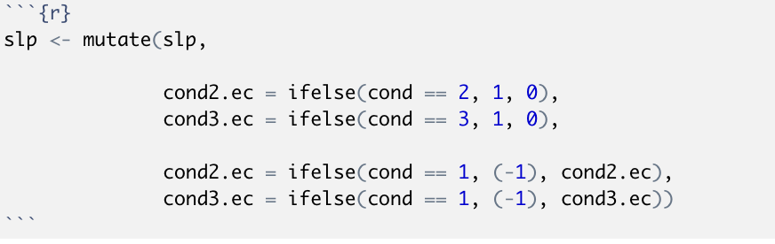
Specify effect coding variables
We created two new variables:
cond2.ec is a effect coded variable in which condition 2 is coded as 1, condition 1 is coded as -1, and condition 3 is coded as 0. This variable allows us to compare the mean difference in Y between condition 2 and the average score across all conditions.
cond3.ec is a is a dummy coded binary variable in which condition 3 is coded as 1, condition 1 is coded as -1, and condition 2 is coded as 0. This variable allows us to compare the mean difference in Y between condition 3 and the average score across all conditions.
Notes:
Renamed variables to avoid potential issues overwriting variables from dummy coding part

Slide 20
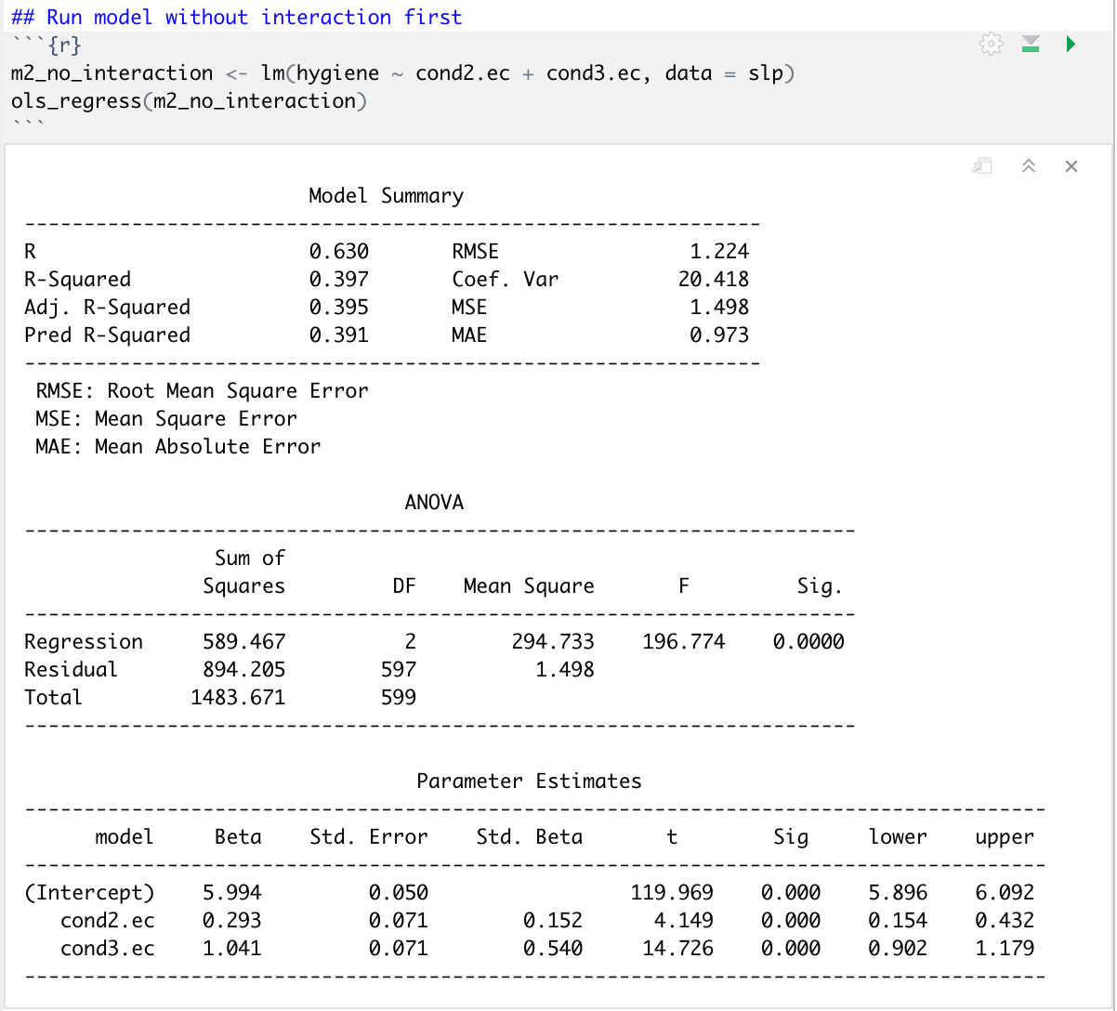
Intercept: In effect coding, the intercept is the grand mean of sleep hygiene across all the three treatment groups
cond2: the predicted difference in sleep hygiene score between participants in condition 2 compared to the mean of all three treatment conditions.
cond3: the predicted difference in sleep hygiene score between participants in condition 3 compared to the mean of all three treatment conditions.
Interpretations

Slide 21
Part 3: contrast Coding

Slide 22
What is contrast coding?
Contrast coding is used to compare specific groups within your variable
It is required that the contrasts are orthogonal. Remember, contrasts are orthogonal if:
The number of contrasts is equal to the df (# of groups – 1)
There are at least three groups
The pairwise products of the corresponding coefficients for each term sum to zero
Contrast 1: Compares Condition 1 to Condition 2 (Ignoring condition 3)
Contrast 2: Compares Condition 3 to Condition 1 & Condition 2
 | Cond1 | Cond2 | Cond3
Contrast 1 | .5 | -.5 | 0
Contrast 2 | -.5 | -.5 | 1
These are orthogonal because: (.5 * -.5) + (-.5 * -.5) + (0 * 1) = 0

Slide 23
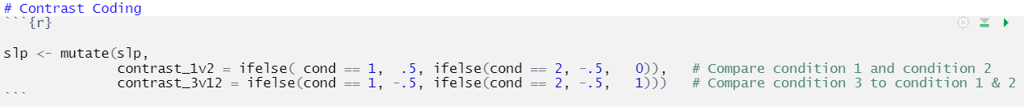
Specify Contrast Codes
We created two new variables:
Contrast_1v2 is a contrast coded variable in which condition 1 is coded as .5, condition 2 is coded as -.5 and condition 3 is coded as 0. This contrast compares condition 1 to condition 2.
Contrast_3v12 is a contrast coded variable in which condition 1 is coded as -.5, condition 2 is coded as -.5, and condition 3 is coded as 1. This contrast compares condition 3 to the average of conditions 1 & 2

Slide 24
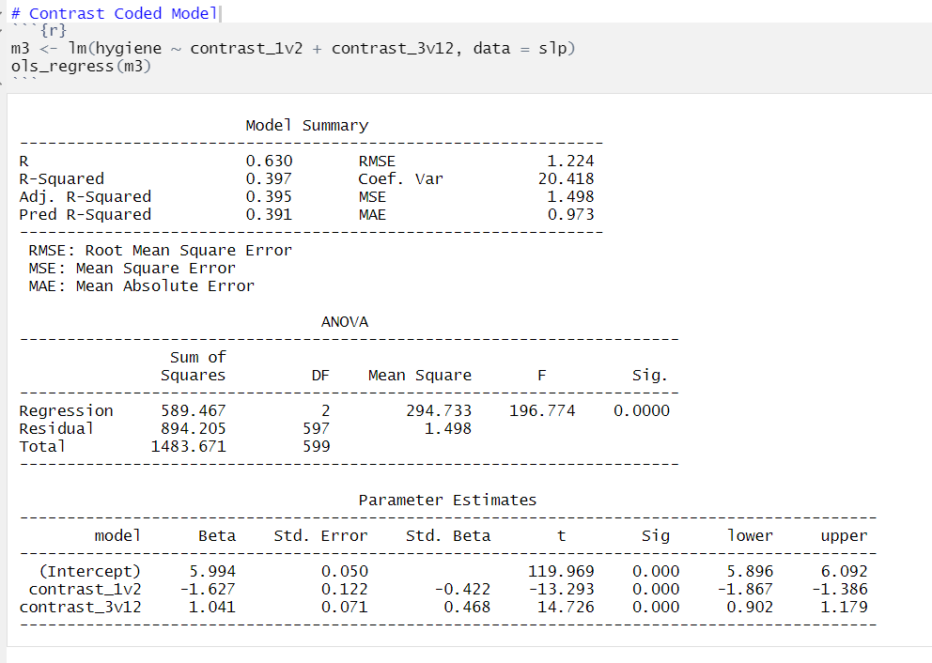
Intercept: In contrast coding, the intercept is the grand mean of sleep hygiene across all the three treatment groups.
Contrast_1v2: The difference between condition 1 and condition 2. It is statistically significant.
Contrast_3v12: The difference between the average of conditions 1 & 2 to condition 3. It is statistically significant.

Slide 25
Additional resources on categorical variable coding systems:
https://stats.idre.ucla.edu/spss/faq/coding-systems-for-categorical-variables-in-regression-analysis/
http://www.jds-online.com/files/JDS-563.pdf

Slide 26
Part 2: Nonlinear regression

Slide 27
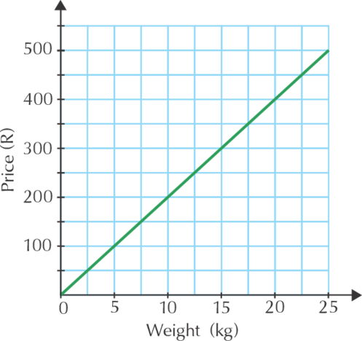
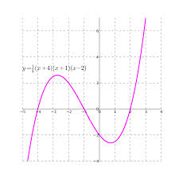
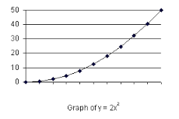
Nonlinear regression
Nonlinear regression is used to assess models in which there is not a linear trend
We can see quadratic, cubic, or even quartic effects. Other types of nonlinear trends are log transformed trends.

Slide 28
Create a new R-Project and r-notebook!
Download the “cogtest.csv” file from Canvas and save it into your R-project file

Slide 29
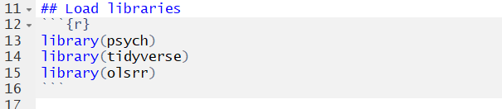
Load libraries

Slide 30
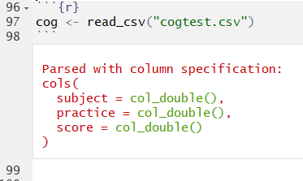
New dataset description
Researchers were interested in the effect of time spent in practice on the performance of a visual discrimination task. Subjects were randomly assigned to different levels of practice, following which a test of visual discrimination is administered, and the number of correct responses is recorded for each subject. 40 subjects were randomly assigned to practice 0 minutes, 2 minutes, 4 minutes, 6 minutes, 8 minutes, 10 minutes, 12 minutes, or 14 minutes.
There are three variables:
Subject = subject ID
practice = minutes spent practicing, this was assigned by the experimenter
score = the number of correct answers on the test

Slide 31
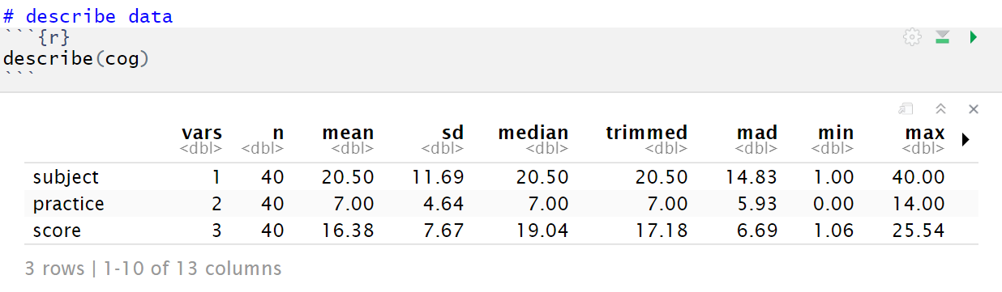
Describe data

Slide 32
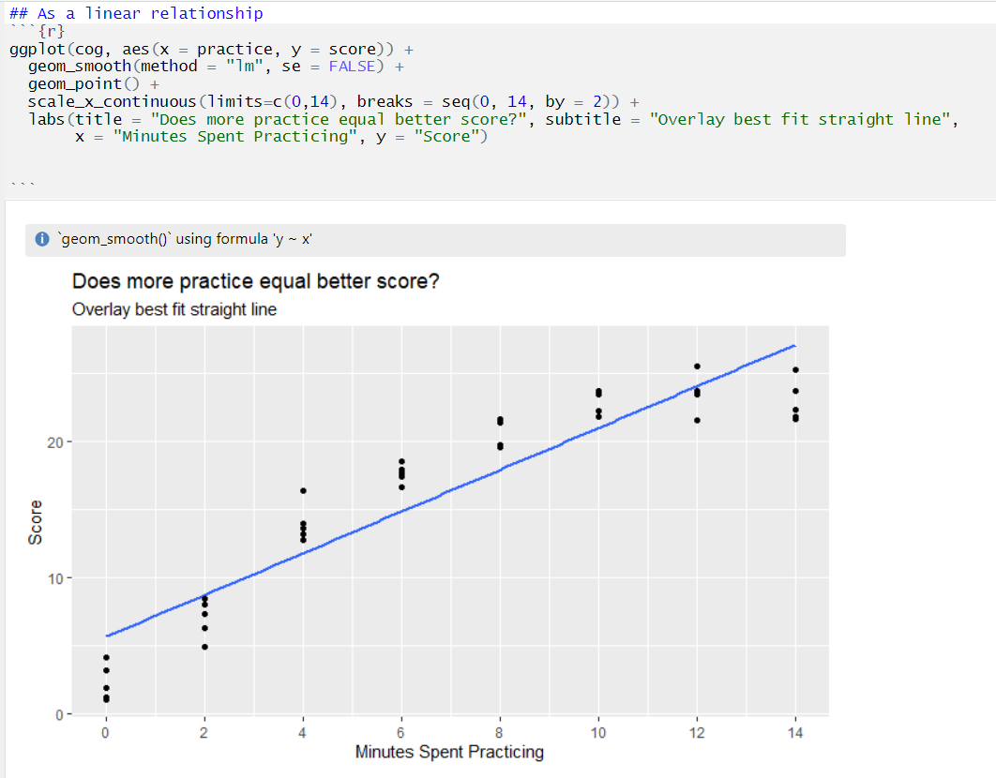
Plot a linear relationship

Slide 33
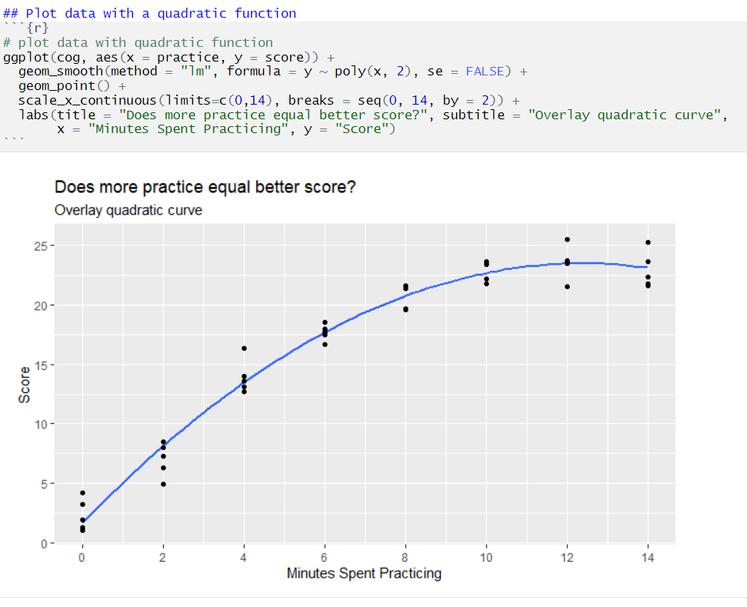
Plot a quadratic relationship

Slide 34
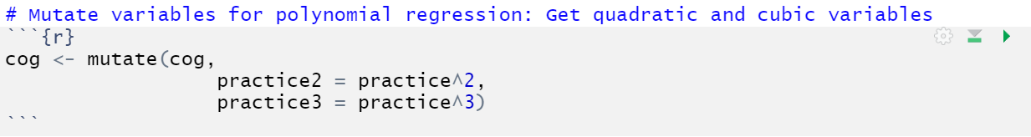
Mutate the practice variable to quadratic and cubic

Slide 35
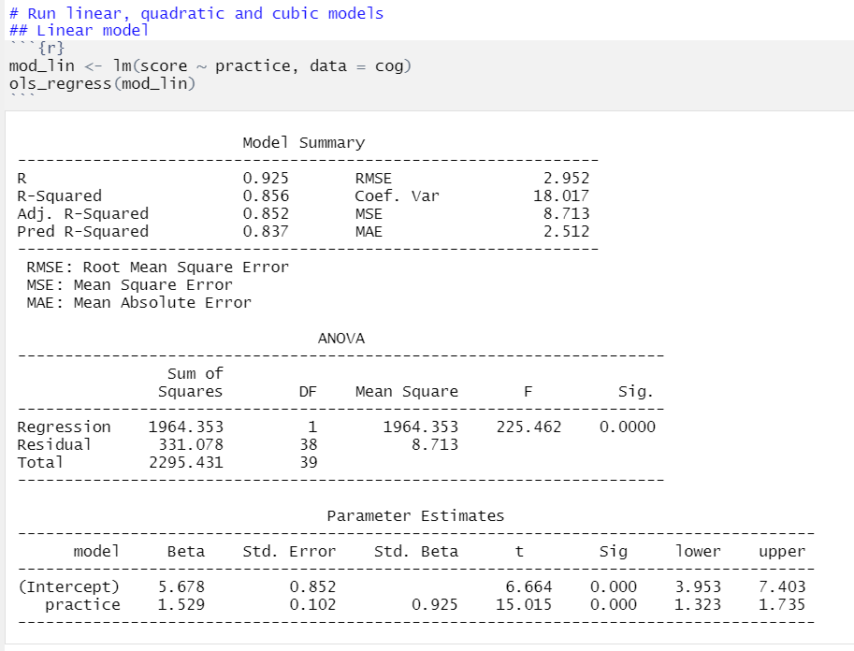
The model testing the linear effect between practice and score explained 85.6% of the variance in score, and the linear trend was statistically significant at p<0.001.
This model fits the data pretty well, but since we observed a potential curved relationship when we plotted the data, there could be a better way to examine this relationship.

Slide 36
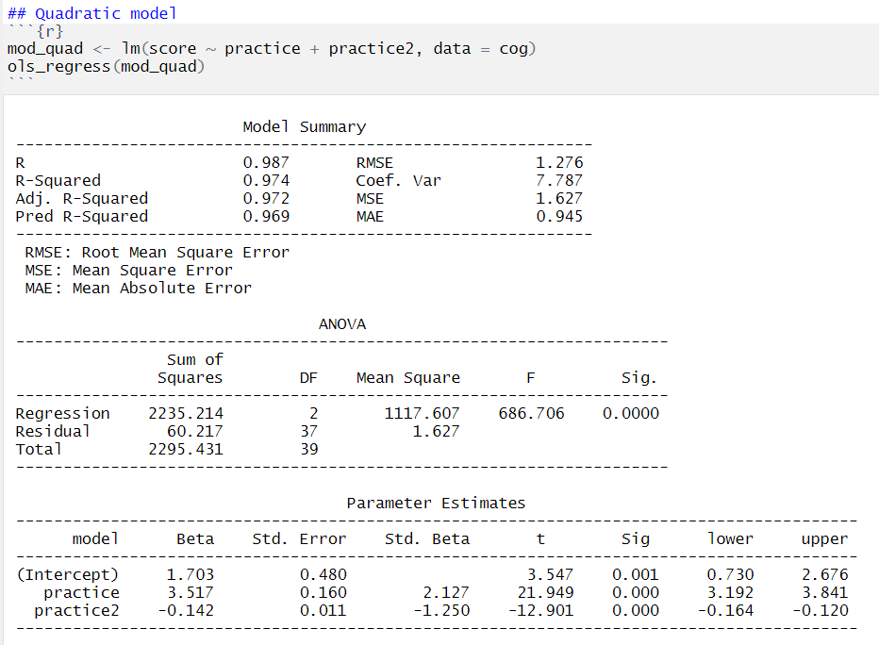
The model testing the linear and quadratic effects between practice and score explained 97.4% of the variance in score, which is 11.8% higher than the model that only tested the linear relation.
The quadratic term is statistically significant, indicating that there is a substantial curve to the relation between practice and score (i.e., it's not linear). We need to maintain the quadratic term in the model.

Slide 37
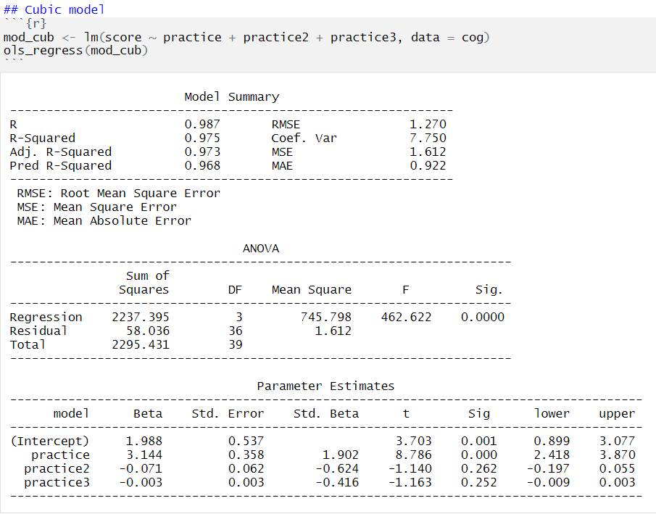
We tested the cubic term to determine if there is a second bend to the relationship between practice and score.
The cubic term is not significant, indicating that there is not a second bend to the relationship.
Therefore, the quadratic model is the best fit for these data.

