Slide 1

Welcome to Psy 653 Lab!
Module 05:
Analyses involving categorical Dependent variables (Logistic regression)
*Thanks to Gemma Wallace for her help with these slides

Slide 2
Objectives
Quick review of logistic regression
Odds ratios
Coding tutorial

Slide 3
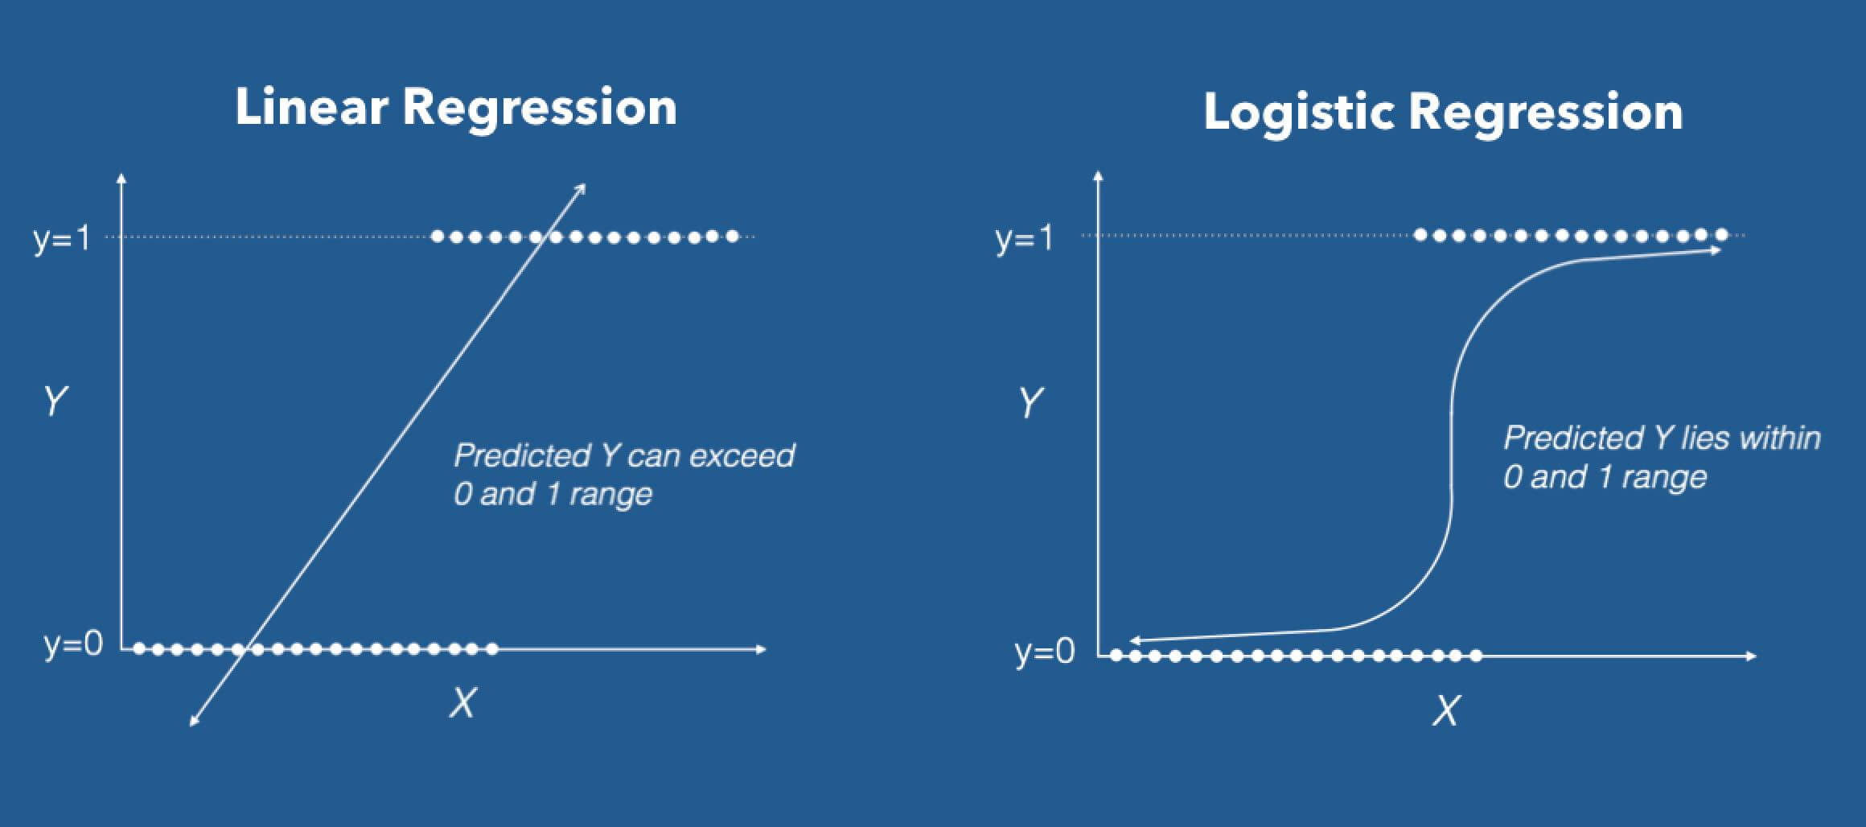
Logistic regression
Logistic regression is used when you have a binomial outcome
Uses a logit link to link the categorical outcome with the predictor variables
You can derive interpretable odds ratios from logistic regression
Which is super neat! Logistic makes it extremely easy to obtain these Odds ratios.

Slide 4
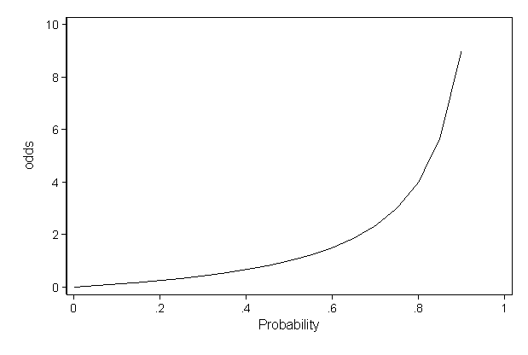
Odds ratios (OR)
Odds ratios range from zero to infinity!
An OR LOWER than 1 indicates that an event is less likely to occur
An OR ABOVE 1 indicates that the even is more likely to occur
An OR of EXACTLY 1 indicates there is no relationship between the predictor and binary outcome
In logistic regression, we’ll be exponentiating our coefficients to obtain the odds ratios

Slide 5

Create a new R-Project and r-notebook!
Download the “Logistic2.csv” file from Canvas and save it into your R-project file

Slide 6

Load Libraries

Slide 7
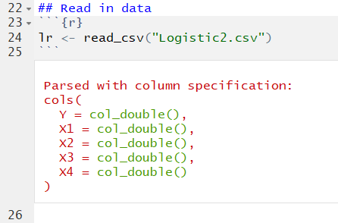
Read in data
This is a simulated dataset with N=164 and 5 variables:
Y: A binary categorical variable (Coded as 0 or 1).
X1: A binary variable (Coded as 0 or 1)
X2: A continuous variable ranging from 0 to 10
X3: A continuous variable ranging from 0 to 5
X4: A continuous variable ranging from 0 to 4

Slide 8
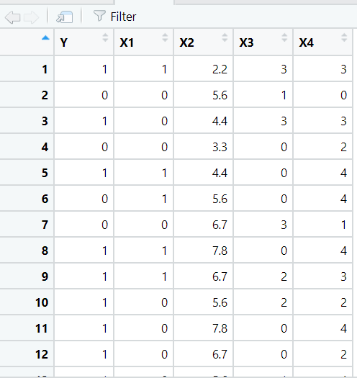
A look at our dataset
Notice how Y is just a series of 0’s and 1’s.

Slide 9
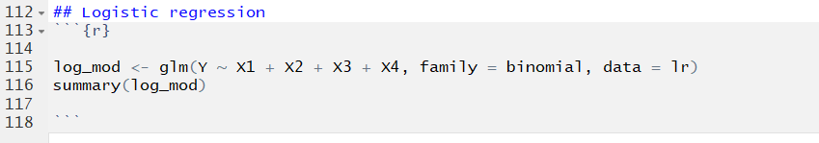
The glm() function
family = binomial tells the model that the outcome variable is binary (zeros and ones)

Slide 10
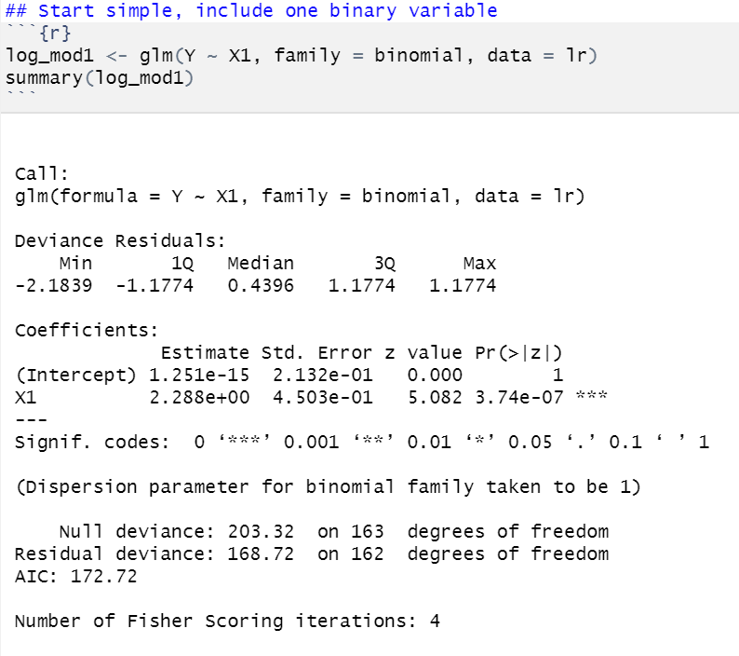
Run a simple logistic regression model one binary predictor
The model displays the log odds of the predictor variable on the outcome of Y.
We can see that X1 is statistically significant. However, to have a better interpretation of each with odds ratios, we need to exponentiate the coefficients.

Slide 11
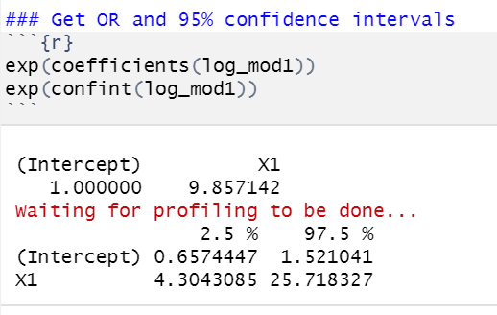
Exponentiate the coefficients and confidence intervals to obtain interpretable Odds ratios.
ODDS RATIOS
CONFIDENCE INTERVALS

Slide 12
Exponentiate the coefficients and confidence intervals to obtain interpretable Odds ratios.
(Intercept): When all of the X variables are zero, the odds are 1.00 times as likely of developing the outcome of Y (Meaning the odds are completely even of developing Y). This is not statistically significant.
X1 (Binary): Those coded as 1 are 9.86 times as likely to develop the outcome of Y as compared to those coded 0. This is statistically significant. But it is a very wide confidence interval!

Slide 13
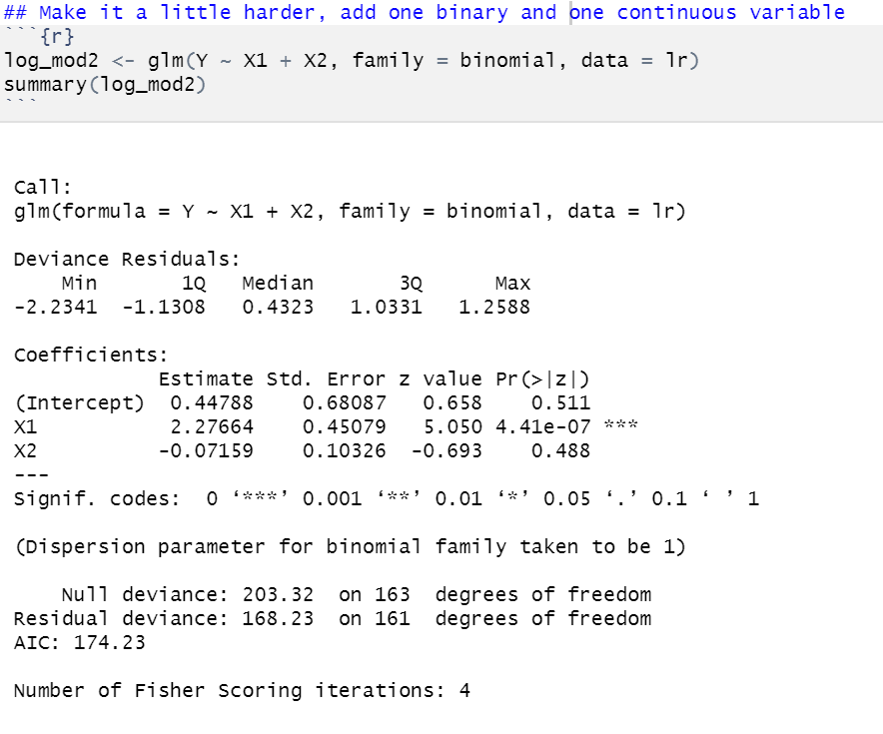
Run a Another logistic regression model one binary predictor & one continuous predictor
The model displays the log odds of the predictor variable on the outcome of Y.
We can see that X1 is statistically significant and X2 is not. However, to have a better interpretation of each with odds ratios, we need to exponentiate the coefficients.

Slide 14
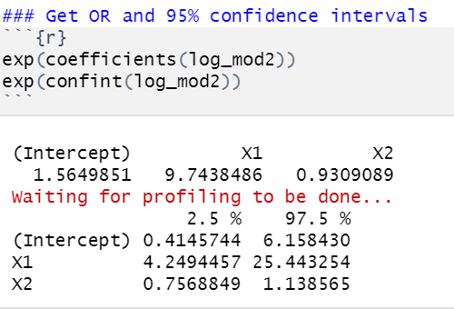
Exponentiate the coefficients and confidence intervals to obtain interpretable Odds ratios.
Intercept: When all of the X variables are zero, the odds are 1.56 times as likely of developing the outcome of Y. This is not statistically significant.
X1 (Binary): After controlling for all variables in the model, Those coded as 1 are 9.74 times as likely to develop the outcome of Y as compared to those coded 0. This is statistically significant.
X2 (Continuous): After controlling for all variables in the model, For every one unit increase in X2, there is an expected increase of 0.931 times of developing Y (Or we can take the inverse and state that for every one unit increase in X2, there is a 1.07 increase in the odds of NOT developing the outcome of Y). This is not statistically significant.

Slide 15
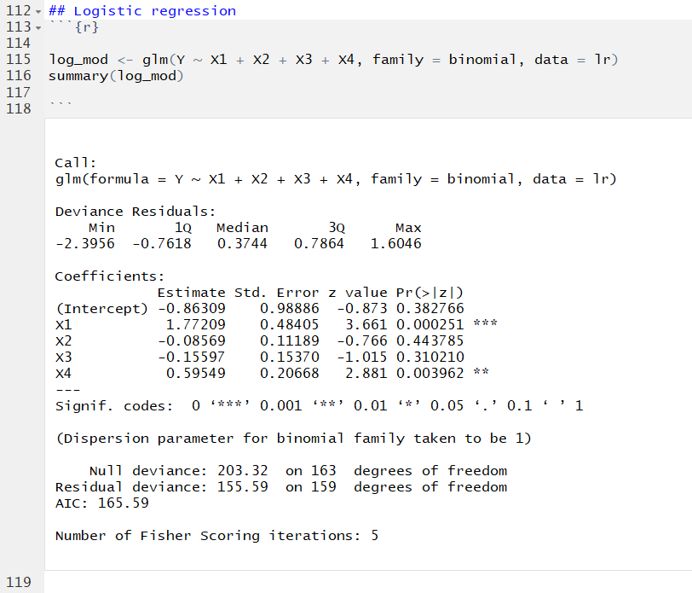
Logistic regression model
The model displays the log odds of each predictor variable (While controlling for all other predictors in the model) on the outcome of Y.
We can see that X1 and X4 are statistically significant. However, to have a better interpretation of each with odds ratios, we need to exponentiate the coefficients.

Slide 16
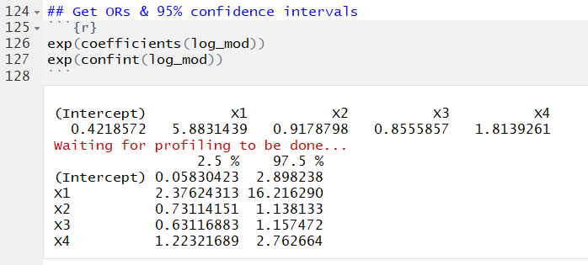
Logistic regression model interpretations
Intercept: When all of the X variables are zero, the odds are .421 times as likely of developing the outcome of Y (Or we can take the inverse and state the they are 2.38 times as likely NOT to develop the outcome of Y). This is not statistically significant.
X1 (Binary): After controlling for all variables in the model, Those coded as 1 are 5.88 times as likely to develop the outcome of Y as compared to those coded 0. This is statistically significant.
X2 (Continuous): After controlling for all variables in the model, For every one unit increase in X2, there is an expected increase of 0.918 times of developing Y (Or we can take the inverse and state that for every one unit increase in X2, there is a 1.09 increase in the odds of NOT developing the outcome of Y). This is not statistically significant.
X3 (Continuous): After controlling for all variables in the model, For every one unit increase in X3, there is an expected increase of 0.856 times in the odds of developing Y (Or we can take the inverse and state that for every one unit increase in X2, there is a 1.17 increase in the odds of NOT developing the outcome of Y). This not is statistically significant.
X4 (Continuous): After controlling for all variables in the model, For every one unit increase in X4, there is an expected increase of 1.81 times in the odds of developing Y. This is statistically significant.
In logistic regression, an effect is significant if the confidence interval does not contain 1 (not zero, as in ols analyses; odds of 1 represent equal odds)

Slide 17
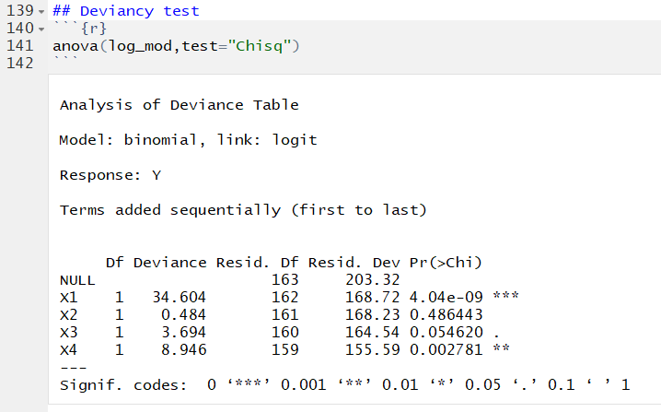
Logistic regression: Examine deviance between models
This compares deviance, an estimate of model fit, between each model and the null model. The values represent:
X1 = model with just X1 vs. NULL model
X2 = model with X1 + X2 vs. NULL model
X3 = model with X1 + X2 + X3 vs. NULL model
X4 = model with X1 + X2 + X3 + X4 vs. NULL model
These comparisons tell us whether adding information to the null model leads to better prediction. In this case, the X2 and X3 models do not significantly improve model fit.

Slide 18
Logistic regression: McFadden’s R²
On the previous slide, we showed how deviance comparisons give information about how each subsequent model compares to the null model.
McFadden’s R² allows you to estimate the percent variance explained by each model, which can serve as an effect size.
McFadden R² = 1-(Deviance model/Deviance Null)

Slide 19
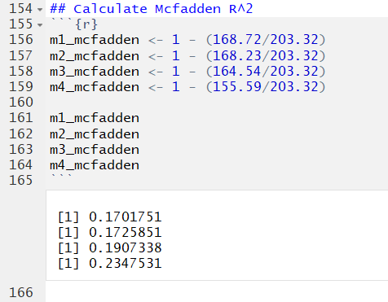
Logistic regression: McFadden’s R²
You can use the McFadden’s R² values to compare changes in the percent of variance in Y for the addition of each variable, like we do in OLS hierarchical regression comparisons:
Percent variance explained in Y:
Model 1 (Y~X1) = 17.02
Model 2 (Y~X1+X2) = 17.26
Model 3 (Y~X1+X2+X3) = 19.07
Model 4(Y~X1 + X2 + X3 + X4) = 23.47
Notes:
Odd that these were quite different in this data but essentially identical in the bac data? Did I make a mistake in mine?

