Slide 1

Welcome to Psy 653 Lab!
Module 06: Repeated Measures and mixed designs
*Thanks to Gemma Wallace for her help with these slides

Slide 2
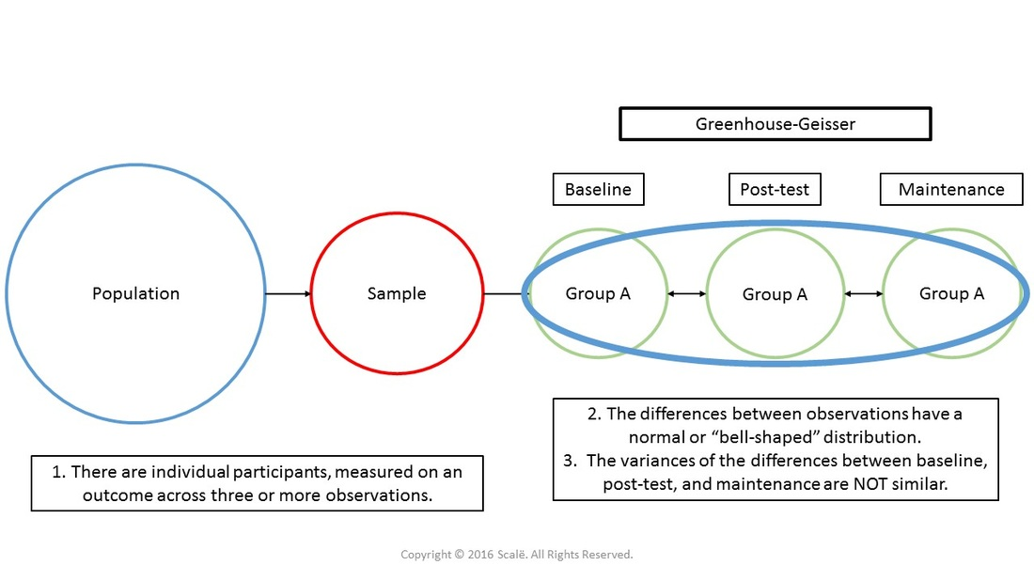
Key terms
Repeated Measures
When subjects participate in all conditions of an experiment or provide data at multiple timepoints
Sphericity
Equality of variances of the differences between treatment levels

Slide 3
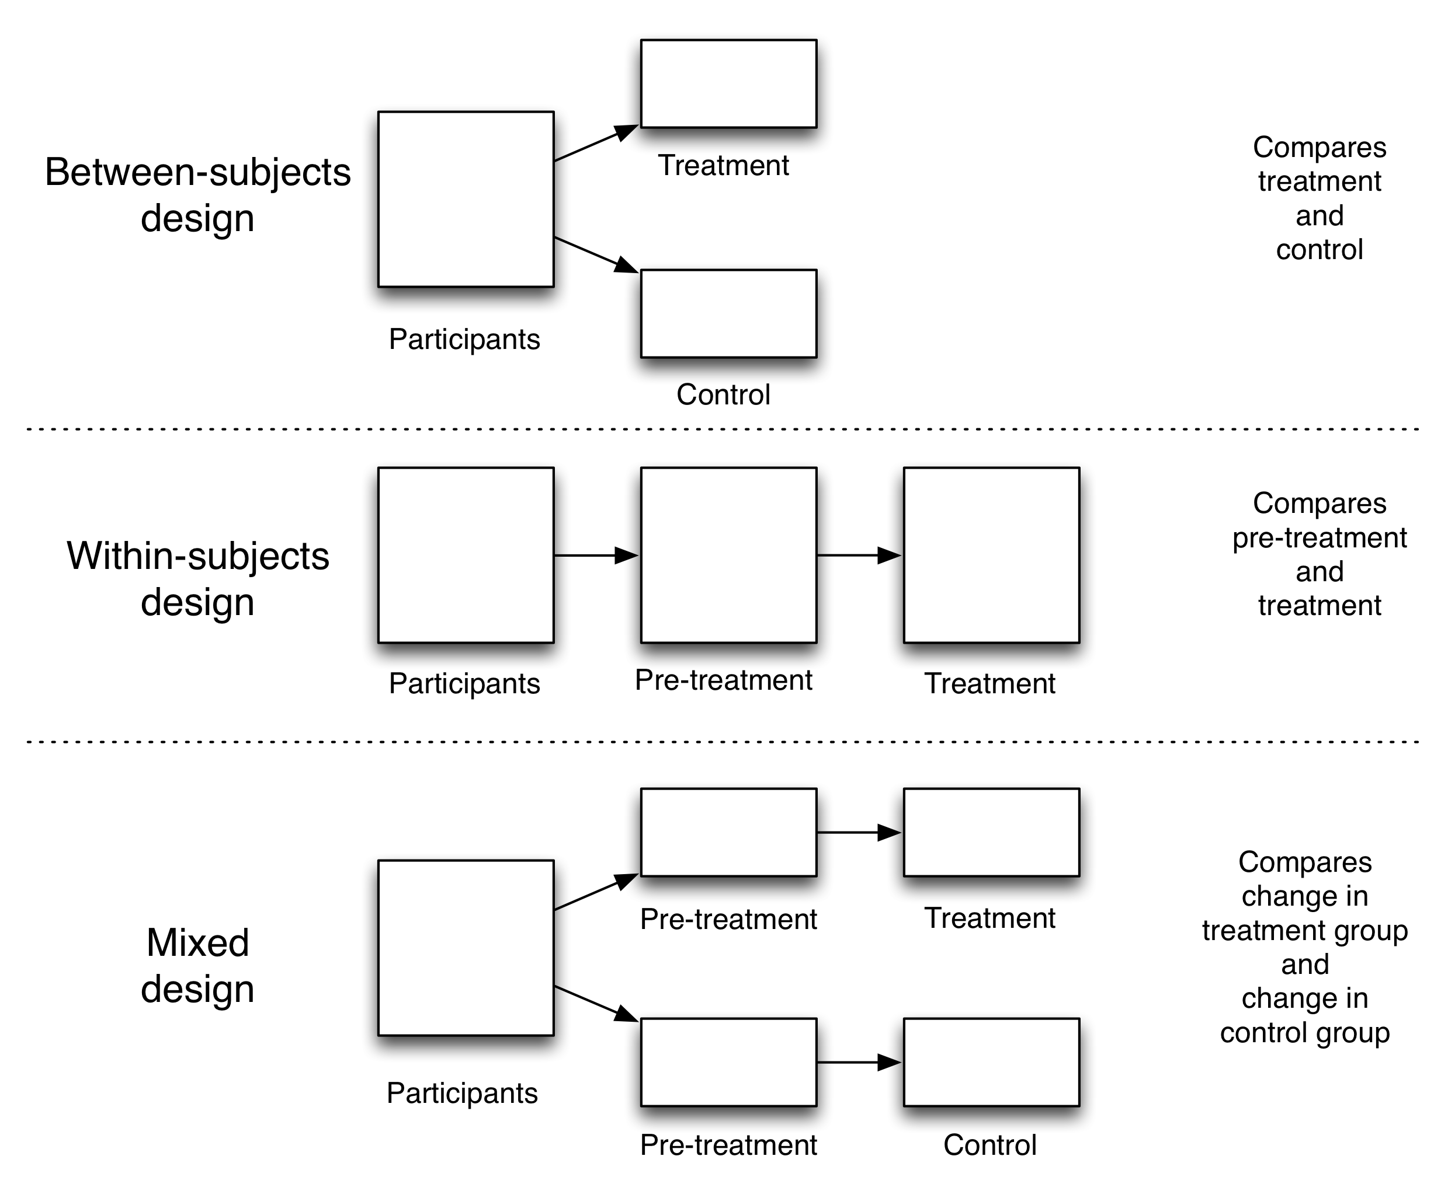

Slide 5
Class example
A researcher is interested in the length of time it takes to say 2 syllable, 3 syllable, and 4 syllable words. She first times how long it takes each participant to say the 2 syllable word, then the 3 syllable word, then the 4 syllable word. However, half the participants are put in a condition in which there is a distracting noise in the background. She is interested if there is a difference between the control condition and the noise condition.
Source: Henderson, L., Coltheart, M., & Woodhouse, D. (1973). Failure to find a syllabic effect in number naming. Memory & Cognition, 1(3), 304-306. Retrieved from: http://users.stat.ufl.edu/~winner/data/

Slide 6
Our variables and research design
Noise Condition = between-subjects factor
Every participant is only exposed to one condition, either control or noisy
# of syllables = within-subjects factor
Every participant reads words of all three syllable lengths
Length of time to say each word = outcome variable
Mixed design
Noisy
# Syllables = 2
# Syllables = 3
# Syllables = 4
Participants
Quiet
# Syllables = 2
# Syllables = 3
# Syllables = 4

Slide 7

Create a new R-Project and r-notebook!
Download the “syllables.csv” file from Canvas and save it into your R-project file

Slide 8
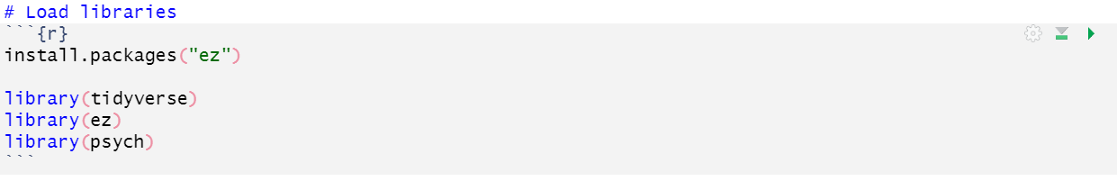
Load libraries

Slide 9
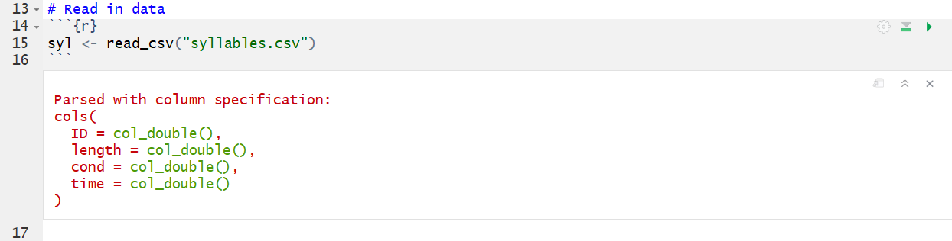
Read in the data
ID = subject id
length = # of syllables in word (2, 3, or 4)
cond = condition (0 = control, 1 = noise condition)
time = milliseconds it took to say the word (outcome variable)

Slide 10
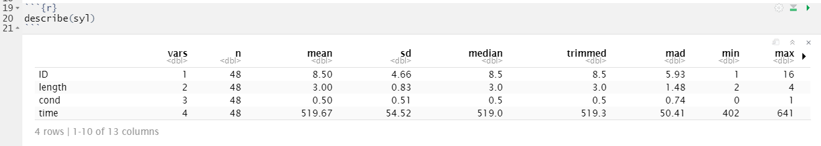
Describe the dataset

Slide 11
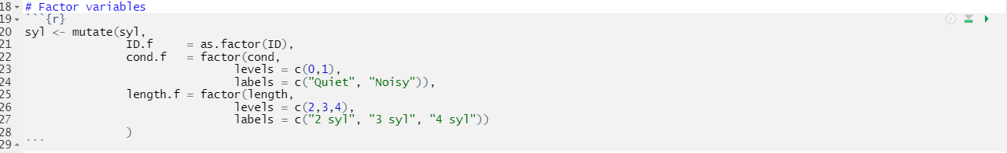
Factor the predictor variables
*Note: ezANOVA() (The main function we’ll be using today) will do this automatically, but it’s nice to remove the warning message and it looks nicer!

Slide 12
The ezANOVA() Function
ezANOVA(data = dataframe,
dv = outcome_variable,
wid = variable_that_identifies_participants,
within = repeated_measures_predictors,
between = between_group_predictors,
detailed = TRUE,
type = 3)
If there are multiple predictor variables for each category, use a “.”, parentheses, and separate them with a comma e.g., .(x,y). Use ?ezANOVA for more information

Slide 13
ANALYSES 1: Research Question
Does length of time to read each word significantly differ by word syllable length?
(We are ignoring Condition for analyses 1)

Slide 14
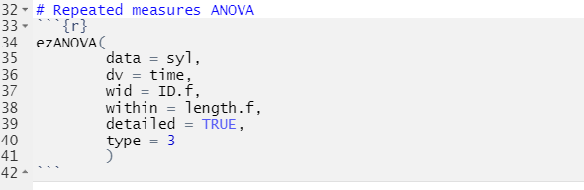
Analysis 1: Run a repeated measures ANOVA (ignoring condition for now)

Slide 15
data = dataset
dv = dependent variable
wid = ID grouping variable (factored)
within = within subject variable (factored)
“detailed = TRUE” indicates we want detailed output
“type = 3” indicates we would like it to perform a type 3 ANOVA

Slide 16
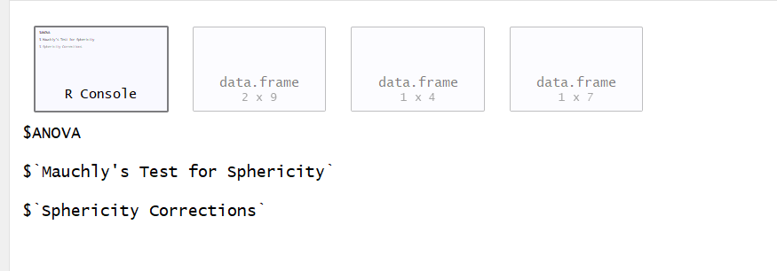
4 windows will be outputted!
R console
(Errors will be reported here)
ANOVA table
Sphericity test
Greenhouse-Geisser & Huynh-Feldt corrections (Use if spericity is violated)

Slide 17
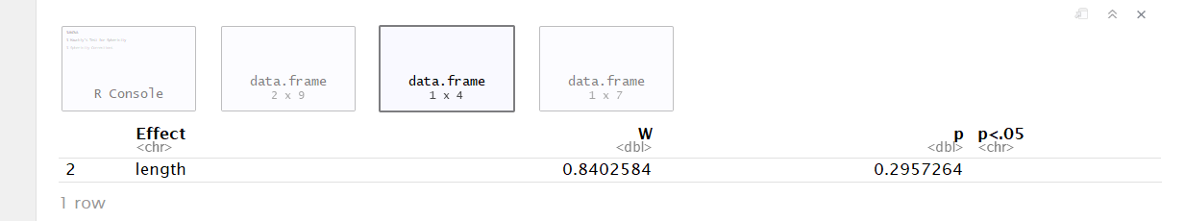
First, check if sphericity is violated
Sphericity = the variances of the differences between all possible pairs of within-subject conditions (i.e., levels of the categorical predictor) are equal
A non-significant p value (i.e., >0.05) means that the condition of sphericity has been met. We do NOT need to use the Greenhouse-Geisser & Huynh-Feldt corrections (Window 4)
Notes:
I.e., relationship between pairs of experimental conditions is similar

Slide 18
Check if sphericity is violated
Was it violated?

Slide 19
Check if sphericity is violated
ANOVA table
Was it violated?
NO!
(therefore we don’t need to deal with window 4)

Slide 20
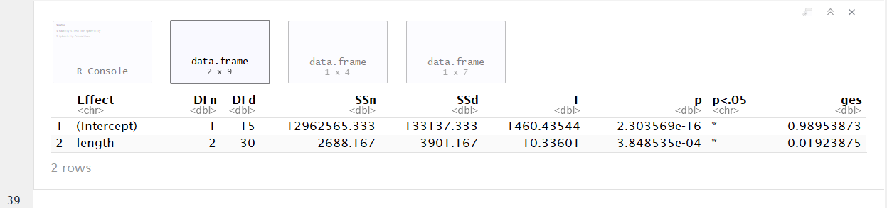
Next, view the ANOVA table (since sphericity wasn’t violated)

Slide 21
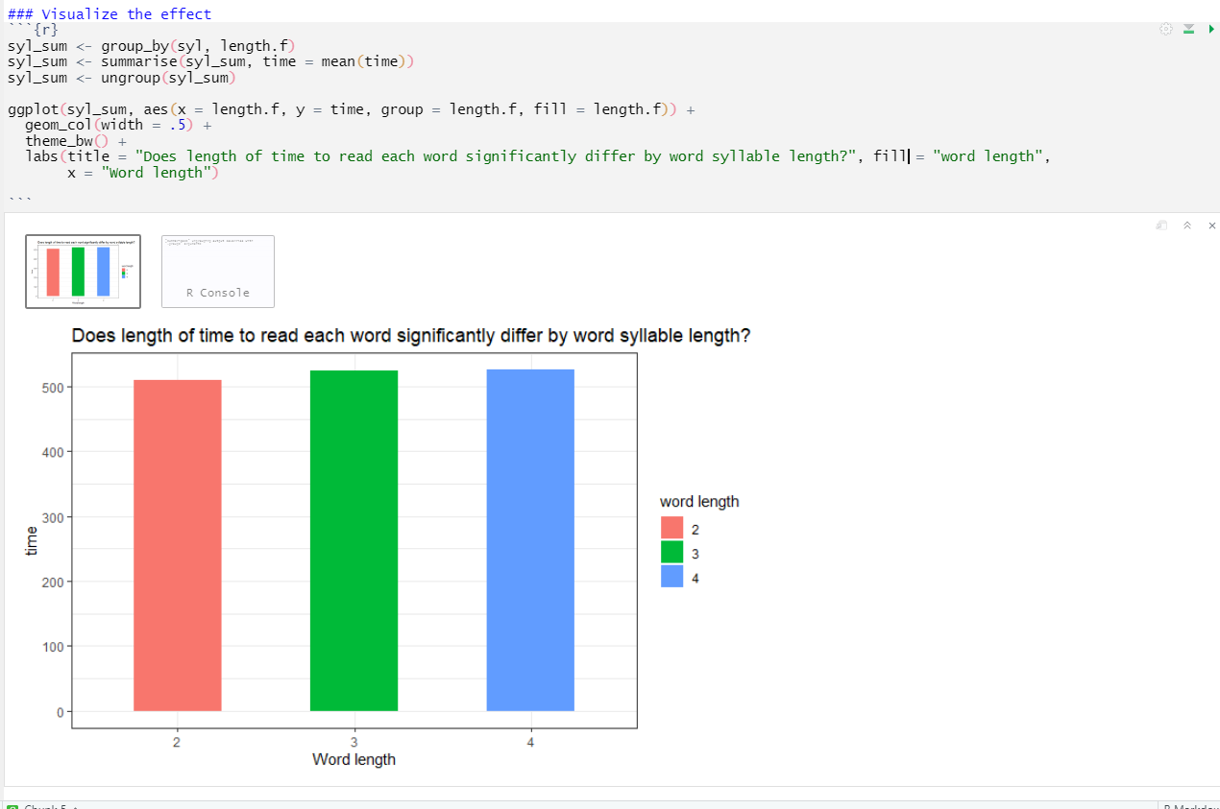

Slide 22
Analysis 2: Run a mixed effects ANOVA to evaluate effects of both # of syllables and noise condition on time
Does length of time to read each word significantly differ by word syllable length AND by condition?

Slide 23
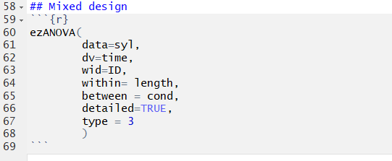
Analysis 2: Run a mixed effects ANOVA to evaluate effects of both # of syllables and noise condition on time

Slide 24
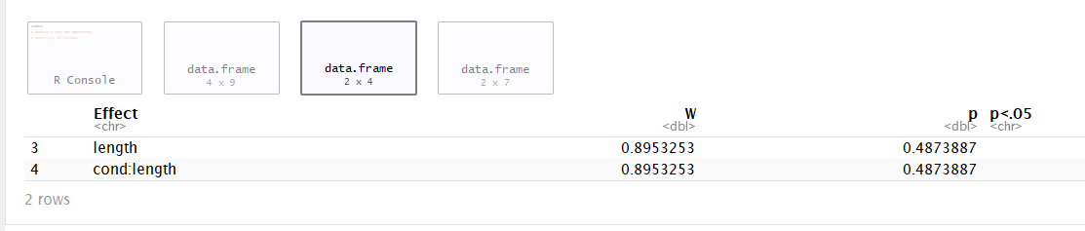
First, check if sphericity was violated

Slide 25
First, check if sphericity was violated
Sphereicity was NOT violated (p > .05)

Slide 26
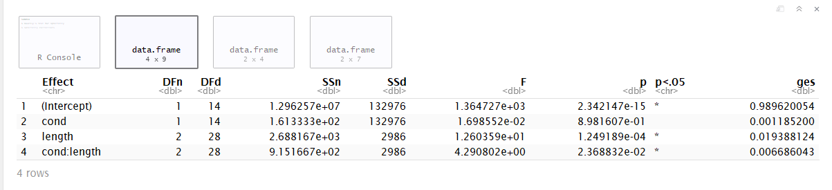
Next, view the ANOVA table (since sphericity wasn’t violated)
SSd = an error term: the amount of unexplained variance across the conditions of the within-subjects variable

Slide 27
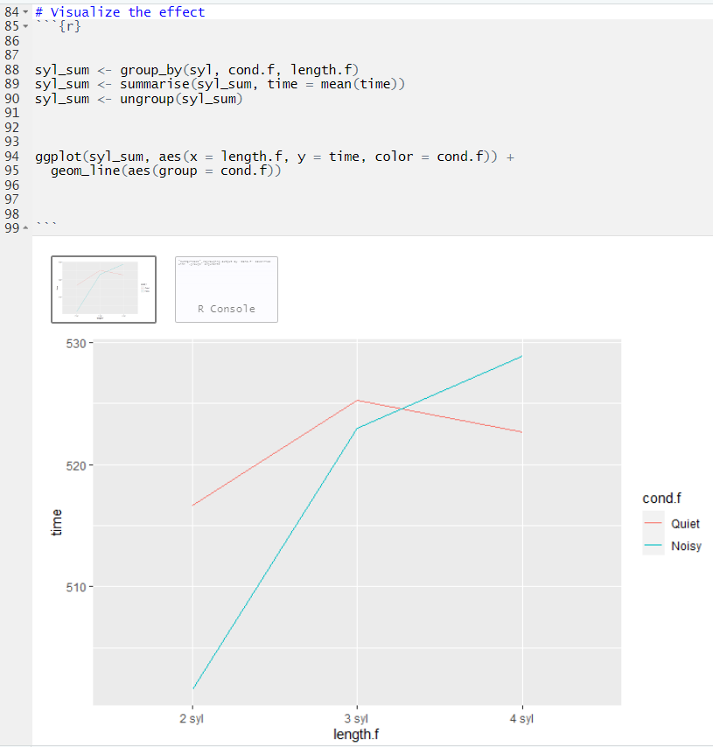
Visualize the effects of syllable length and noise condition on time to say each word

Slide 28
What should you do if the sphericity assumption is violated?
We didn’t violate the assumption in this demo activity, but if we had:
Use the output from Window 4 and apply a correction to the model F Ratio,and then use that value in your model interpretations.

