Slide 1

Welcome to Psy 653 Lab!
Module 07: Time series and the analysis of longitudinal data – ARIMA modeling

Slide 2
objectives
Explanation of ARIMA models
Seasonality and stationarity in ARIMA models (The “I” in ARIMA)
Differencing
Explanation of AR & MA terms in ARIMA
Coding tutorial

Slide 3
ARIMA Modeling
ARIMA stands for: Auto Regressive Integrated Moving Average
Auto Regressive (p) = refers to the lag function of the differenced series. An auto regressive model makes use of a previous time step to make a prediction about a future time step.
Integrated (d) = Is the number of differences used to make the time series stationary. This will be explained in more detail later.
Moving Average (q) = How much the average changes from one time point to the next.
In short, an ARIMA models use previous time periods to predict outcomes in the future.

Slide 4
Our goal
Today we will be running a series of statistics to fit the best ARIMA model given our data.
By fitting the model, we will be able to forecast what data in the future will look like.
We will be calculating three components to the ARIMA model
The number of lags needed in the stationary series (The number of autoregressive terms to fit our model), our AR (AKA “p”)
The number of differences needed to make the data stationary (The number of nonseasonal differences), our I (AKA “d”)
The number of lags of the forecast error (The number of moving average terms), our MA (AKA “q”)
With these components, we are able to fit a model that can properly forecast future events. (Or at least we hope so…)

Slide 5
Three components to learn:
Seasonal component refers to fluctuations in the data related to calendar cycles. Usually, seasonality is fixed at some number; for instance, quarter or month of the year.
Trend component is the overall pattern of the series
Cycle component consists of decreasing or increasing patterns that are not seasonal. Usually, trend and cycle components are grouped together. Trend-cycle component is estimated using moving averages.

Slide 6
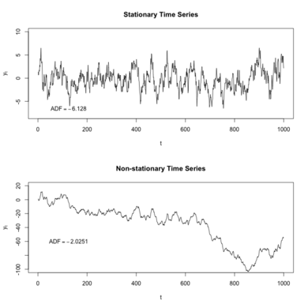
Stationarity
A stationary model is one that does not have a seasonality component to it. In other words, the day/month/year/decade does not influence what the datapoint will be.

Slide 7
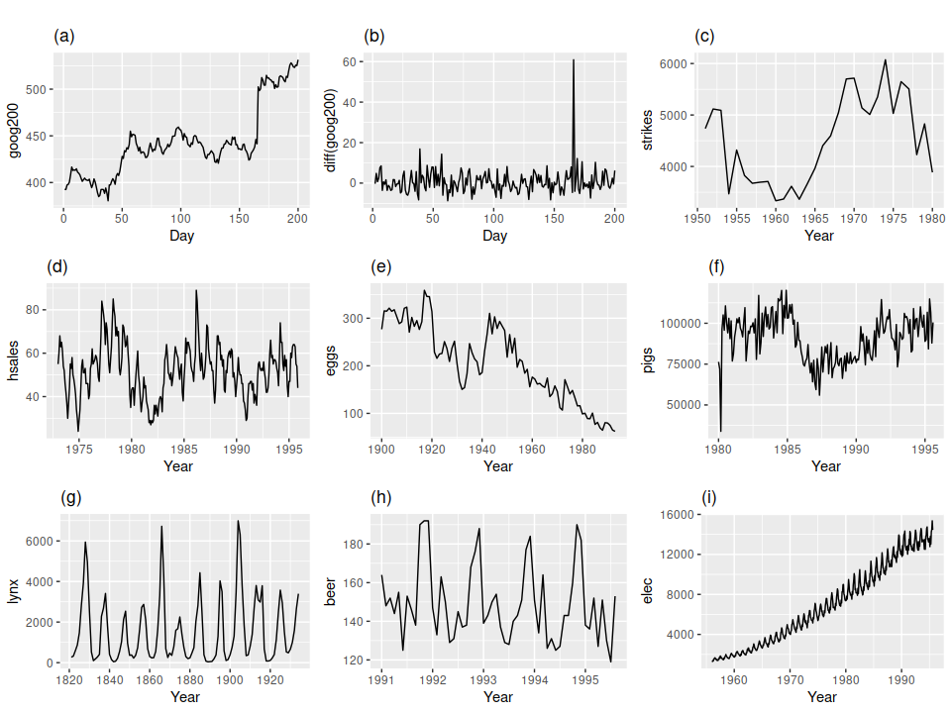
ARIMA model Assumptions
1.) Data should be stationary: by stationary it means that the properties of the series doesn’t depend on the time when it is captured. AKA there is NO seasonality in the trend (The variable being modeled does not depend on the day/month/year you choose it).
2.) Data should be univariate: ARIMA models only works on a single variable.
https://otexts.com/fpp2/stationarity.html

Slide 8
ARIMA model Assumptions
1.) Data should be stationary: by stationary it means that the properties of the series doesn’t depend on the time when it is captured. AKA there is NO seasonality in the trend (The variable being modeled does not depend on the day/month/year you choose it).
Look at the graphs on the left, which models are stationary?
https://otexts.com/fpp2/stationarity.html

Slide 9
ARIMA model Assumptions
1.) Data should be stationary: by stationary it means that the properties of the series doesn’t depend on the time when it is captured. AKA there is NO seasonality in the trend (The variable being modeled does not depend on the day/month/year you choose it).
Look at the graphs on the left, which models are stationary?
Only graph (b) and (g) show a stationary trend. The rest will need to be transformed before we can run an ARIMA model on it. At first glance, (g) may appear seasonal, but the cycles are aperiodic.
https://otexts.com/fpp2/stationarity.html

Slide 10
How do we make a dataset stationary
Through differencing!
Differencing = computing the differences between consecutive observations.
The more seasonality (non-stationarity) our data has, the more differencing we will need to do.
Luckily, the R packages we will be using handle all of this for us (tseries and forecast packages)
By determining the number of differences you need, you have figured out the “I” (Integrated) in the ARIMA model. This is otherwise characterized as a (d).

Slide 11
What about the AR (p) and MA (q) portions of the ARIMA Model? What exactly does this mean?
We will be looking at displays later in the slides to determine what the best AR (p) and MA (q) terms for our model will be.
But in the end, we will get models that look as so: arima(p = 1, d = 1, q = 1).
In short, we are saying that the model requires 1 AR (p) term, 1 differencing (d) terms, and 1 MA (q) term.
A model with an AR term specifies that the model tends to return to its mean relatively quickly. If it had to AR terms, then it would indicate that there is an oscillatory pattern associated with it.
A model with an MA term shows that the Moving average tends to experience “shocks”. As in, it has severe spikes in the data. The more MA terms we have, the more “shocks” the model has.

Slide 12
A couple of notes:
The process of fitting an ARIMA model is completely exploratory
We will be using statistical tests to guide our decisions, but different people may come to different conclusions.
Some components of this unit will seem like a “black box”
The program will do a lot of the work for us. The underlying equations and processes are beyond the scope of this class.

Slide 13

Create a new R-Project and r-notebook!
Download the “day.csv” file from Canvas and save it into your R-project file

Slide 14
Dataset Explanation
This dataset contains the daily count of rental bikes between years 2011 and 2012 in Capital bikeshare system with the corresponding weather and seasonal information.
Variables of interest:
Date: Date
season: 1 = Winter, 2 = Spring, 3 = Summer, 4 = Fall
cnt = # of bikes rented on that day.
Data obtained from: https://archive.ics.uci.edu/ml/datasets/Bike+Sharing+Dataset

Slide 15
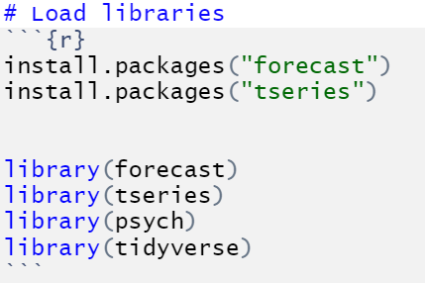

Slide 16
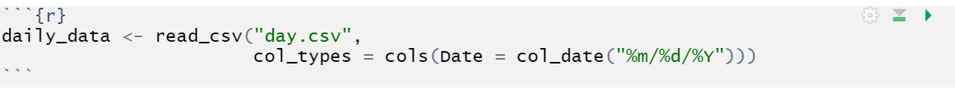
read_csv()… a little differently
We need to specify that the Date variable is indeed a date. Additionally, we need to specify the date format, “%m/%d/%Y” is telling R that the format of the date is in the American month/day/year format.

Slide 17
select() variables of interest

Slide 18
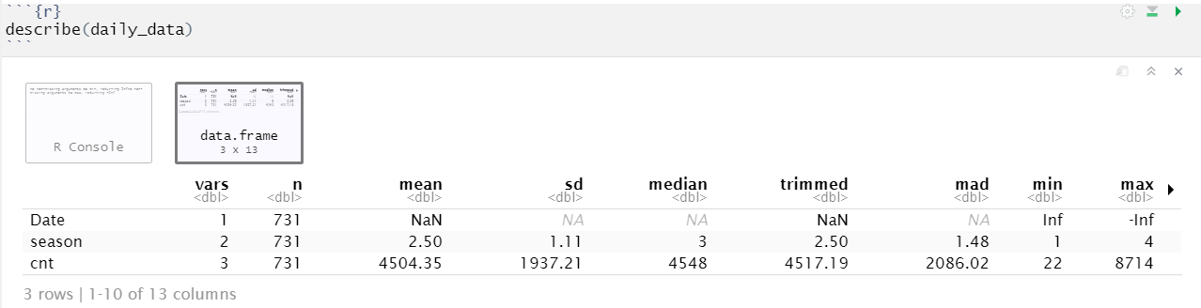
describe() data

Slide 19
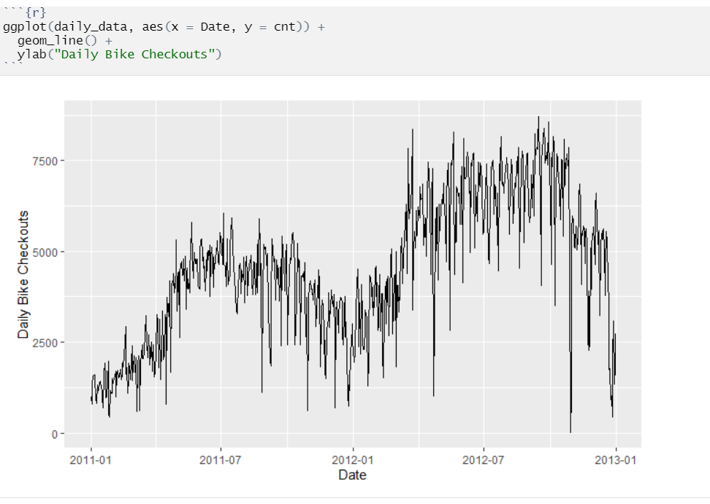
Plot the data

Slide 20
Is there seasonality?
Looks like it! More bikes seem to be rented in the summer months. Therefore, the data does NOT look stationary.
…We’ll statistically check next

Slide 21
Statistically Checking for Stationarity
1. Convert data into a time series object (using ts() )
2. Use the adf.test() function to test for stationarity
ADF test stands for “Augmented Dickey-Fuller” test. It assesses if the data is stationary or not.

Slide 22
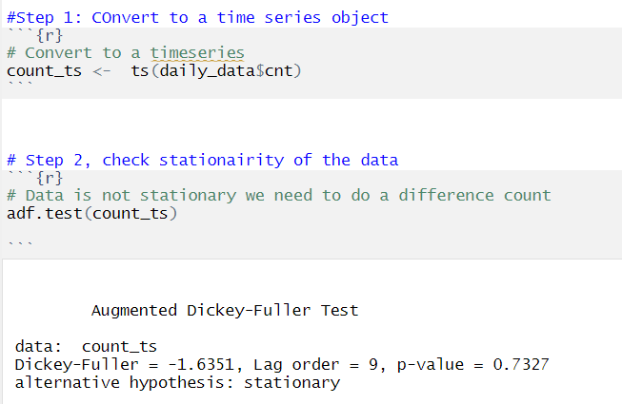

Slide 23
A nonsignificant p-value indicates the data is NOT stationary

Slide 24
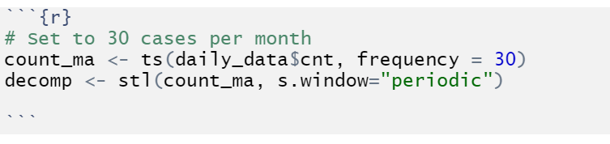
Remove seasonality from the data Step 1: Use stl() to smooth our data

Slide 25
Remove seasonality from the data Step 1: Use stl() to smooth our data
Sets us up to smooth our data by month
Data smoothing

Slide 26
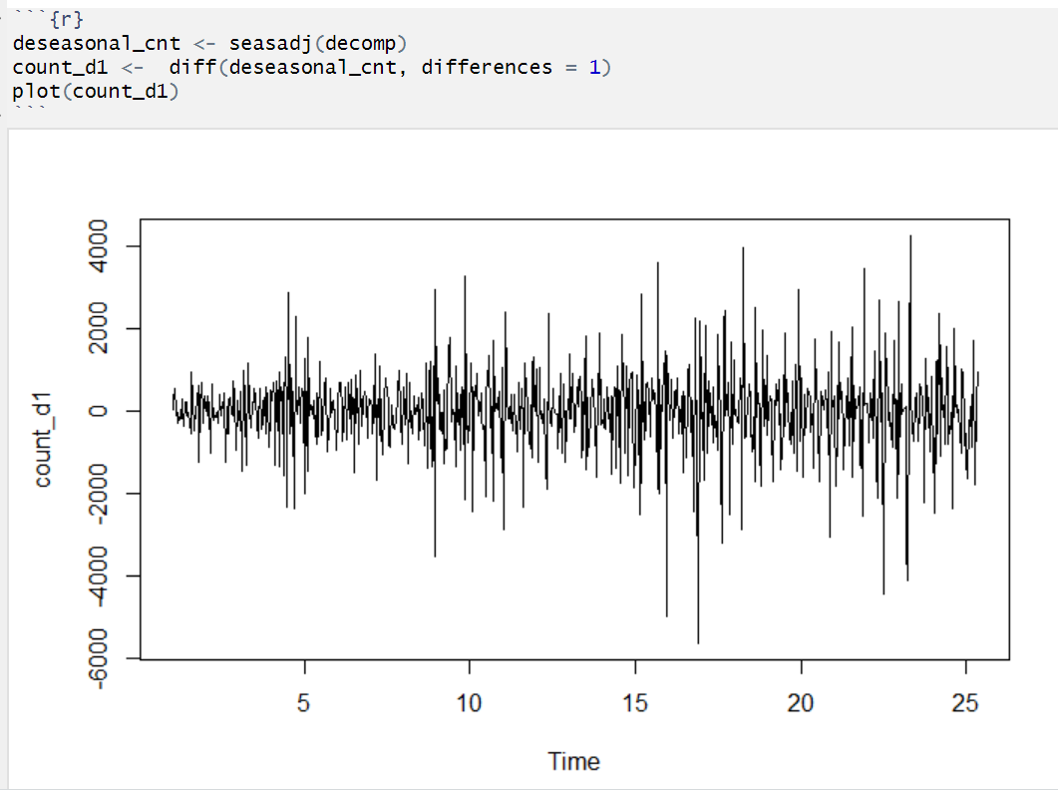
Remove seasonality from the data Step 2: Remove seasonality and plot the results

Slide 27
Remove seasonality from the data Step 2: Remove seasonality and plot the results
Remove seasonality component
Set up lag difference of 1
Plot to see that seasonality has been removed

Slide 28
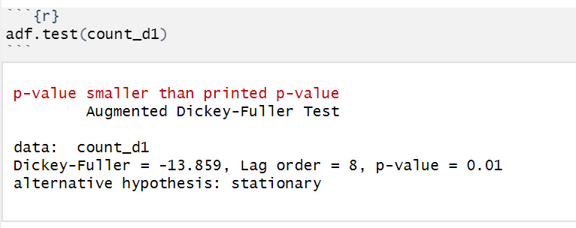
Use our adf.test() again to confirm seasonality was removed

Slide 29
Autocorrelation function Plots (ACF) & partial auto correlation function (PACF) plots to determine the AR (p) & MA (q) potions of our model
We use autocorrelation functions (ACF) and Partial autocorrelation functions (PACF) to determine what to set our auto regressive (AR) and moving average (MA) aspects of our ARIMA model.
ACF is used to determine what our AR should be
PACF is used to determine what our MA should be
In the next set of slides, we will be outputting ACF and PACF graphs. We will literally be eyeballing these graphs to determine what we will be setting out AR and MA portions of our ARIMA model.

Slide 30
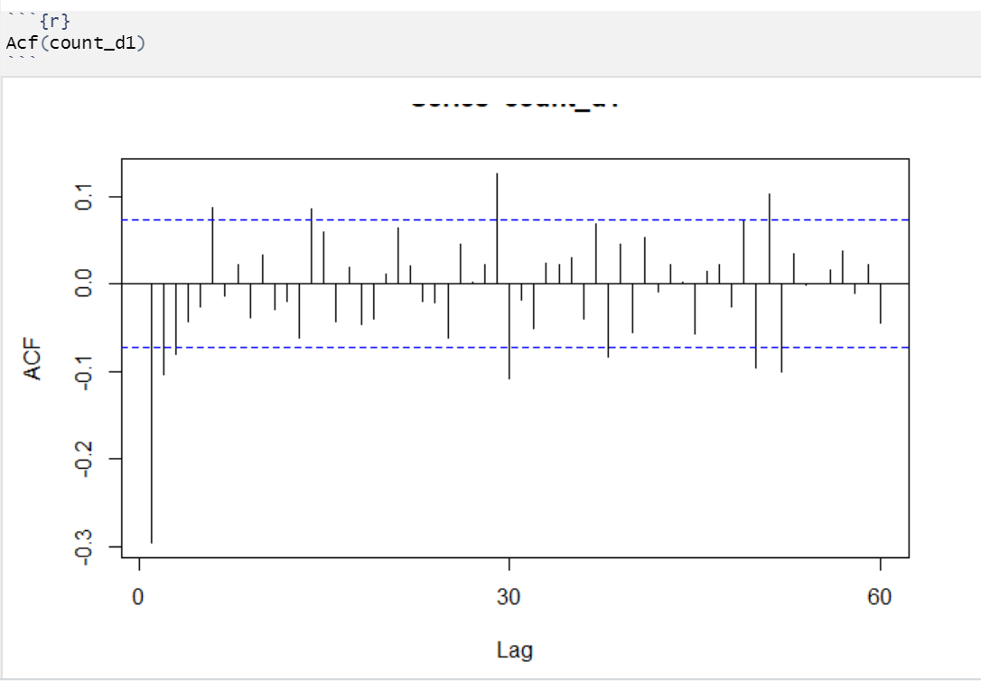
ACF plot: Used to determine the AR (p) of our model
This plot shows the correlation of the series with itself with different lag functions applied to it.

Slide 31
ACF plot: Used to determine the AR (p) of our model
To read this plot, we need to see how many of the lines fall outside the range of our 95% confidence intervals (The blue dashed lines).

Slide 32
ACF plot: Used to determine the AR (p) of our model
Lines 1, 2, & 3 are the first immediate lines that fall out of our confidence intervals. However, line 1 seems to be the most significant and it is a sharp decay after line 1. Therefore, we are going to initially set our AR to 1. We want parsimony in our model. The less AR terms we set, the better.

Slide 33
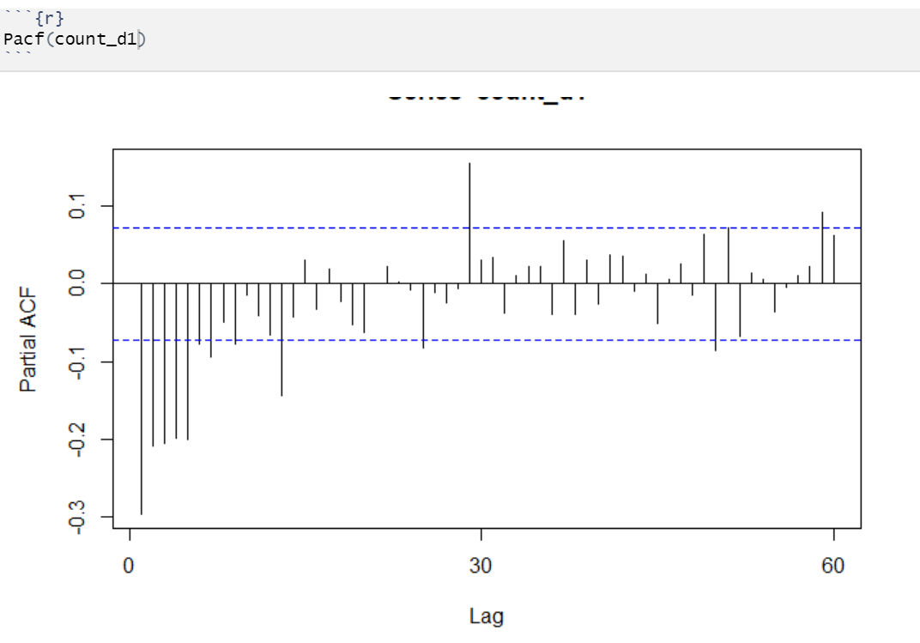
PACF plot: Used to determine the MA (q) of our model
This plot shows the amount of autocorrelation at corresponding “lags” that is not explained by lower-order autocorrelations.

Slide 34
PACF plot: Used to determine the MA (q) of our model
To read this plot, we need to see how many of the lines fall outside the range of our 95% confidence intervals (The blue dashed lines). It is similar to how we read the ACF plot.

Slide 35
PACF plot: Used to determine the MA (q) of our model
Lines 1, 2, 3, 4, & 5 are the first immediate lines that fall out of our confidence intervals. However, line 1 seems to be the most significant and it is a sharp decay after line 1. Therefore, we are going to initially set our MA to 1. We want parsimony in our model. The less MA terms we set, the better.

Slide 36
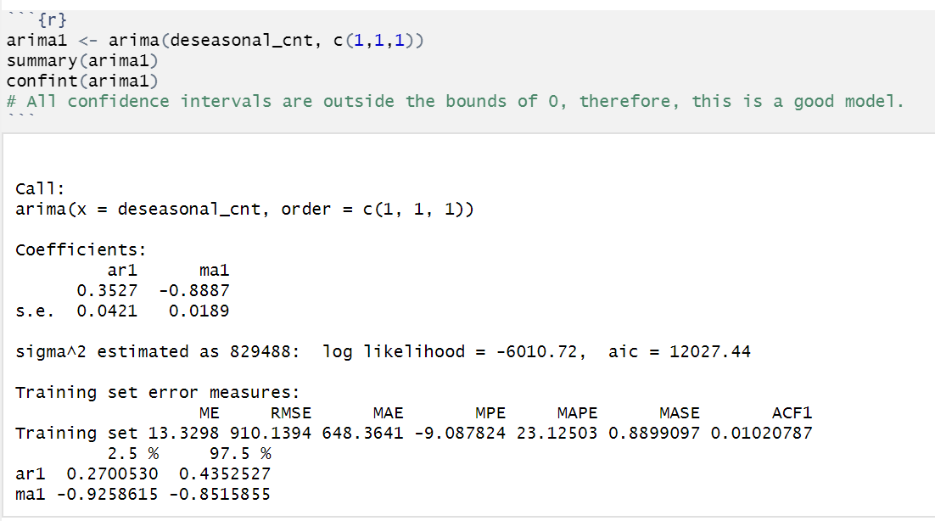
Let’s model!

Slide 37
Let’s model!
p,d,q
ar1: This is a coefficient to show how quickly the time series model tends to pull back towards the mean. The closer it is to 0, the more it tends to pull towards the mean. It is significant because the confidence intervals do NOT contain zero.
ma1: An indication of the moving average behavior. The closer to zero it is, the less the average moves. It is significant because the confidence intervals do NOT contain zero.

Slide 38
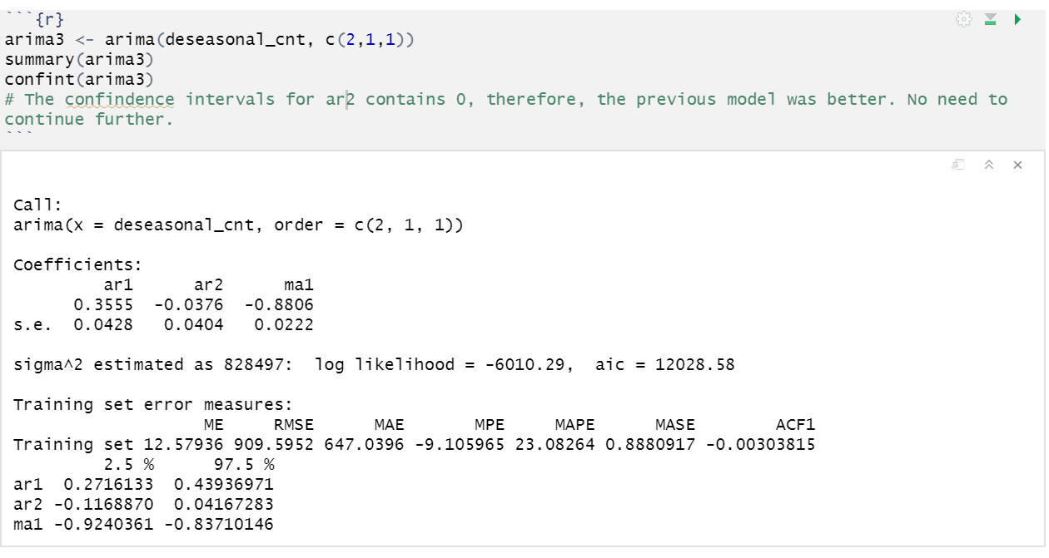
Exploratory, let’s try another model: set the AR to two terms
The ar2 95% CI contains zero. Therefore, it is NOT worth it to keep it in the model.

Slide 39

Exploratory, let’s try another model: set the MA to two terms
The ma2 95% CI contains zero. Therefore, it is NOT worth it to keep it in the model.

Slide 40
Our best model is the first one we ran!

Slide 41
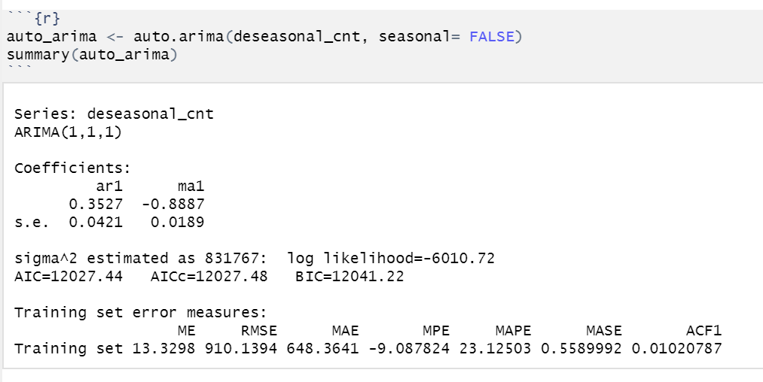
Final step: Use auto.arima() to have R create the model for us

Slide 42
Final step: Use auto.arima() to have R create the model for us
The auto.arima() function chose the same model we chose (arima( 1,1,1) ). Therefore, we can have more assurance that our model is the correct one.

Slide 43
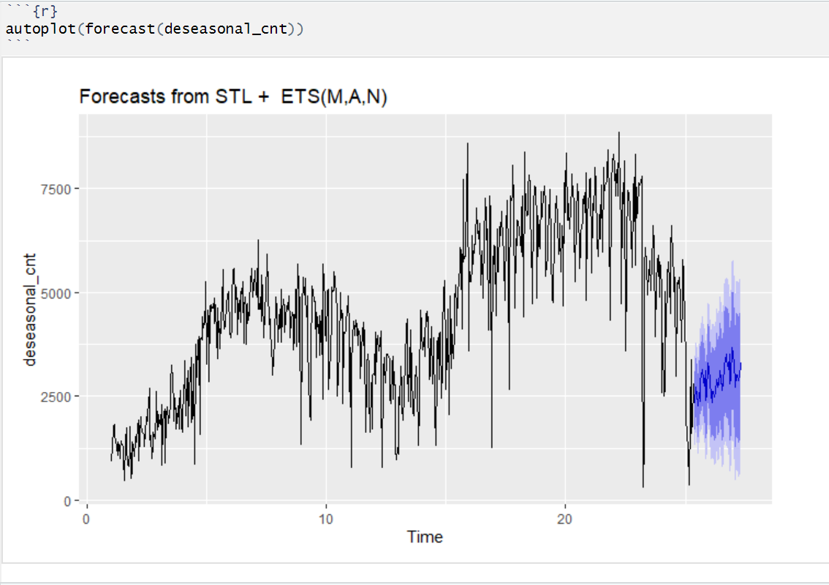
Plot the model with forecasting

Slide 44
Extra resources
https://people.duke.edu/~rnau/Slides_on_ARIMA_models--Robert_Nau.pdf
https://blogs.oracle.com/datascience/introduction-to-forecasting-with-arima-in-r
https://datascienceplus.com/time-series-analysis-using-arima-model-in-r/

