Slide 1

Welcome to Psy 653 Lab!
Module 07: Time series and the analysis of longitudinal data
*Thanks to Gemma Wallace for her help with these slides

Slide 2
Class Example
A research team is interested if student performance in coding skills increased over time during a coding class. During each week of the program, all participants completed a coding challenge. Each challenge had a set of coding skills that had to be employed to solve the challenge, but each challenge focused on solving some substantive problem (e.g., mapping social networks of users on an online forum, developing an algorithm to recommend new music based on a user’s Spotify history, etc.). Each student’s performance on the challenge was graded by the research team using a valid and reliable rubric able to detect growth in skills over time.
This dataset was provided by Kim Henry, PhD.

Slide 3
Variables
kid_id: Subject ID
week: Week in program (0-6)
perform: Performance grade (scaled from 1-10)

Slide 4
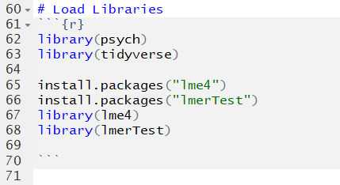
Load & install packages

Slide 5
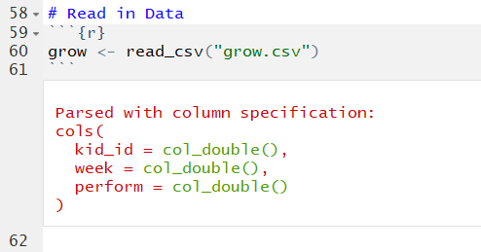
Read in Data

Slide 6
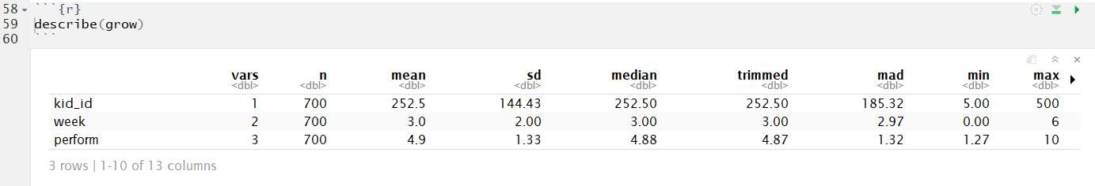
Describe the data

Slide 7
Describe the data
Remember this number! This is called the “Mean of Means”

Slide 8
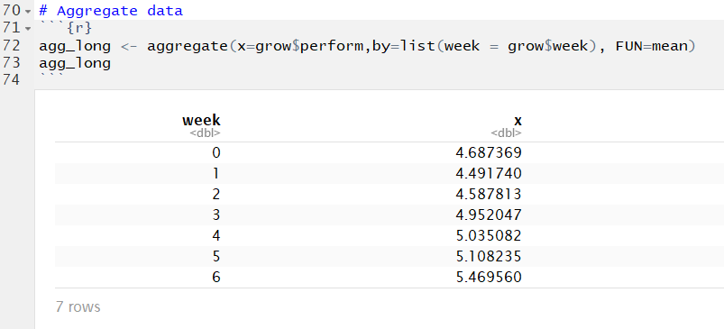

Slide 9
Mean of Means = 4.9

Slide 10
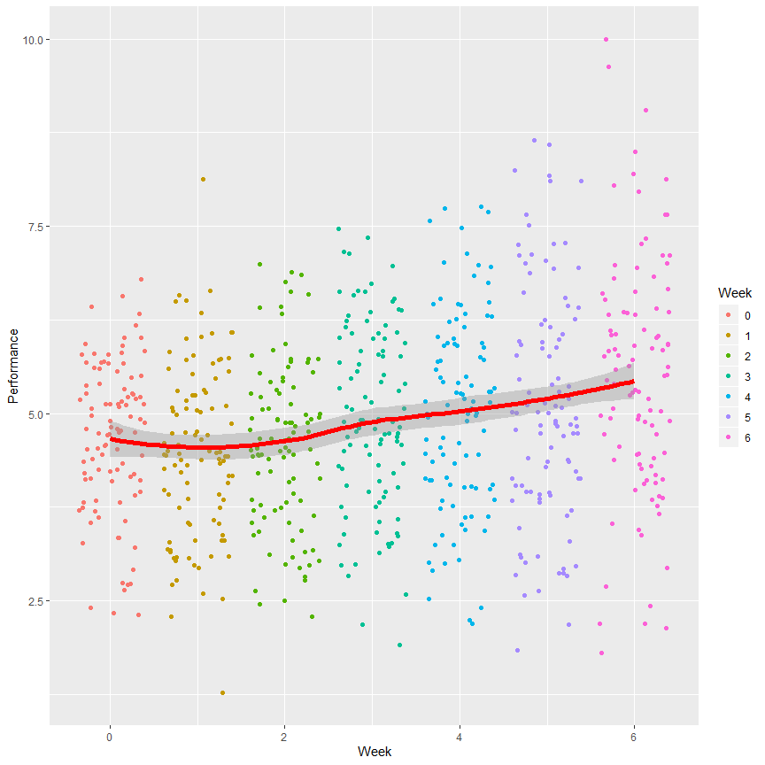
Visualize the data!
```{r, fig.width=9, fig.height=9}
ggplot(grow, aes(x = week, y = perform)) +
geom_jitter(aes(color = factor(week))) +
geom_smooth(method = "loess", color = "red", size = 2) +
xlab("Week") +
ylab("Performance") +
labs(color = "Week")
```

Slide 11
Based on this plot, do you think you have justification to test for a linear effect of time on GPA?
What about a quadratic effect?

Slide 12
Visualize each individual subject!
```{r, fig.height = 12, fig.width=12}
ggplot(data = grow, aes(x = week, y = perform)) +
geom_point() +
geom_smooth(method = "lm", se = FALSE) +
scale_y_continuous(limits = c(0,10)) +
scale_x_continuous(limits = c(0,6), breaks = c(0,1,2,3,4,5,6)) +
facet_wrap(~kid_id) +
labs(title = "Do students in the control condition improve their task performance over the course of the program?",
x = "Week in the program", y = "Task Performance")
```

Slide 13
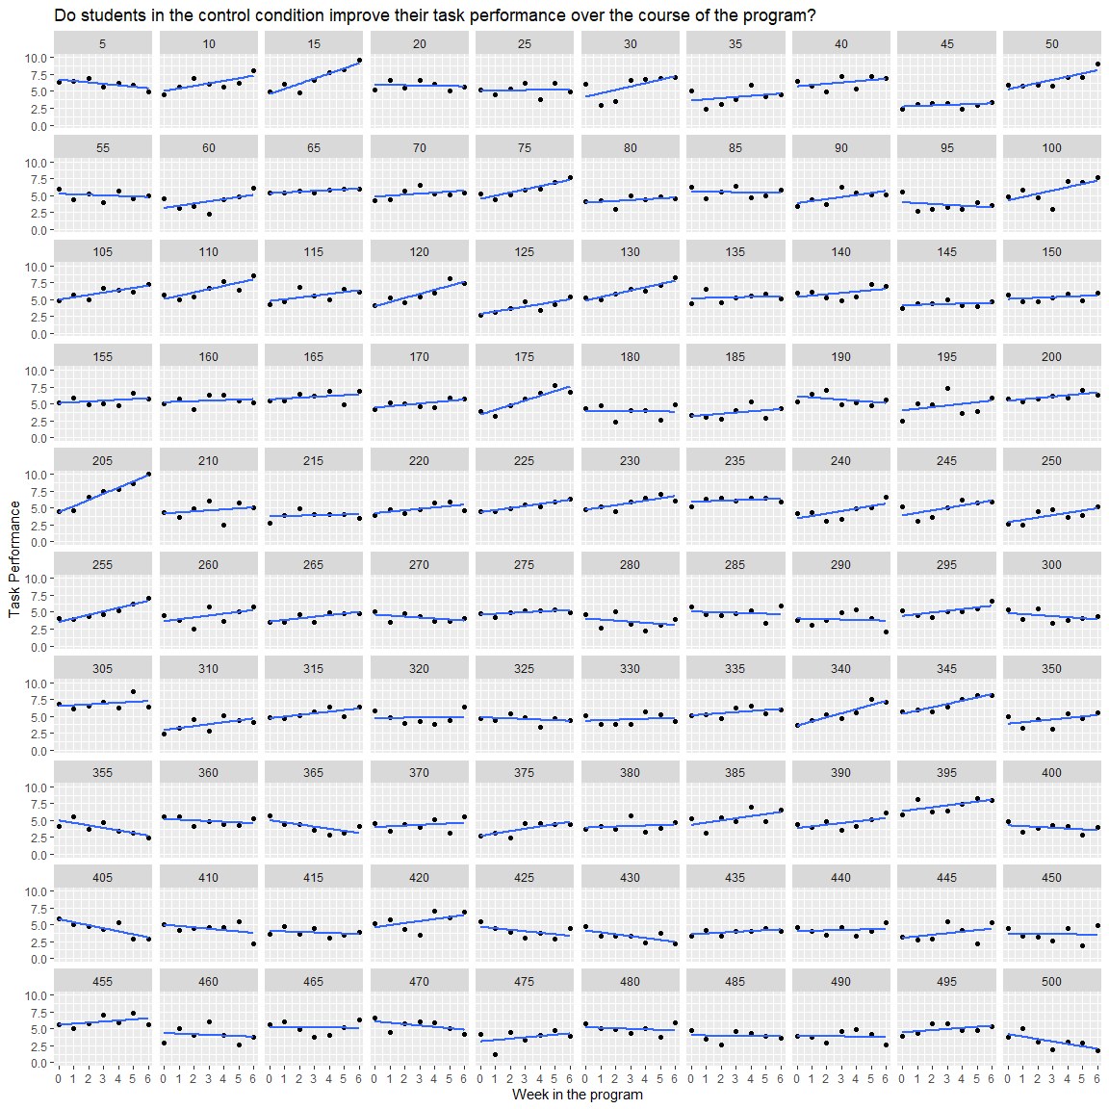
Average Intercept = 4.47
Average Slope = 0.14

Slide 14
Average Intercept = 4.47
Average Slope = 0.14
Remember these numbers!

Slide 15
Defining fixed and random effects in the lmer package
These definitions are a little different in longitudinal analyses than in ANOVAs.
Fixed effect = does not vary over subjects of groups – average value of slope or intercept
Random effect = might vary across subjects or groups – intercepts and slopes might be calculated for each group or each subject to see if they vary meaningfully

Slide 16

Build Baseline model

Slide 17
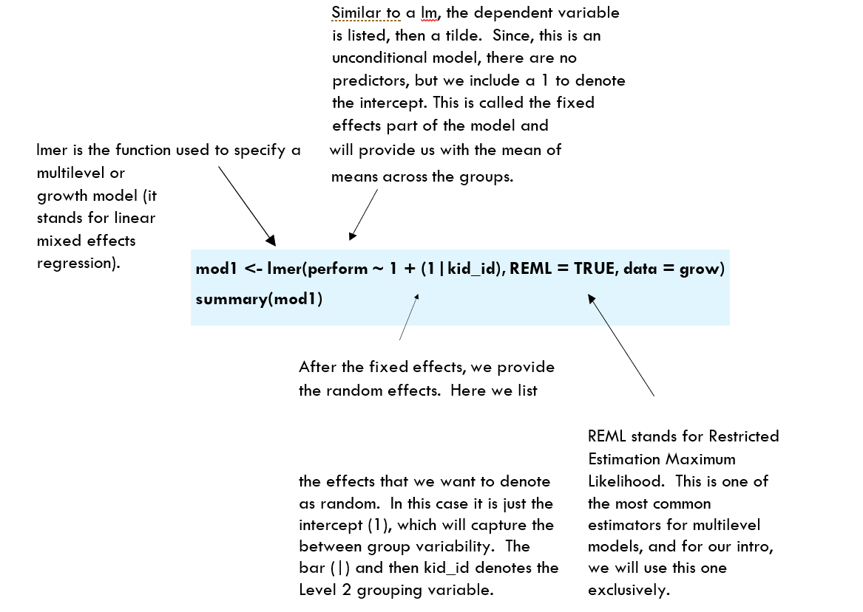
Ⓒ Kim Henry

Slide 18
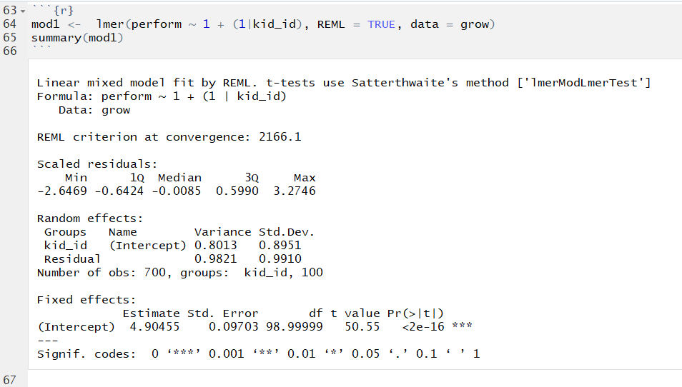

Slide 19
Random intercept: On average, kids vary from the grand mean by .895 standard deviations
Fixed Intercept: In the absence of any fixed effects, this intercept represents the “mean of means” of our outcome variable.

Slide 20
Add week as a fixed and random effect

Slide 21
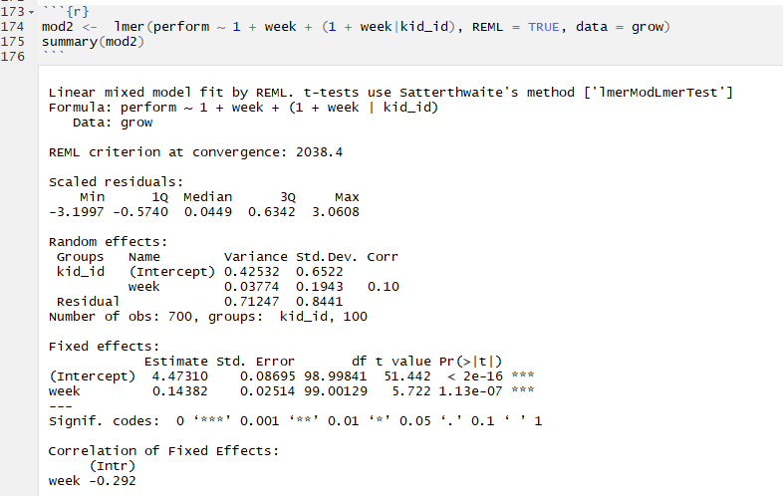

Slide 22
Random Intercept: On average, subject intercepts vary by 0.652 standard deviations
Random Slope: On average, subject slopes vary by 0.194 standard deviations
Fixed Intercept: The average intercept, while incorporating week, is 4.473
Fixed Slope: On average, subject scores increased at a rate of 0.144 units

Slide 23
ICC Calculation
ICC = σ²_{RandomEffect} / σ²_{RandomTotal}
ICC = .0377 / (.0377 + .7124)
ICC = .05028
There is only a small amount of variation in slopes across subjects (ICC = .050)

Slide 24
One final plot (Optional)
```{r, fig.width=12, fig.height=8}
# add_predictions comes from the modelr package
install.packages(“modelr”)
library(modelr)
# Get predicted values
mod2.plot <- add_predictions(data = grow, model = mod2)
# Make plot
ggplot(data = mod2.plot, aes(x = week, y = pred, group = kid_id)) +
geom_line(color = "grey53") +
geom_abline(intercept = 4.4731, slope = .1438, color="red", size=3) +
scale_y_continuous(limits = c(0,10)) +
scale_x_continuous(limits = c(0,6), breaks = c(0,1,2,3,4,5,6)) +
labs(title = "Do students improve on task performance over the course of the program?",
x = "Week", y = "Predicted Performance") +
theme_bw()
```

Slide 25
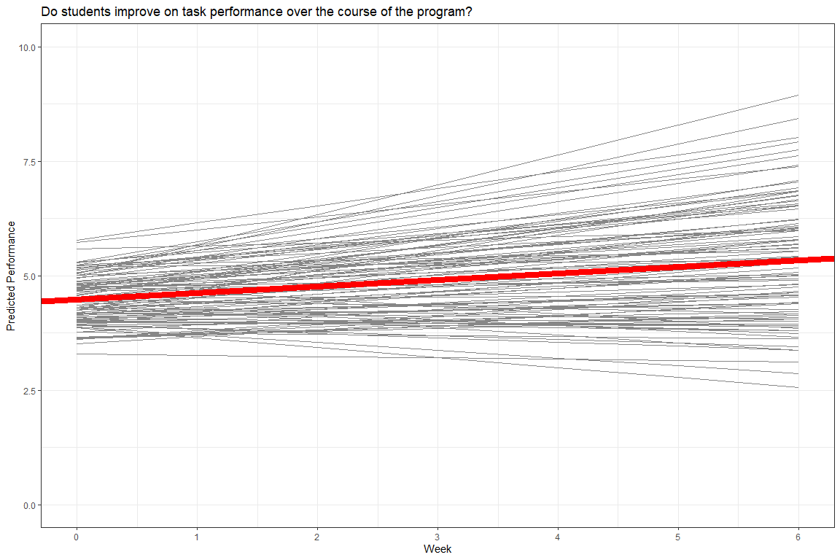

Slide 26
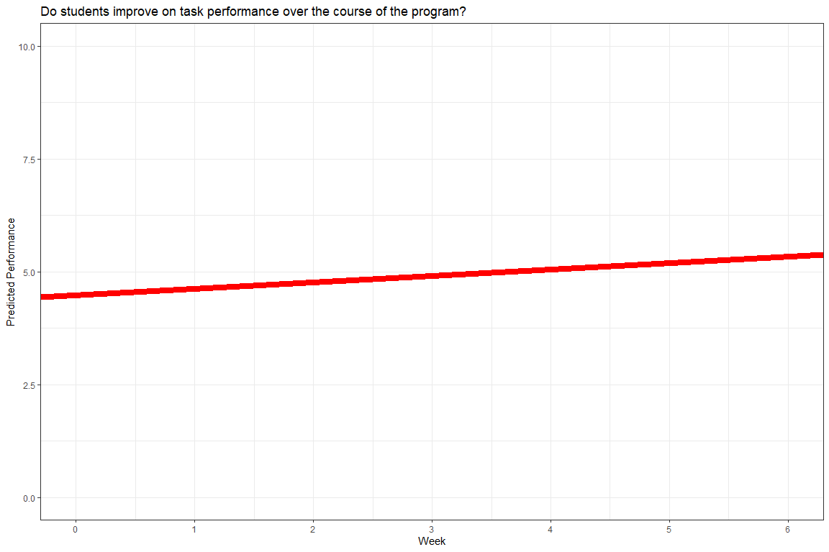
FIXED EFFECTS
Slope = 0.14
Intercept = 4.47

Slide 27
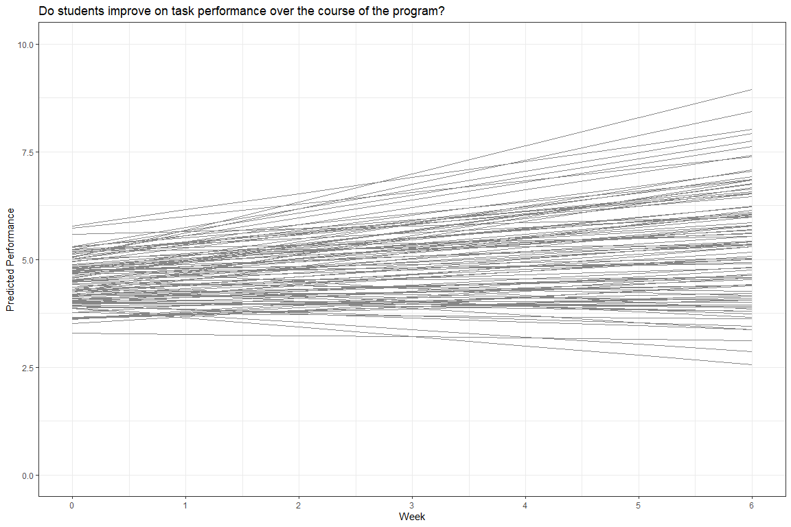
RANDOM EFFECTS
Intercept variance = .43 (.65 SD)
Slope variance = .04 (.19 SD)

