Slide 1

Welcome to Psy 653 Lab!
Module 08: Random coefficients model

Slide 2
Objectives
Quick overview of random coefficient modeling
Dataset description
Load in data
Learn to pivot data from a wide format to long format
Visualize data
Model data

Slide 3
Random coefficient modeling
The first step to understanding multilevel modeling
Random coefficient modeling utilizes Maximum Likelihood (ML) Estimation
  This is in contrast to Ordinary Least squares (OLS) which we have been using previously

Slide 4
Defining fixed and random effectS
These definitions are a little different in multilevel analyses than in ANOVAs.
Fixed effect = does not vary over subjects of groups – average value of slope or intercept (i.e., what is the estimate of the effect across all of the groups?)
Random effect = might vary across subjects or groups – intercepts and slopes might be calculated for each group or each subject to see if they vary meaningfully (i.e., how much does the estimate for the effect vary across the groups?)

Slide 5
Class Example
A research team is interested if student performance in coding skills increased over time during a coding class. During each week of the program, all participants completed a coding challenge. Each challenge had a set of coding skills that had to be employed to solve the challenge, but each challenge focused on solving some substantive problem (e.g., mapping social networks of users on an online forum, developing an algorithm to recommend new music based on a user’s Spotify history, etc.). Each student’s performance on the challenge was graded by the research team using a valid and reliable rubric able to detect growth in skills over time.
This dataset was provided by Kim Henry, PhD.

Slide 6

Create a new
R-Project and r-notebook!
Download the “mlm_grow.csv” file from Canvas and save it into your R-project file

Slide 7
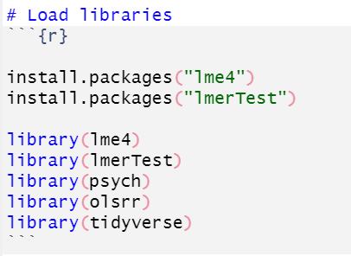

Slide 8
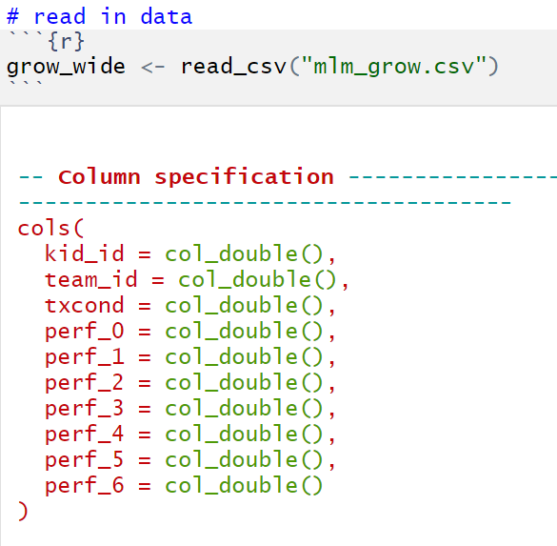
Import data
kid_id: The student’s ID number.
team_id: The team ID of the student.
txcond: The treatment condition, 0 = individual-focused condition, 1 = team-focused condition.
perf_0 - perf_6: Performance on the coding challenge each week of the program, starting at baseline (before the program began (perf_0) and ending at week 6 (perf_6). The score ranges from 0 to 10.

Slide 9
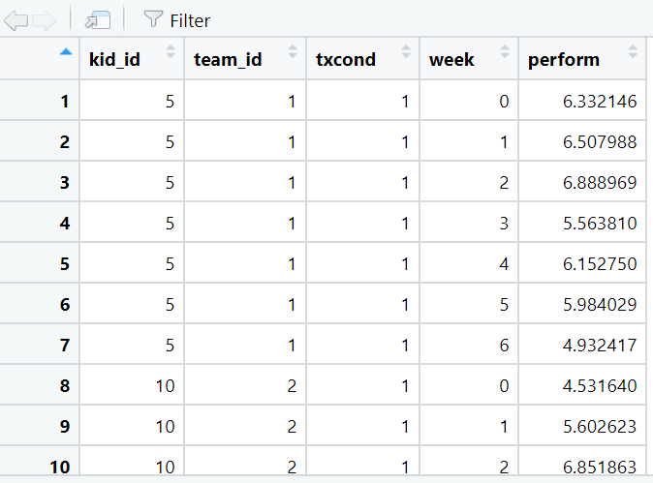
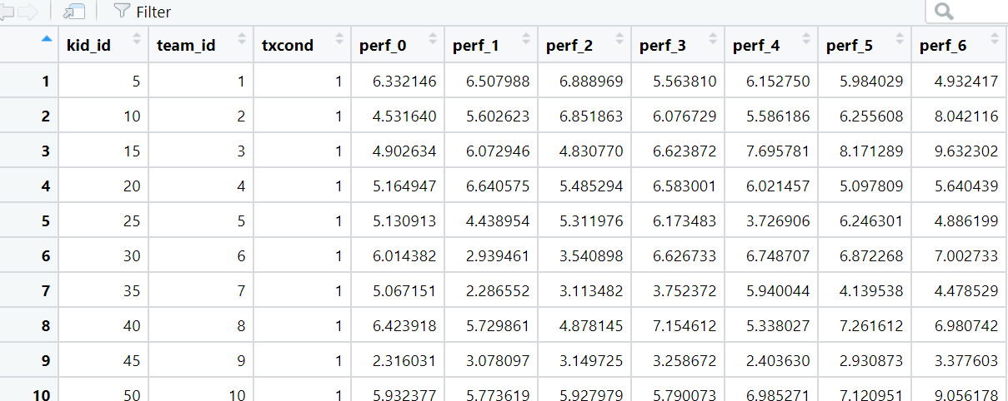
The data is wide, and we want to convert it to long

Slide 10
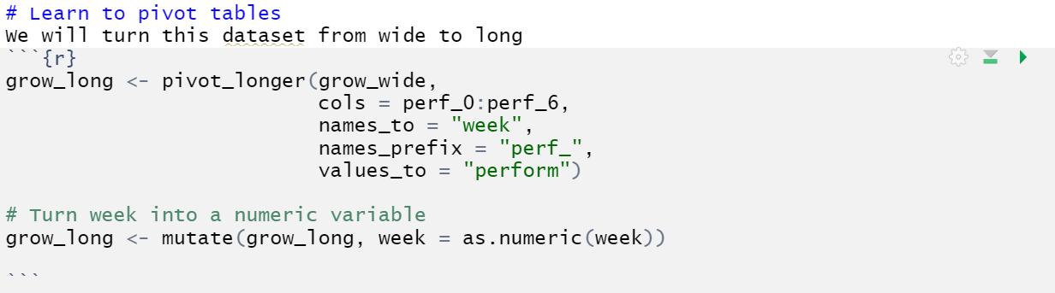
Pivot_longer(): Turns wide datasets to long

Slide 11
Converts week to a numeric variable (Otherwise it will be read as a character variable)
pivot_longer: function
grow_wide: dataset name
cols = perf_0:perf_6: columns to convert to long (A colon indicates take all the variables inbetween)
names_to: “week”: what to name the column that the variable names go to.
names_prefix = “perf_”: remove the prefix of “perf_” from the names column
values_to = “perform”: what to name the values column

Slide 12
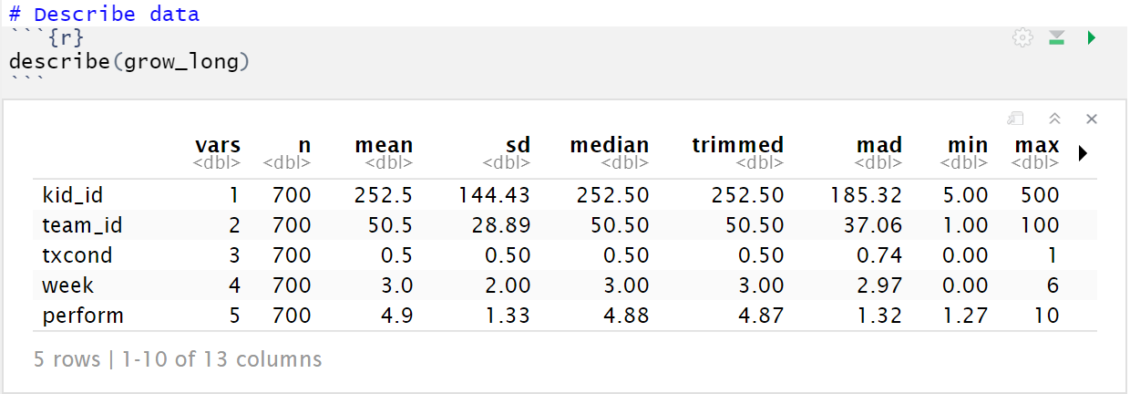

Slide 13
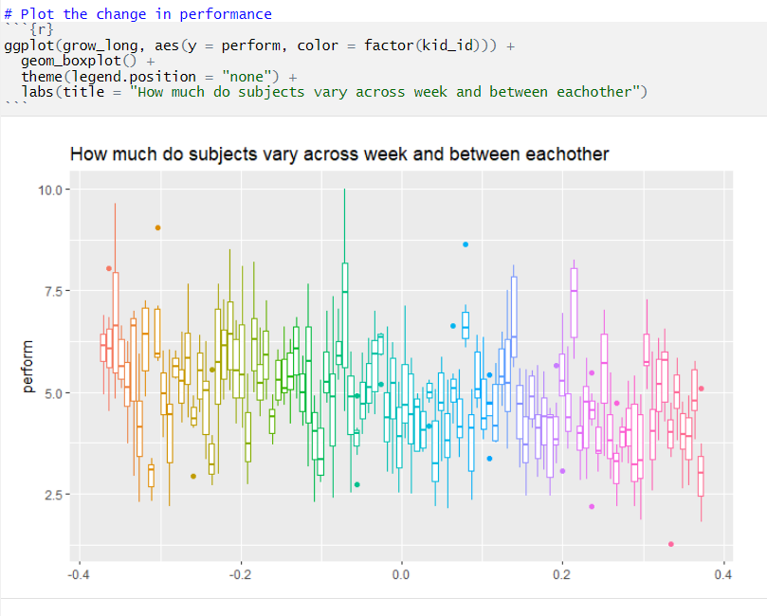
Visualize the amount of variation between participants

Slide 14
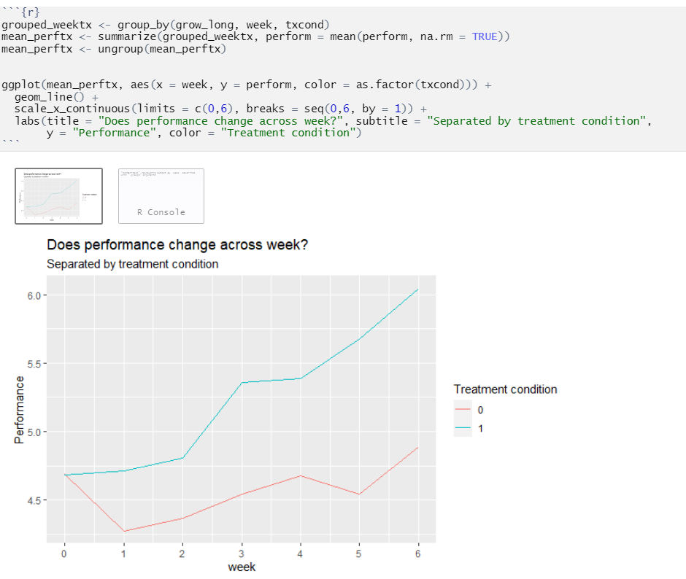
Visualize the data –- By Treatment group

Slide 15
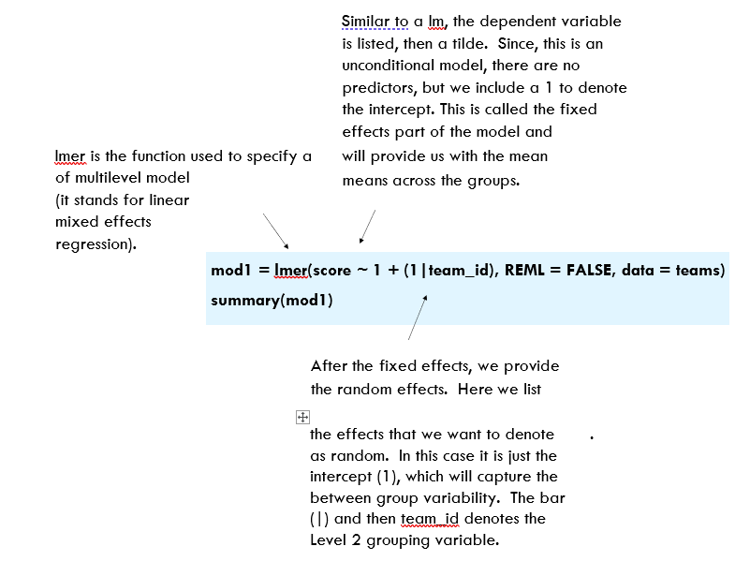
The lmer() function
© Kim Henry

Slide 16
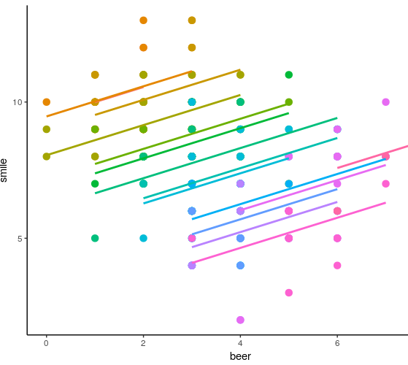
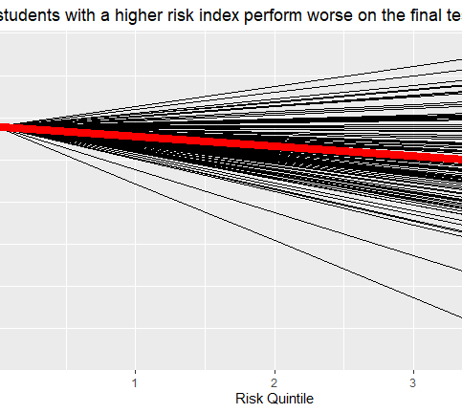
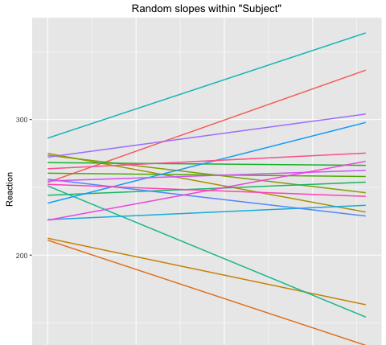
Random intercept, random slope
Random Intercept Model
Random slope Model
Random Intercept and slope Model

Slide 17
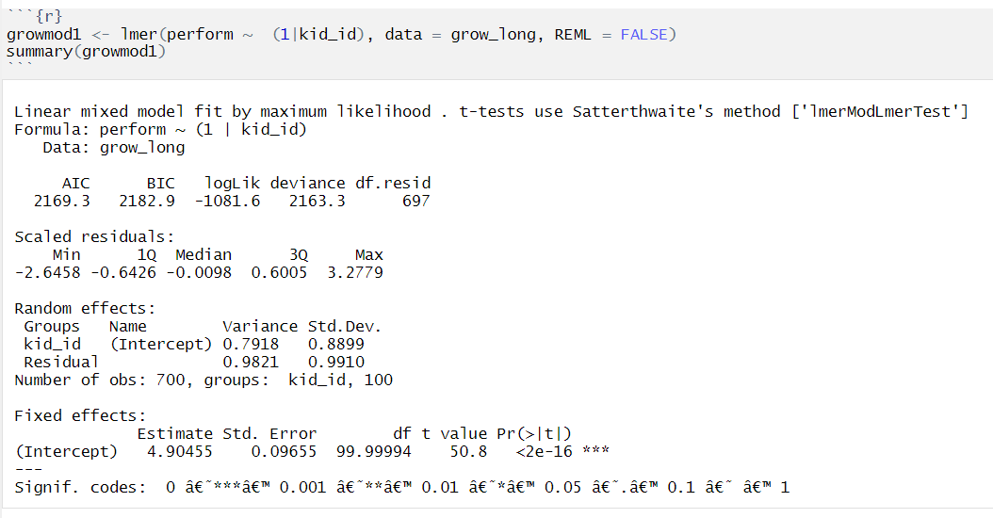
Model 1: random intercept only

Slide 18
Model 1: random intercept only
On average, kid intercepts vary by .8899 std. deviations
In the absence of fixed effects, this is the Grand Mean

Slide 19
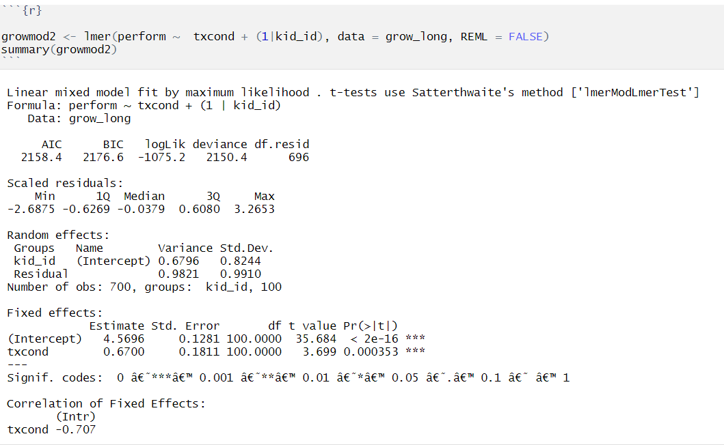
Model 2: random intercept and fixed slope

Slide 20
Model 2: random intercept and fixed slope
On average, while incorporating txcond, the intercept varies by .8244 std. deviations
Average intercept for kids in txcond = 0
Average change of moving from txcond = 0 to txcond = 1

Slide 21
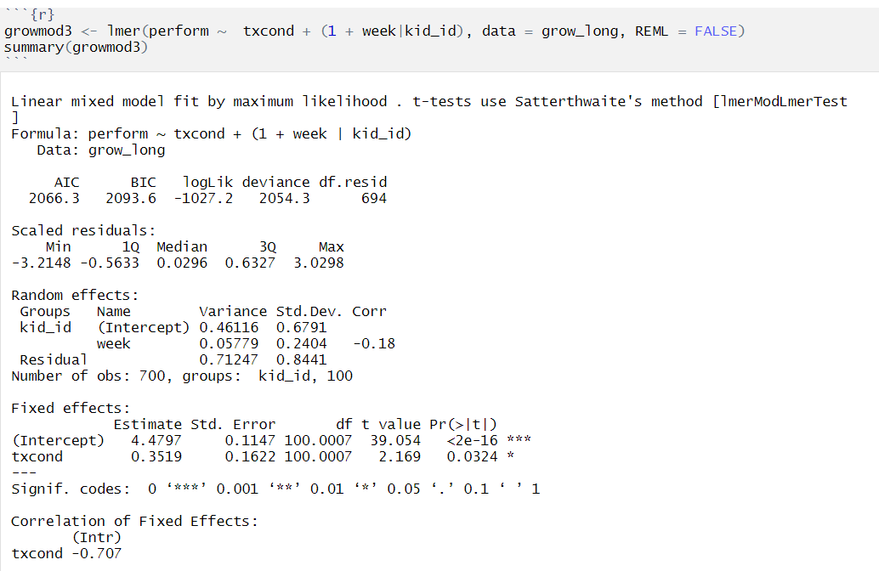
Model 3: random intercept, Random slope, and fixed slope

Slide 22
Model 3: random intercept, Random slope, and fixed slope
On average, while incorporating txcond, and week the intercept varies by .6791 std. deviations
On average, slopes differ by an average of .2404 std. deviations
Average intercept for kids in txcond = 0
Average change of moving from txcond = 0 to txcond = 1

Slide 23
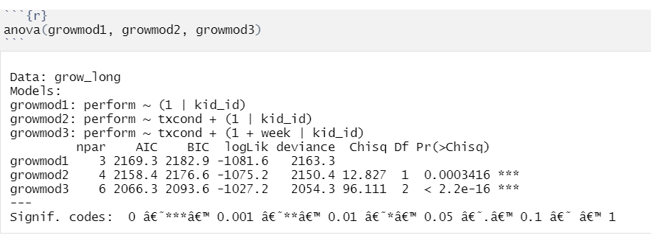
Compare models

