Slide 1

Welcome to Psy 653 Lab!
Module 09: Multilevel modeling
*Thanks to Gemma Wallace for her help with these slides

Slide 2
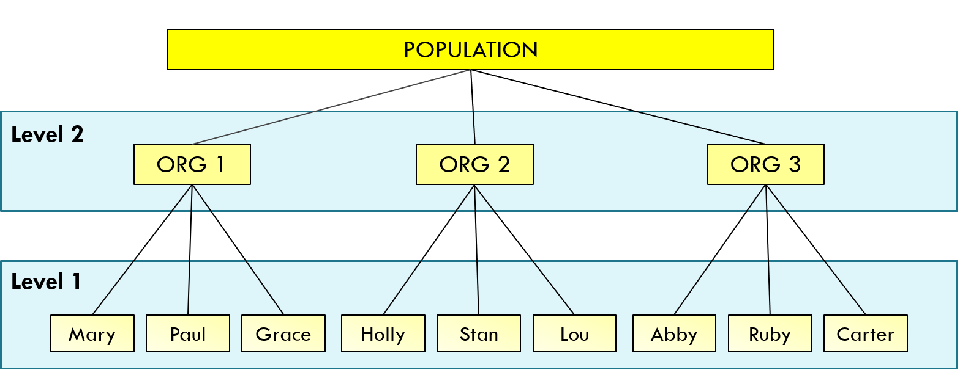
Multilevel modeling
A multilevel model (also commonly called a random effects model, a mixed effects model, and a hierarchical linear model) is used to model hierarchical data. In data that arise from a hierarchical design, the upper level units (e.g., organizations) are selected from the population. Then, cases (e.g., employees) are selected from within these upper level units. In this way, employees (Level 1 of the hierarchy) are nested in organizations (Level 2 of the hierarchy).
©️ Kim Henry

Slide 3

Create a new R-Project and r-notebook!
Download the “mlm_teams.csv” file from Canvas and save it into your R-project file

Slide 4
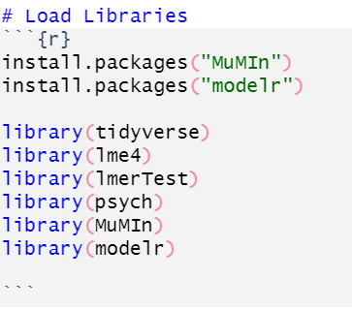
Load Libraries
We’ll use the lme4 package to conduct multilevel models
We’ll use the MuMIn package to calculate model pseudo R² values
We’ll use the modelr package to build cool optional plots

Slide 5
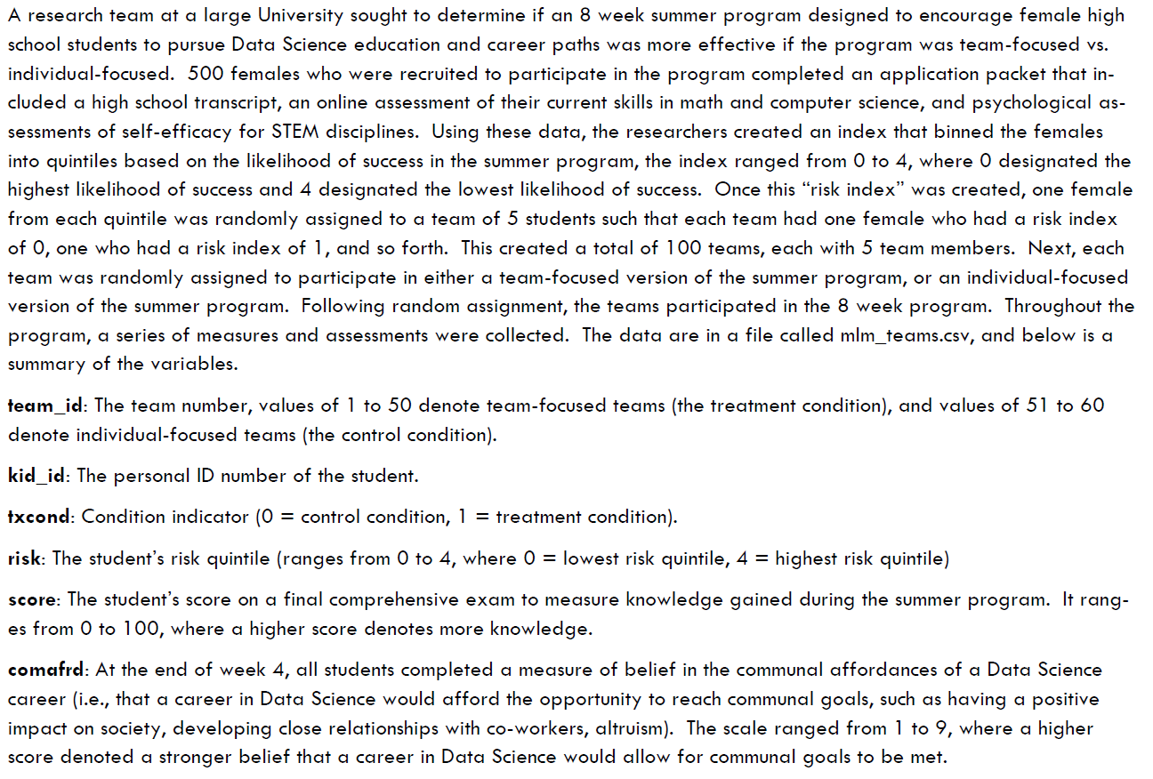
Dataset Description
Dataset courtesy of Dr. Kim Henry

Slide 6
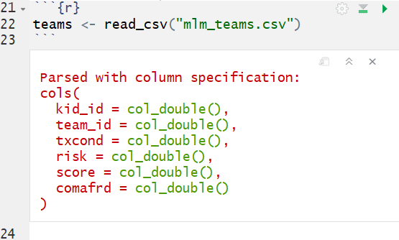
Read in data

Slide 7
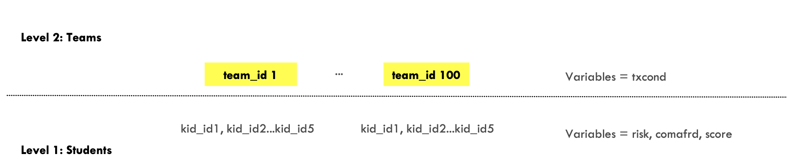
Structure of the data
Level 1 variables are nested within Level 2 variables
©️ Kim Henry
Level 1 variables: individual level = each student’s id number (kid_id), risk index (risk), belief in communal affordances of STEM career (comafrd), and final exam score (score)
Level 2 variables: upper/group level = each student’s team number (team_id), the treatment condition the team was assigned to (txcond)

Slide 8
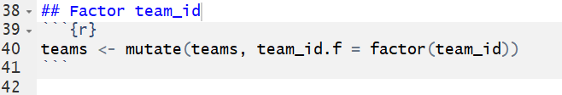
Before running analyses, we need to factor our categorical variables

Slide 9
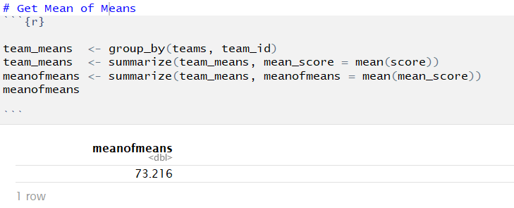
Get Mean of Means
We saved this value as the object “meanofmeans”, which we’ll use in upcoming figures, and we’ll see again in some model output

Slide 10
Visualize how final scores varied across the teams
ggplot(data = teams, aes(x = team_id.f, y = score)) +
geom_boxplot() +
stat_summary(aes(y = score, group = team_id.f), fun = mean, color = "red", geom = "point", pch = 17, size = 1.5) +
geom_hline(yintercept = meanofmeans$meanofmeans, linetype="dashed", color = "black", size = 1) +
scale_y_continuous(limits = c(20,100), breaks = seq(20, 100, 10)) +
labs(title = "Mean and variability of final scores across teams",
subtitle = "dashed line = mean of team means, red triangle = team mean",
x = "Team ID", y = "Final Score") +
theme(axis.text.x = element_text(colour="grey20", size=8, angle=90, hjust=.5))
(Note: this plot is optional for the try-it-yourself activity, but recommended for extra ggplot practice!)

Slide 11
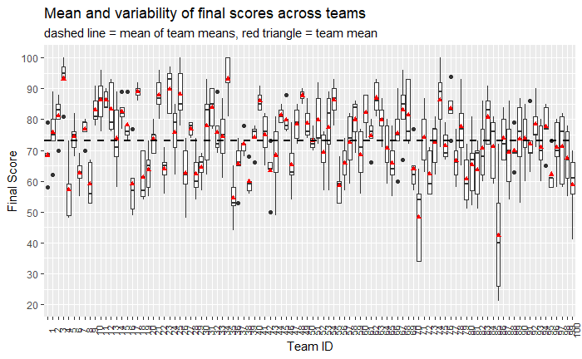
Visualize how final scores varied across the teams
Notice all of the variability between & within Teams.

Slide 12
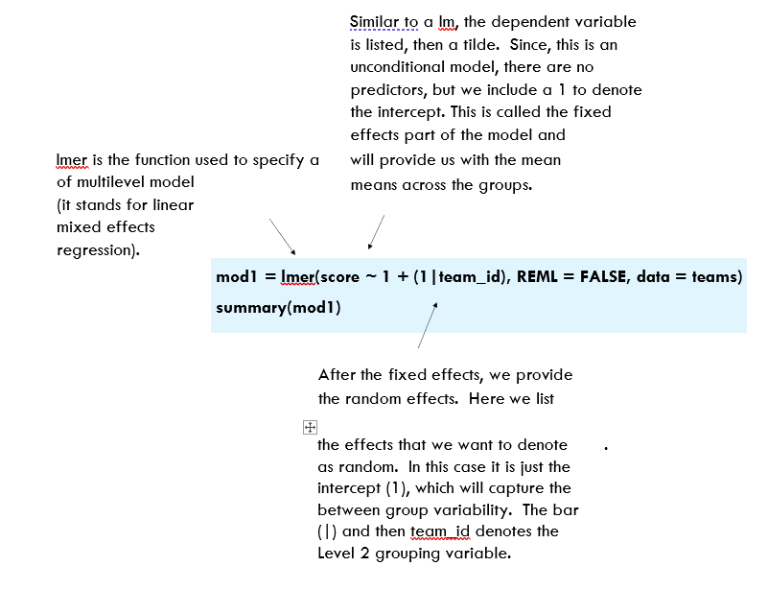
The lmer() function
© Kim Henry

Slide 13
Defining fixed and random effects in the lmer package
These definitions are a little different in multilevel analyses than in ANOVAs.
Fixed effect = does not vary over subjects of groups – average value of slope or intercept (i.e., what is the estimate of the effect across all of the groups?)
Random effect = might vary across subjects or groups – intercepts and slopes might be calculated for each group or each subject to see if they vary meaningfully (i.e., how much does the estimate for the effect vary across the groups?)

Slide 14
Useful effect sizes in multilevel modeling
Intraclass correlation (ICC): the proportion of variance in a Level 1 variable (i.e., individual-level variable) that is accounted for by a Level 2 variable (i.e, between-group differences)
Another way to interpret ICC: the average correlation of a Level 1 variable between two individuals in the same Level 2 group.
ICC > 0.2 generally indicates a meaningful Level 2 effect, ICC > 0.05 is worth further investigation
The ICC is calculated by dividing the random effect variance by the total variance (i.e. the sum of the random effect variance and the residual variance)

Slide 15
Useful effect sizes in multilevel modeling
Pseudo R² values: will not be comparable to OLS R² values on same data
Marginal R² = amount of variance explained in Y by fixed effects only
Conditional R² = amount of variance explained in Y by fixed and random effects

Slide 16
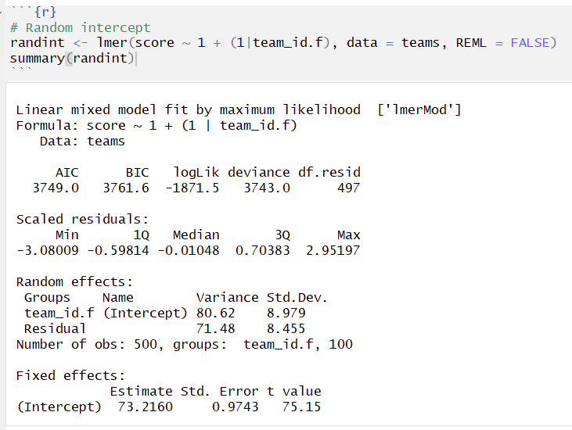
Model 1: Random intercept only
Mean of Means

Slide 17
Model 1: Random intercept only
Random intercept: On average, the mean of each team varies from the grand mean by 8.979 standard deviations
Fixed Intercept: In the absence of any fixed effects, this intercept represents the “mean of means” of our outcome variable.

Slide 18
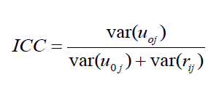
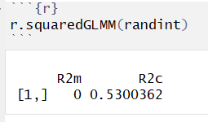
Model 1: Random intercept only
Calculate ICC & Pseudo R²
ICC = 80.62 / (80.62 + 71.48)
ICC = .53
R2m (Marginal R²): NA, no fixed effects in this model
R2c (Conditional R²): 53% of the variance in scores can be explained by the model’s fixed and random effects
53% of the variance in final test scores can be attributed to differences between teams.
Notes:
Marginal R^2 = fixed effects
Conditional R^2 = fixed + random effects

Slide 19
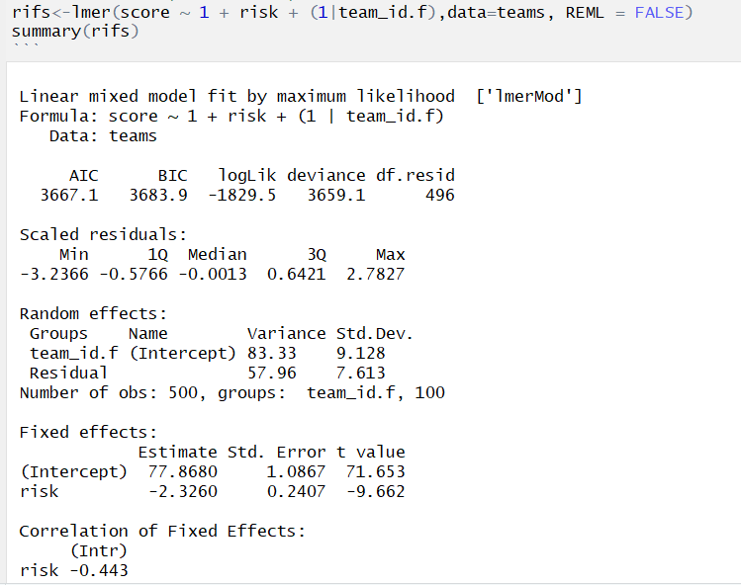
Model 2: Random Intercept, Fixed Slope
Here, we added risk as a fixed level 1 predictor
Random Intercept: On average, team intercepts vary by 9.128 standard deviations
Fixed Intercept: The average intercept, while incorporating risk, is 77.868
Fixed Slope: On average, team scores decreased at a rate of 2.326 units for a 1-unit increase in risk

Slide 20
Plot: Random Intercept, Fixed Slope
# Model without random slope
mod2_b.plot <- add_predictions(data = teams, model = rifs)
ggplot(data = mod2_b.plot, aes(x = risk, y = pred, group = team_id.f)) +
geom_line() +
geom_abline(intercept = 77.868, slope = -2.326, color="red", size=3) +
labs(title = "Do students with a higher risk index perform worse on the final test?", x = "Risk Quintile", y =
"Predicted Final Score")

Slide 21
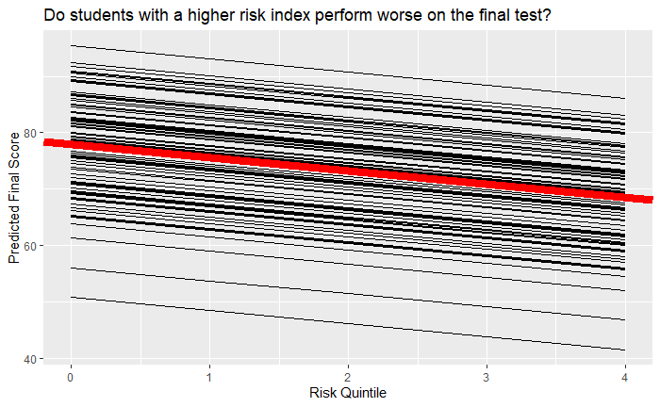
Plot: Random Intercept, Fixed Slope
Notice the slopes are all exactly the same.
Red line = Fixed Effects

Slide 22
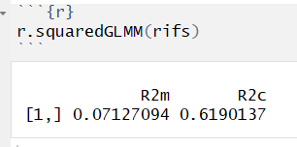
Calculate ICC & Pseudo R²
Model 2: Random Intercept, Fixed Slope
ICC = 83.33 / (83.33 + 57.96)
ICC = .59
R2m (Marginal R²): 7% of the variance in scores can be explained by the model’s fixed effects
R2c (Conditional R²): 62% of the variance in scores can be explained by the model’s fixed and random effects
59% of the variance in final test scores can be attributed to differences between teams.

Slide 23
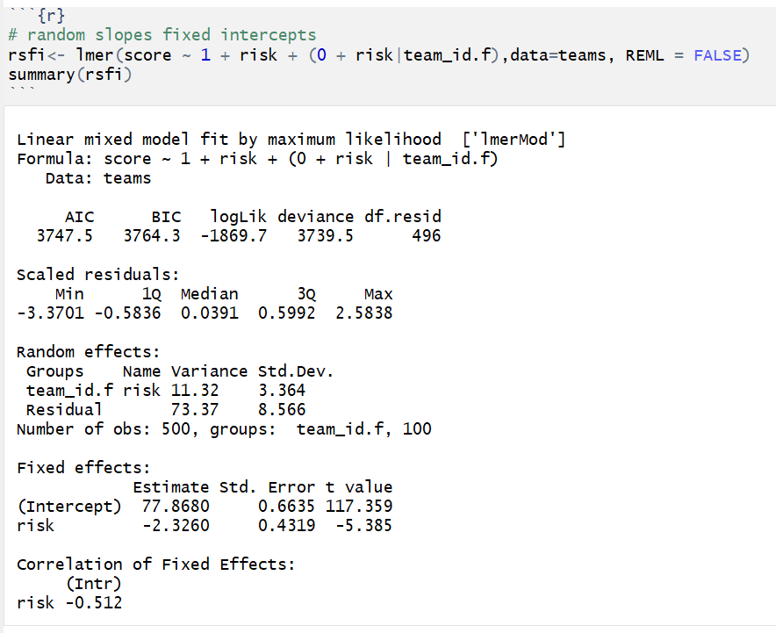
Model 3: Random Slope, Fixed Intercept

Slide 24
Model 3: Random Slope, Fixed Intercept
Here, we plug in a 0 to our random effects to indicate the intercept is fixed.
Random Slope: On average, team slopes vary by 3.364 standard deviations
Fixed Intercept: The average intercept, while incorporating risk, is 77.868
Fixed Slope: On average, team scores decreased at a rate of 2.326 units for a 1-unit increase in risk

Slide 25
Plot: Fixed Intercept, Random slope
# Model without random intercept
mod2_b.plot <- add_predictions(data = teams, model = rsfi)
ggplot(data = mod2_b.plot, aes(x = risk, y = pred, group = team_id.f)) +
geom_line() +
geom_abline(intercept = 77.868, slope = -2.326, color="red", size=3) +
labs(title = "Do students with a higher risk index perform worse on the final test?", x = "Risk Quintile", y =
"Predicted Final Score")

Slide 26
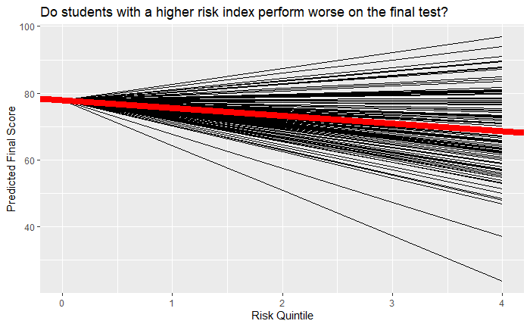
Plot: Fixed Intercept, Random slope
Notice all slopes come from the same intercept
Red line = Fixed Effects

Slide 27
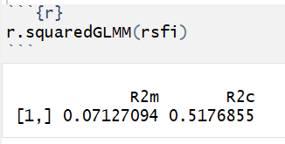
Calculate ICC & Pseudo R²
Model 3: Random Slope, Fixed Intercept
ICC = 11.32 / (11.32 + 73.37)
ICC = .13
R2m (Marginal R²): 7% of the variance in scores can be explained by the model’s fixed effects
R2c (Conditional R²): 52% of the variance in scores can be explained by the model’s fixed and random effects
13% of the variance in final test scores can be attributed to differences between teams.

Slide 28
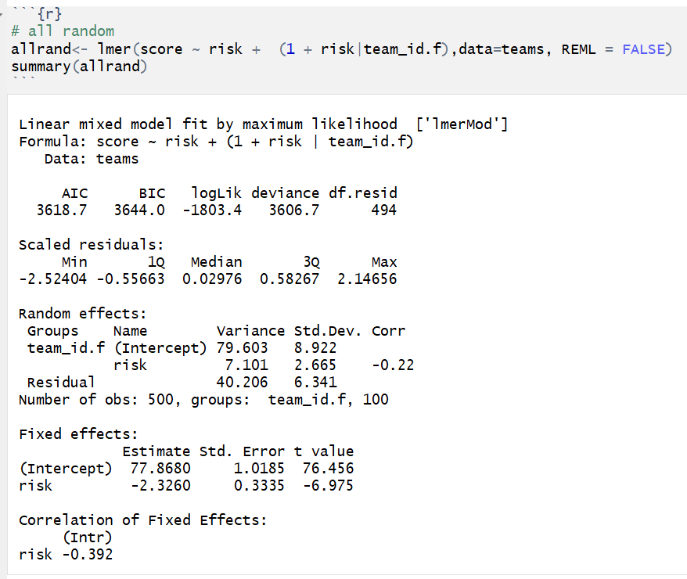
Model 4: All Random

Slide 29
Model 4: All Random
Random Intercept: On average, team intercepts vary by 8.922 standard deviations
Random Slope: On average, team slopes vary by 2.665 standard deviations
Fixed Intercept: The average intercept, while incorporating risk, is 77.868
Fixed Slope: On average, team scores decreased at a rate of 2.326 units for a 1-unit increase in risk

Slide 30
Plot: All random
# Model with random slope & Intercept
mod2_a.plot <- add_predictions(data = teams, model = allrand)
ggplot(data = mod2_a.plot, aes(x = risk, y = pred, group = team_id.f)) +
geom_line() +
geom_abline(intercept = 77.868, slope = -2.326, color="red", size=3) +
labs(title = "Do students with a higher risk index perform worse on the final test?", x = "Risk Quintile", y = "Predicted Final Score")

Slide 31
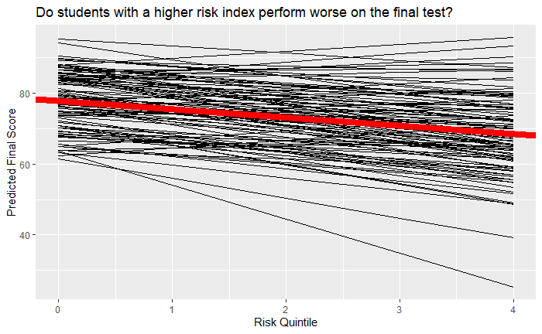
Plot: All random
Notice that all slopes and intercepts are different
Red line = Fixed Effects

Slide 32
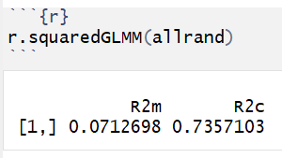
Model 4: All Random
Calculate ICC & Pseudo R²
ICC = (79.60 + 7.21) / (79.60 + 7.21 + 40.21)
ICC = .68
R2m (Marginal R²): 7% of the variance in scores can be explained by the model’s fixed effects
R2c (Conditional R²): 73% of the variance in scores can be explained by the model’s fixed and random effects
68% of the variance in final test scores can be attributed to differences between teams.

Slide 33
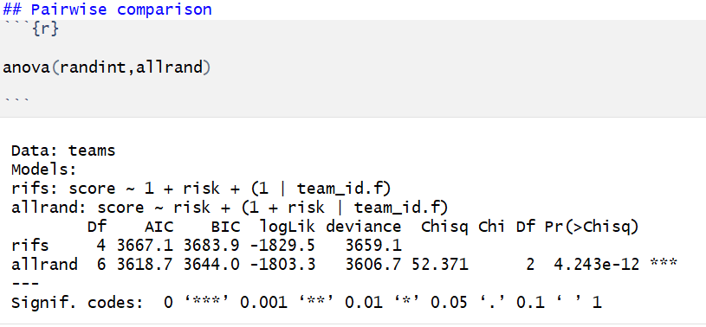
Log likelihood test: Random Intercept-Only vs. All Random
The inclusion of the random effects significantly improves model fit

Slide 34
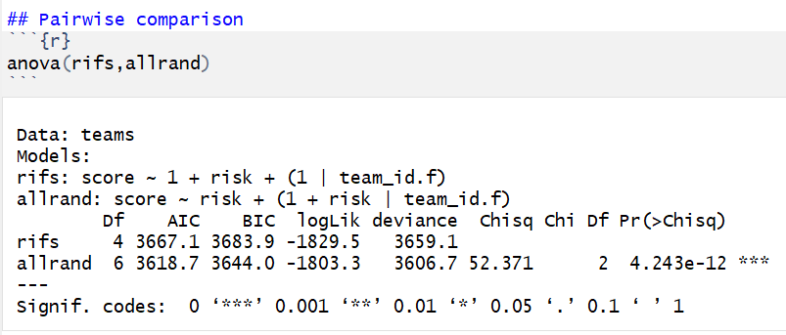
Log likelihood test: Random Intercept Fixed Slope vs. All Random
The inclusion of the random effects significantly improves model fit

Slide 35
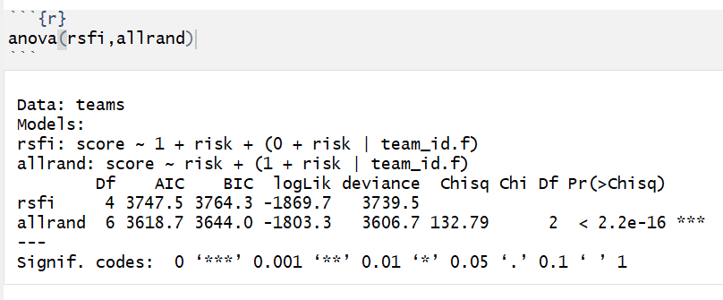
Log likelihood test: Fixed Intercept Random Slope vs. All Random
The inclusion of the random effects significantly improves model fit

