Slide 1

Welcome to Psy 653 Lab!
Module 10: Meta-Analyses & Missing data
*Thanks to Gemma Wallace for her help with these slides

Slide 2
Objectives
Part 1: Meta-Analyses
Part 2: Handling Missing data

Slide 3
Part 1: Meta-Analyses

Slide 4
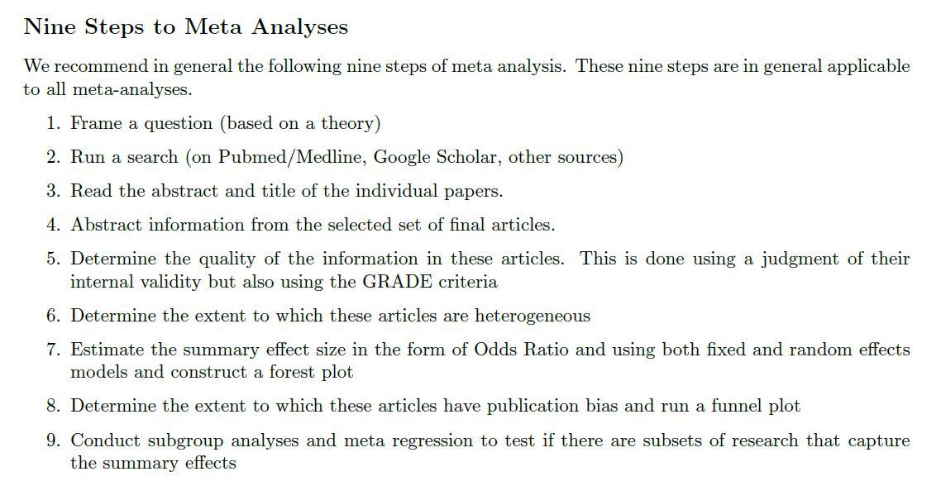

Slide 5
We are here

Slide 6

Create a new R-Project and r-notebook!
Download the “studies.csv” file from Canvas and save it into your R-project file

Slide 7
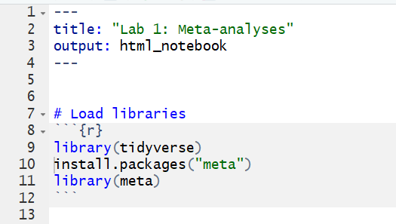
Load Libraries

Slide 8
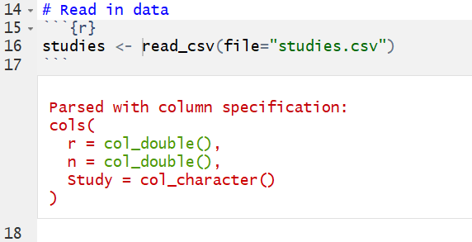
Read in data

Slide 9
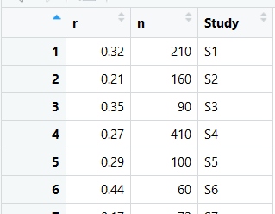
A look at our dataset
r = Study effect size (correlations)
n = Study sample size
Study = Name of study (i.e. Yetz et al., 2003)

Slide 10
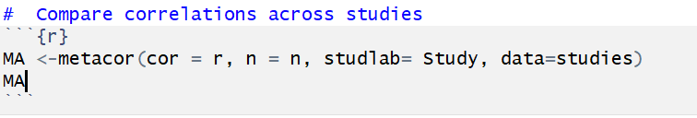
Run the meta analysis with metacor()

Slide 11
Run the meta analysis with metacor()
MA = object
metacor() = function to compare correlations across studies (From meta package)
“cor =” = column that correlations are placed (r)
“n =” = column where sample sizes are placed (n)
“studlab =” = column where study names are placed (Study)
“data =” = dataset where information is stored (studies)

Slide 12
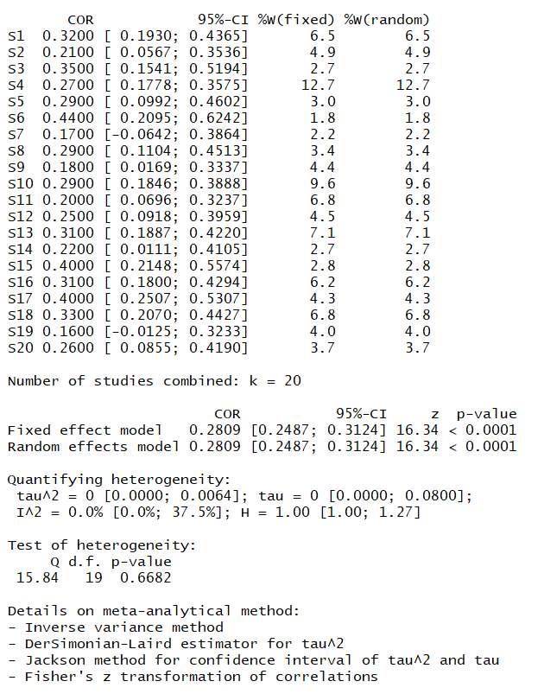
Output!
Weight each study encompasses for both fixed & random effect models.
Weighted average correlation for both fixed & random effects models.
I²: Percentage of total variability due to true heterogeneity across studies. [Hopefully lower than 30%]
Cochran’s Q: The sum of squared deviations of ES estimates from the overall mean value. A significant value is an indicator of heterogeneity [Not good].

Slide 13

Forest Plot with forest()

Slide 14
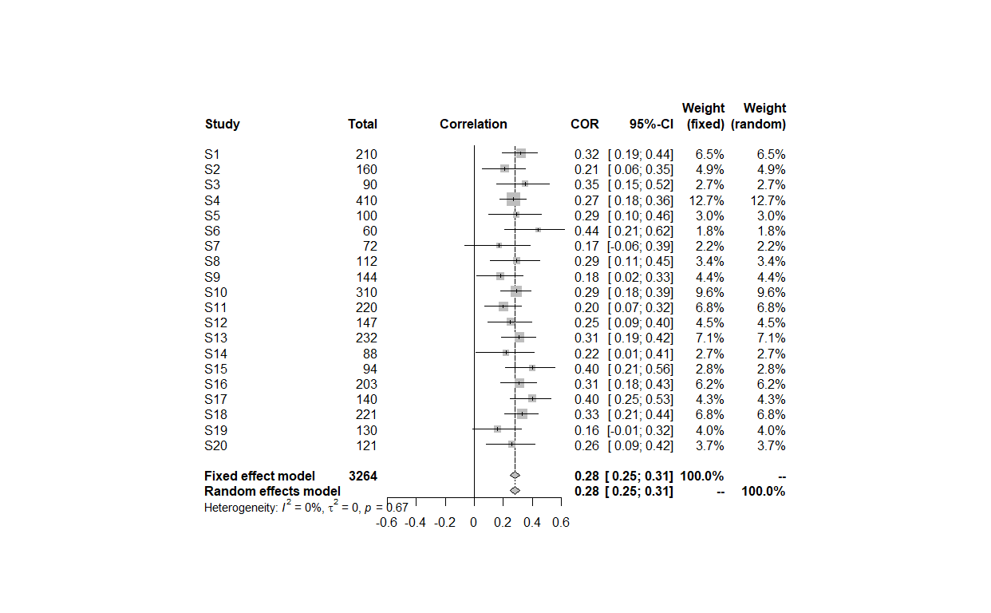
Forest Plot with forest()

Slide 15
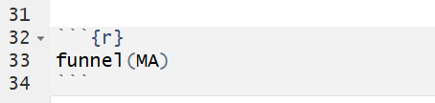
Funnel plot with funnel()

Slide 16
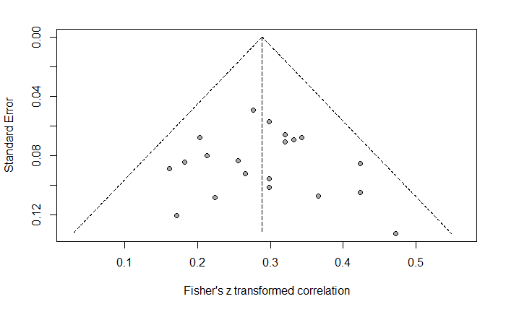
Funnel plot with funnel()

Slide 17
A note on the meta package
The meta package allows you to run many more meta analyses rather than comparing correlations across studies.
You can compare different effect sizes such as Odds ratios (metabin) or Cohen’s d values (metacont) and more!
To read more on the meta package, view the vignette here:
https://cran.r-project.org/web/packages/meta/meta.pdf

Slide 18
Part 2: Handling missing data

Slide 19
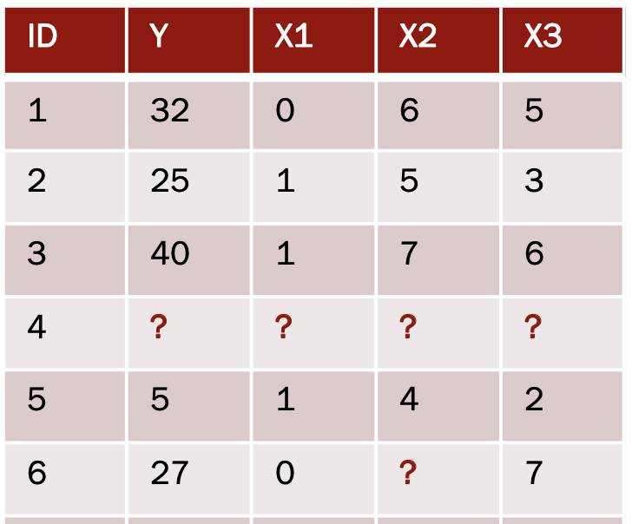
Missing data
Missing data are observations that should be part of your data but aren’t
© Kim Henry

Slide 20
Methods for handling missing data
There are several!
R uses listwise deletion by default
Can lose power and/or bias results
Multiple Imputation by Chained Equations (MICE)
Imputation = substituting missing data with estimated values

Slide 21
MICE Lab Demo
Run a simple linear regression using pairwise deletion, the default in R
Impute dataset’s missing vales using the mice package
Run a simple linear regression in the imputed data
Compare model estimates across missing data techniques

Slide 22
Create a new R-Project and r-notebook!
Download the “mice_data1.csv” file from Canvas and save it into your R-project file

Slide 23
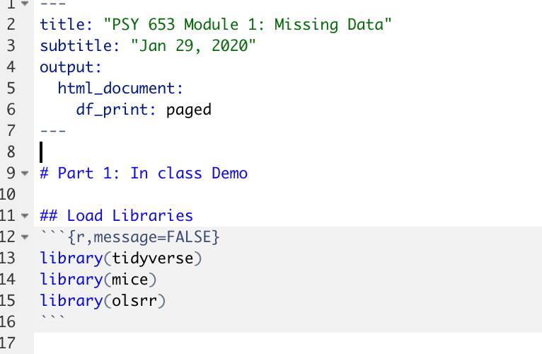
Load Libraries

Slide 24
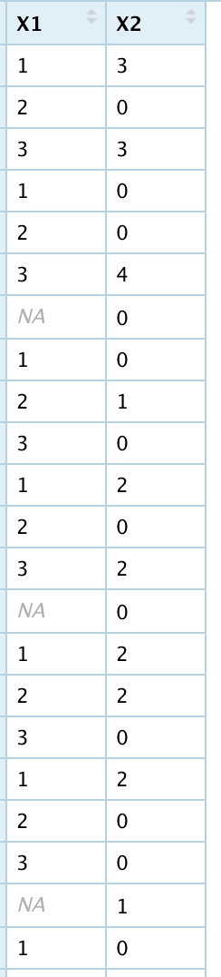
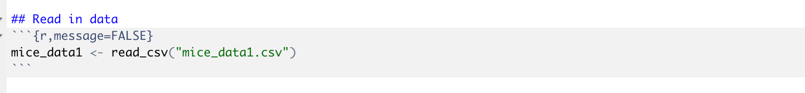
Read in data
This dataset has 2 simulated variables: X1 and X2
X1 has some missing values

Slide 25
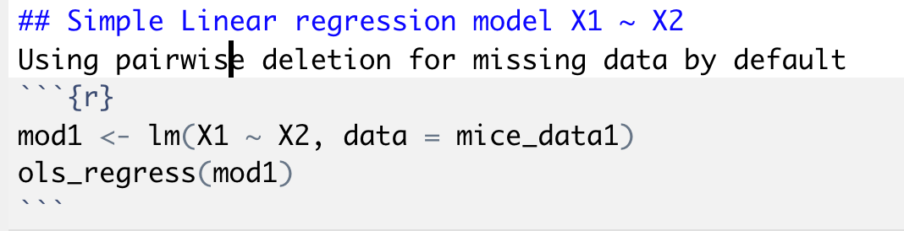
Use a Simple Linear Regression to regress X1 on X2

Slide 26
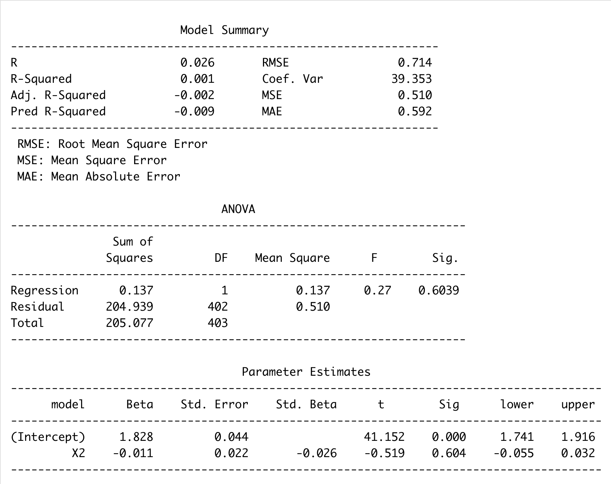
Simple linear regression output with pairwise deletion
We interpret this output as usual
In write-up, would specify “missing data
were handled using pairwise deletion”

Slide 27
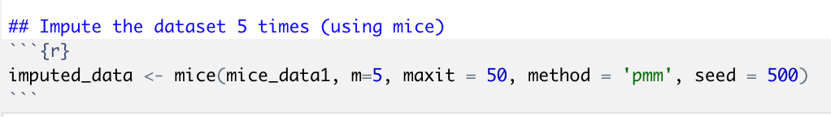
Impute the data with mice
mice_data1 = name of the dataset you are imputing
m = # of imputations (# of imputed versions of the dataset you will create)
maxit = number of iterations for each imputation (default is 5, generally do more)
method = pmm = “Predictive Mean Matching”
seed = specifying a # will allow you to get the same results each time

Slide 28
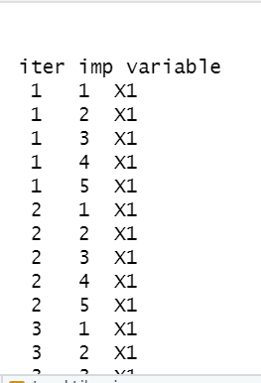
What the imputation process look like
MICE uses all of the other variables to predict each missing value

Slide 29
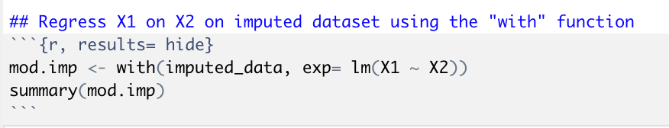
Run the same simple linear regression of X1 on X2, but this time use the imputed dataset
mod.imp = model name
with() = tells R to run the analysis in all imputations of the data
exp = an expression with a formula object
lm(X1 ~ X2) = the model you want to run. In this case, a simple linear regression
summary() = use to view model output

Slide 30
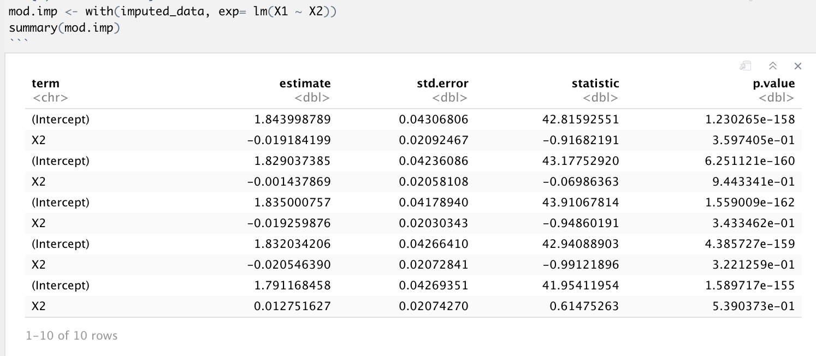
Simple linear regression output with MICE for all imputations
Imputation 1
Imputation 2
Imputation 3
Imputation 4
Imputation 5

Slide 31
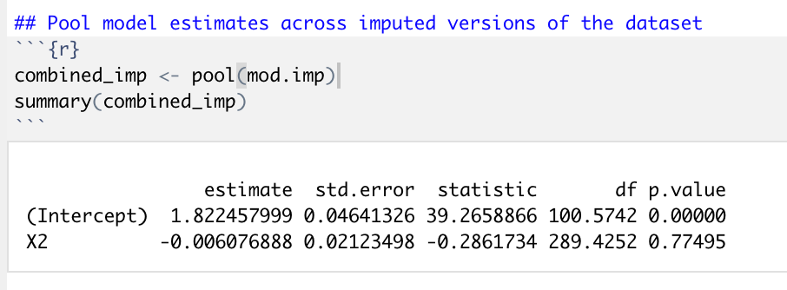
Pool model estimates from all the imputations
mod.imp = model name for SLR
pool() = tells R to combine model estimates across each imputation
summary() = use to view model output

Slide 32
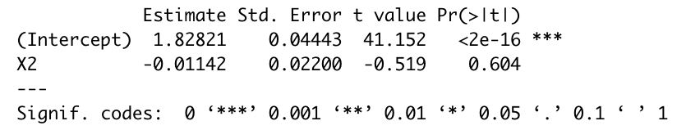
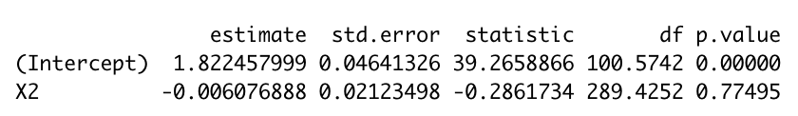
Compare model results between the missing data techniques
Pairwise Deletion:
Pooled across MICE datasets:

Slide 33
A few notes on the mice package
The with() and pool() functions allow you to pool model estimates for many common analyses
In general, you should examine missing data patterns before using mice
Can take a lot of computational power and time to run in larger datasets
Not currently compatible with machine learning and some multivariate analyses
Mplus has its own code for multiple imputation
To read more on the mice package, view the vignette here:
https://cran.r-project.org/web/packages/mice/mice.pdf

