Slide 1

Welcome to Psy 653 Lab!
Module 11: Minimum effects testing & Bayesian analyses
*Thanks to Gemma Wallace for her help with these slides

Slide 2
Objectives
Practice identifying minimum effects for rejecting specific hypotheses
Conduct regular and Bayesian ANOVAs to determine whether gender and occupation are related to mental health
Interpret and compare results from the two analytic approaches

Slide 3
Part 1: Minimum effects practice

Slide 4
Minimum Effects Testing (MET)
It tests the hypothesis that the effect of treatments falls somewhere in an interval between zero and some number
Rather than testing if an effect is precisely zero, we can test if it falls above a range of values (The minimum effect you are testing)

Slide 5
The authors used Right Wing Authoritarianism (RWA) to predict differences in response time to in-group and out-group faces, and found a squared correlation of .07, which was significant, with F(1,161) = 4.81

Slide 6
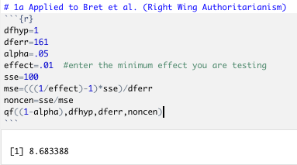
Identifying minimum effects: Kevin’s minimum effects code
F(1,161) = 4.81,
𝝰 = .05,
Minimum effect = 1%
Don’t change

Slide 7
Detecting minimum effects: Kevin’s minimum effects code
F(1,161) = 4.81
Compare the resulting minimum F-value needed to test an effect of 1% or more to the obtained F-value.
In this case we did NOT reach the threshold F-value to have a significant effect at 1%. The authors need an F-value of 8.68 to obtain a significant effect at a minimum effect of 1%.

Slide 8
Identifying minimum effects via Murphy, Myors & Woloch (2014) “One Stop” F-table (Appendix B)

Slide 9
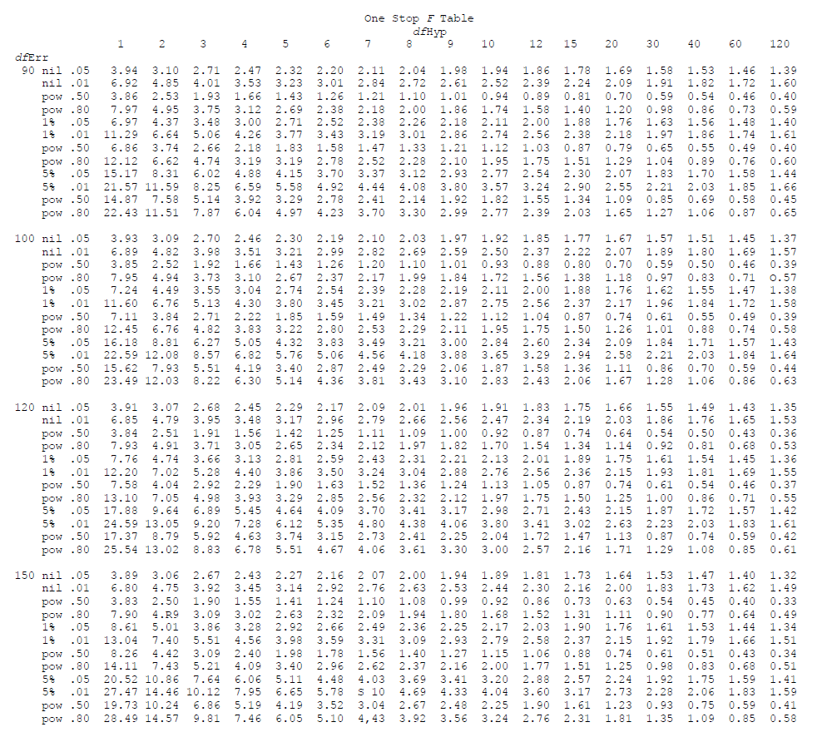
Minimum F required (Appendix B)
With a DF_{hyp} = 1 and DF_{err} = 161, the Authors need an F-value of 3.89 or more to obtain a significant effect.
Obtained F = 4.81

Slide 10
Minimum F required (Appendix B)
Comparison to a Nil effect
With a DF_{hyp} = 1 and DF_{err} = 161, the Authors need an F-value of 3.89 or more to obtain a significant effect.
Obtained F = 4.81
We have a significant effect

Slide 11
Minimum F required (Appendix B)
Comparison to a 1% effect
With a DF_{hyp} = 1 and DF_{err} = 161, the Authors need an F-value of 8.61 or more to obtain a significant effect.
Obtained F = 4.81
We do NOT have a significant effect

Slide 12
Part 2: Bayesian analyses

Slide 13
A quick introduction to bayesian statistics
Increasingly popular in psychology
Models account for background knowledge (not discussed in detail in this lab)
May allow us to overcome several limitations of NHSTs (e.g., the reproducibility crisis in psychology and reliance on large sample sizes)
All common statistical analyses can be conducted in a bayesian framework (ANOVAs, regression, correlation, factor analysis, etc.)
Interpretations are often more concrete than significance tests (clear probability statements)
Today we will be calculating a statistic called a “Bayes factor”
Note: While bayesian analyses are on the rise and may overcome several limitations of frequentist methods, use of classical statistics has been argued for as well (e.g., this NY Times article from 2014: https://www.nytimes.com/2014/09/30/science/the-odds-continually-updated.html?_r=1)

Slide 14
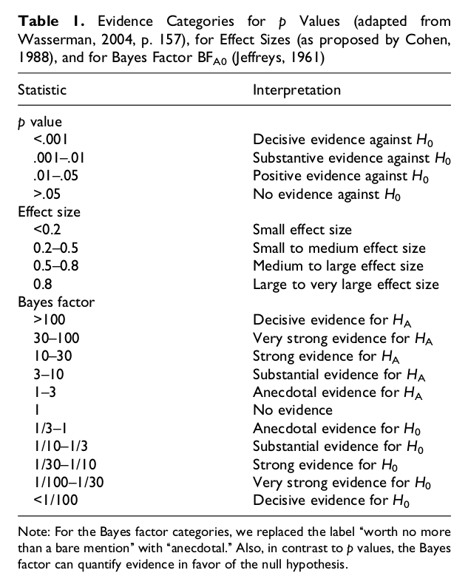
Rules of Thumb for Bayes Factor Interpretations
Bayes factors are indices of relative evidence of one model (or hypothesis) over another
Evidence for alternative hypothesis (compared to null hypothesis)
Evidence for null hypothesis (compared to alternative hypothesis)
Wetzels et al., 2011 https://journals.sagepub.com/doi/abs/10.1177/1745691611406923

Slide 15
Dataset description
A team of researchers analyzed if People’s mental health after retirement was better or worse based on their sex and previous occupation.
sex: participant sex. 1 = Female, 2 = Male
occupation: Participant occupation prior to retirement. 1 = Professional, 2 = Manager, 3 = nonmanual worker, 4 = Skilled worker, 5 = semi-skilled worker, 6 = unskilled worker.
mental: The participants score on a mental health measure. Higher scores indicate better mental health.

Slide 16
Let’s Code!
Last tutorial of the semester! ☺
You all have been great!

Slide 17

Create a new R-Project and r-notebook!
Download the “retirement.csv” file from Canvas and save it into your R-project file

Slide 18
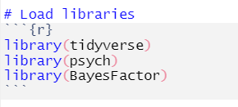
Load Libraries

Slide 19
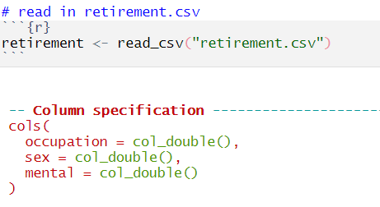
Read in the retirement.csv

Slide 20
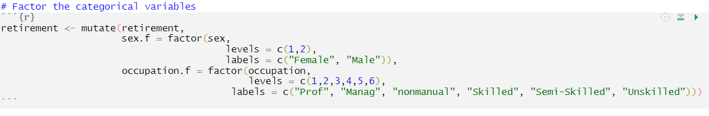
Factor categorical variables

Slide 21
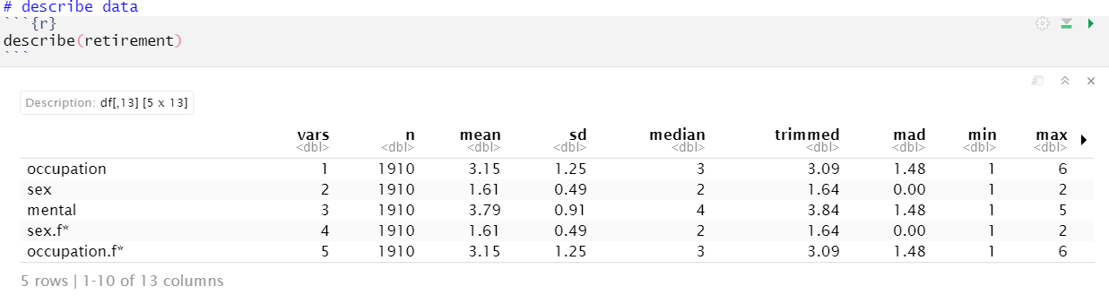
Describe data

Slide 22
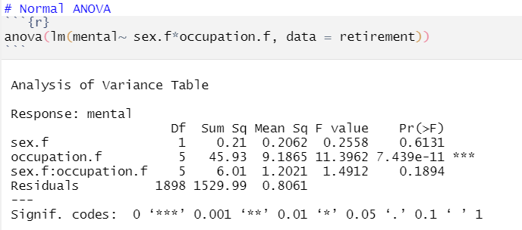
Run a normal anova

Slide 23
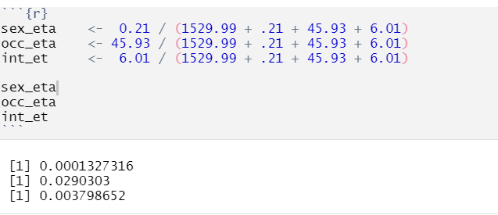
Calculate eta² effect size
Eta² = SSeffect / SStotal

Slide 24
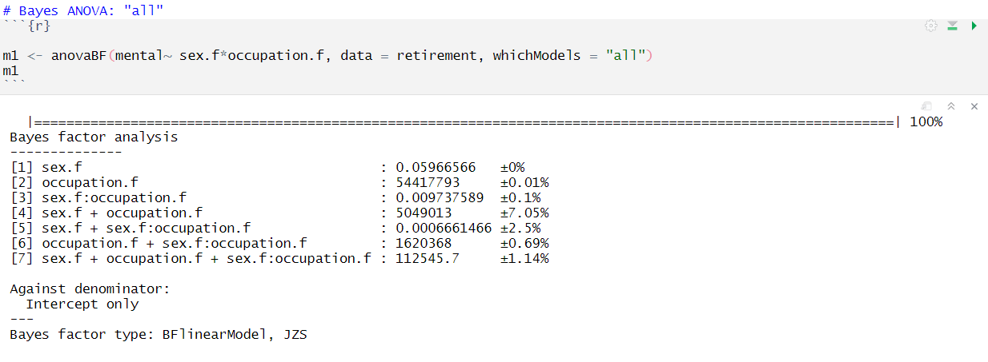
Run Bayes Factor ANOVA, whichModels = “all”
Shows Bayes factor for all possible models.
As can be seen: Any model with the inclusion of occupation.f main effect results in an extremely large Bayes factor!

Slide 25
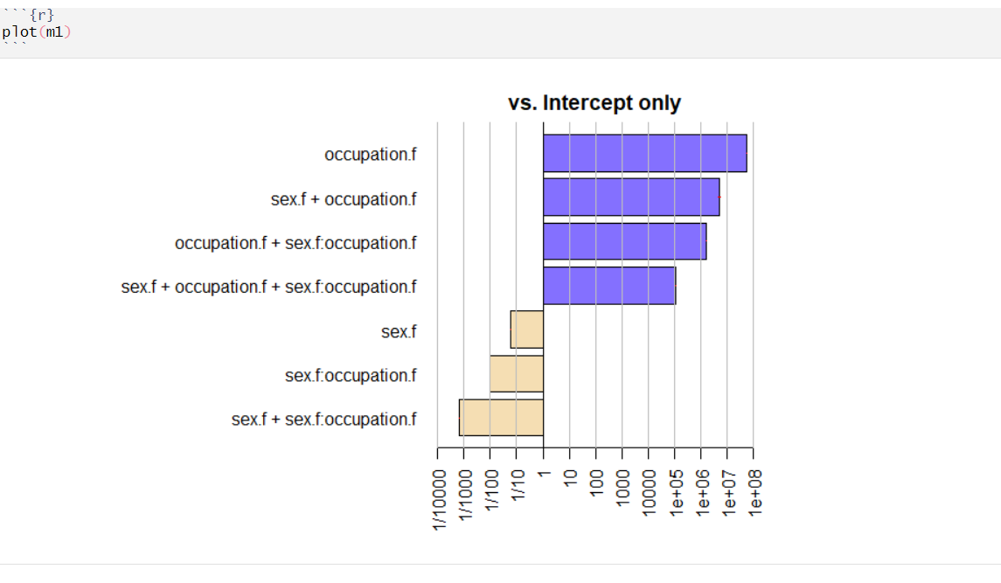
Plot Bayes Factor ANOVA, whichModels = “all”

Slide 26
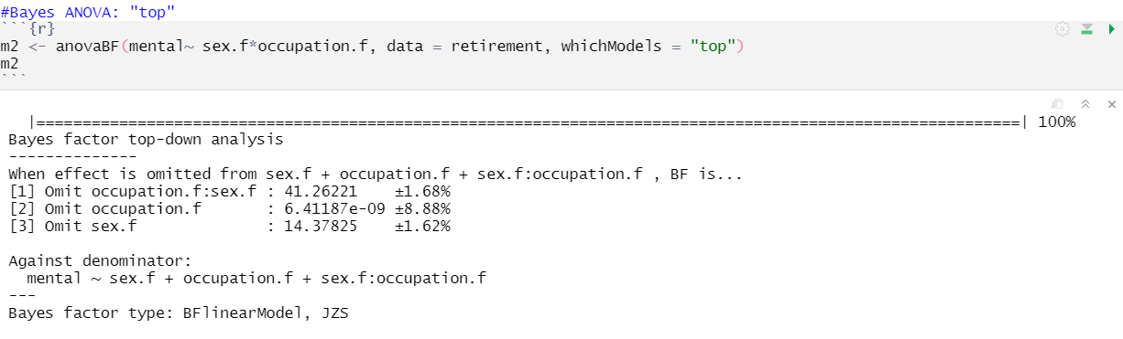
Run Bayes Factor ANOVA, whichModels = “top”
Shows how the omission of a variable will affect the Bayes factor value
As can be seen: Any model with the omission of occupation.f main effect results in an extremely small Bayes factor!

Slide 27
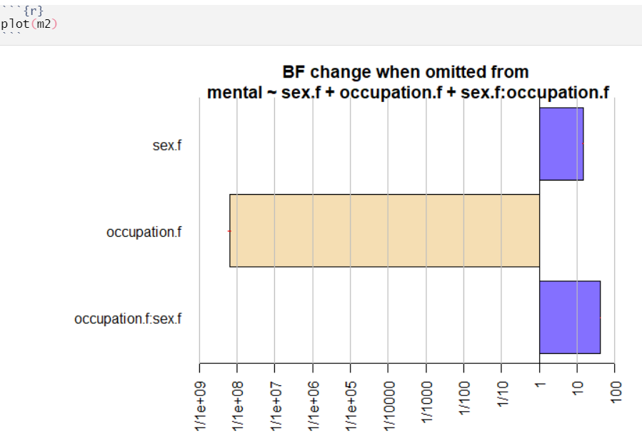
Plot Bayes Factor ANOVA, whichModels = “top”

Slide 28
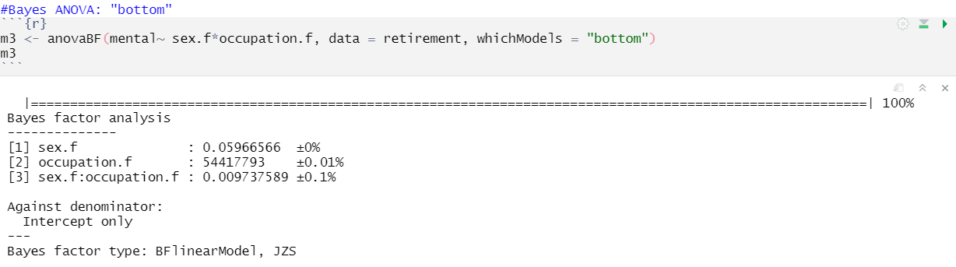
Run Bayes Factor ANOVA, whichModels = “bottom”
Shows Bayes factor for adding in a variable
As can be seen: Any model with the addition of occupation.f main effect results in an extremely large Bayes factor!

Slide 29
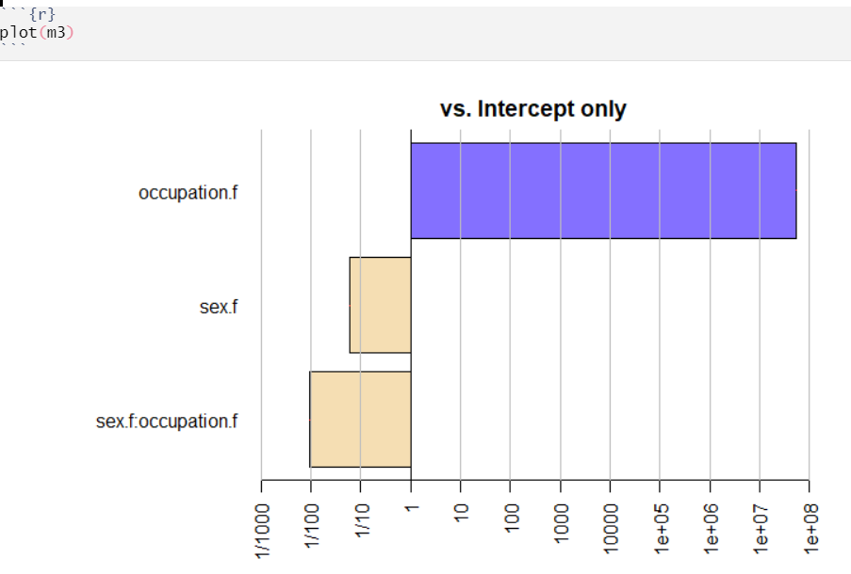
Plot Bayes Factor ANOVA, whichModels = “bottom”

Slide 30
Additional resources on bayesian approaches
An article by Etz & Vandekerckhove (2018) about basic bayesian inferences. It opens with a quote by Dumbledore, so you know you want to read it! https://link.springer.com/article/10.3758/s13423-017-1262-3
Helpful tutorials for learning bayesian analyses using the BayesFactor package: https://richarddmorey.github.io/BayesFactor/#fixed
More great tutorials for getting started with bayesian analyses, this time from the BayestestR package: https://cran.r-project.org/web/packages/bayestestR/vignettes/bayestestR.html
The accompanying citation for the BayestestR package can be found at: https://www.theoj.org/joss-papers/joss.01541/10.21105.joss.01541.pdf
An example of using top down and bottom-up approaches with bayesian analyses: https://datascienceplus.com/bayesian-statistics-analysis-of-health-data/
An article by Krypotos et al. (2017) that calls for increased use of Bayesian approaches (and less NHST) in experimental psychology: https://journals.sagepub.com/doi/10.5127/jep.057316

Slide 31
Thanks for a great semester!
Once a student, always a student!
Never hesitate to reach out in the future! - ndyetz@gmail.com
I will keep all the YouTube videos up for your future reference
THANK YOU FOR BEING SUCH A WONDERFUL CLASS!
I enjoyed every minute of it!

