Slide 1



THE EVOLUTION OF SOCIAL NETWORKS IN A GROUP-BASED MENTORING PROGRAM FOR VULNERABLE TEENS: WHAT TYPES OF RELATIONSHIPS MATTER MOST?
Neil Yetz Thesis Proposal
07/15/2020

Slide 2
Objectives
Adolescent background – A critical time for intervention
Mentorship interventions: A promising strategy
Belongingness as an intermediate goal
A quick background on social networks
Methods

Slide 3
Introduction

Slide 4

Adolescence – A critical time for intervention
Adolescents cannot be considered older children or young adults¹
It is a unique and crucial developmental period
Adolescents are at-risk for:
Impulsive behaviors¹
Substance use²
Unsafe sexual practices³

Slide 5


Adolescent biology
Numerous biological/neurological changes occur during this time period⁴
Increased activation of the frontal lobe⁴
Increased pruning and myelination of the brain^{1,4}
Enhanced capacity of the dopaminergic reward system⁵
Changes in nucleus accumbens⁶

Slide 6
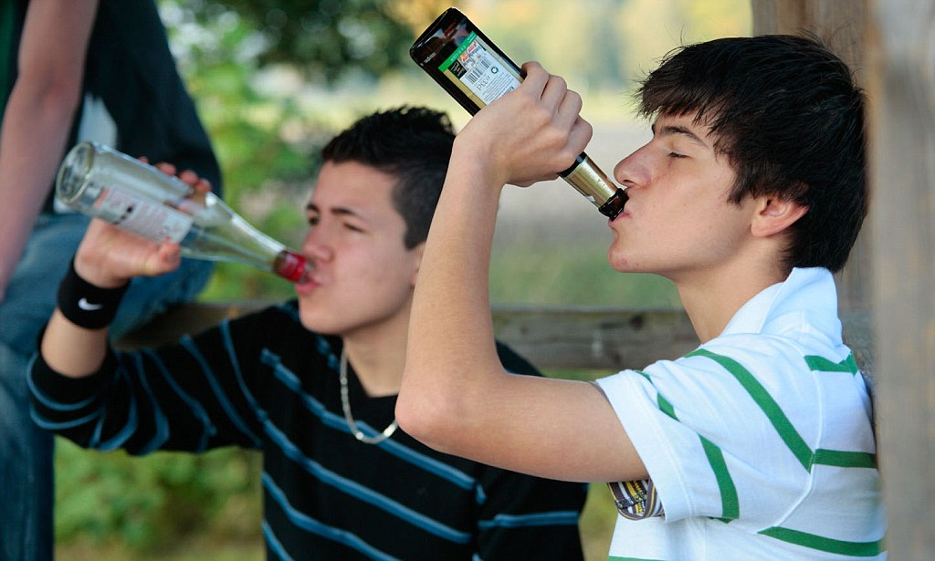
“At-risk” adolescents
Certain factors increase the likelihood an adolescent will engage in risk behaviors⁷
I.e. Low parental involvement, parental substance abuse, association with delinquent peers, etc.
Preventive efforts are needed to reduce behavioral difficulties
Many interventions have been utilized to target at-risk adolescents⁸

Slide 7

Mentorship interventions

Slide 8
Mentorship Interventions
Provide an adolescent with a role model from the community in which they both reside
Mentors are encouraged to:
Enhance mentee coping strategies
Reduce stressors
Create an attachment
Studies show effect sizes to be small to medium⁸

Slide 9
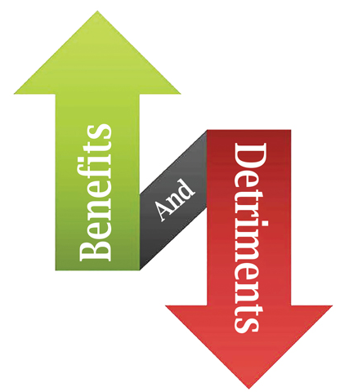
Group-based mentorship interventions
Benefits
Serve larger number of youth at once
Has shown beneficial outcomes in resiliency and prosocial attitudes^{9,10}
Detriments
Deviancy training¹¹

Slide 10
Belongingness as an Intermediate Goal of Group-based Mentoring Programs
Belongingness is a fundamental part of forming relationships with adolescent peers It is associated with higher relationship satisfaction¹²
I propose that belongingness is an essential link between social connections and desired outcomes (e.g. academic aspirations) in an adolescent group mentoring program

Slide 11
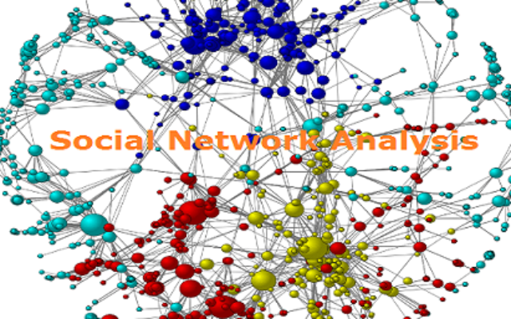
Social Networks
A social network is the structure of relationships that connect people within a defined population
I will utilize social networks to identify what aspects of bonds formed in a group-based intervention may contribute most to an adolescent’s sense of belonging in the program
Ultimately, I will see how it relates to developmental outcomes as well (delinquency, depression, anger & academic aspirations)

Slide 12
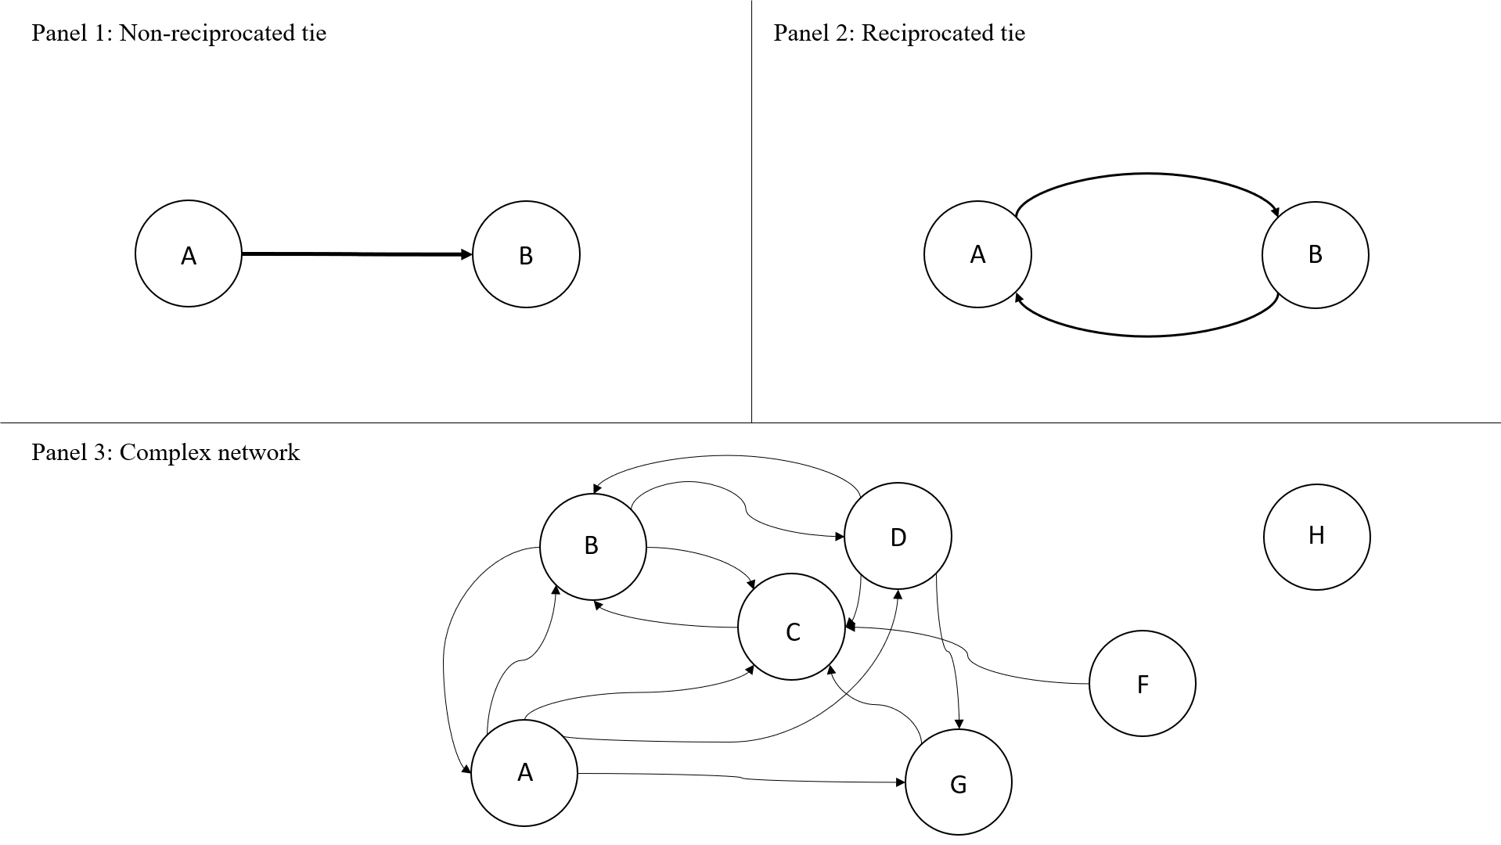

Slide 13
Research Questions
Does the number and strength of connections developed with other individuals in the mentoring program correlate with a measure of belongingness? Additionally, what type(s) of social connections (i.e., with the primary mentor, with other mentors, with other mentees) is/are the strongest indicator(s) of belongingness in the program?
Does belongingness mediate the effect of the strength of social connections on improvement in the developmental outcomes (i.e., academic aspirations, depression, anger, and delinquent behaviors)?

Slide 14
METHOD

Slide 15
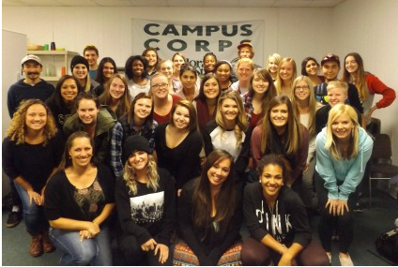

Participant recruitment: Campus Connections
12 week Mentorship program open to all majors/years at Colorado State University (CSU)
CSU students mentor at-risk adolescents (11-18 years old) referred from the juvenile justice system, schools, human services
Mentors are paired 1:1 with mentees and work both individually and in multidisciplinary teams

Slide 16
Inclusion/Exclusion criteria
11 – 18 years of age
Never participated in Campus Connections previously
Have at least one risk factor from Herrera et al.’s (2013) Risk Screening Tool
Available to participate in Campus Connections during operating hours

Slide 17
Sample
Data has been collected on the youth three years (2015 – 2018) as part of a William T. Grant funded project
Five timepoints
Week 1, 3, 6, 9, & 11 of the Campus Connections program

Slide 18
Measures
Primary measures
Belongingness¹³
Strength of social connections (inbound, outbound, and all connections)
Delinquency¹⁸
Academic aspirations¹⁴
Depression¹⁵
Anger¹⁶
Control measures
Demographics
Age
Sex
Race/ethnicity
Household income
Social emotional competencies¹⁷

Slide 19
Procedures
Adolescent participants were asked to indicate all friendships they had with other youth in the program
Then were asked to evaluate the strength of that relationship
Belongingness was assessed at concurrent timepoints
Outcome measures (delinquency, academic aspirations, depression, anger) were assessed pre and post intervention.

Slide 20





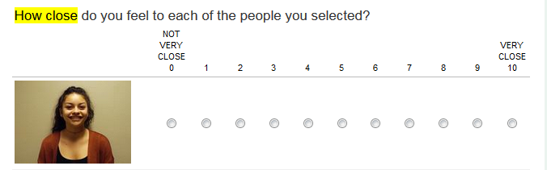


A visual example

Slide 21
Statistical Procedures: RQ1
Latent growth modeling will be used to model the growth of belongingness and social connections across all five waves of Campus Connections
More specifically a parallel process growth model will be specified (One for belongingness, one for strength of social connections)
To allow for a non-linear fit, this will be a latent basis growth model will be assessed

Slide 22
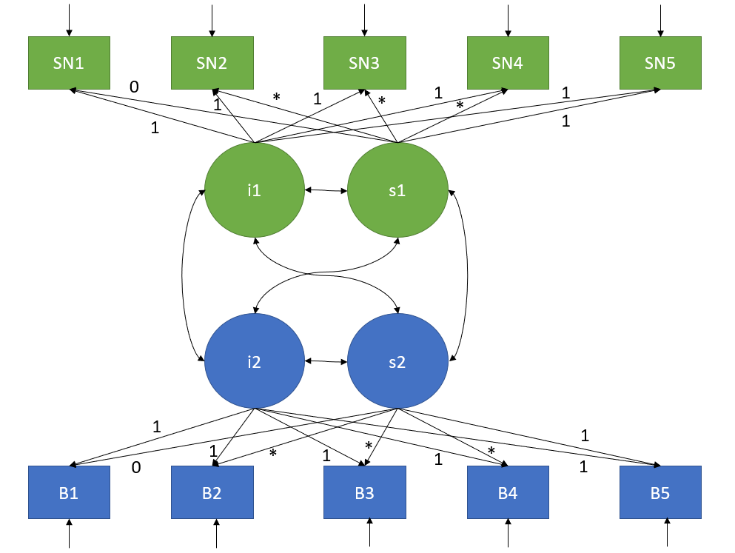

Slide 23

Determining the appropriate model(s)
Comparison of AIC values across models (Inbound, outbound, and all)
Comparison of the unstandardized estimate of the covariation/correlation between the slopes

Slide 24
Statistical Procedures: RQ2
I will fit a series of mediation model
The primary predictor in each model will be the strength of the social connections
The primary mediator will be belongingness
The outcome variable will be one of each of our developmental outcome variables (anger, depression, academic aspirations, delinquency).

Slide 25
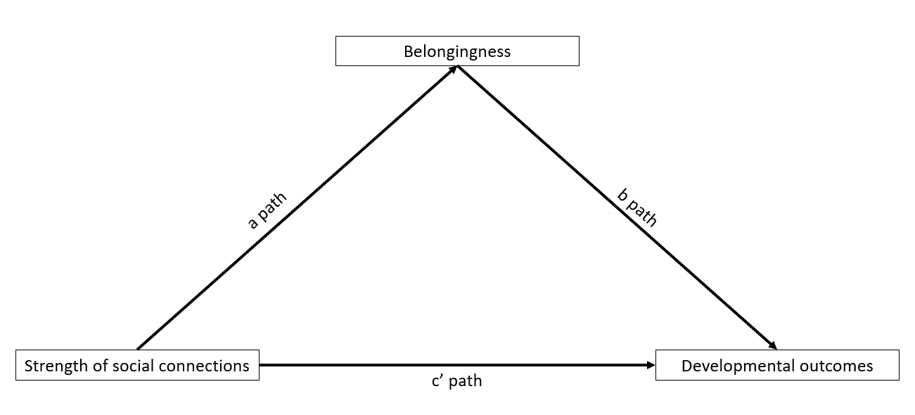
Mediation Model

Slide 26
Thank you!
A special thanks to my thesis committee
Dr. Kimberly Henry (Advisor)
Dr. Bailey Fosdick
Dr. Michael Thomas

Slide 27
References
Steinberg, L. (2007). Risk taking in adolescence: New perspectives from brain and behavioral science. Current Directions in Psychological Science, 16(2), 55–59. https://doi.org/10.1111/j.1467-8721.2007.00475.x
Henry, K. L., Thornberry, T. P., & Huizinga, D. H. (2009). A discrete-time survival analysis of the relationship between truancy and the onset of marijuana use. Journal of Studies on Alcohol and Drugs, 70(1), 5–15. https://doi.org/10.15288/jsad.2009.70.5
Myklestad, I., & Rise, J. (2007). Predicting Willingness to Engage in Unsafe Sex and Intention to Perform Sexual Protective Behaviors Among Adolescents. Journals.Sagepub.Com, 34(4), 686–699. https://doi.org/10.1177/1090198106289571
Paus, T., Keshavan, M., & Giedd, J. N. (2008, December). Why do many psychiatric disorders emerge during adolescence? Nature Reviews Neuroscience, Vol. 9, pp. 947–957. https://doi.org/10.1038/nrn2513
Siegel, D. (2015). Brainstorm: The power and purpose of the teenage brain.
Galvan, A., Hare, T. A., Parra, C. E., Penn, J., Voss, H., Glover, G., & Casey, B. J. (2006). Behavioral/Systems/Cognitive Earlier Development of the Accumbens Relative to Orbitofrontal Cortex Might Underlie Risk-Taking Behavior in Adolescents. Soc Neuroscience. https://doi.org/10.1523/JNEUROSCI.1062-06.2006
Mcdaniel, S., & Yarbrough, A.-M. (n.d.). A Literature Review of Afterschool Mentoring Programs for Children At Risk.
Raposa, E. B., Rhodes, J., Stams, G. J. J. M., Card, N., Burton, S., Schwartz, S., … Hussain, S. (2019, March 15). The Effects of Youth Mentoring Programs: A Meta-analysis of Outcome Studies. Journal of Youth and Adolescence, Vol. 48, pp. 423–443. https://doi.org/10.1007/s10964-019-00982-8
Kuperminc, G. P., Chan, W. Y., Hale, K. E., Joseph, H. L., & Delbasso, C. A. (2019). The Role of School-based Group Mentoring in Promoting Resilience among Vulnerable High School Students. American Journal of Community Psychology, ajcp.12347. https://doi.org/10.1002/ajcp.12347
Weiler, L. M., Haddock, S. A., Zimmerman, T. S., Henry, K. L., Krafchick, J. L., & Youngblade, L. M. (2015). Time-Limited, Structured Youth Mentoring and Adolescent Problem Behaviors. Applied Developmental Science, 19(4), 196–205. https://doi.org/10.1080/10888691.2015.1014484
Dishion, T. J., & Tipsord, J. M. (2011). Peer Contagion in Child and Adolescent Social and Emotional Development. Annual Review of Psychology, 62(1), 189–214. https://doi.org/10.1146/annurev.psych.093008.100412
Marsh, S. C., & Evans, W. P. (2009). Youth Perspectives on Their Relationships With Staff in Juvenile Correction Settings and Perceived Likelihood of Success on Release. Youth Violence and Juvenile Justice, 7(1), 46–67. https://doi.org/10.1177/1541204008324484
Alberti Gambone, M., Klem, A. M., & Connell, J. P. (2002). Finding Out for Youth: Finding Out What Matters for Youth: Testing Key Links in a Community Action Framework for Youth Development.
Appleton, J. J., Christenson, S. L., Kim, D., & Reschly, A. L. (2006). Measuring cognitive and psychological engagement: Validation of the Student Engagement Instrument. Journal of School Psychology, 44(5), 427–445. https://doi.org/10.1016/j.jsp.2006.04.002
Haroz, E., Ybarra, M., Disorders, W. E.-J. of affective, & 2014, U. (2014). Psychometric evaluation of a self-report scale to measure adolescent depression: The CESDR-10 in two national adolescent samples in the United States. Elsevier, 158, 154–160.
Deffenbacher, J. L., Oetting, E. R., Lynch, R. S., & Morris, C. D. (1996). The expression of anger and its consequences. Behaviour Research and Therapy, 34(7), 575–590. https://doi.org/10.1016/0005-7967(96)00018-6
LeBuffe, P., Shapiro, V., & Naglieri, J. (2009). The Devereux Student Strengths Assessment (DESSA) Assessment, Technical Manual, and User’s Guide. Charlotte, NC: Apperson.
Elliott, D. S., Huizinga, D., Ageton, S. S. (1985). Explaining Delinquency and Drug Use. Sage, Beverly Hills.

Slide 28

Discussion

