Slide 1

Beneath the shattered sky - demo project -

Slide 2
AGENDA
This brief presentation contains a few short videos and pictures that attempt to encapsulate some of the gameplay for Beneath the Shattered Sky – Demo project

Slide 3
Gameplay Start and Cutscene
Please CTRL+Click the box to view the game play.
https://youtu.be/YAMoRq5BU2o

Slide 4
Crossing the Rocks
Please CTRL+Click the box to view the game play.
https://youtu.be/Qa7NoFEMWWo

Slide 5
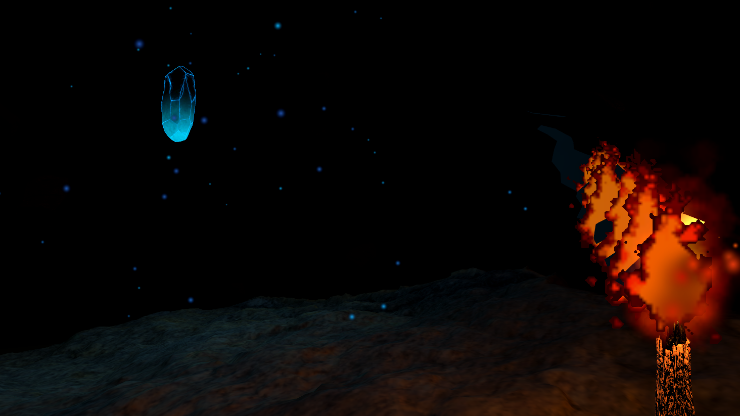
Amareal

Slide 6
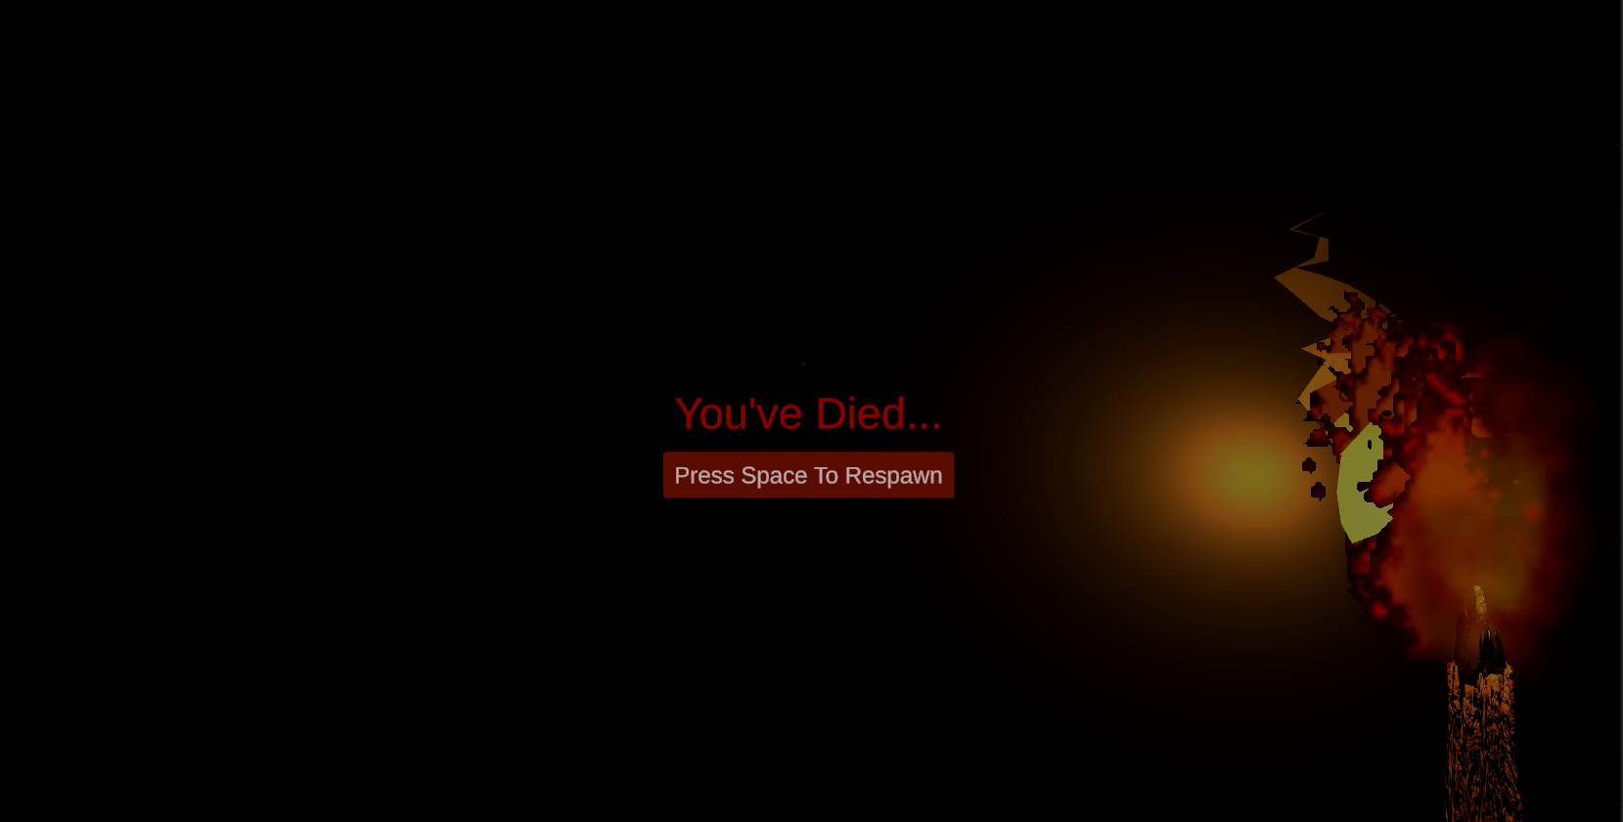
Death Screen

Slide 7
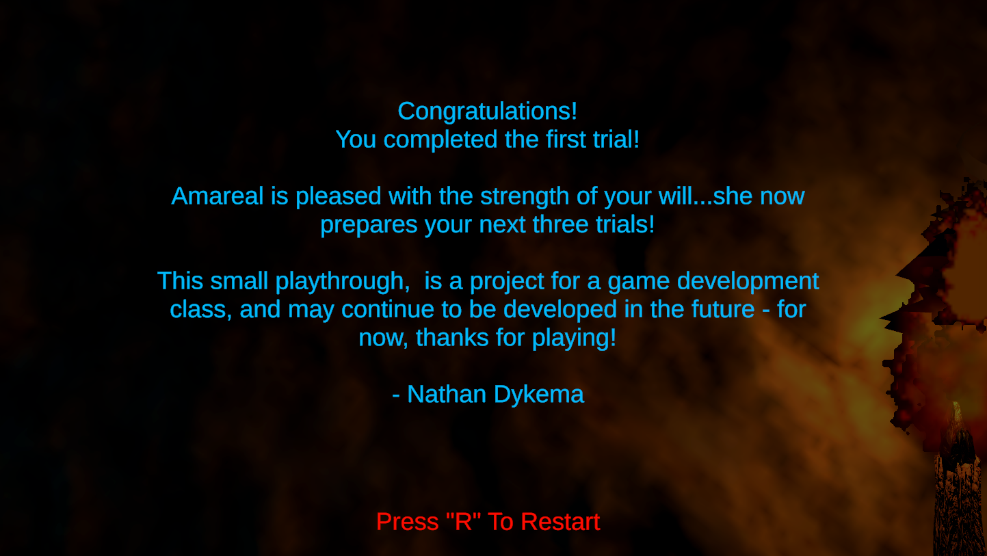
End Game – Credit Screen

