Slide 1

Final Project Presentation
Natalie Johnson

Slide 2

Project Description
Datasets containing text-based or label-based features are categorically encoded.
Encoding operations such as frequency, label/ordinal, mean and one-hot are common.
Logistic Regression, Random Forest and Neural Networks are typical techniques.
Data will be encoded and the models will be compared using their accuracy scores.

Slide 3
Project Description
Research Questions:
How does the type of encoding effect the model accuracy?
Which model can produce high accuracy results with as fewest features as possible?

Slide 4
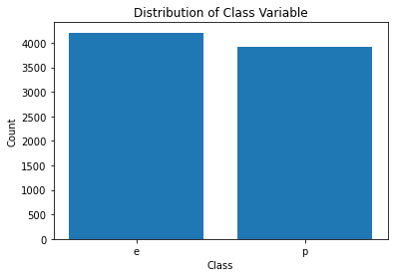
Project Dataset
Mushroom dataset from the UCI ML Repository*
8124 observations over 22 feature columns and 1 response column indicating if the mushroom is poisonous or edible.
Observations are hypothetical mushroom samples taken from The Audubon Society Field Guide to North American Mushrooms (1981)**.
All 22 feature columns are nominally valued and must be encoded.
Even class distribution with no missing values.
* Dua, D. and Graff, C. (2019). UCI Machine Learning Repository [http://archive.ics.uci.edu/ml]. Irvine, CA: University of California, School of Information and Computer Science.
** The Audubon Society Field Guide to North American Mushrooms (1981). G. H. Lincoff (Pres.), New York: Alfred A. Knopf

Slide 5
Project Dataset
Sampling of Features:
cap-shape: bell=b, conical=c, convex=x, flat=f, knobbed=k, sunken=s
odor: almond=a, anise=l, creosote=c, fishy=y, foul=f, musty=m, none=n, pungent=p, spicy=s
gill-size: broad=b, narrow=n
stalk-root: bulbous=b, club=c, cup=u, equal=e, rhizomorphs=z, rooted=r, missing=?
habitat: grasses=g, leaves=l, meadows=m, paths=p, urban=u, waste=w, woods=d

Slide 6
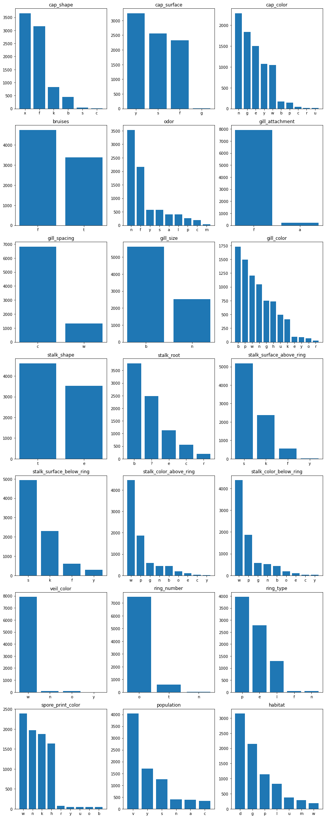
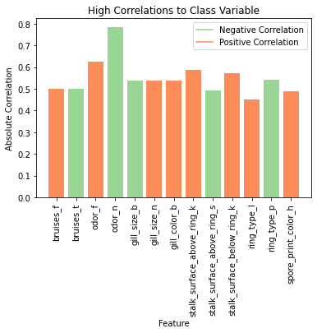
Project Dataset
Feature Distributions
Feature Correlation with Class Variable

Slide 7
Project Methodology
Created encoded dataframes using label/ordinal encoding and one-hot encoding.
Evaluated logistic regression and random forest models on each of the encoded dataframes.
Used accuracy as the metric to compare the models and encoding schemes.
Determined the fewest number of features to produce the most accurate results.

Slide 8
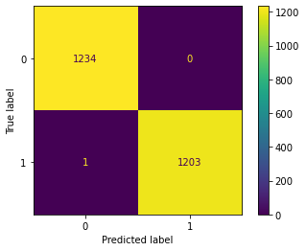
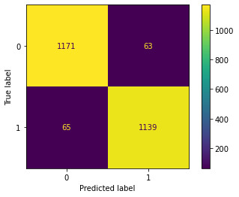
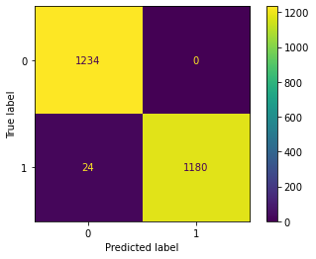

Project Results
Logistic Regression
Random Forest
70/30 Train/Test Split
One-hot encoding Label/Ordinal
GridSearch to optimize parameters
70/30 Train/Test Split
One-hot encoding Label/Ordinal
Accuracy: 0.9996
Accuracy: 0.9475
Accuracy: 0.9902
Accuracy: 0.9885

Slide 9
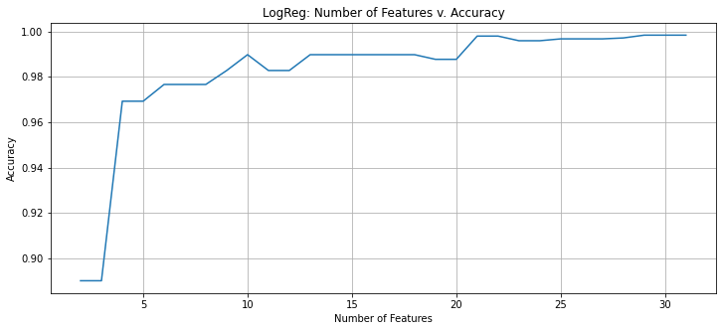
Project Results
Logistic Regression with less features
Features chosen by importance calculation.
Accuracy Score:
4-features = 0.9692
10-features = 0.9898
21-features = 0.9980

Slide 10
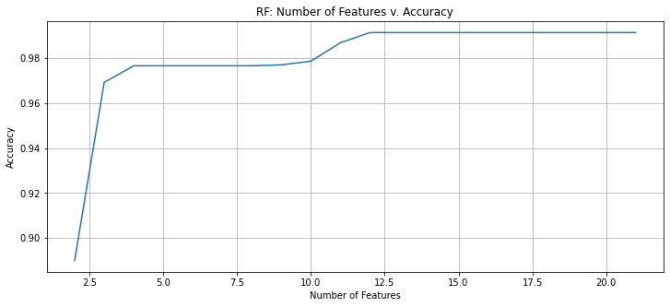
Project Results
Random Forest with less features
Features chosen by feature importance attribute.
Accuracy Score:
3-features = 0.9692
4-features = 0.9766
12-features = 0.9914

Slide 11
Project Findings
Features that drive the logistic regression and random forest models compared with the features that have the highest correlation with the class variable.
Logistic Regression | Random Forest | Correlation with Class Variable
Odor: foul | Odor: none | Odor: none
Gill size: broad | Gill size: broad | Odor: foul
Odor: none | Odor: foul | Stalk surface above ring: silky
Stalk root: bulbous | Stalk surface above ring: silky | Stalk surface below ring: silky

Slide 12
Conclusions
One-hot encoding performed better than ordinal encoding.
Random forest modeling resulted in the highest accuracy using as few features as possible. However, the difference was marginal.

