Slide 1
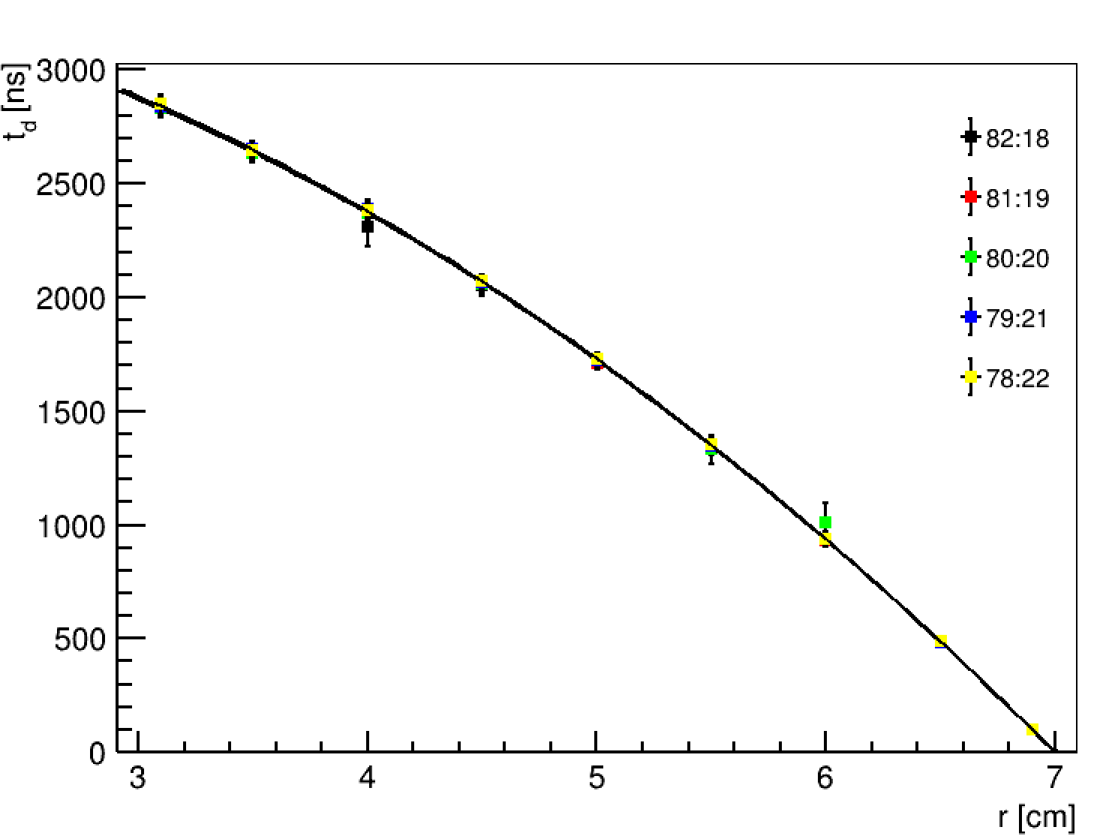
2% Gas-mixture Variations
82:18, t_max: 2834.81
81:19, t_max: 2843.67
80:20, t_max: 2828.87
79:21, t_max: 2834.61
78:22, t_max: 2847.63

Slide 2
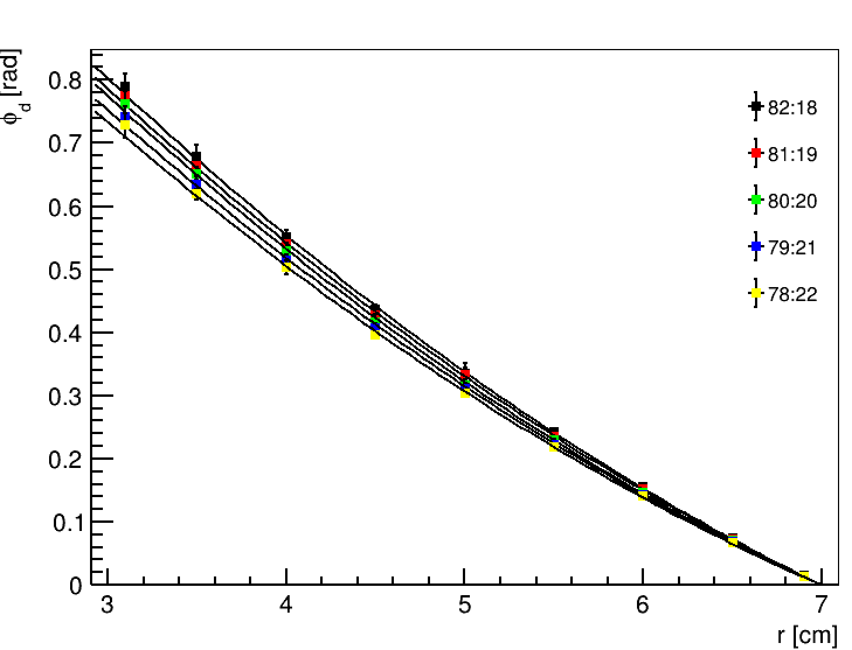
2% Gas-mixture Variations
82:18, phi_max: 0.789483
81:19, phi_max: 0.774728
80:20, phi_max: 0.762025
79:21, phi_max: 0.742272
78:22, phi_max: 0.728091

Slide 3
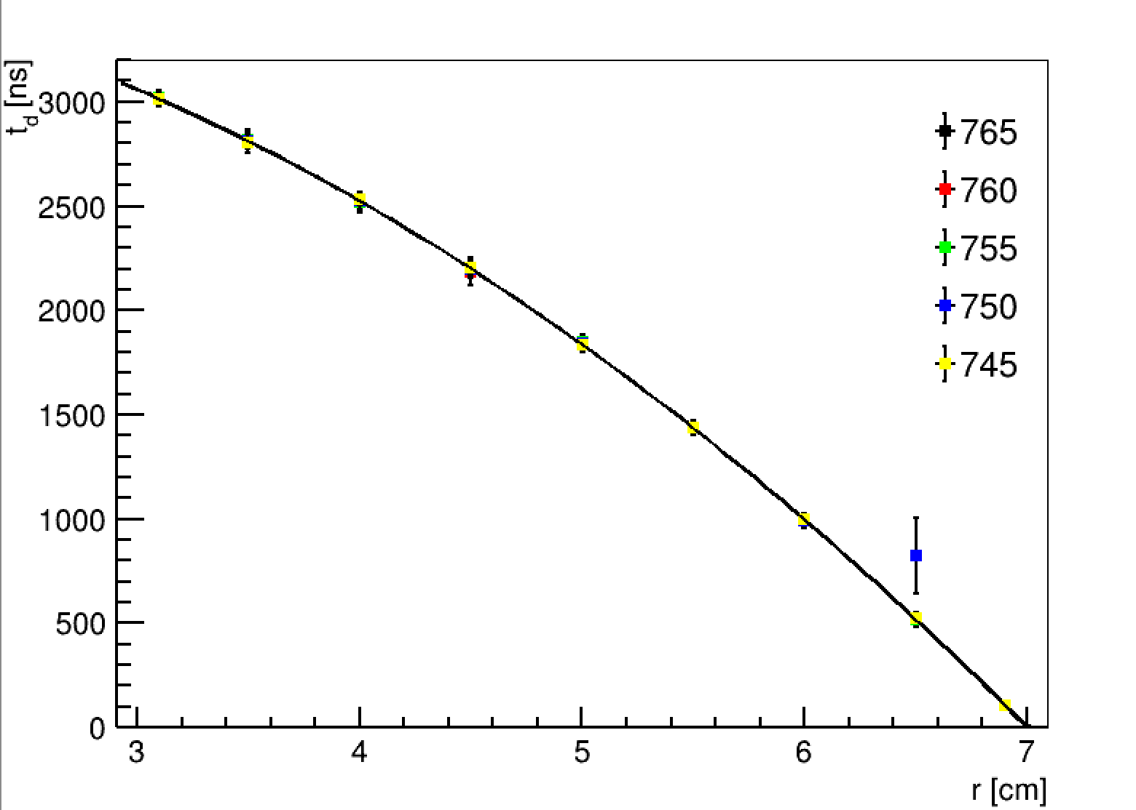
1% Pressure Variations
P = 765, t_max: 2870.29
P = 760, t_max: 2870.61
P = 755, t_max: 2853.88
P = 750, t_max: 2944.57
P = 745, t_max: 2864.98

Slide 4
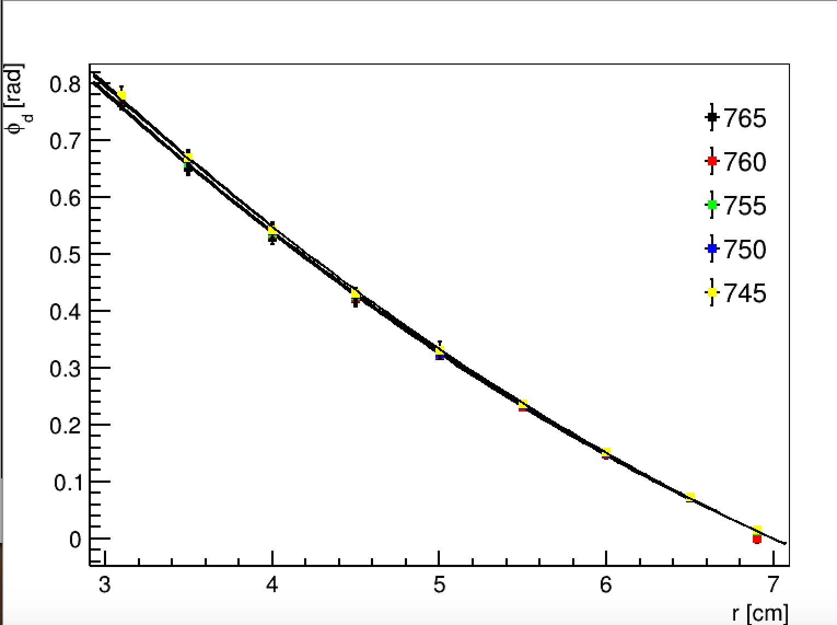
1% Pressure Variations
P = 765, phi_max: 0.765184
P = 760, phi_max: 0.768699
P = 755, phi_max: 0.777048
P = 750, phi_max: 0.779225
P = 745, phi_max: 0.779816

Slide 5
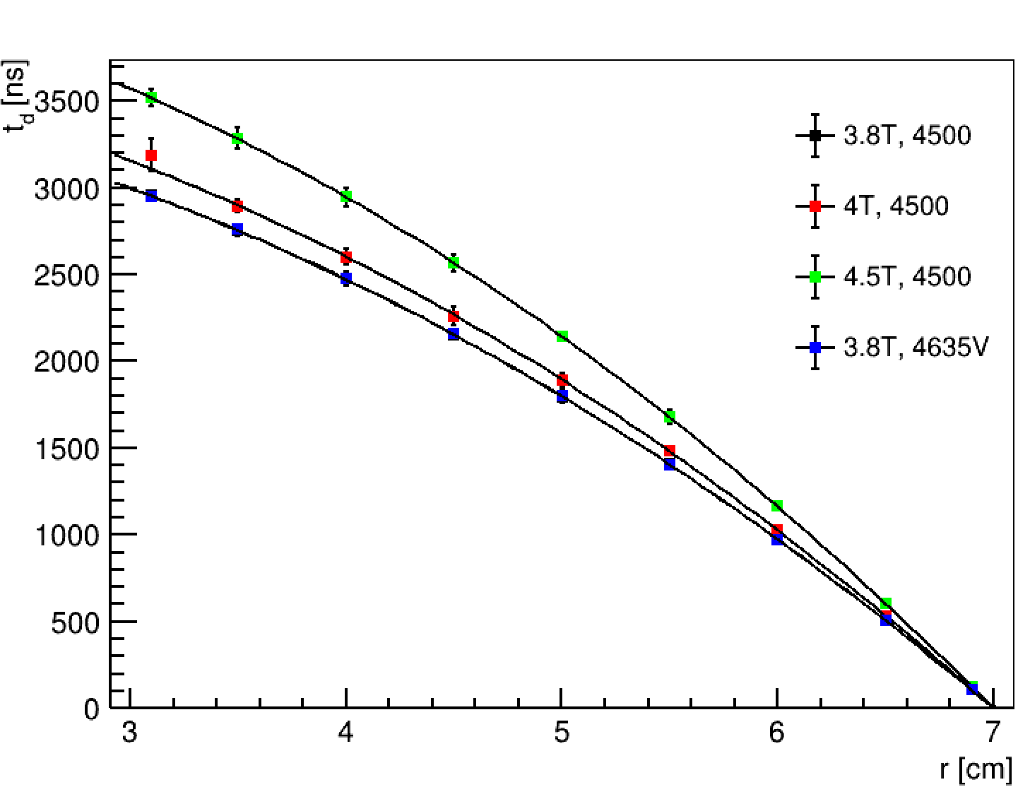
B-field, V_drift Variations
B = 3.8T, V = 4.5kV, t_max: 2953.03
B = 4T , V= 4.5kV, t_max: 3188.73
B = 4.5T, V=4.5kV, t_max: 3517.41
B = 3.8 T, V=4635V, t_max: 2951.76

Slide 6
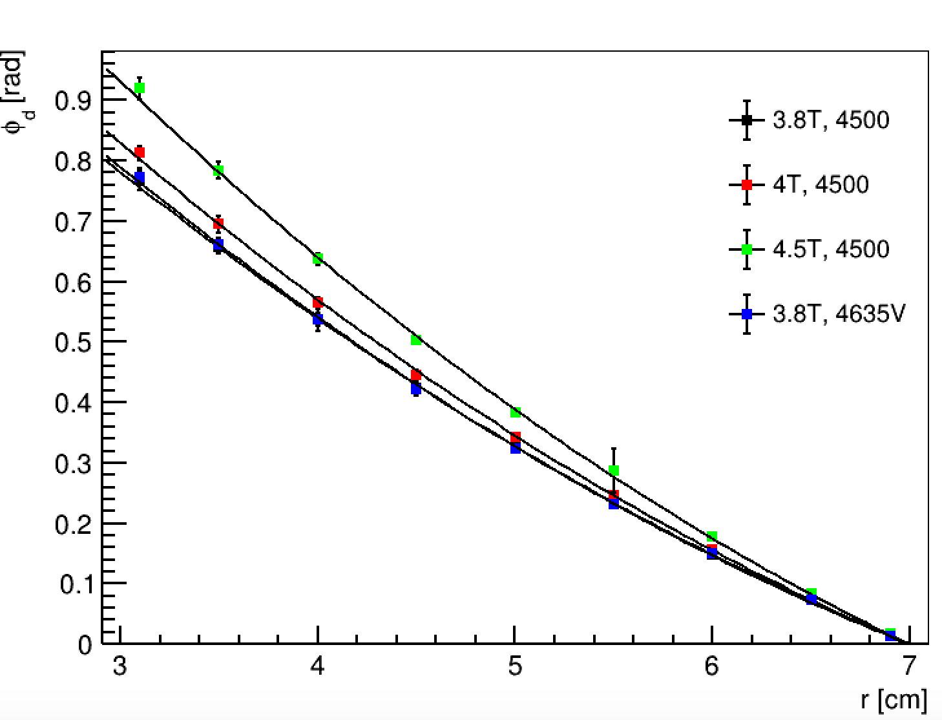
B-field, V_drift Variations
B = 3.8T, V = 4.5kV, phi_max: 0.769212
B = 4T , V= 4.5kV, phi_max: 0.812433
B = 4.5T, V=4.5kV, phi_max: 0.918956
B = 3.8 T, V=4635V, phi_max: 0.772162

