Slide 1


Actual Run 11847:
V_anode = +2115V, T=22.2416C, P=765.9918torr
t_CH1 = 851.77 ns $±$ 21.832 ns
t_CH2 = 2420.815 ns $±$ 20.027 ns

Slide 2
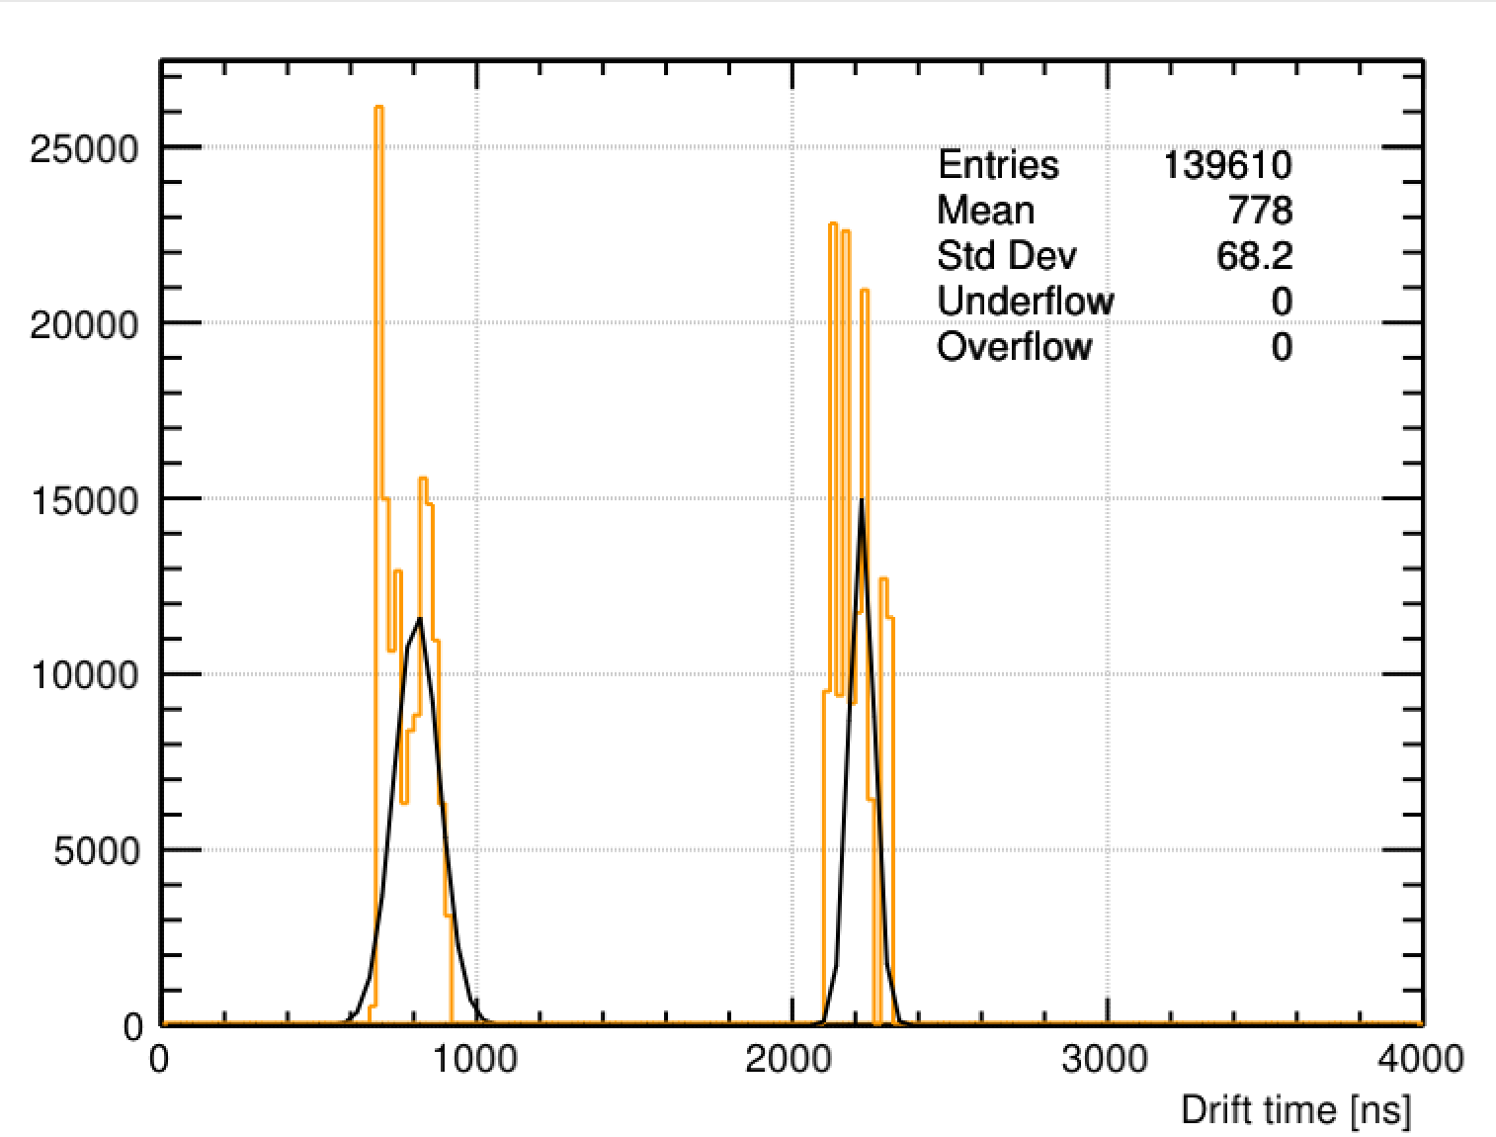


Simulated Run 11847:
V_anode = +2115V, T=22.2416C, P=765.9918torr
t_CH1 = 809.639 ns $±$ 36.0733 ns
t_CH2 = 2220.25 ns $±$ 19.26775 ns

Slide 3
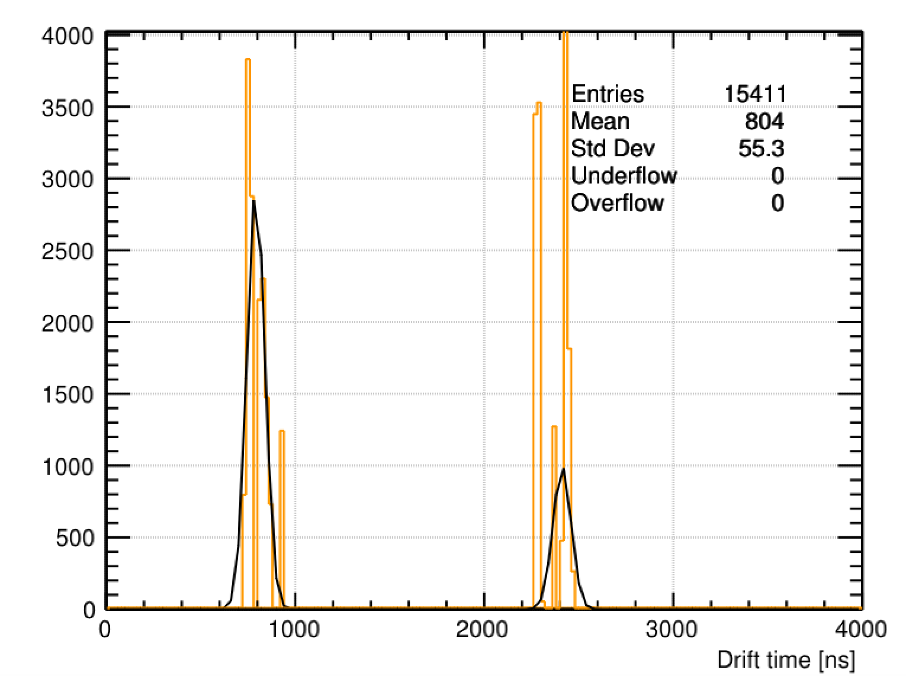


Run 11847: Change He:CO2 to 75:25
t_CH1 = 804.004 ns $±$ 12.1426 ns
t_CH2 = 2411.82ns $±$ 17.4301 ns

