Slide 1
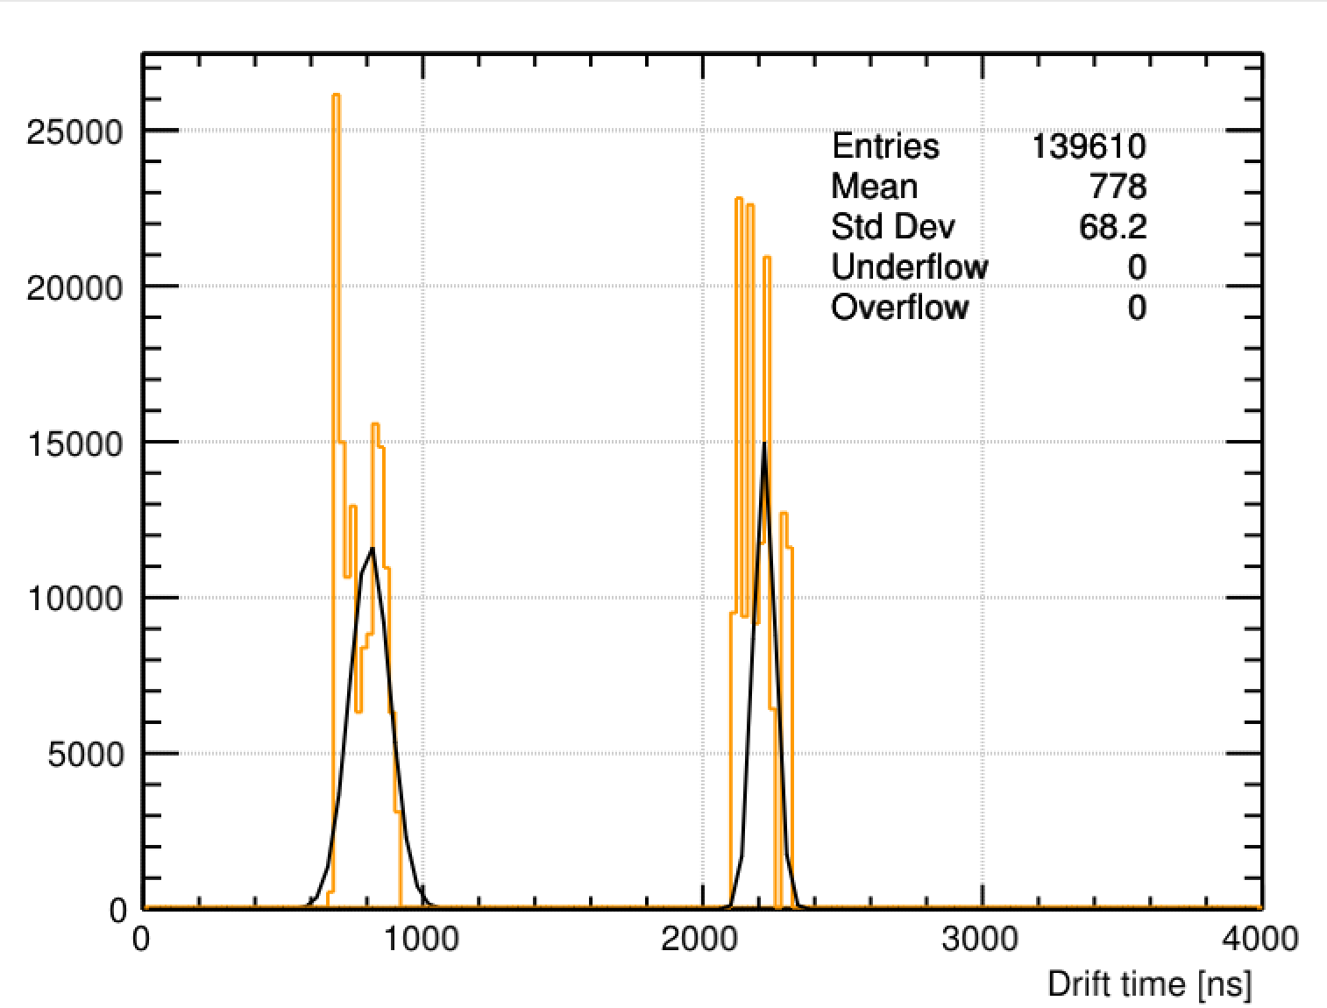


Run 11847: V_anode = +2115V, T=22.2416C, P=765.9918torr
t_CH1 = 809.639 ns $±$ 36.0733 ns
t_CH2 = 2220.25 ns $±$ 19.26775 ns

Slide 2
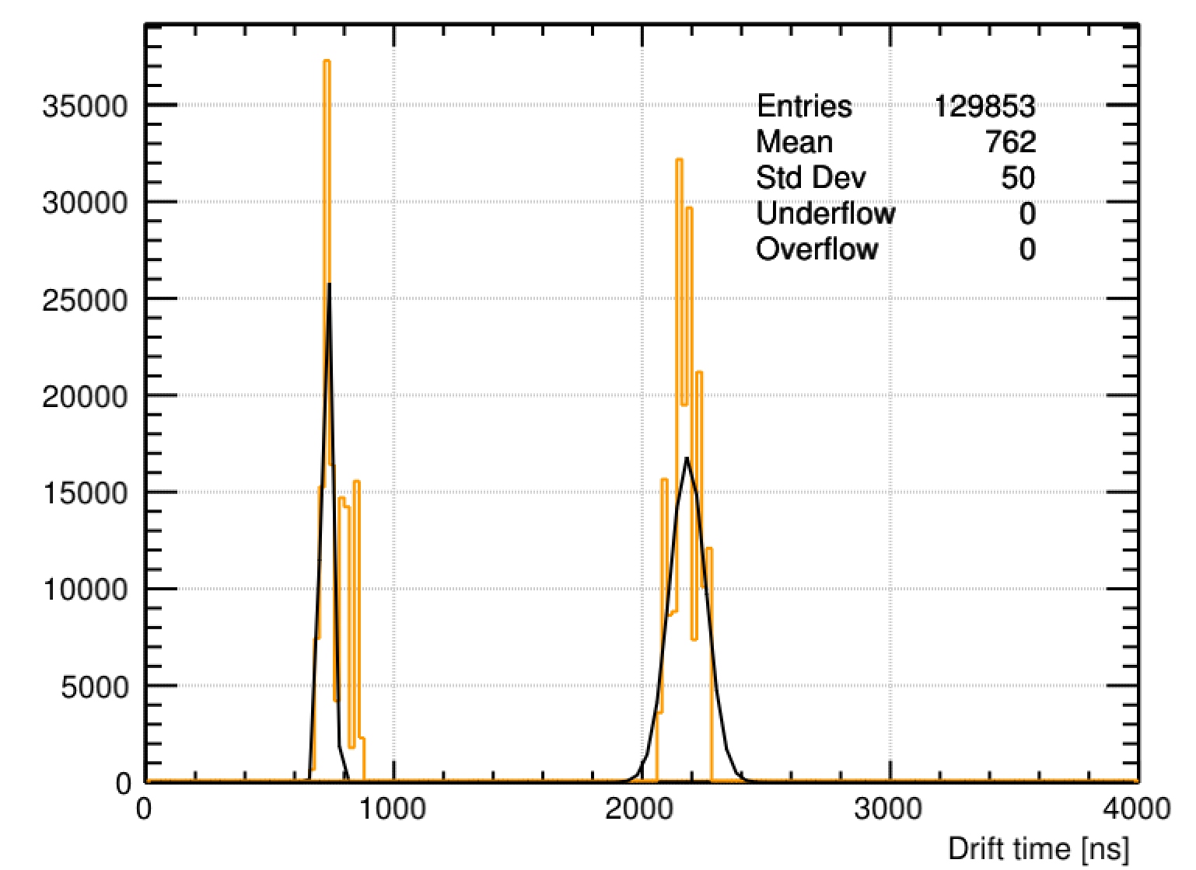


Run 11892: V_anode = +2115V, T=22.5812C, P=751.0872 torr
t_CH1 = 729.420 ns $±$ 10.79785 ns
t_CH2 = 2183.07 ns $±$ 36.7453 ns

