Slide 1
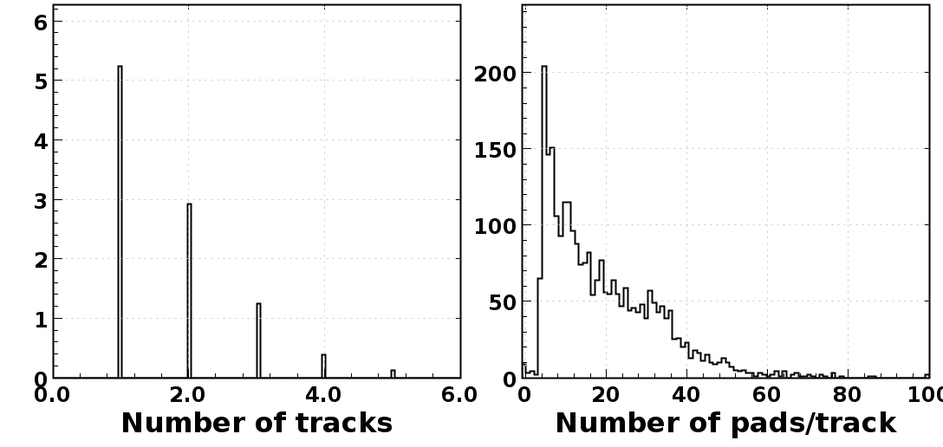
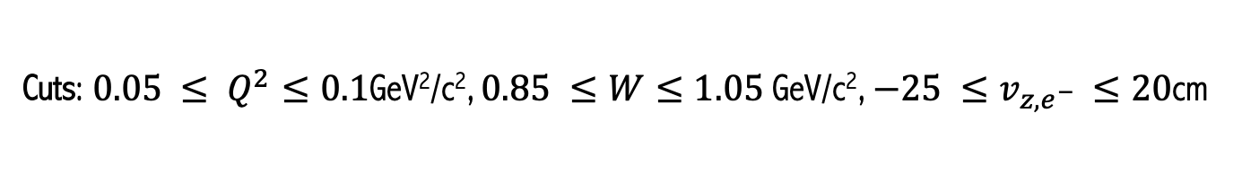
Run 11637 – RTPC Proton Analysis
Cuts: $0.05 ≤ Q^{2}≤0.1$GeV²/c², $0.85 ≤W≤1.05$ GeV/c², $−25 ≤v_{z,e^{−} }≤20$cm

Slide 2
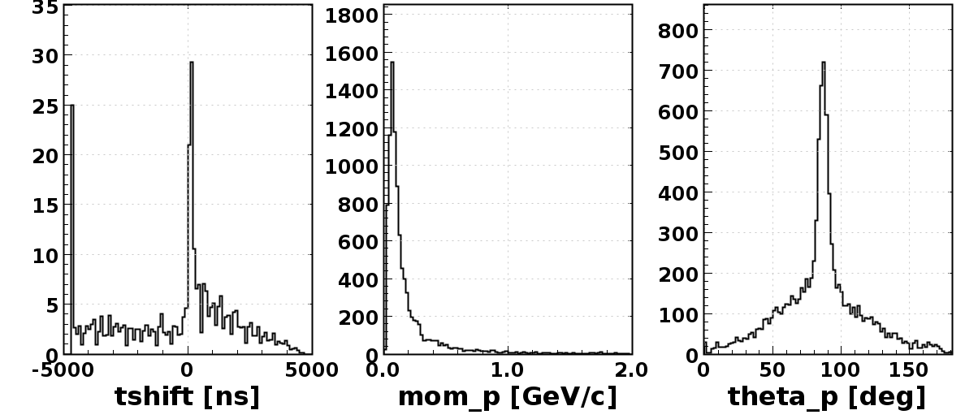
Run 11637 – RTPC Proton Analysis
Cuts: $0.05 ≤ Q^{2}≤0.1$GeV²/c², $0.85 ≤W≤1.05$ GeV/c², $−25 ≤v_{z,e^{−} }≤20$cm

Slide 3
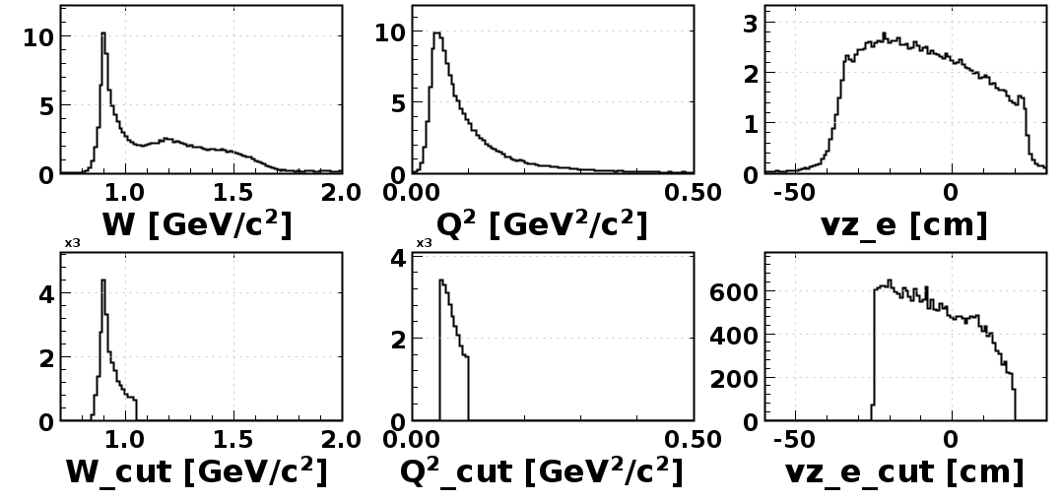
Run 11637 – RTPC Proton Analysis
Cuts: $0.05 ≤ Q^{2}≤0.1$GeV²/c², $0.85 ≤W≤1.05$ GeV/c², $−25 ≤v_{z,e^{−} }≤20$cm

Slide 4
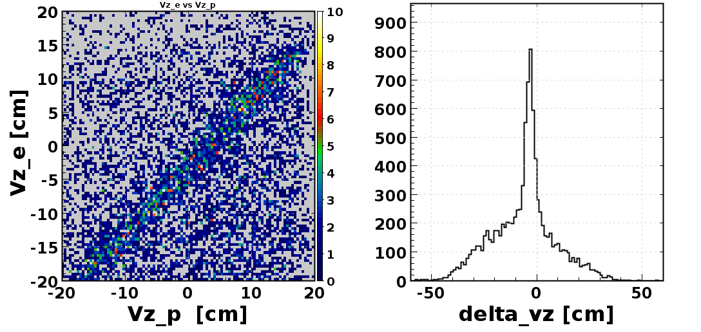
Run 11637 – RTPC Proton Analysis
Cuts: $0.05 ≤ Q^{2}≤0.1$GeV²/c², $0.85 ≤W≤1.05$ GeV/c², $−25 ≤v_{z,e^{−} }≤20$cm

Slide 5
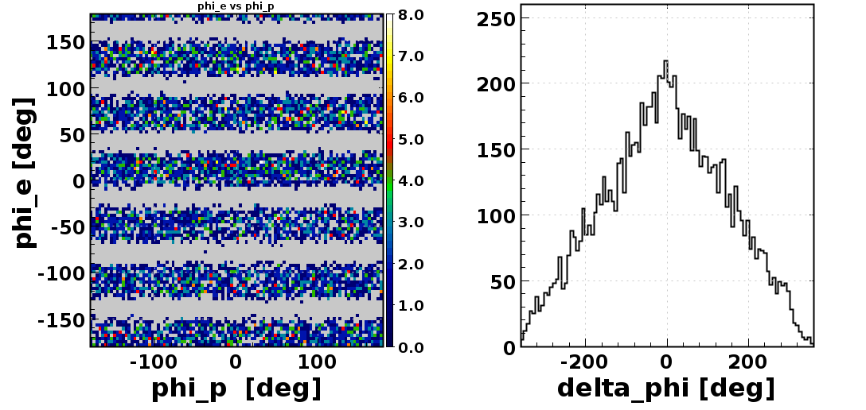
Run 11637 – RTPC Proton Analysis
Cuts: $0.05 ≤ Q^{2}≤0.1$GeV²/c², $0.85 ≤W≤1.05$ GeV/c², $−25 ≤v_{z,e^{−} }≤20$cm

Slide 6
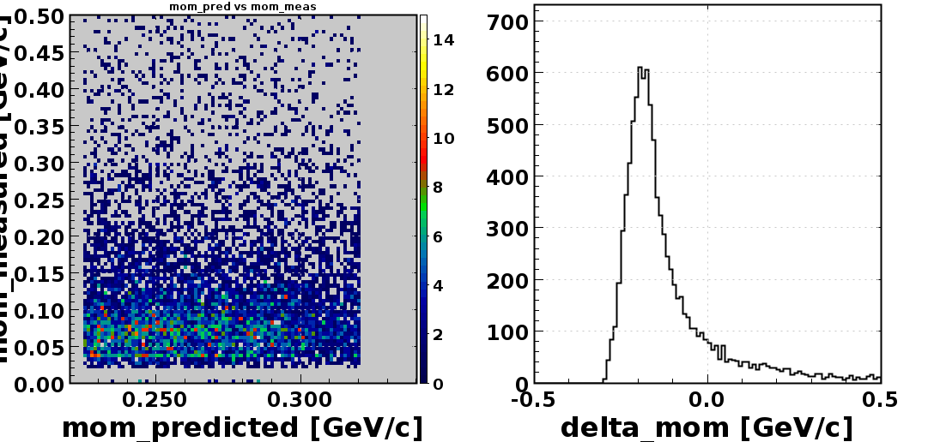
Run 11637 – RTPC Proton Analysis
Cuts: $0.05 ≤ Q^{2}≤0.1$GeV²/c², $0.85 ≤W≤1.05$ GeV/c², $−25 ≤v_{z,e^{−} }≤20$cm

Slide 7
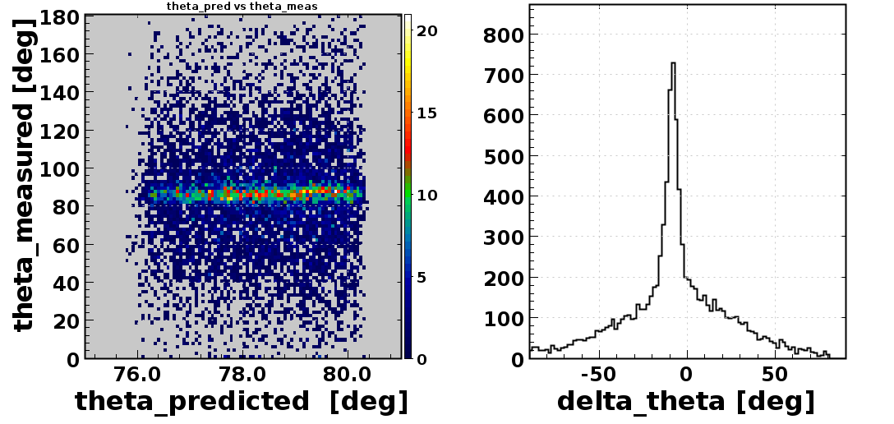
Run 11637 – RTPC Proton Analysis
Cuts: $0.05 ≤ Q^{2}≤0.1$GeV²/c², $0.85 ≤W≤1.05$ GeV/c², $−25 ≤v_{z,e^{−} }≤20$cm

