Slide 1
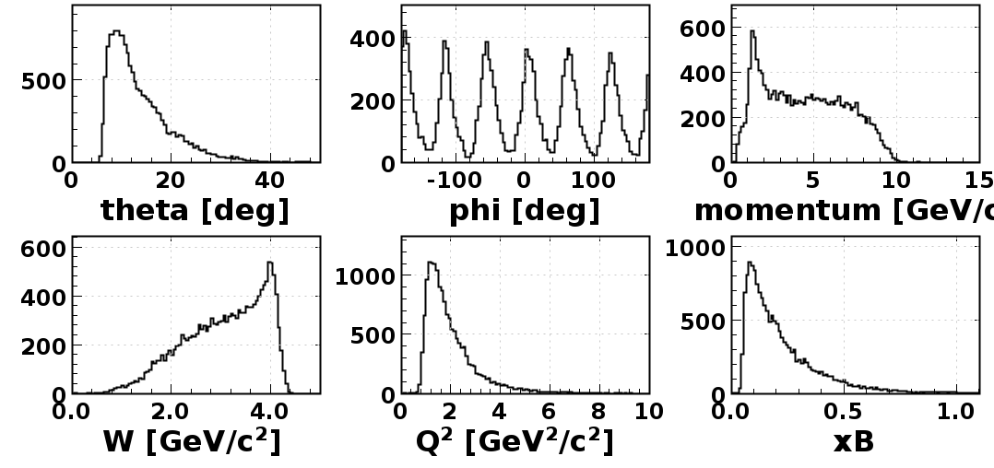
RG-F Analysis – Run 11663
Electron kinematics

Slide 2
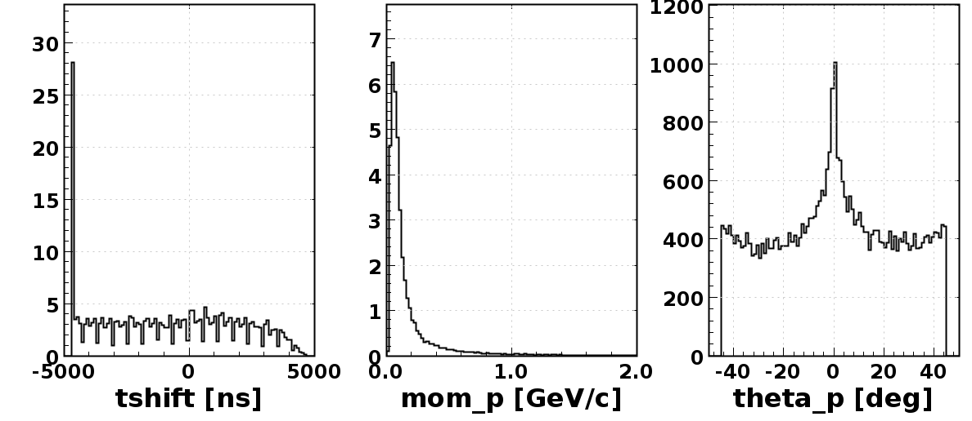
RG-F Analysis – Run 11663

Slide 3
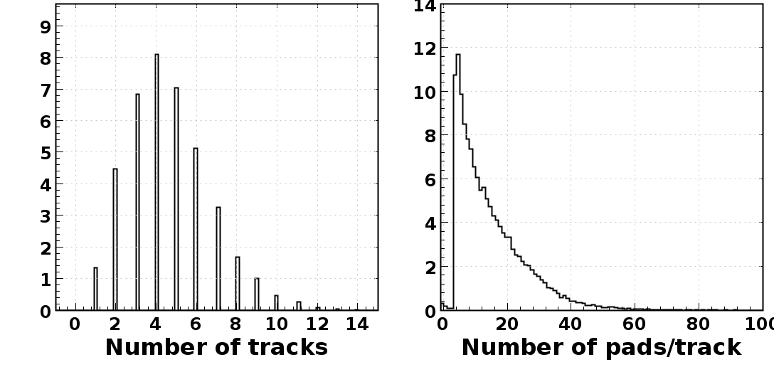
RG-F Analysis – Run 11663

Slide 4
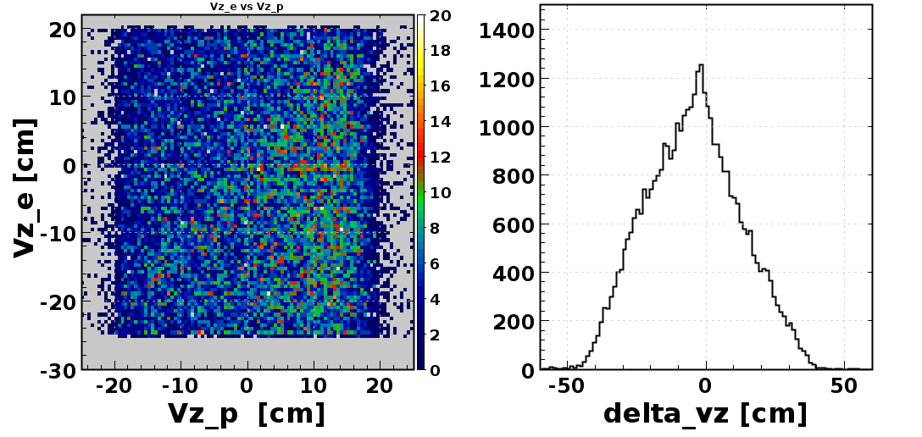
RG-F Analysis – Run 11663

Slide 5
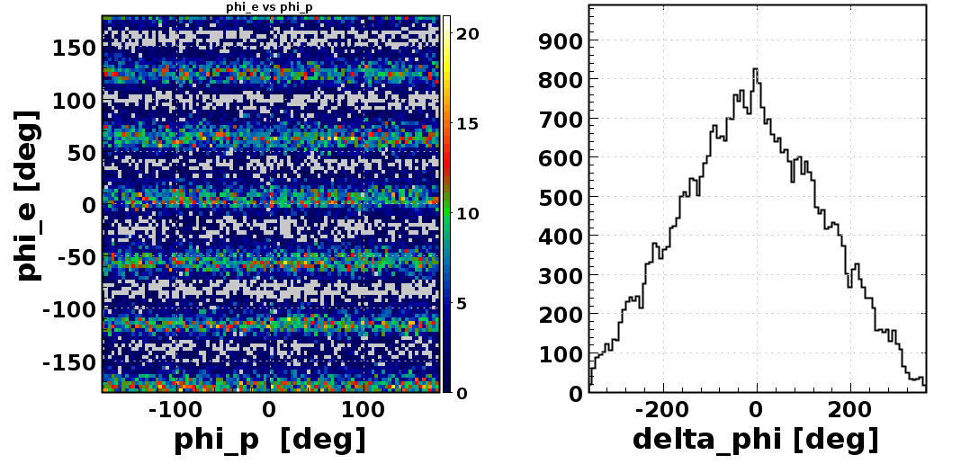
RG-F Analysis – Run 11663

