Slide 1
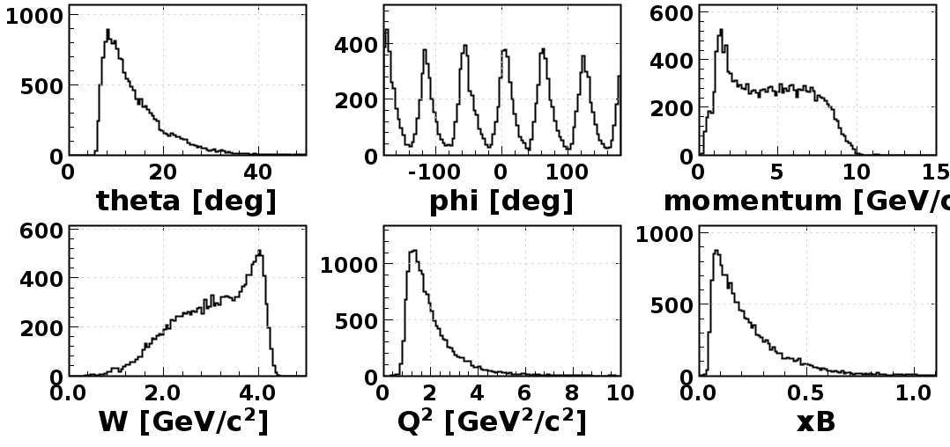
RG-F Analysis – Run 11662
Electron kinematics

Slide 2
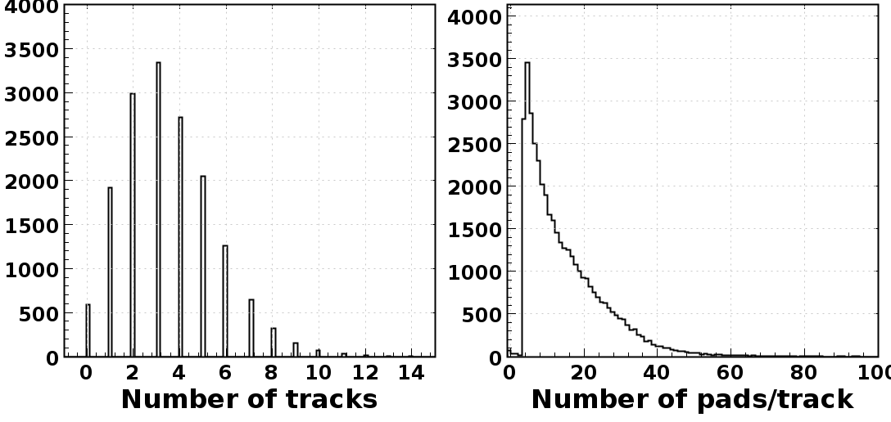
RG-F Analysis – Run 11662

Slide 3
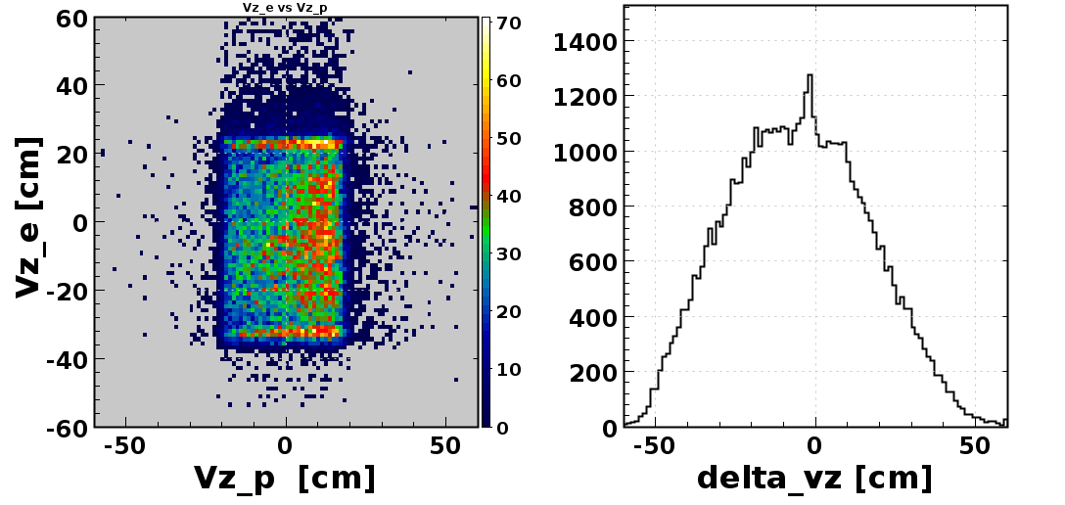
RG-F Analysis – Run 11662

Slide 4
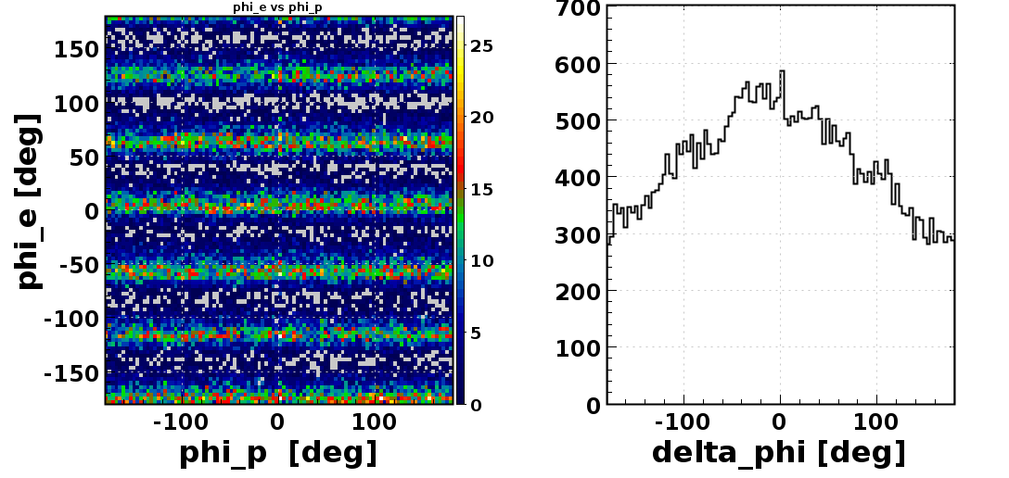
RG-F Analysis – Run 11662

