Slide 1
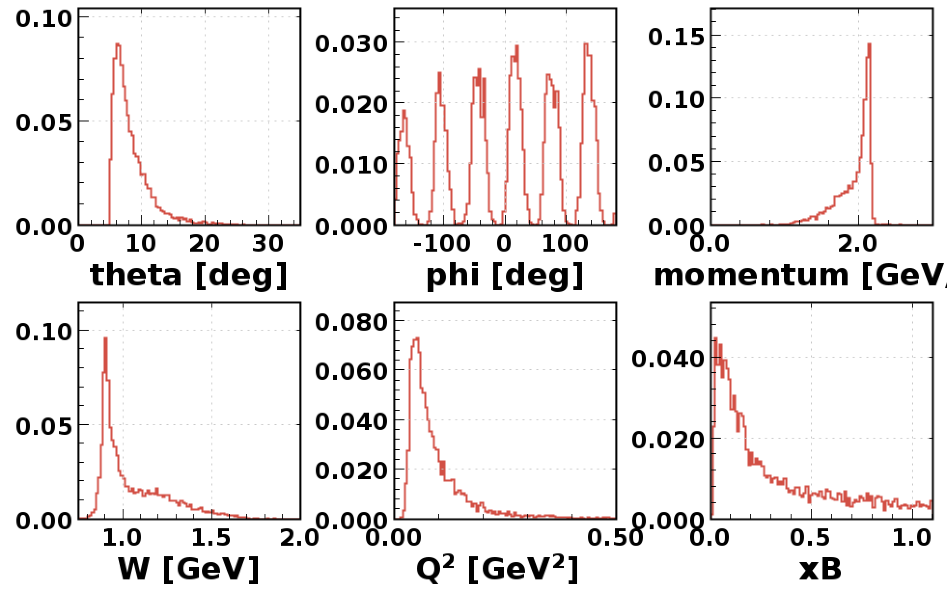
RG-F e ⁻ Analysis – Run 11637

Slide 2
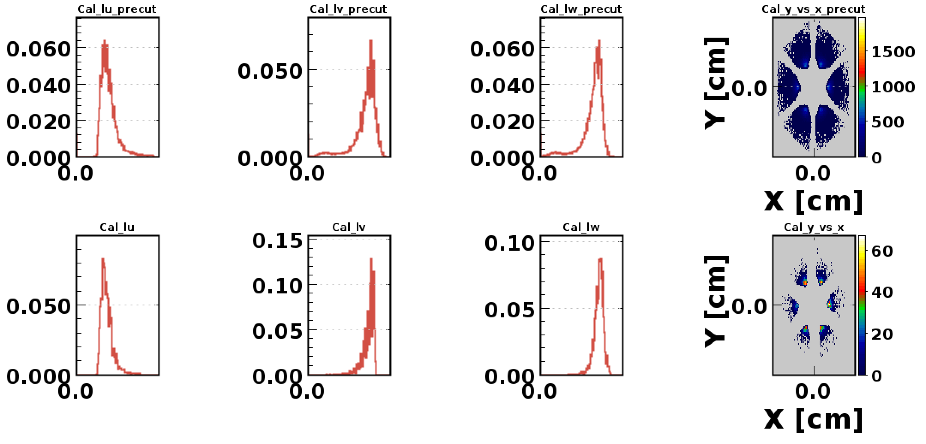
RG-F e ⁻ Analysis – Run 11637

Slide 3
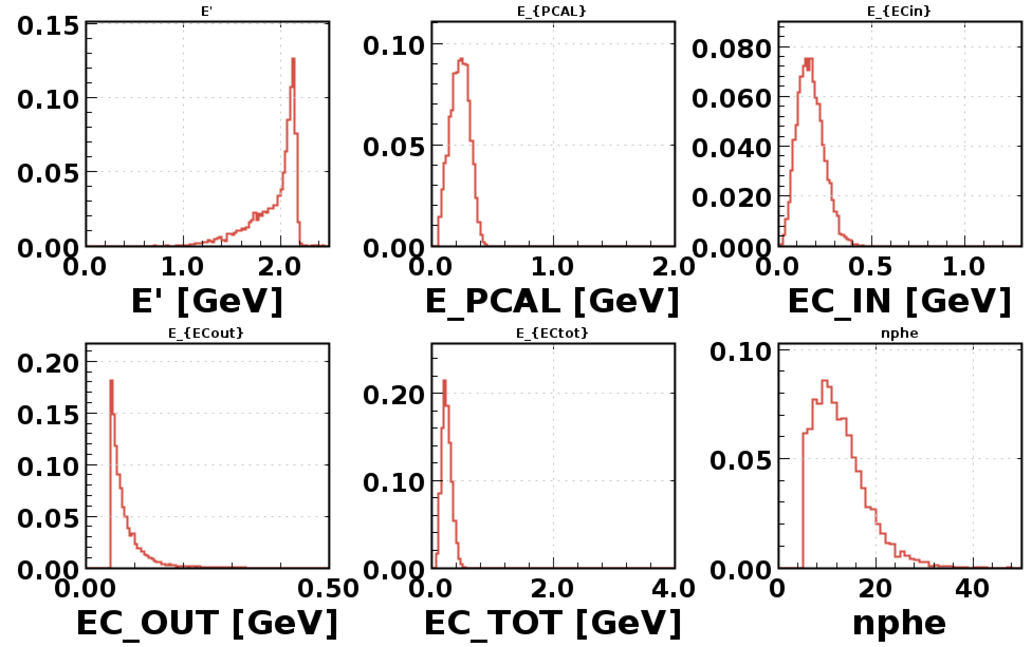
RG-F e ⁻ Analysis – Run 11637

Slide 4
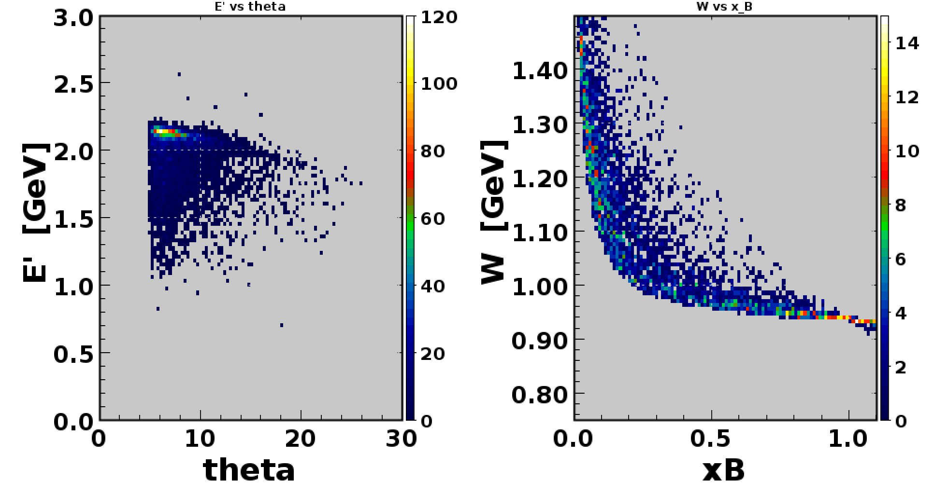
RG-F e ⁻ Analysis – Run 11637

Slide 5
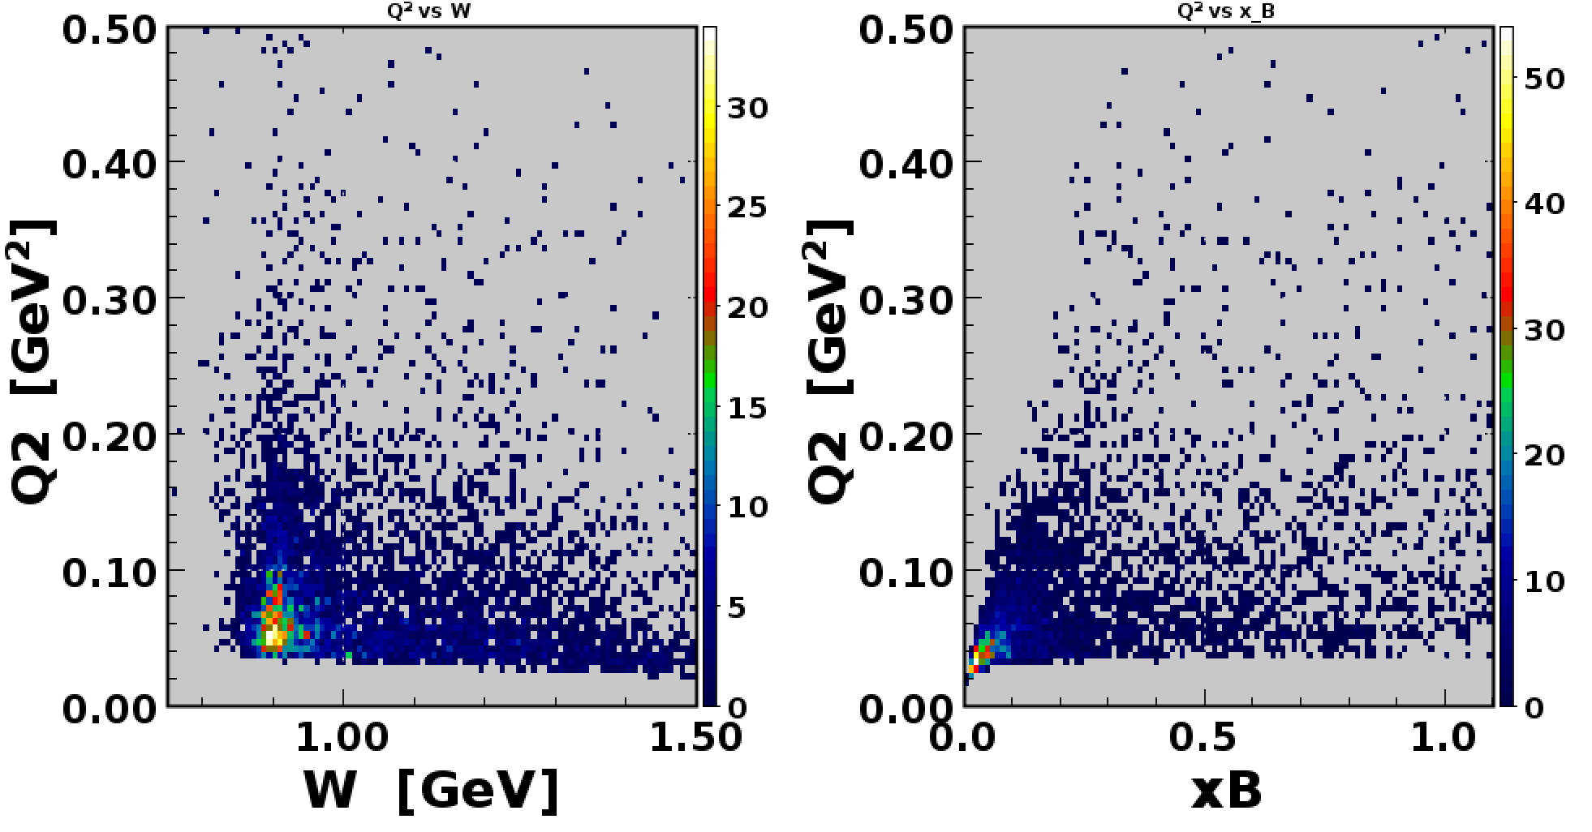
RG-F e ⁻ Analysis – Run 11637

Slide 6
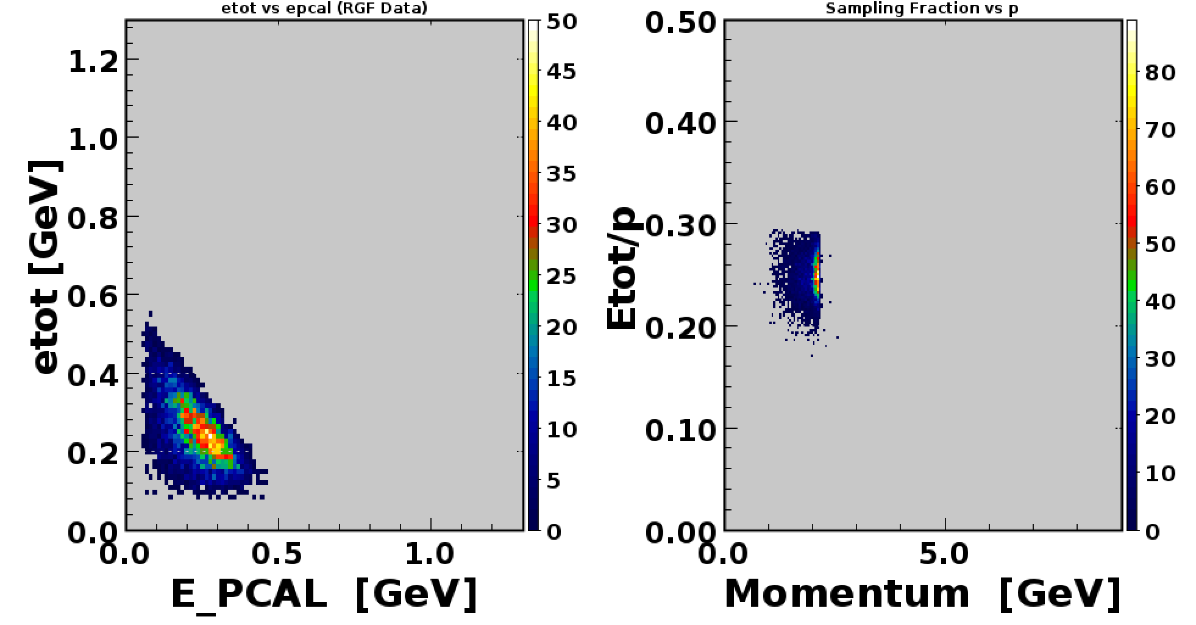
RG-F e ⁻ Analysis – Run 11637

