Slide 1
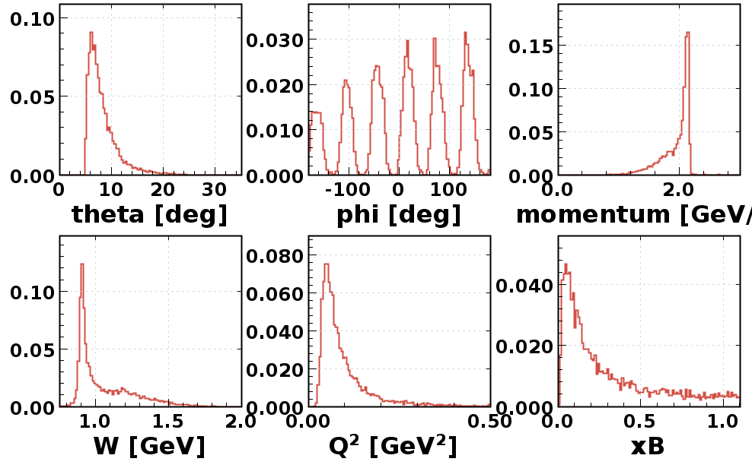
RG-F e ⁻ Analysis – Run 11645

Slide 2
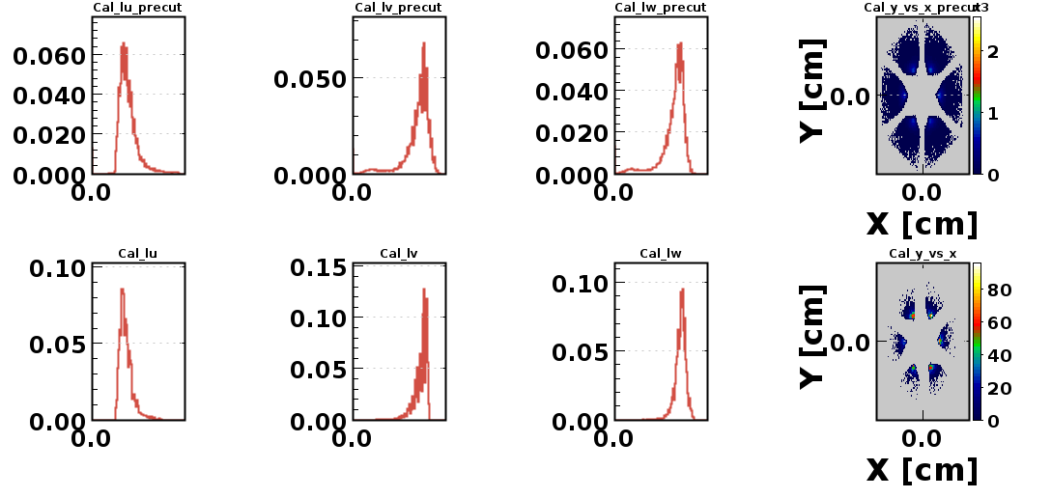
RG-F e ⁻ Analysis – Run 11645

Slide 3
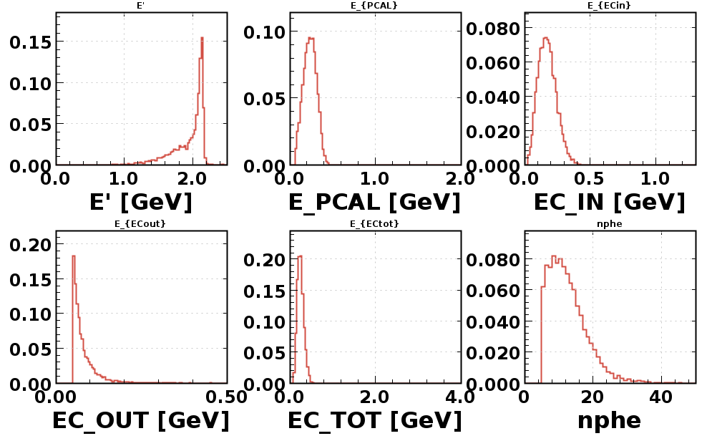
RG-F e ⁻ Analysis – Run 11645

Slide 4
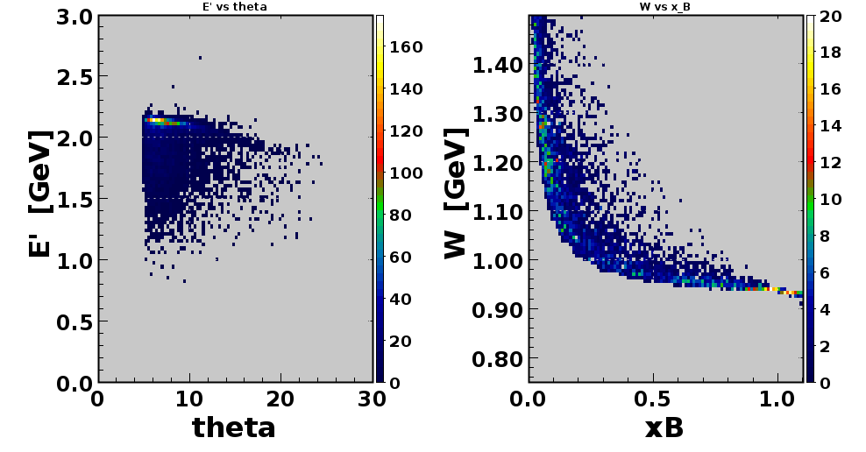
RG-F e ⁻ Analysis – Run 11645

Slide 5
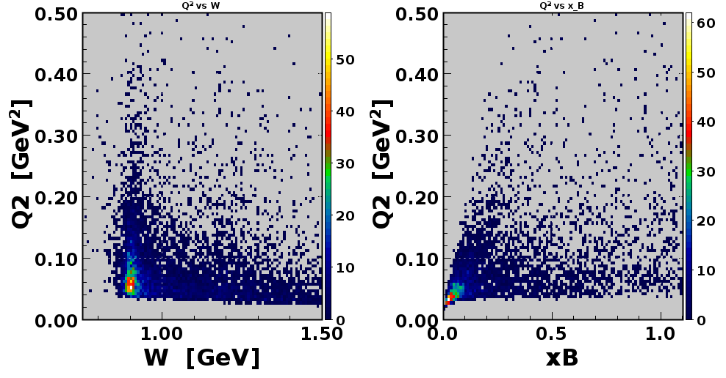
RG-F e ⁻ Analysis – Run 11645

Slide 6
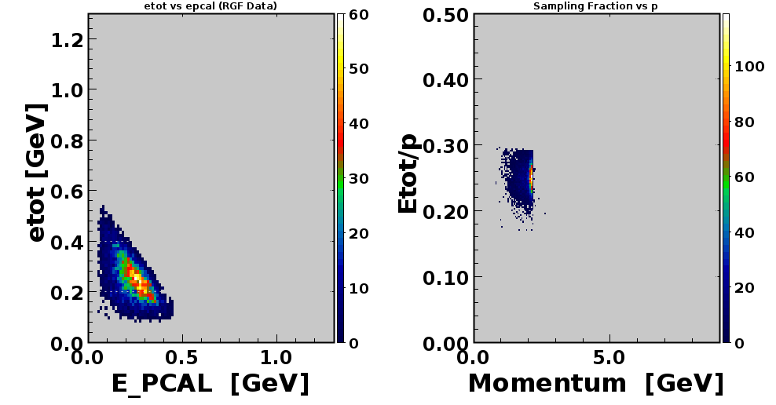
RG-F e ⁻ Analysis – Run 11645

