Slide 1
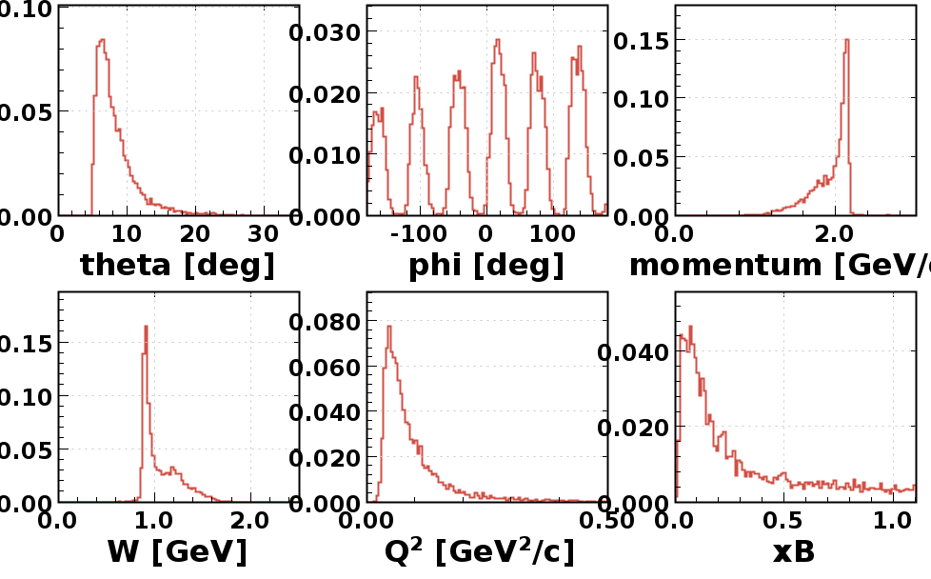
RG-F e ⁻ Analysis – Run 11656

Slide 2
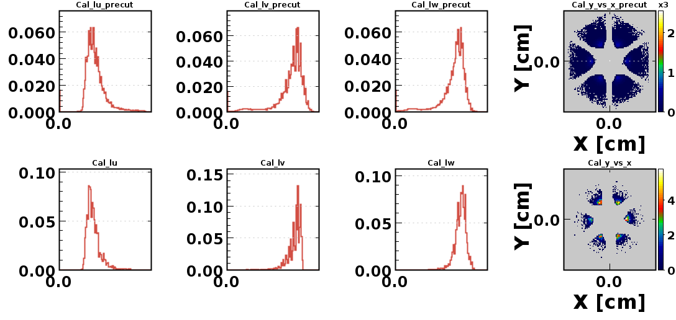
RG-F e ⁻ Analysis – Run 11656

Slide 3
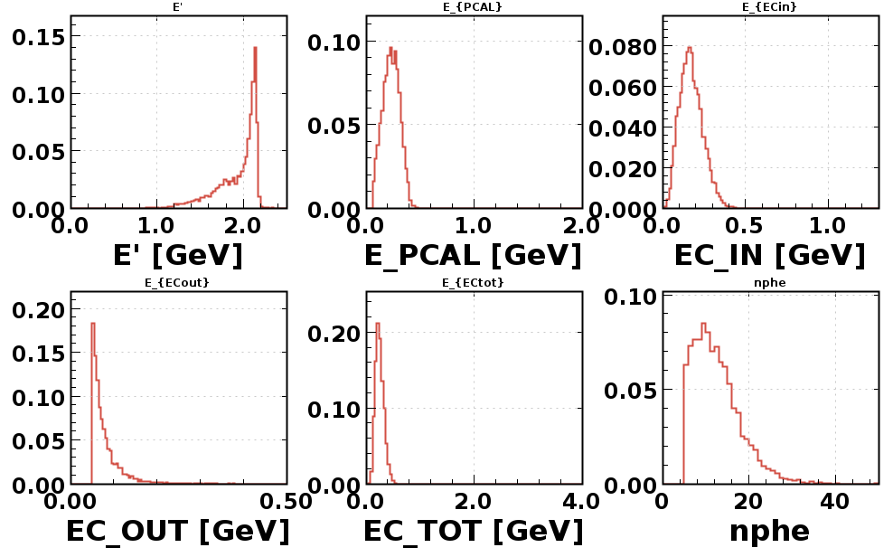
RG-F e ⁻ Analysis – Run 11656

Slide 4
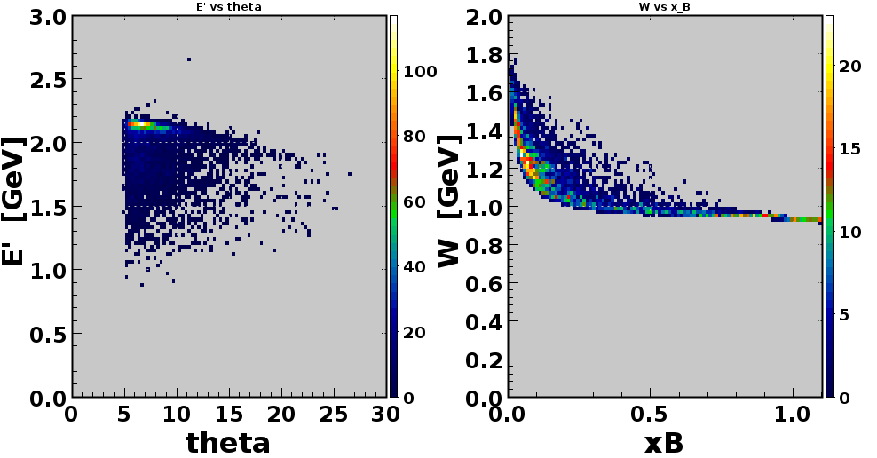
RG-F e ⁻ Analysis – Run 11656

Slide 5
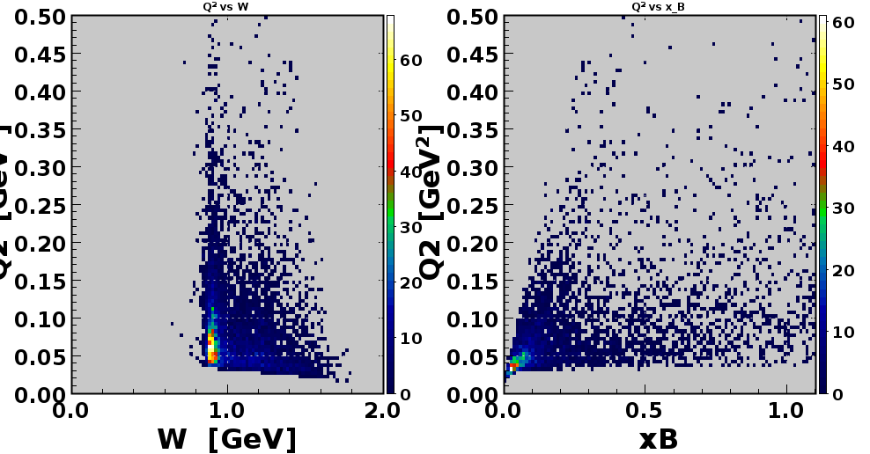
RG-F e ⁻ Analysis – Run 11656

Slide 6
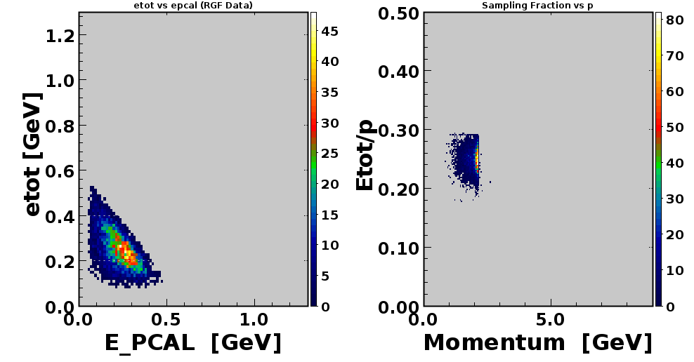
RG-F e ⁻ Analysis – Run 11656

