Slide 1
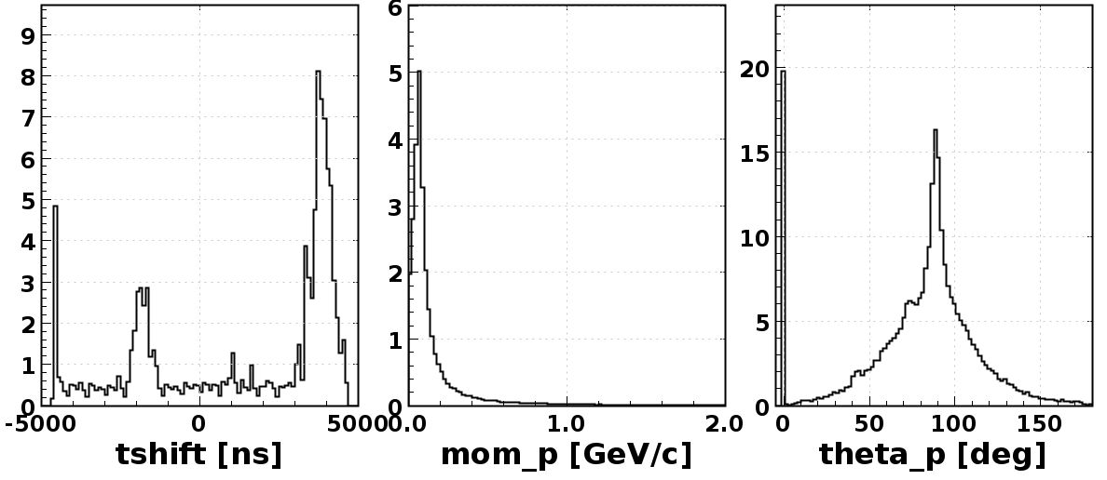
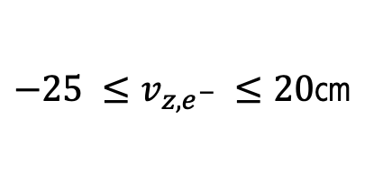
Run 11802 – RTPC Analysis
$−25 ≤v_{z,e^{−} }≤20$cm

Slide 2
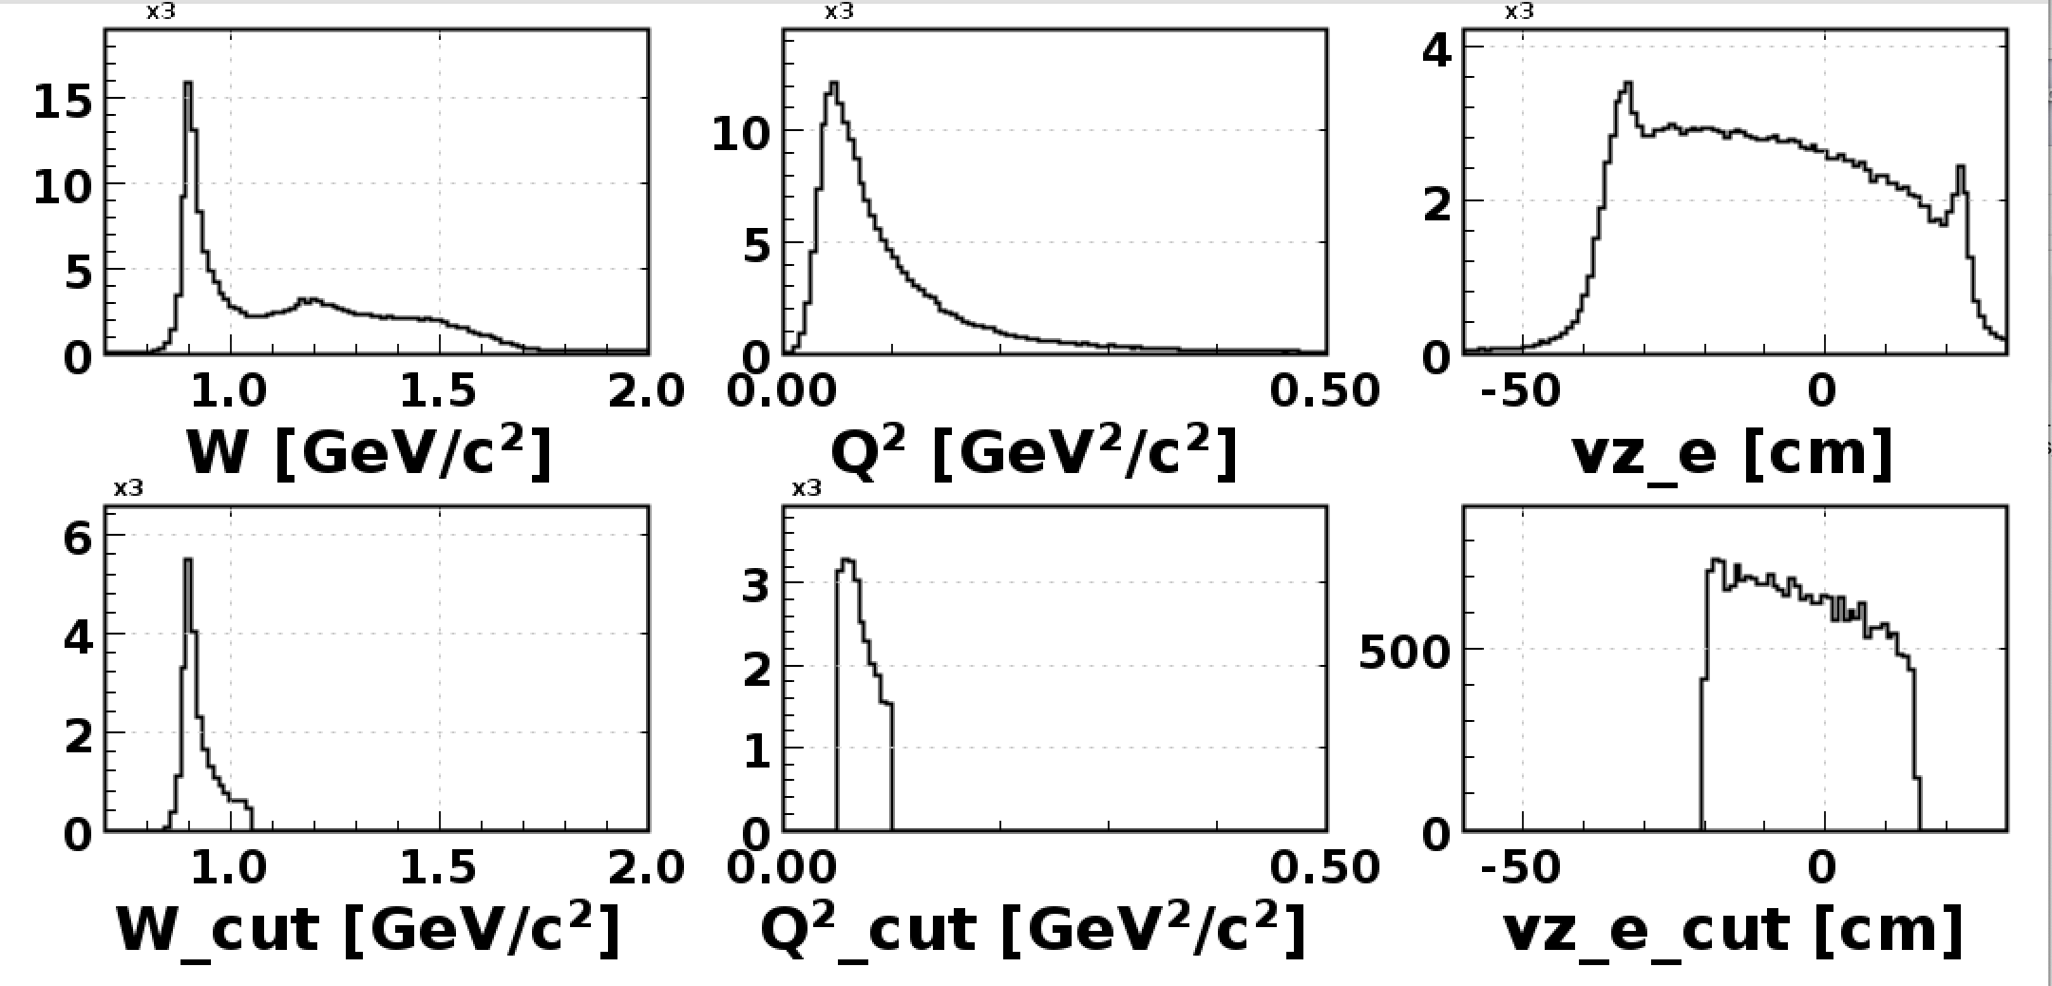
Run 11802 – RTPC Analysis
$−25 ≤v_{z,e^{−} }≤20$cm

Slide 3
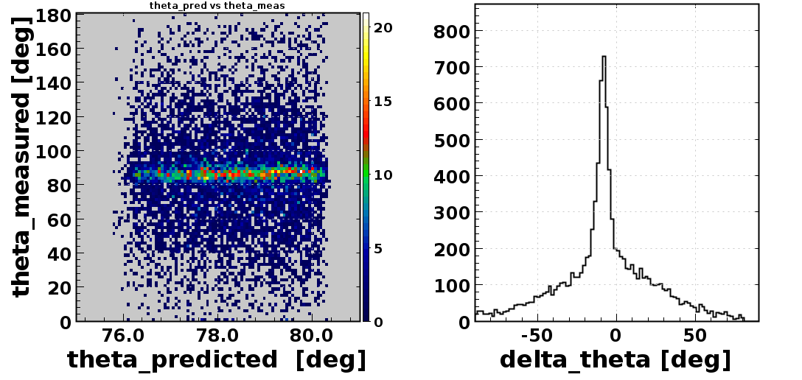
Run 11802 – RTPC Analysis
$−25 ≤v_{z,e^{−} }≤20$cm

Slide 4
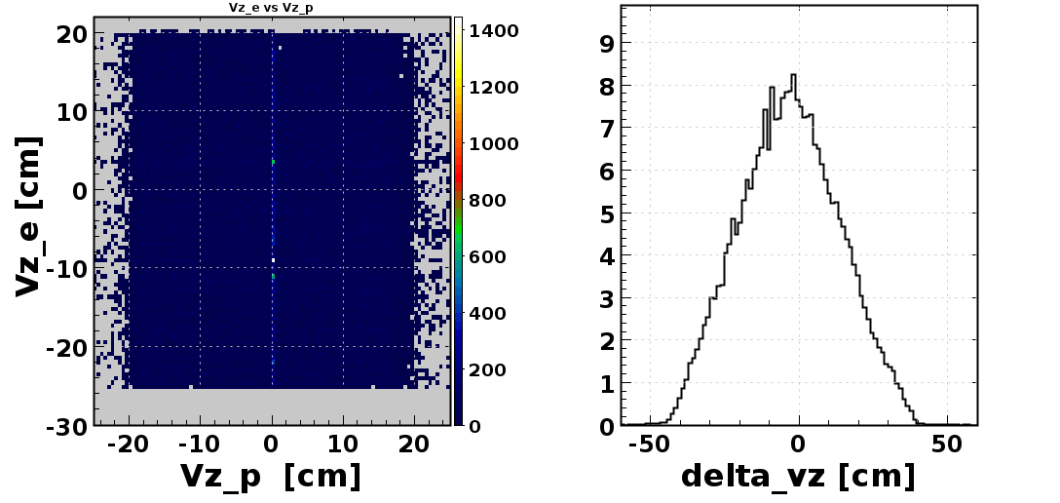
Run 11802 – RTPC Analysis
$−25 ≤v_{z,e^{−} }≤20$cm

Slide 5
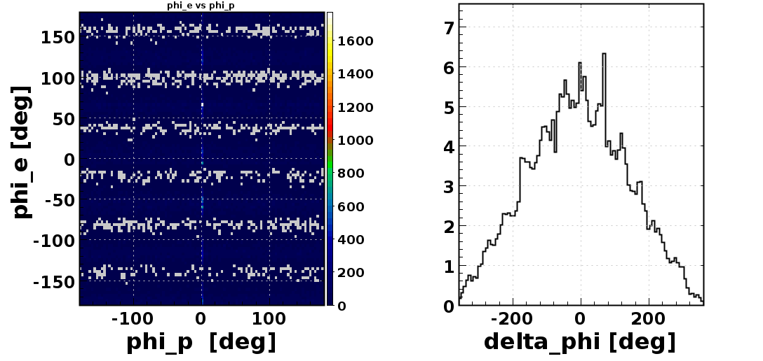
Run 11802 – RTPC Analysis
$−25 ≤v_{z,e^{−} }≤20$cm

