Slide 1
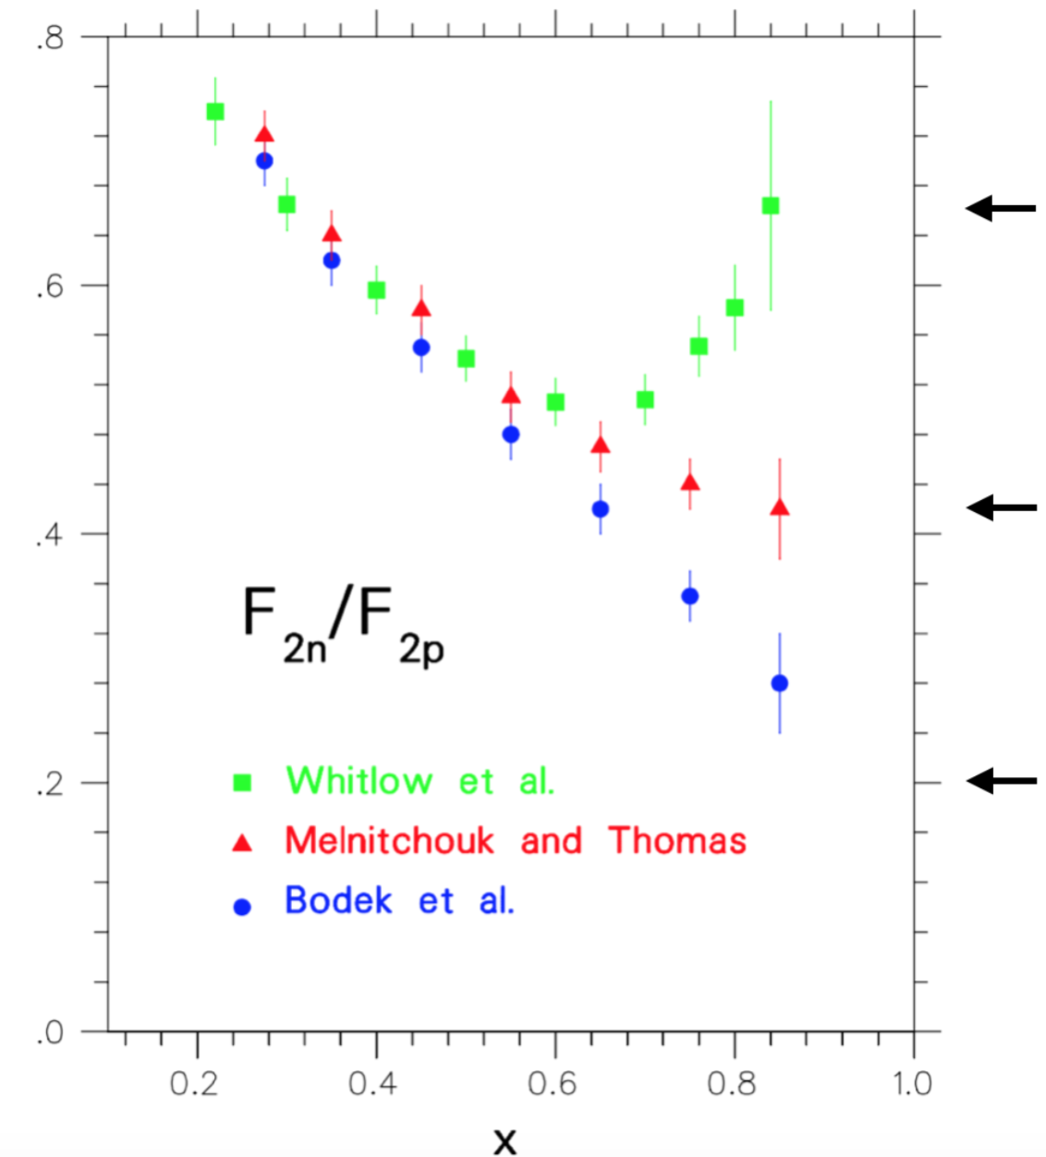

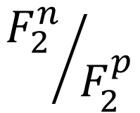
$${F_{2}^{n}}/{F_{2}^{p}}$$
SU(6) quark
model
d/u = 1/2
pQCD
d/u = 1/5
1-gluon
exchange
d/u = 0
$$x$$

