Slide 1
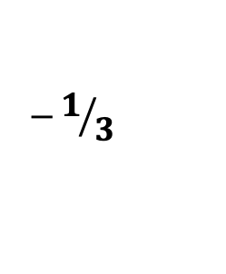


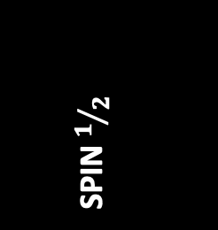




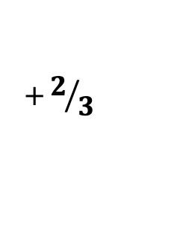
THE STANDARD MODEL
of particle physics
Up
Charm
Top
Gluons
$$+2/3$$
QUARKS
$$0$$
Down
Strange
Bottom
Photon
$$−1/3$$
SPIN 1
FERMIONS
BOSONS
SPIN $1/2$
Electron
Muon
Tau
W+
$$+1$$
$$−1$$
Z
$$0$$
W-
$$−1$$
LEPTONS
Electron
Neutrino
Muon Neutrino
Tau Neutrino
Higgs
$$0$$
$$0$$
SPIN 0
CHARGE
CHARGE

