Slide 1
IBM Data Science Professional Certification
Applied Capstone Project
Recommending a Friend where to open a Sub-Saharan African Restaurant

Slide 2
Introduction
According to Wikipedia, London is the largest City in the UK and has been a major settlement for two millennia now. London is also considered one of the world's most important global cities in the world with attributes such as most visited, most infleuntial, most expensive and most vegetarian freindly city in the world. There is a saying in my culture which goes like this " L'homme c'est le ventre et le bas ventre". This just means a man cannot do without food and african food is known to be one of the best in the world. I can only recommend having a taste if you have never done by now

Slide 3
Business Problem and Data Set
I have a friend living in Manchester who came some two months back to pay me a visit. He is into Food Business and is looking to open up a Sub-Saharan-African Restaurant in London neighborhood. Since he knows i am a data scientist, he asked to know which neighborhood will be the best suited for his Restaurant. The idea of this project is to locate the best Neighborhood in London to open a Restaurant for people of Sub-Saharan African descend. I will use the immigration data in London and Foursquare to evaluate and select the neighborhood suitable for my friend. This information could be of great help to Business people who may want to modify their Menu based on the preferences of the people living in that particular area.

Slide 4
The data that would be used for this project is the immigration data taken from the London data store. This data presents Annual population survey based on diversity or country of birth. This data is published by the office for national statistics (ONS). The data set gives us information on the annual population survey of migrants, immigrants, british, UK born between 2004 and 2017. The population figures are measured in thousands.

Slide 5
Variable Description
- Year tells us the year in which the survey was conducted
- Area_Code is the code of the area in which the survey was conducted
- Area_Name is the name of the area in question
- Broad_goup tells us if the people surveyed are British, from the European Union or Non-European Union
- Detailed_group specifies where the people surveyed exactly came from. e.g from north america or south asia
- Estimate provides the estimated total number of people surveyed in thousands

Slide 6
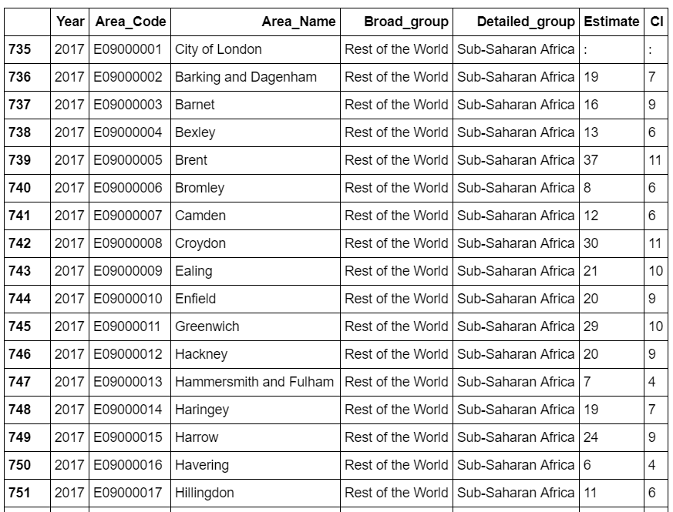
A snapshot of the data set looks like this

Slide 7
Methodology
After retrieving the data,i prepared the data in such a way that we only had the data we need to proceed with our analysis (data with Detailed_group = Sub-Saharan Africa
Entries with funny estimates or null values were excluded while i used Foursqaure to get information about african Restaurants in and around London
Then i made use of the Euclidean Clustering method to classify the African Restaurants in and around London by their Neighborhoods.

Slide 8
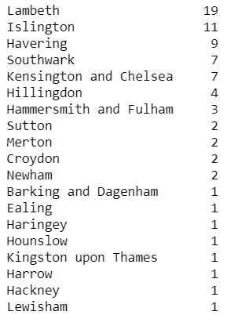
Results
From the results on the right, we can see that though the sub saharan population has continuously been high or increasing in Croydon and Ealing, there are only 2 and 1 African Restaurant in these Locations.

Slide 9
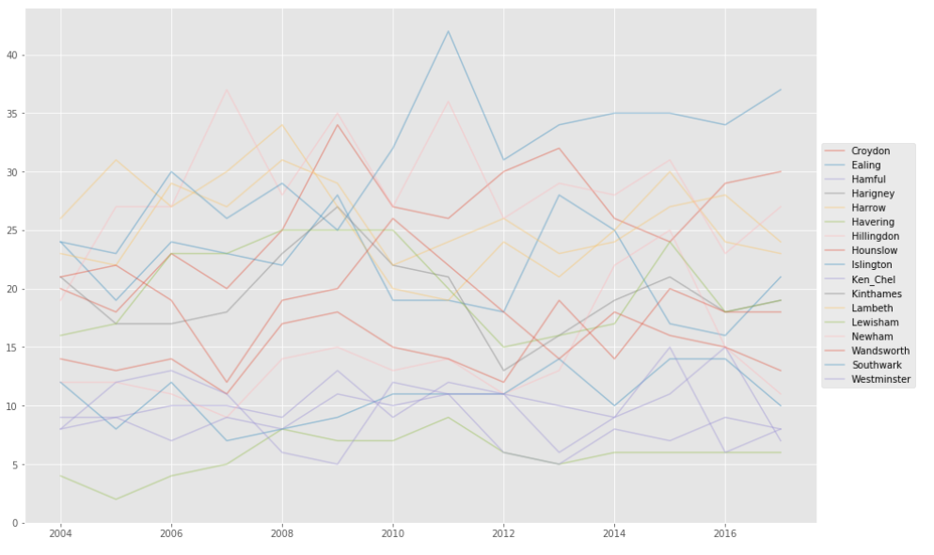
Results
Croydon and Ealing are the two regions where more Sub-Saharan Africans are moving to as can be seen in the time series plot below

Slide 10
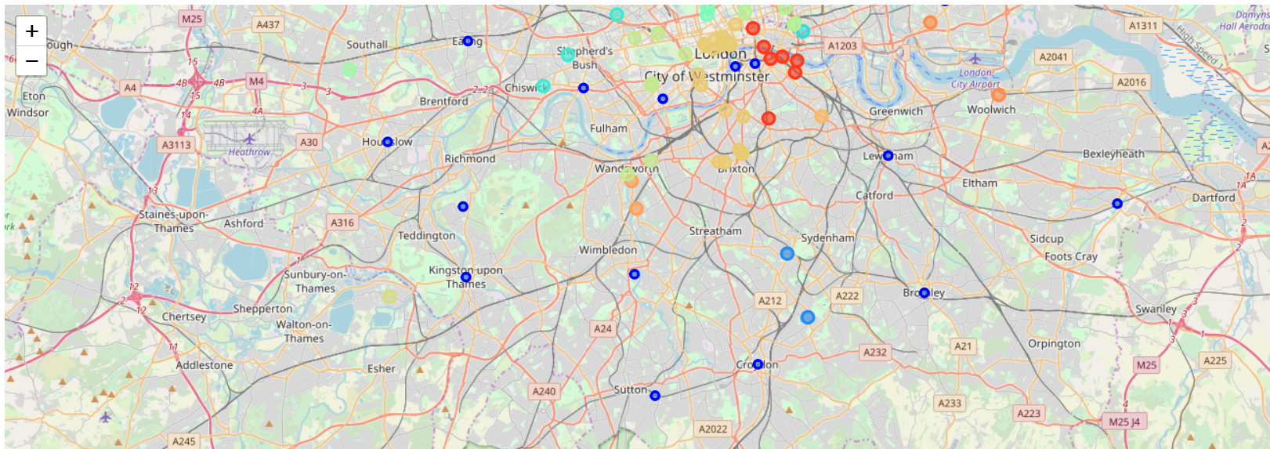
African Restaurants clustered into 6 categories as shown below

Slide 11
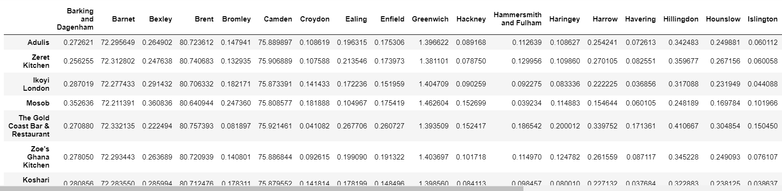
Euclidean Distances

Slide 12
Discussion
I noticed that using the foursquare data, one can get different results with the Geocode especially when you rerun the notebook
One could thing of using another Clustering Method to compare results but from the euclidean method i used, i would recommend My friend to open the African Restaurant either in Croydon or Ealing

Slide 13
Conclusion
This project helped me to put some hands on into what we practiced about using foursqaure data to really draw maps and explore neighborhoods

Slide 14
Thanks for Reading through

