Slide 1
CST8227 Interfacing
Lab 1 Help Slides

Slide 2
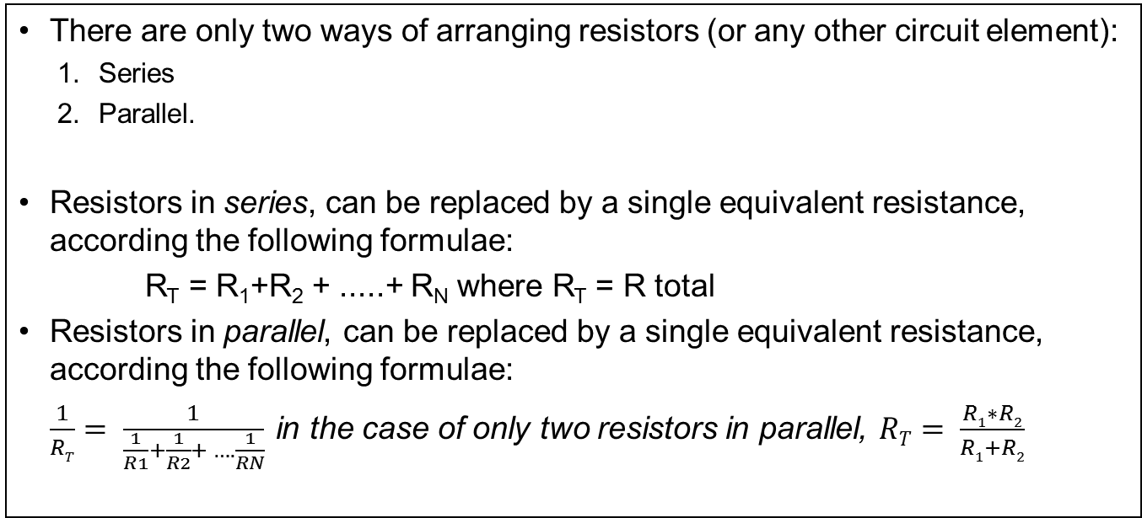
Series and Parallel Circuits
There are only two ways of arranging resistors (or any other circuit element):
Series
Parallel.
Resistors in series, can be replaced by a single equivalent resistance, according the following formulae:
R_{T} = R₁+R₂ + .....+ R_{N} where R_{T} = R total
Resistors in parallel, can be replaced by a single equivalent resistance, according the following formulae:
$\frac{1}{RT}= \frac{1}{\frac{1}{R1}+\frac{1}{R2}+ ….\frac{1}{RN}}$ in the case of only two resistors in parallel, $RT= \frac{R1∗R2}{R1+R2}$

Slide 3
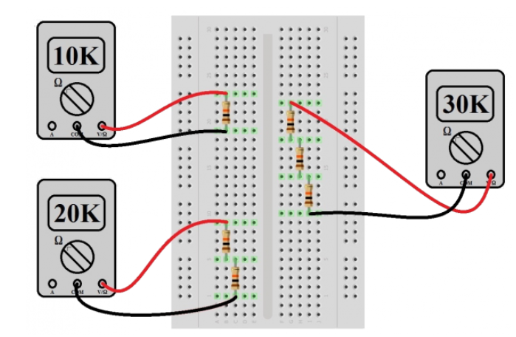
Series Components in a Protoboard
Graphic courtesy of https://learn.sparkfun.com/tutorials/series-and-parallel-circuits

Slide 4
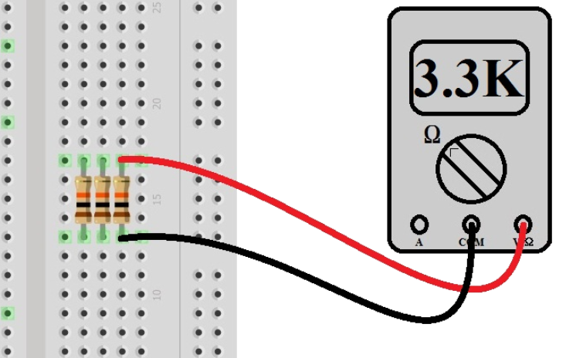
Parallel Components in a Protoboard
Graphic courtesy of https://learn.sparkfun.com/tutorials/series-and-parallel-circuits

Slide 5
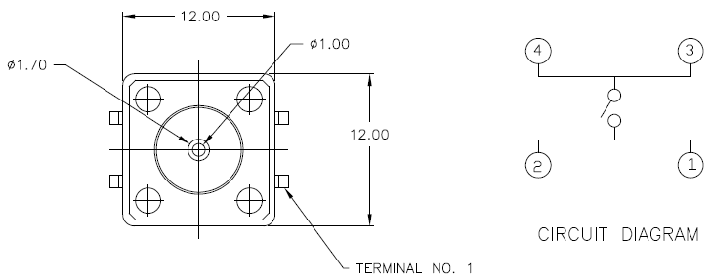
Switch pinout and Schematic

Slide 6
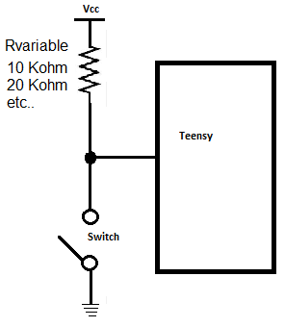
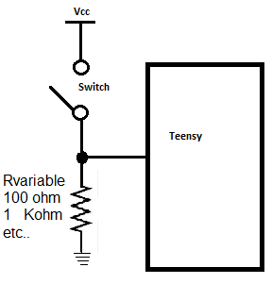
Pull-Up and Pull-down Resistors
Pull-down configuration
Pull-Up configuration

Slide 7
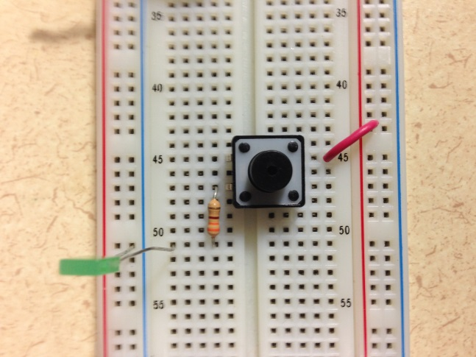
Pull-down Configuration
Pull-down configuration

Slide 8
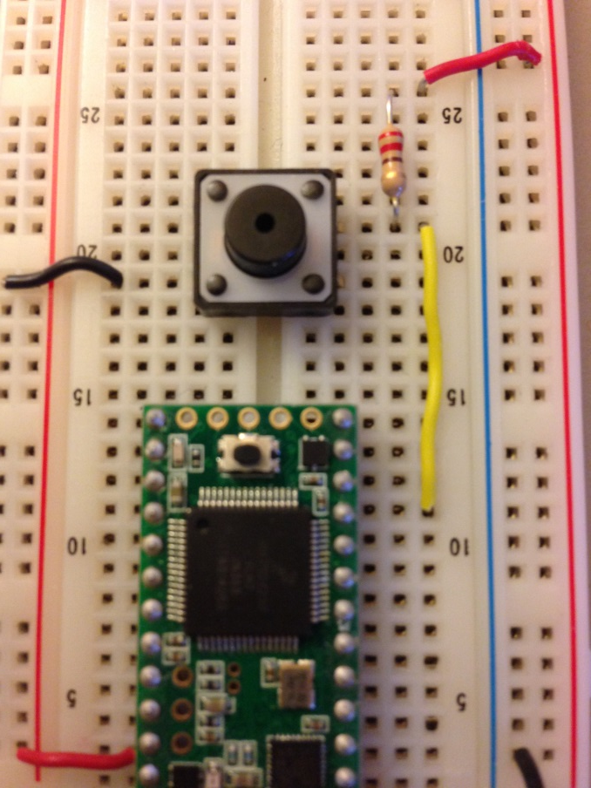
Pull-Up Configuration
Pull-Up configuration

Slide 9
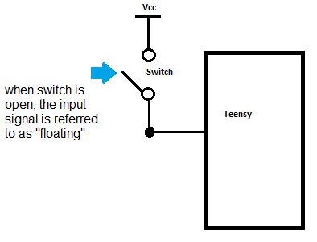
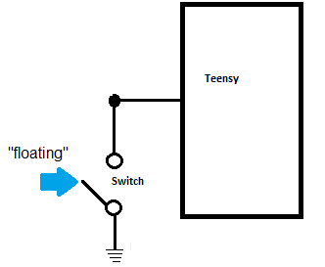
Why use these two configurations?
To avoid a condition known as “floating inputs”.
A floating input is an input that is not connected to a GND or VCC – it is left open-circuited.
Anything nearby may accidently trigger a false positive and the circuit may “think” that a relevant input has been specified.
Things that could accidently trigger a false positive could be static electricity in the room (especially in dry Canadian winters), electrical noise (perhaps due to fluorescent lights), etc…

Slide 10
Some noteworthy definitions
Closed circuit:
In order for current to flow, a circuit must have a closed path (i.e. all components are connected in either a series or parallel configuration).
Open circuit:
A circuit that has a component that is not interconnected
Continuity Test and short circuits:
A test that determines if a circuit is open, closed or a short circuit.
Use a multimeter set on resistance [Ω]
If the meter reads ~0 Ω, then the circuit is a short circuit
If the meter reads something like O.L. (overload) then the amount of resistance is [theoretically] infinite, and is called an open circuit.

