Slide 1
FIREWALL
Prepared by: Niladri Sengupta & Varun Chapgar

Slide 2
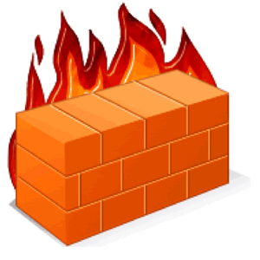
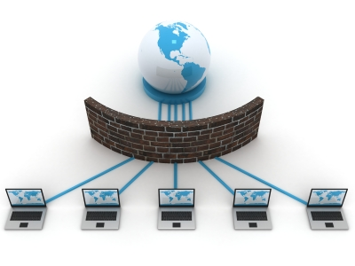
What is a Firewall?
Meaning: A wall designed to prevent the spread of fire.
Technological meaning: To prevent and/or remove malware from entering or accessing a computer system that has an active connection to the internet.
Firewall is any software or hardware that is used to filter incoming traffic and/or avoid direct access to the internet.
Origin of name: The wall is referred to the packet filtering and the fire is referred to the malware.
Every firewall goes through a series of standard tests before being sold in the market.

Slide 3
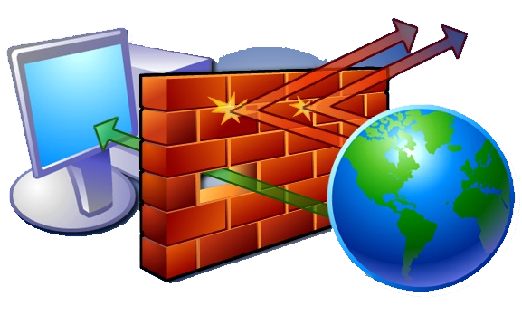
How does Firewall work?
The internet communicates in terms of packets. Every bit of information is divided into several packets (sending and receiving).
Different segments of the internet operates in different protocols and rules, which results in the packets being sent or received according to those protocols.
When a computer system receives a packet in order to receive and accept the packet, the protocol of the computer system and the packet has to match along with the destination address given in the packet.
When the protocols are matched, the series of packets are passed through another filter because some file types are not allowed to be send over the internet (example: batch files)

Slide 4


Why do we need Firewall?
Having an active internet connection leaves you vulnerable to hackers who will attempt to access your personal and financial information stored on your system.
A firewall acts as a shield or fortification between your computer system and the internet.
When connected, and accessing the internet, the system is in a constant state of uploading and downloading information. All information entering the system pass through the firewall which examines each small packet of information and blocks those that do not meet the security criteria.

Slide 5

Least Secured System
Having no Firewall (please do not attempt)
WEP or any internet security developed more than 4 years ago.
It only takes a few minutes for crack/decoded a WEP encryption. It is no longer used.
Old security systems are no longer reliable because there are many programs that can pass through them without any human help.

Slide 6

Regular Secured System
WPA2-PSK (Wi-Fi Protected Access 2 – Pre-Shared Key):
WPA2-PSK (TKIP) – Temporary Key Integrity Protocol. Used to replace the old and unreliable WEP.
WPA2-PSK (AES) – Advanced Encryption Standard
A standard consumer-level anti-virus that adds a second layer of security along with the anti-virus.

Slide 7
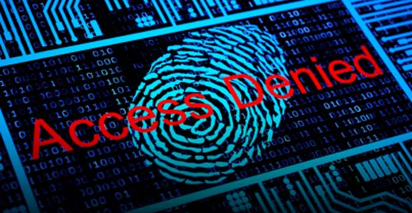
Advanced Secured System
WPA2-PSK (AES) – Advanced Encryption Standard
A standard consumer-level anti-virus that adds a second layer of security along with the anti-virus.
VPN – Virtual Private Network. Accessing the internet from a remote private server while the user-based system is else where.
TOR – The Onion Router. It disguises the identity of the user by moving traffic across different TOR servers. It encrypts all the traffic such that the it cannot be traced.

Slide 8
Strength of Different Types of Firewall
We took four identical computer systems with different levels of Firewalls installed in each of them.
System 1 – No firewall or any sort of security protocol
System 2 – Old Firewall (example: WEP)
System 3 – WPA2-PSK (TKIP) + anti-virus
System 4 – WPA2-PSK (AES) + anti-virus + VPN + TOR
After setting up the systems, identical malware was exposed to it via closed connection. The systems were judged based on the following:-
1 - Detection Capability. 2 – Performance Check. 3 – Data Usage Privileges. 4 – System Recovery

Slide 9
Results - 1

Slide 10
Results - 2

Slide 11
Recovery
System - A: To use again, complete reformat, hardware changes recommended
System - B: An operating system reformatting required
System - C: Full system anti-virus run cleanup required
System - D: Little to no action required.

Slide 12
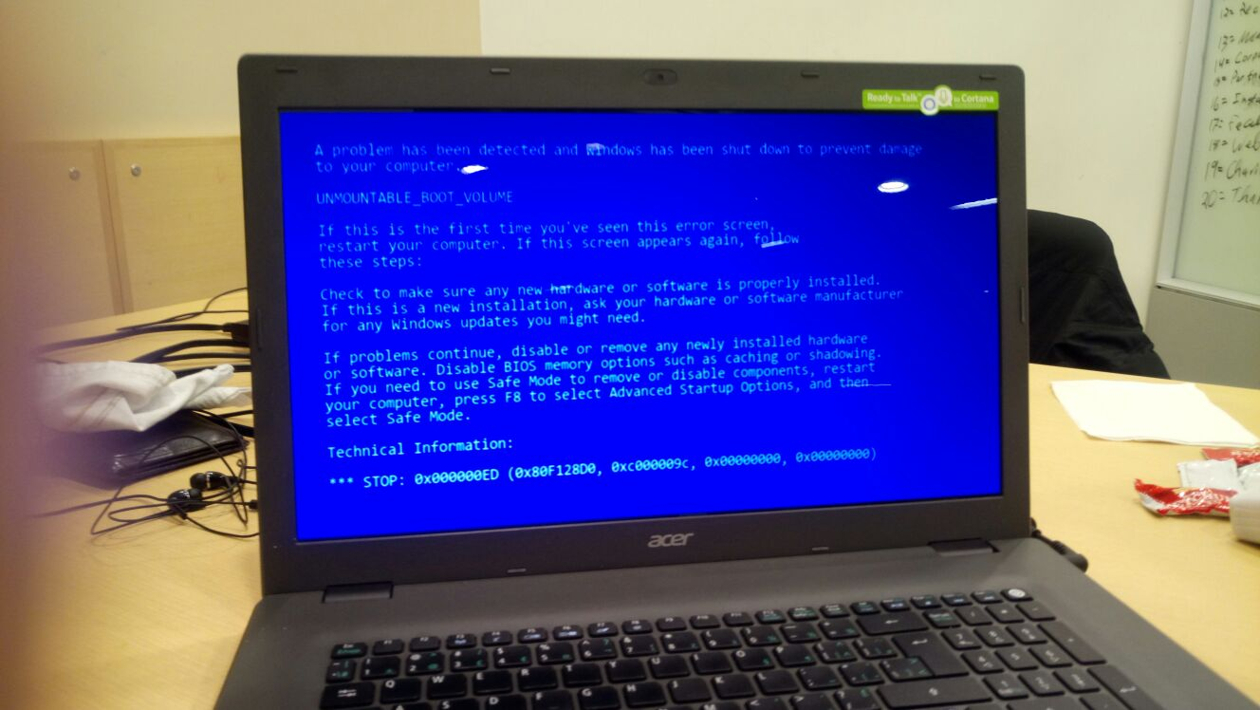
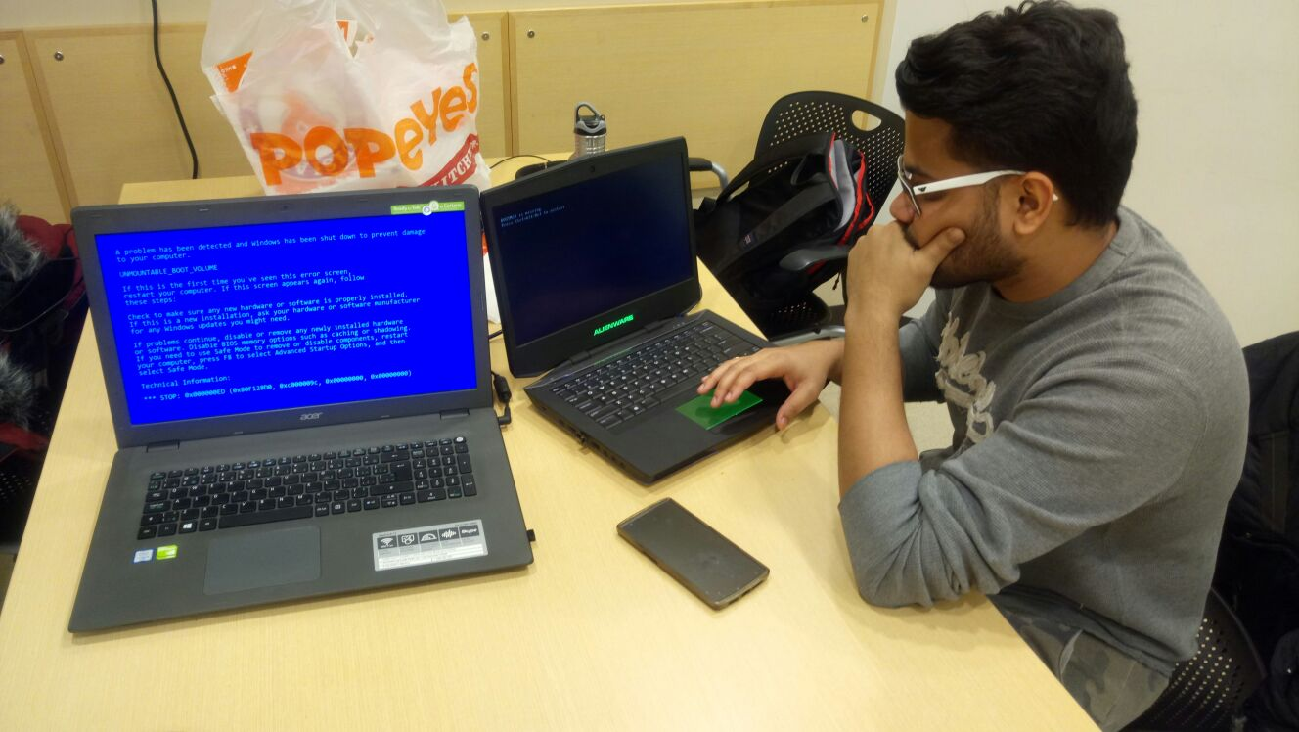
System-A Recovery (Recovered After 8 Attempts)

Slide 13
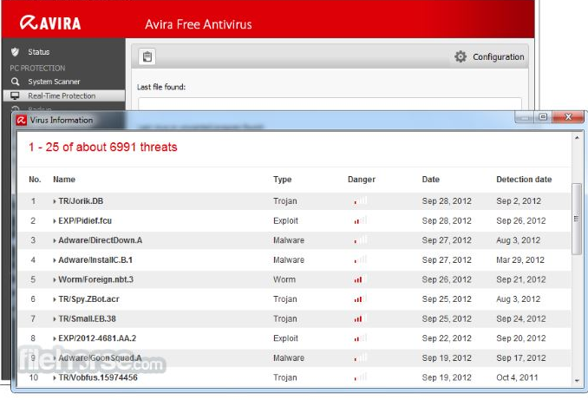
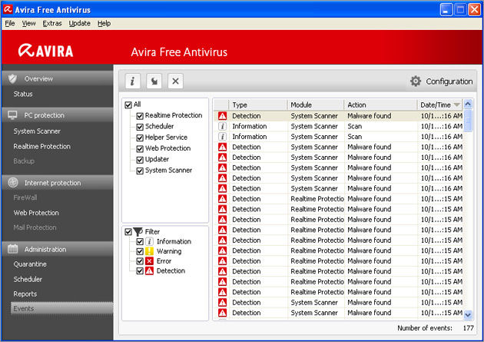
System-B Recovery

Slide 14
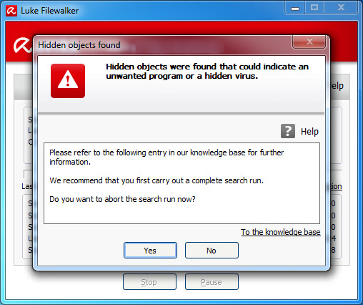
System – C Recovery
Full system anti-virus cleanup required.

Slide 15
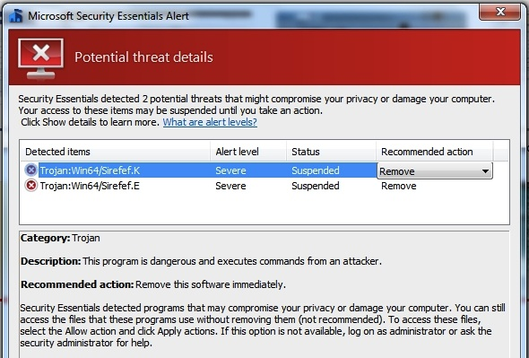
System – D Recovery
Little to no action required.

Slide 16
Summary
System A was a failure and performed the duty of lowest possible protection level possible in a computer system.
System B was a failure, as the firewall did not protect the system-32 files along with private data. Amount of information that could be stolen in such an attack is unacceptable in a modern computer system.
System C was a close pass, most files were undamaged and main system-32 files were not changed or damaged. Private data was protected but if private data was accessed by the user during the infection period it could have been stolen or corrupted.
System D was a success, with no files being harmed other than those accessed by the user using the Trojan. System ran at stable performance even during the attack. Ideal system for higher security computer systems.

Slide 17
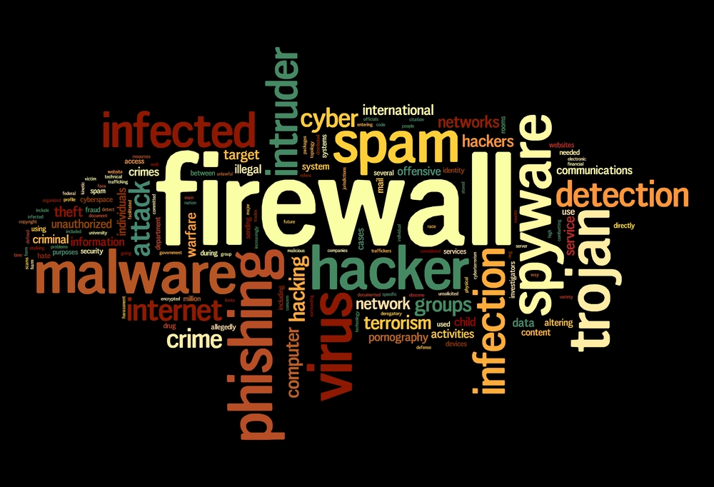
THANK YOU!

