Slide 1
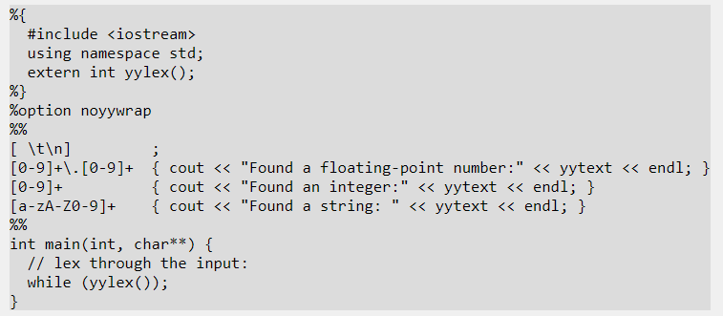

Slide 2
CODE:
%{
#include<cstdio>
#include <iostream>
using namespace std;
extern int yylex();
extern int yyparse();
extern FILE *yyin;
void yyerror(const char *s);
%}
%union {
int ival;
float fval;
char *sval;
}
%token <ival> INT
%token <fval> FLOAT
%token <sval> STRING
%%
sample:
INT {
cout << "bison found an int: " << $1 << endl;
}
| FLOAT {
cout << "bison found a float: " << $1 << endl;
}
| STRING {
cout << "bison found a string: " << $1 << endl; free($1);
}
;
%%
int main(int, char**) {
// Open a file handle to a particular file:
FILE *myfile = fopen("input", "r");
// Make sure it is valid:
if (!myfile) {
cout << "I can't open file!" << endl;
return -1;
}
yyin = myfile;
yyparse();

Slide 3
CODE:
%{
#include <iostream>
using namespace std;
#include"sample.tab.h"
extern int yylex();
%}
%%
[ \t\n] ;
[0-9]+\.[0-9]+ { yylval.fval = atof(yytext); return FLOAT; }
[0-9]+ { yylval.fval = atoi(yytext); return INT; }
[a-zA-Z0-9]+ { yylval.sval = strdup(yytext); return STRING; }
%%
Compilation and run :
bison -d sample.y
flex sample.l
g++ sample.tab.c lex.yy.c -lfl -o sample

