Slide 1

Clean architecture
with FlirtingApp

Slide 2

This talk is not about…
Front end.
Domain driven design.
Microservices.
Even sourcing.

Slide 3
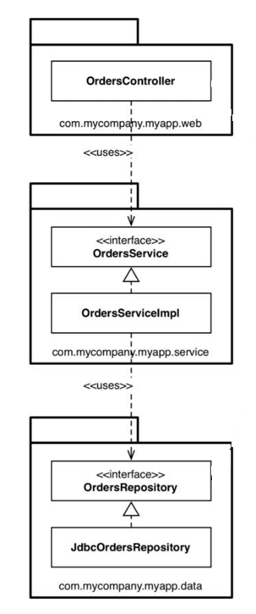
Why do n-tier architecture often fail?

Slide 4
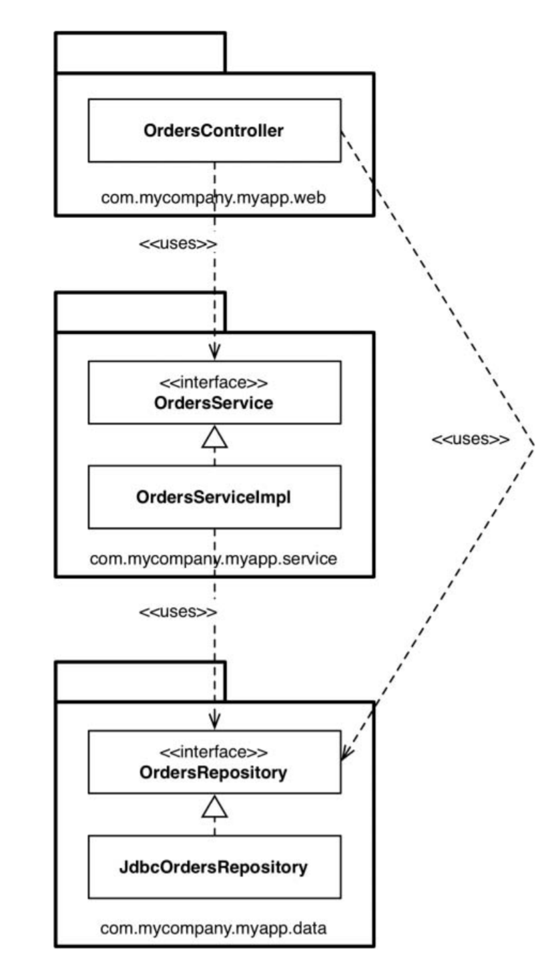
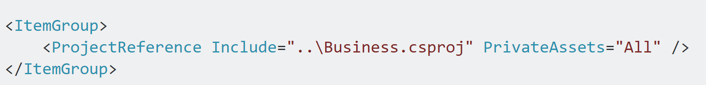
Default transitive referencing in dotnet core and dotnet standard projects
A -> B -> C (by default A -> C)

Slide 5
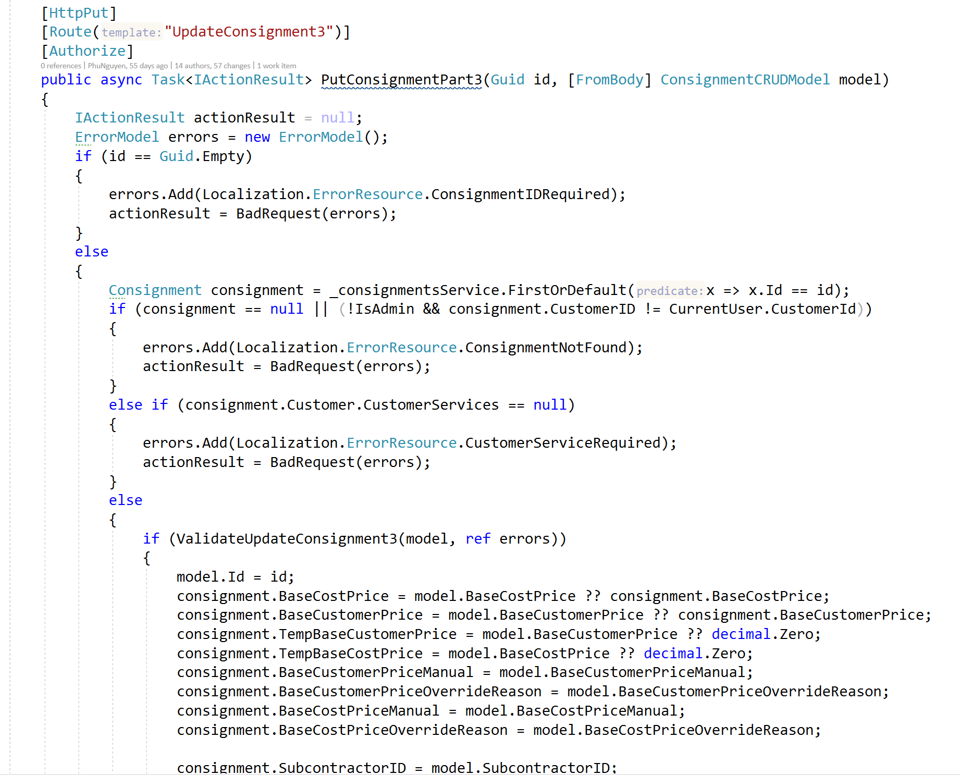
Fresher developer often…

Slide 6
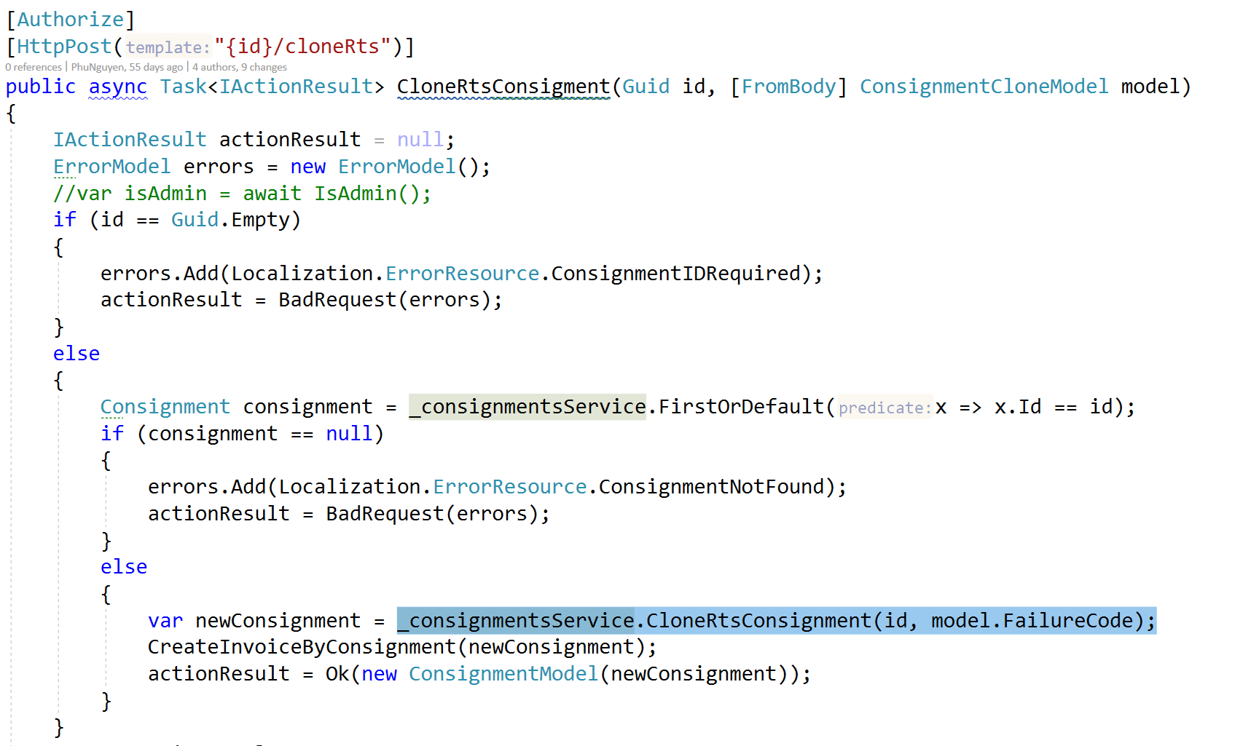
Junior developer often…

Slide 7
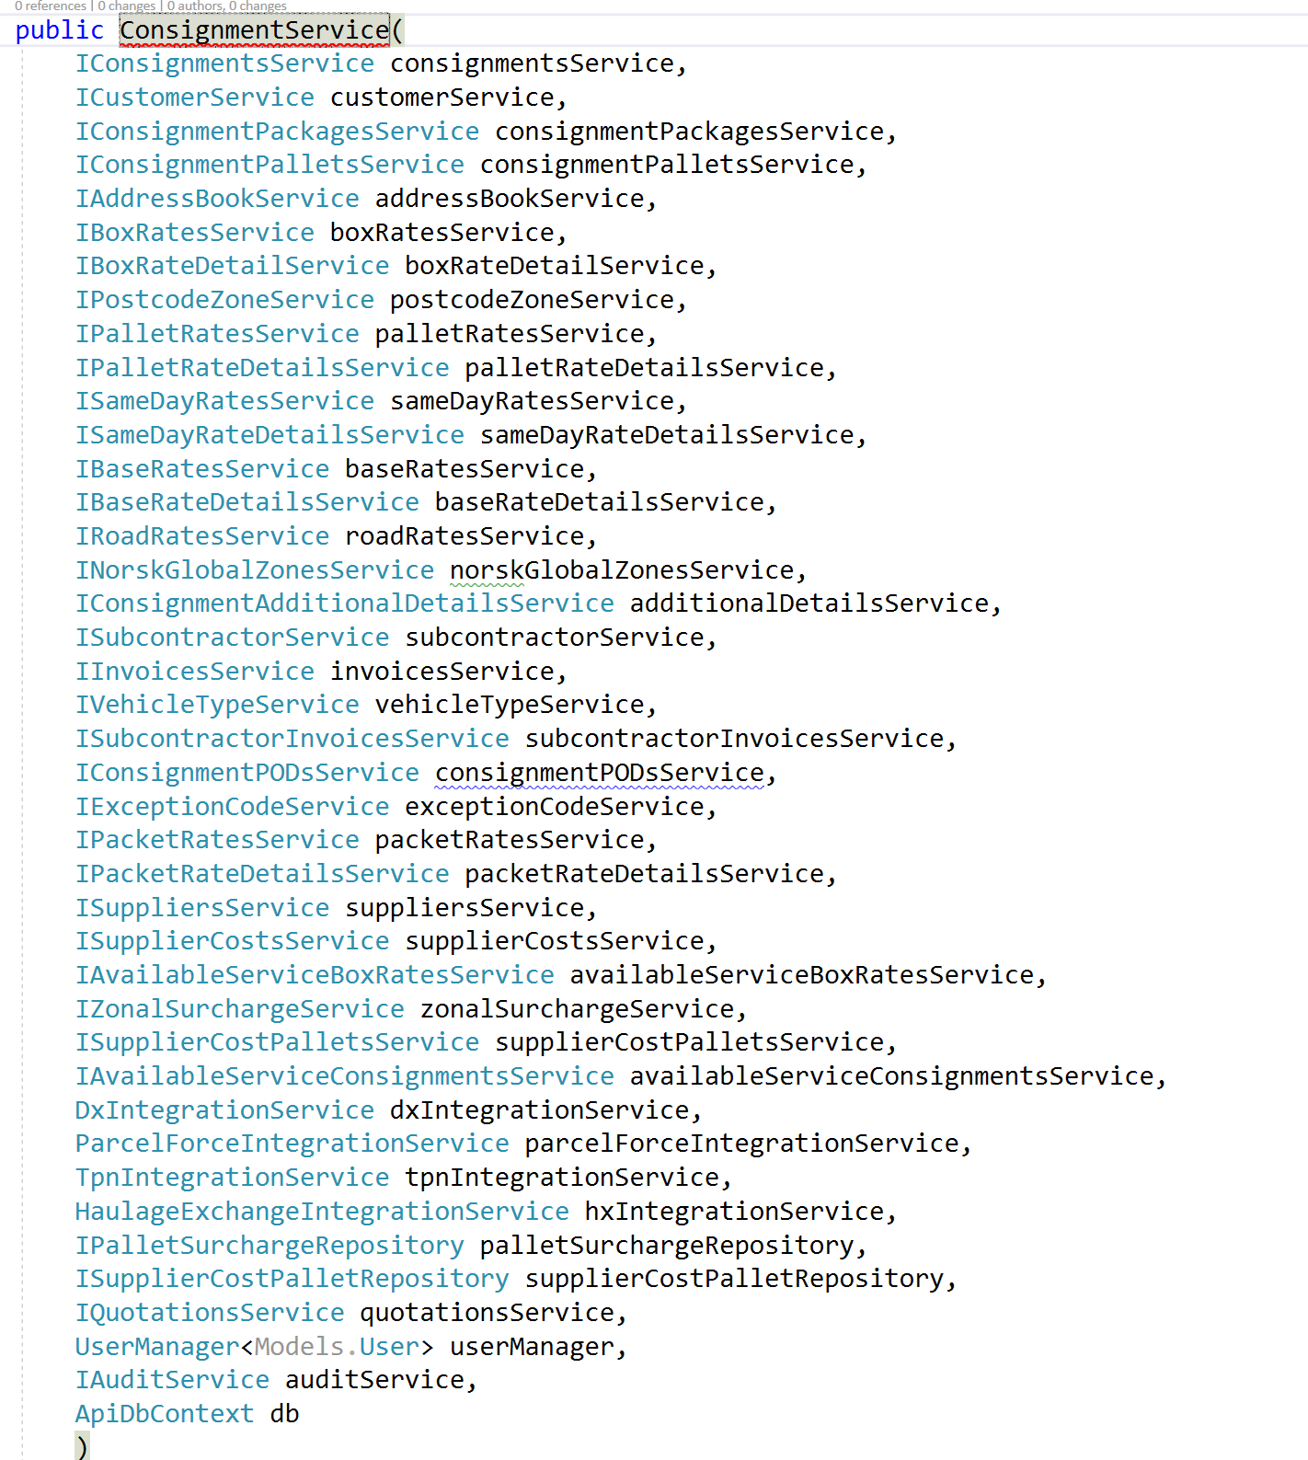
GOD service

Slide 8
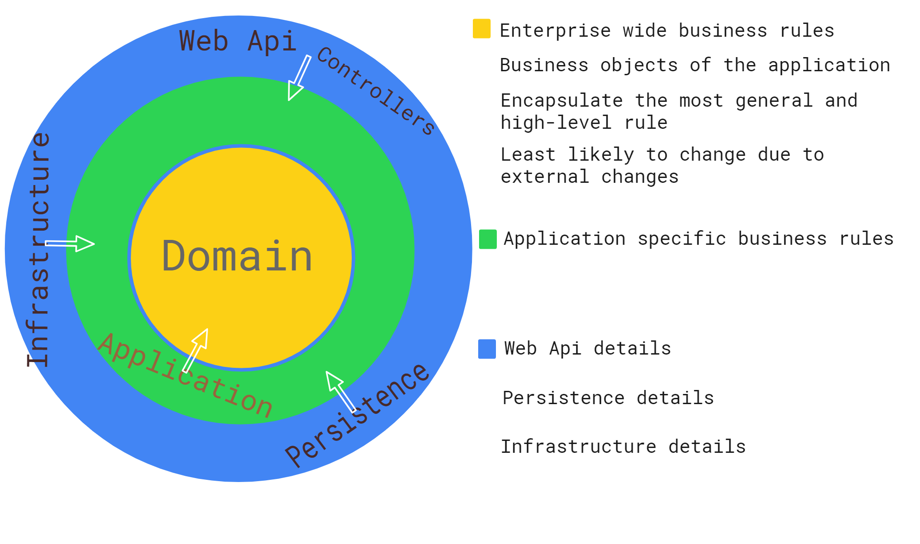

Slide 9
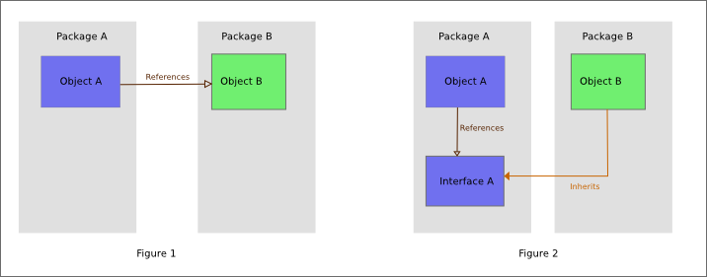
Why dependency always point inward?
The Dependency Inversion Principle (DIP) states that high level modules should not depend on low level modules; both should depend on abstractions.

Slide 10
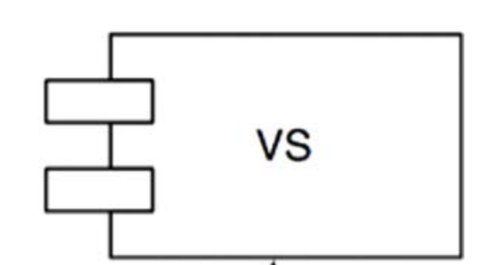
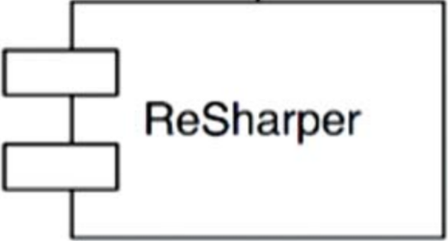

Slide 11
Clean architecture systems should be:
Independent of Frameworks.
Testable.
Independent of UI.
Independent of Database.
Independent of any external agency.

Slide 12
Introducing FlirtingApp
ASP.NET Core 3.1 LTS, ASP.NET Core 3.1 Identity
Angular 8 with Angular material component, Angular flex-layout
CQRS with Mediator: Commands will write to both SQL Server and MongoDb, Queries will read from MongoDb for optimized performance.
2 DbContext: 1 for Application entities, 1 for IdentityDbContext.
Location searching for users and find users based on X distances using mongodb geospatial
Jwt Authentication with refresh token.
Heavily unit tested with separates test projects.
Validation with FluentValidation.
Remove usage of default ASP.NET Core validation with ModelState and move validation to Application layer as it's part of business logic.
Implement Presenter and IOutputPort to separate presentation logic from controllers
Cloudinary integration for uploading images
Custom exceptions for each layers.
Unify exceptions errors message with ExceptionMiddleware

Slide 13
Persistence layer
ORMs
Mongodb generic repository
Mongo configuration
Ef core entity configuration

Slide 14
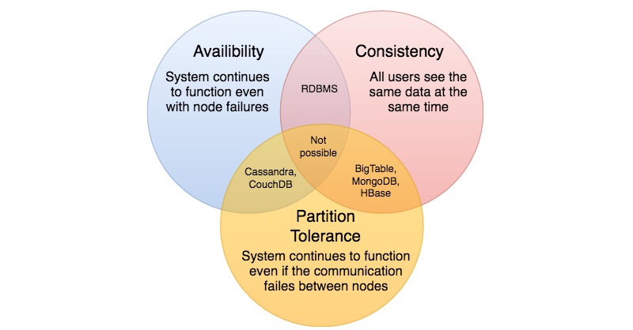
Why MongoDb + Sql Server
Mongodb is about speed.
Sql Server is about ACID(atomicity, consistency, isolation, durability) + Analysis Services (SSAS)

Slide 15
Do you need repository + UOW with EF core?
No. Ef core has DbSet and context.SaveChanges() is already repository + uow pattern.
Ef core has in memory provider so DbContext is fully testable.
Unless, you have a very specific reason to do so…

Slide 16
Infrastructure layer
IdentityDbContext
Any cross-cutting concerns (e.g. storing, uploading photo using Cloudinary)

Slide 17
WebApi layer
Controllers
Dependency injection
Exception middleware
Presenters

Slide 18
WebApi layer
Controllers
Dependency injection
Exception middleware
Hosted services
Presenters

Slide 19
WebApi layer
Presenters
Controllers
Dependency injection
Exception middleware
Hosted services

Slide 20
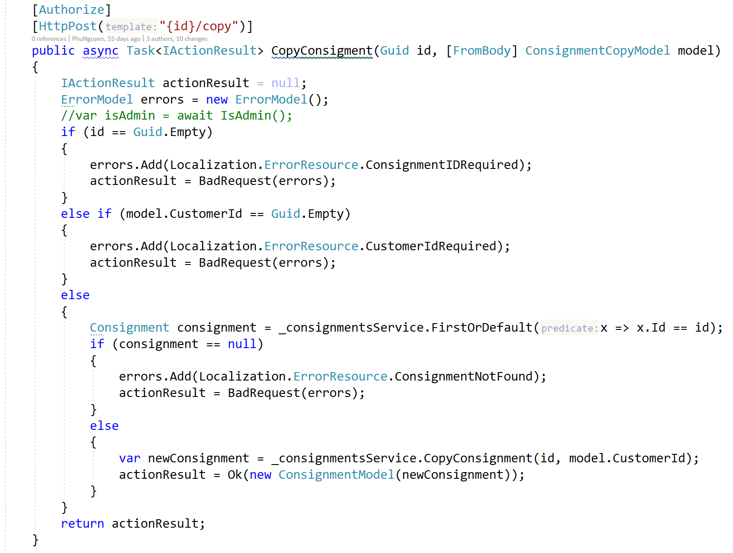
How many jobs do this controller have to do?

Slide 21
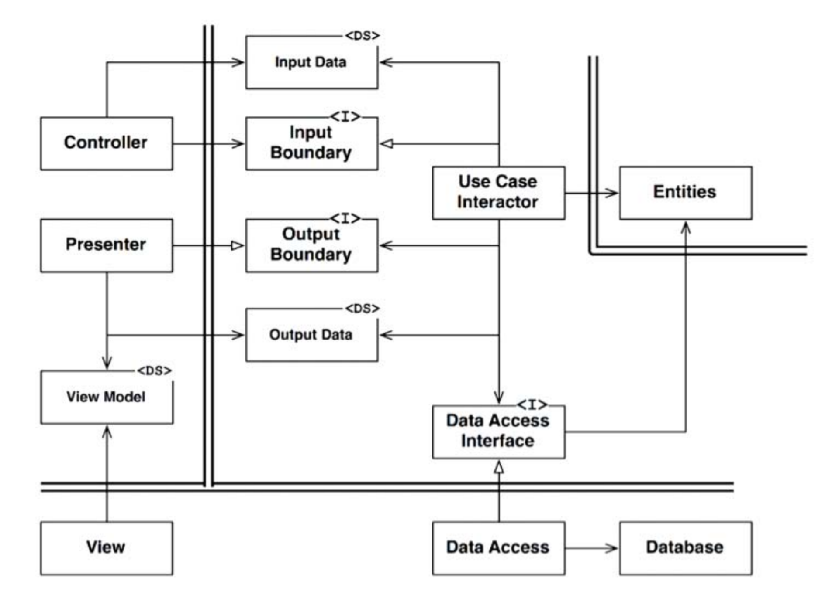
Presenter and Output port pattern

