Slide 1
ASM GENOMICS
11 June 2015
Jacksonville, FL

Slide 2
Agenda
Time | Topic
10:30 AM | Introduction
10:45 AM | Generating the data John Hanon, Research and Testing Laboratories
11:00 PM | Connecting to the cloud
12:30 PM | Lunch
1:15 PM | Unix, Bash, and the CLI
1:30 PM | Data Analysis: Getting started
?:?? PM | Data Analysis: Cleaning the data
?:?? PM | Data Analysis: Assembly*
?:?? PM | Data Analysis: Secondary analyses
?:?? PM | Data Analysis: Repeat on your own?
4:00 PM | Problem solving
4:30 PM | Disconnecting from the cloud

Slide 3

Introduction
Primary Goal:
Exposure to a genomics workflow
Secondary Goal:
Assembling mitochondrial genomes

Slide 4
Generating the data
Data on hand:

Slide 5


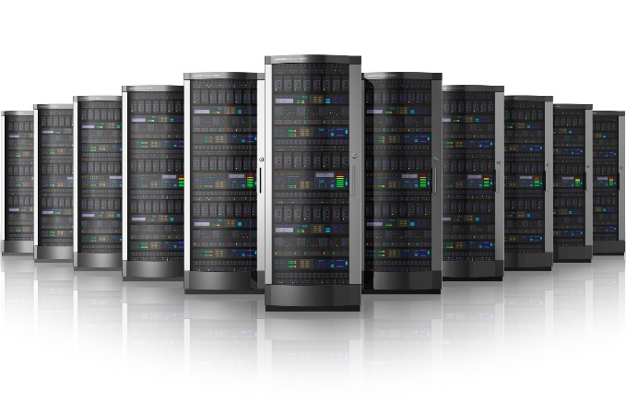

Connecting to the Cloud
Amazon Web Services
Pay to play.
Advantages over maintaining a dedicated cluster
Reproducible
Building a “computer” from multiple parts
Launch, connect, mount (demonstration)

Slide 6
But first…Terminology
Local computer
Amazon Machine Image (AMI)
Elastic Block Store(age) (EBS)
Elastic Cloud Compute (EC2)
aka an “instance”

Slide 7

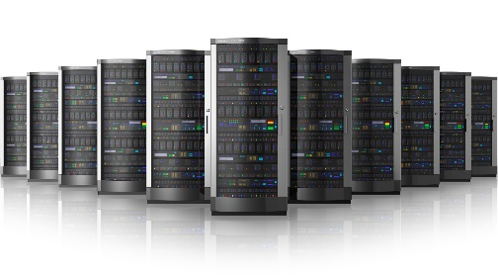


+

Slide 8

Amazon
+
SSH
FTP or SCP

Slide 9
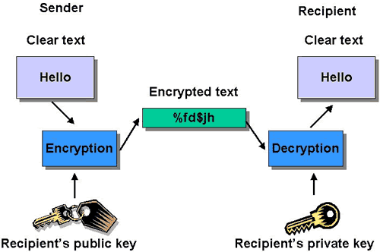
SSH
+

Slide 10

Amazon
+
SSH
FTP or SCP

Slide 11
Launching & Connecting (demonstration)

Slide 12
*nix, bash, and bash scripting
Linux/Unix is the operating system
bash is a programming language
sh, csh, tcsh, ksh
scripting!
Variables ($VARIABLE)
Powerful Unix programs (grep, wc)
Combinations (cat SEQ.fas| grep “>” | wc –l)
REPRODUCIBLE

Slide 13
CLI: Basic commands
Cheat Sheet
ls
cd
pwd
cat
head
tail
less
pico or nano
mkdir
tar
gzip
wget
echo
sort
Man
grep
awk

Slide 14
THE shell script
GitHub
https://github.com/nealplatt
git clone https://github.com/nealplatt/ASMomics2015.git
Reproducibility
Open in text editor (with syntax highlighting)
Reproducibility

Slide 15
Analyzing Data
(switch to shell script)

Slide 16
Shutting down
Terminate vs. shutting down EC2
Detaching vs. deleting EBS
Cost estimate

