Slide 1
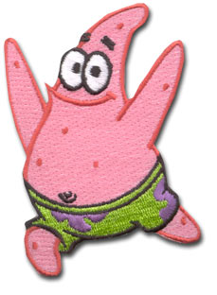
STARFISH
DISSECTION
http://www.emerchandise.com/images/p/SBS/pdPASBS0005.jpg

Slide 2
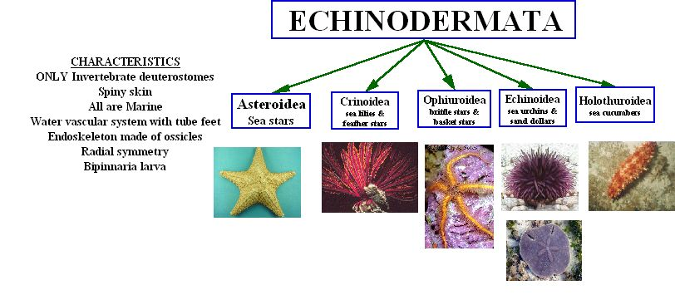
Kidspiration by Riedell

Slide 3

STARFISH
LATIN meaning
KINGDOM _____________
PHYLUM _____________________________
CLASS _______________________________
ANIMALIA
ECHINODERMATA “spiny skin”
ASTEROIDEA “star-like”

Slide 4
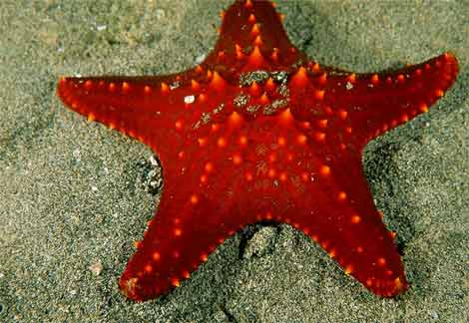
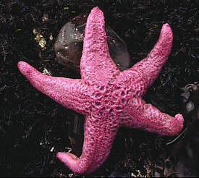
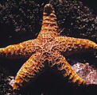
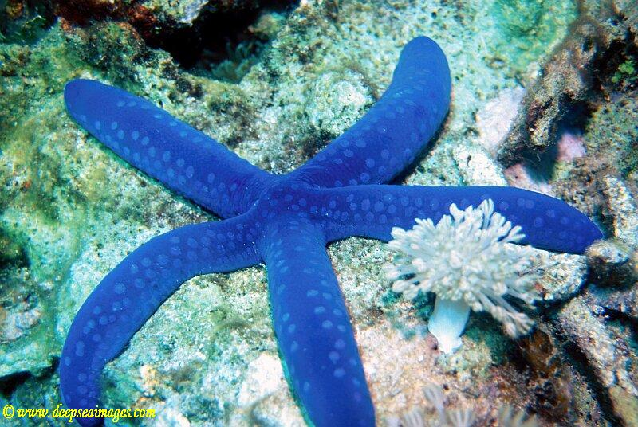
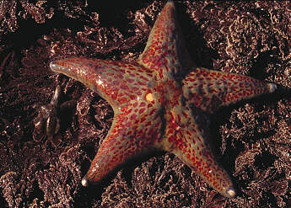
Starfish (sea stars)
Come in a variety of colors
http://www.trinitykids.org/Portals/2/graphics/starfish.jpg
http://www.perspective.com/nature/animalia/starfish.html
http://www.perspective.com/nature/animalia/starfish.html
http://www.deepseaimages.com/dsilibrary/data/1143/706-28a.jpg

Slide 5
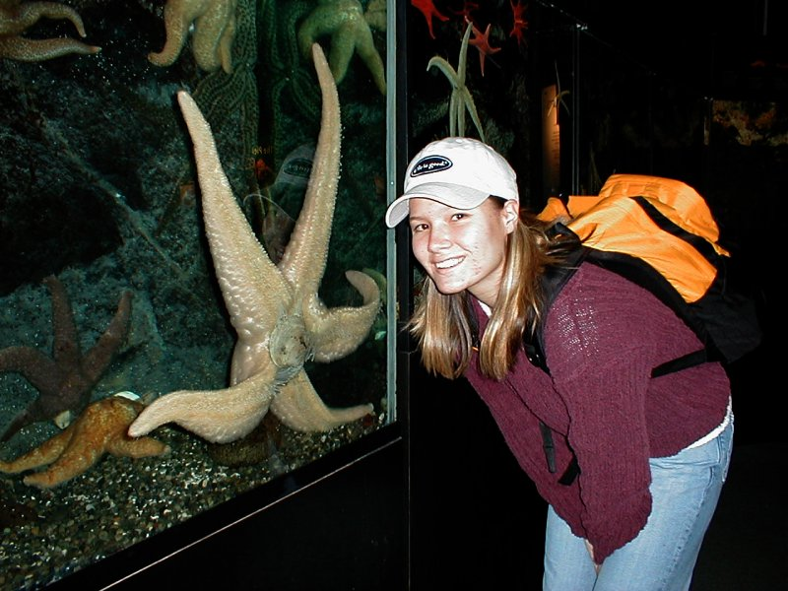
. . . and sizes
http://bcuniversal.com/familyimages/Natasha%20&%20Starfish%20Seattle%202000.JPG

Slide 6
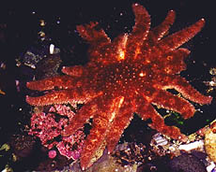
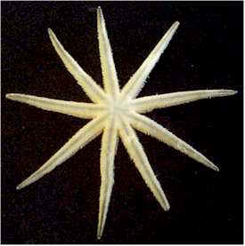
Not all starfish have 5 arms
http://www.perspective.com/nature/animalia/starfish.html
http://www.seashells.org/identcatagories/starfish.htm

Slide 7
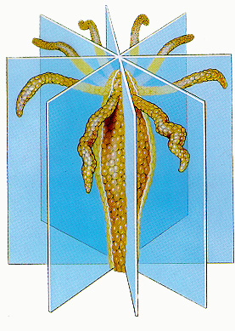

SYMMETRY
ADULTS- Radial
LARVA- Bilateral
http://www.uic.edu/classes/bios/bios100/labs/radial.jpg

Slide 8
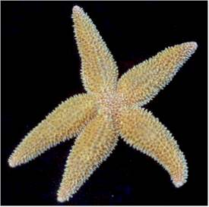
PENTARADIAL
(5 armed starfish)
http://www.seashells.org/identcatagories/starfish.htm

Slide 9
INVERTEBRATES
(No backbone)
ALL INVERTEBRATES ARE PROTOSTOMES EXCEPT
ECHINODERMS
ONLY INVERTEBRATES that are DEUTEROSTOMES

Slide 10

SPINES
PEDICELLARIA
SKIN GILLS
Image by Riedell

Slide 11
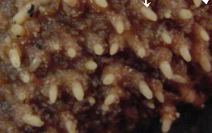
SPINY SKIN
http://wwwbio200.nsm.buffalo.edu/labs/tutor/Starfish
SPINES for protection connect to
ENDOSKELETON inside underneath skin

Slide 12
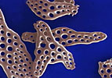
OSSICLES
Calcium carbonate plates
form endoskeleton inside
http://ebiomedia.com/prod/BOechinoderms.html

Slide 13
SPINES
PEDICELLARIA
SKIN GILLS
Image by Riedell

Slide 14
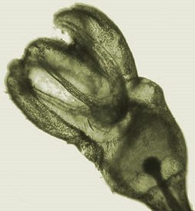
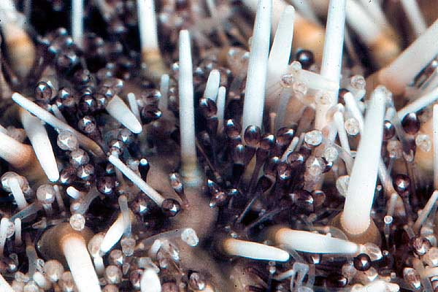
PEDICELLARIAE
(sing. Pedicellaria)
http://www.discoveringfossils.co.uk/echinoid_pedicillaria.jpg
http://attleborobio.blogspot.com/2008/04/weekly-urchin-pedicellariae.html
Keep surface clear of organisms

Slide 15
SKIN GILLS
Hollow skin tubes that project from skin for increased surface area
connect to coelom inside
Image by Riedell

Slide 16
Skin gills between spines
http://wwwbio200.nsm.buffalo.edu/labs/tutor/Starfish
EXCHANGE GASES and
EXCRETE NITROGEN WASTE

Slide 17
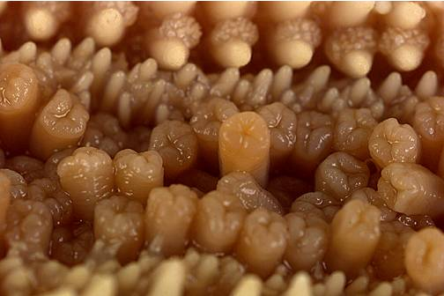
TUBE FEET surfaces
http://wwwbio200.nsm.buffalo.edu/labs/tutor/Starfish
Can exchange gases and excrete nitrogen waste

Slide 18
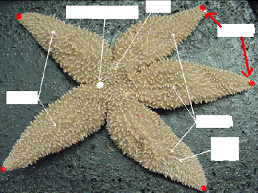
EYESPOTS
Sense light/dark

Slide 19
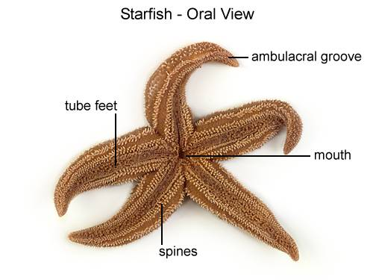
ORAL VIEW
http://wwwbio200.nsm.buffalo.edu/labs/tutor/Starfish/Starfish02D.html

Slide 20
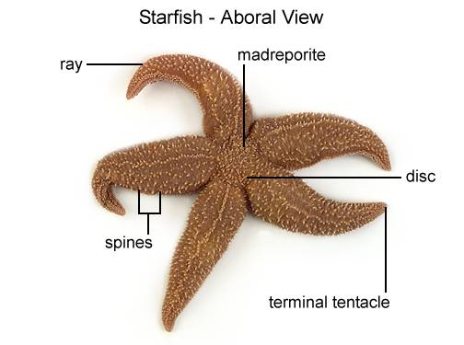
http://wwwbio200.nsm.buffalo.edu/labs/tutor/Starfish

Slide 21
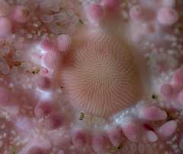
Madreporite
Opening to water vascular system
http://ebiomedia.com/gall/skin/skin1.html

Slide 22
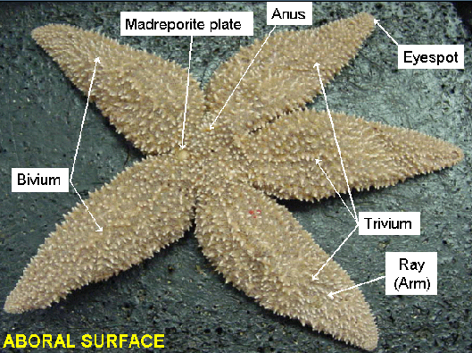

Slide 23
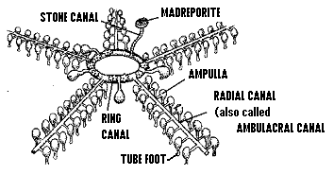
WATER VASCULAR SYSTEM
BIODIDAC

Slide 24
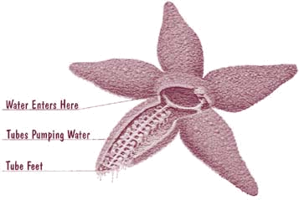
http://mbgnet.mobot.org/salt/animals/star.jpg

Slide 25
ORAL VIEW
MOUTH
http://wwwbio200.nsm.buffalo.edu/labs/tutor/Starfish/Starfish02D.html

Slide 26
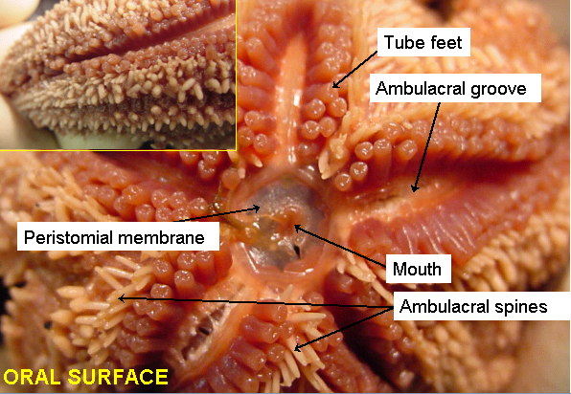

Slide 27
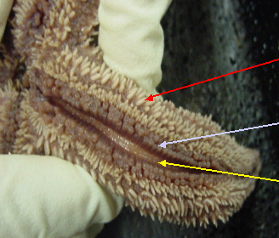
AMBULACRAL GROOVE
TUBE FEET sit in GROOVE

Slide 28
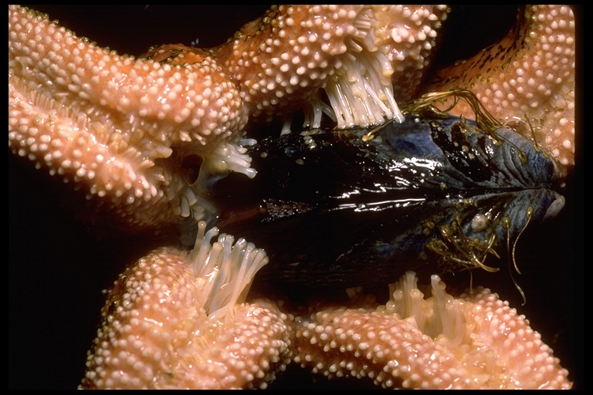
TUBE FEET
Used for feeding & locomotion
http://www.scsc.k12.ar.us/2001Outwest/PacificNaturalHistory/Projects/ReynoldsJ/starfish.jpg

Slide 29
TUBE FEET
Used for feeding & locomotion
http://wwwbio200.nsm.buffalo.edu/labs/tutor/Starfish
Can exchange gases and excrete nitrogen waste

Slide 30
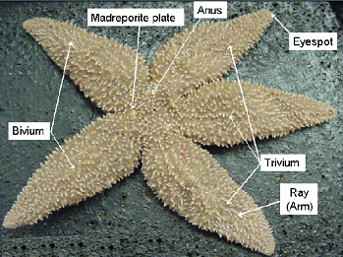
CUT TRIVIUM

Slide 31
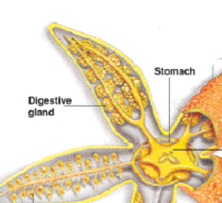
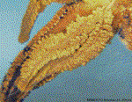
DIGESTIVE GLAND
Makes BILE
ABSORBS NUTRIENTS

Slide 32
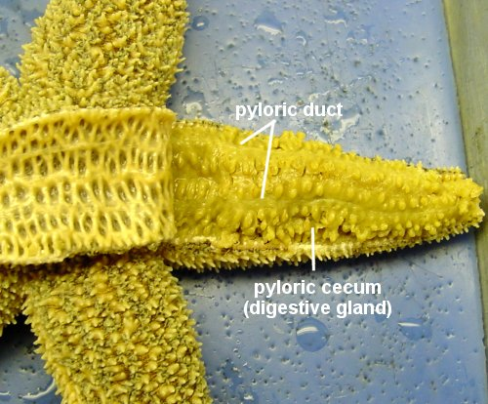
http://www.k-state.edu/organismic/echinoderms_and_protochordates.htm

Slide 33
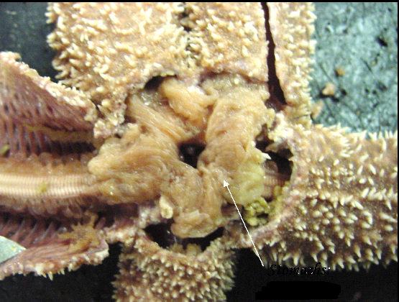
2 part STOMACH

Slide 34
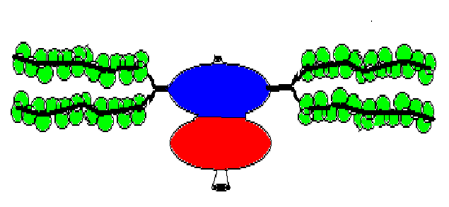
DIGESTIVE SYSTEM
ANUS
DIGESTIVE
GLANDS
DIGESTIVE
GLANDS
MOUTH
Image by Riedell

Slide 35
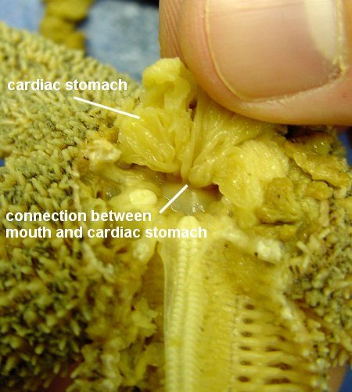
http://www.k-state.edu/organismic/echinoderms_and_protochordates.htm
CARDIAC stomach connects to mouth
(extruded during feeding)
PYLORIC stomach
connects to digestive glands and ANUS

Slide 36
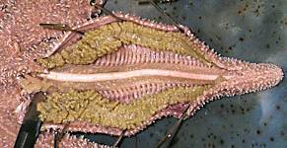
EUCOELOM
OPEN CIRCULATION
http://faculty.baruch.cuny.edu/jwahlert/bio1003/echinoderm.html

Slide 37
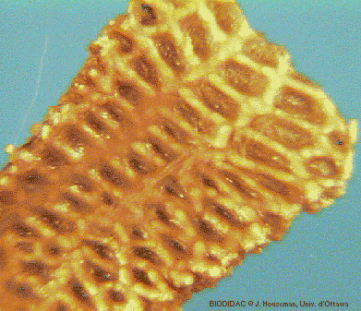
ENDOSKELETON made of OSSICLES
http://www.esu.edu/~milewski/intro_biol_two/lab__13_echinoderm/starfish_endoskeleton.html

Slide 38
OSSICLES
Calcium carbonate plates
form endoskeleton inside
http://ebiomedia.com/prod/BOechinoderms.html

Slide 39
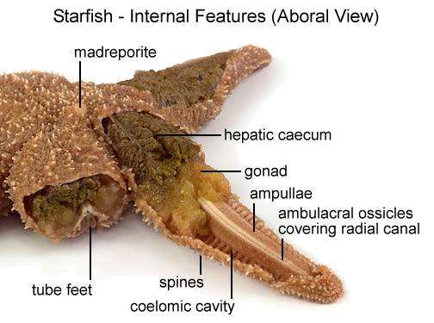
http://wwwbio200.nsm.buffalo.edu/labs/tutor/Starfish/

Slide 40
WATER VASCULAR SYSTEM
BIODIDAC

Slide 41
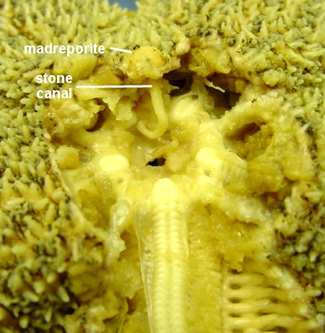
http://www.k-state.edu/organismic/echinoderms_and_protochordates.htm

Slide 42
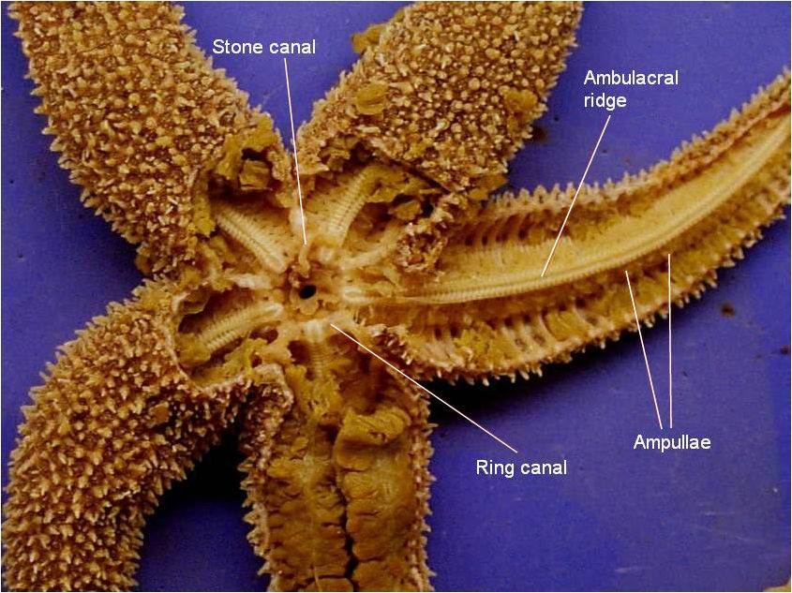
GONADS

Slide 43
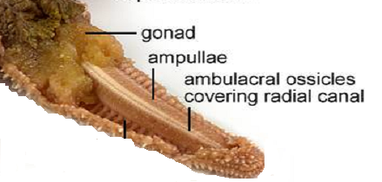
http://wwwbio200.nsm.buffalo.edu/labs/tutor/Starfish/
AMBULACRAL RIDGE covered by OSSICLES
contains RADIAL NERVE (nervous)
RADIAL CANAL (water vascular system)

Slide 44
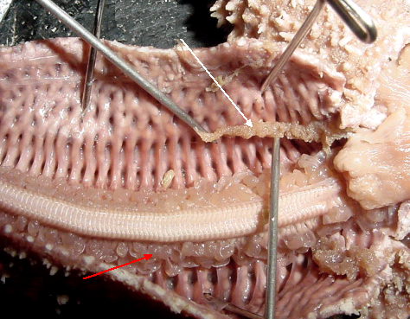
AMBULACRAL RIDGE
AMPULLAE (tops of tube feet)

Slide 45
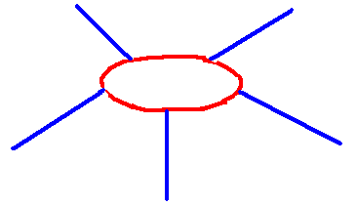
NERVOUS SYSTEM follows WVS
Image by Riedell
NERVE RING
encircles mouth
RADIAL NERVES run inside
AMBULACRAL RIDGE in each arm

Slide 46
SEPARATE SEXES
GONADS-
reproductive organs
Starfish have both
SEXUAL
ASEXUAL (Regeneration)

Slide 47
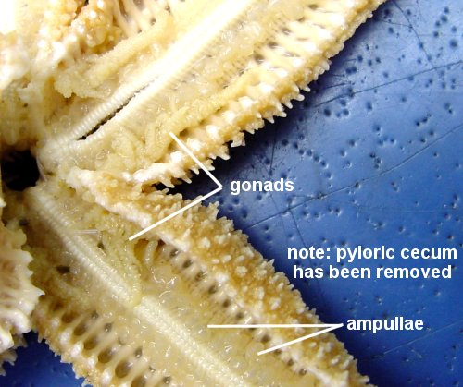
http://www.k-state.edu/organismic/echinoderms_and_protochordates.htm

Slide 48
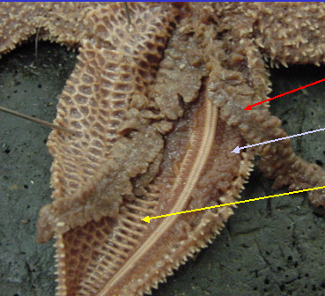
DIGESTIVE
GLAND
GONAD
OSSICLES

Slide 49
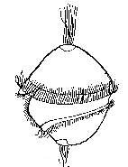
MOLLUSKS
(some ANNELIDS)
Have a
TROCHOPHORE
LARVA
http://www.okc.cc.ok.us/biologylabs/Images/Evolimages/trochophore.JPG

Slide 50

SEXUAL REPRODUCTION
FERTILIZATION
EXTERNAL
DEVELOPMENT
INDIRECT
LARVA
BIPINNARIA
Has BILATERAL SYMMETRY
and wings to swim

Slide 51
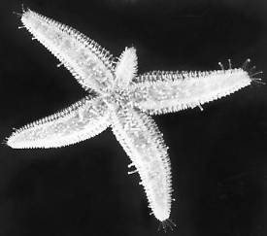
ASEXUAL REPRODUCTION
Ability to self amputate
AUTOTOMY
Ability to regrow lost parts
REGENERATION
http://users.rcn.com/jkimball.ma.ultranet/BiologyPages/R/Regeneration.html

