Slide 1
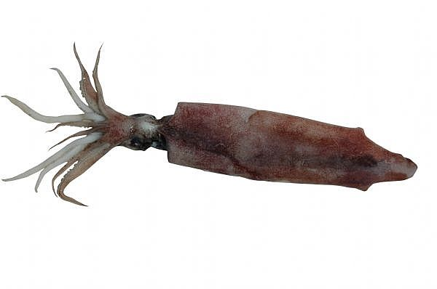
Squid Dissection

Slide 2
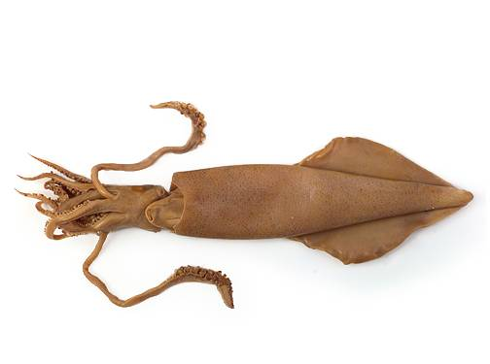
Taxonomy of the Squid
Kingdom: Animalia Phylum: Mollusca Class: Cephalopoda Order: Teuthida Family: Loliginidae Genus: Loligo Species: brevipenna

Slide 3
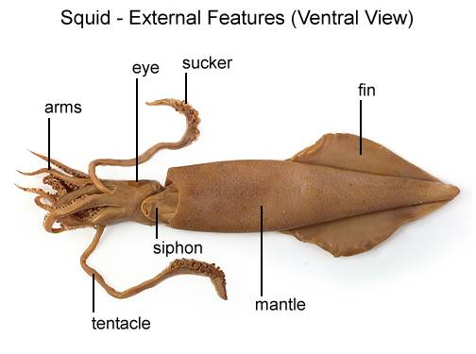

Slide 4
External Anatomy
Arms and tentacles
Look at the suckers with the handlens.
Notice all the small teeth in a ring around the suckers, they are used to holding fast to their prey.
Squid capture their prey with the tentacles and bring it in to the arms to be held until the prey stops struggling.

Slide 5
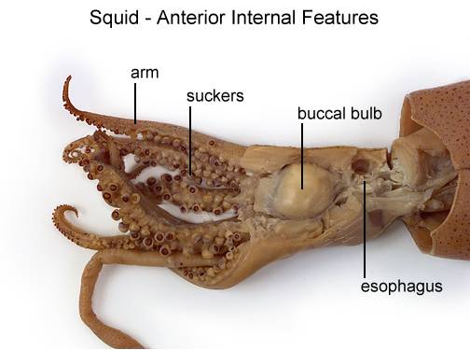

Slide 6
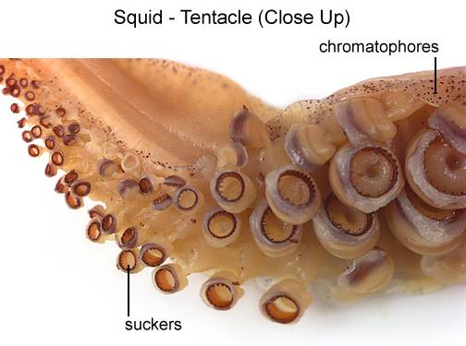

Slide 7
External Anatomy
Eyes.
Theses are much like our own, but the lens is shaped like a football (ours is round).
If you carefully snip open the eye you can remove the hard lens with you fingers.
Squid can tell the difference between light and dark, blue and yellow and forms a complete image of whatever it is looking at.

Slide 8
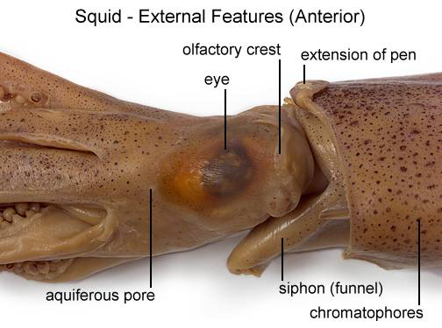

Slide 9
External Anatomy
The main part of the body containing all the organs is called the mantle.
The mantle is covered in pigment cells called chromatophores.
The squid can change color rapidly and use this to camouflage themselves, attract mates, and to communicate with each other.
The squid has two fins, on the mantle near the pointed end of its body.
The fins are used as stabilizers and to propel the squid with dainty motions at relatively slow speeds and to guide sudden turns.

Slide 10
External Anatomy
The siphon is a short tube with one opening near the eyes and the other end just under the mantle collar.
The siphon works to propel the squid through the water in the opposite direction to which the siphon is pointing, much like jet propulsion.
To use this jet propulsion the squid takes in a large volume of water through the large opening in the mantle and then closes off the opening.
The mantle muscles contract and the water comes out with enough force to propel the squid through the water at about 20 miles per hour!

Slide 11
External Anatomy
Beak.
Look inside the circle of the arms and tentacles. The small black dot is the beak.
It looks like a parrot beak, and is very powerful. It is used to tear pieces from the prey.
If you are careful you can use your fingers to gentle squeeze the beak from the surrounding tissue (buccal mass). You might be able to see the radula, which is the file-like tongue used to shred the pieces of food before they are swallowed.

Slide 12
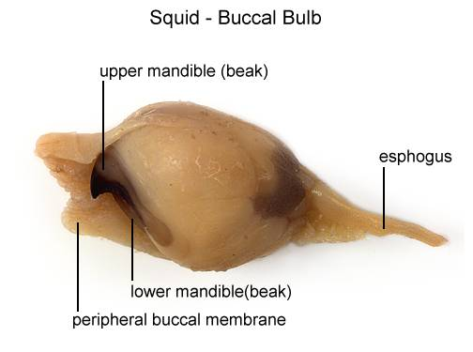

Slide 13
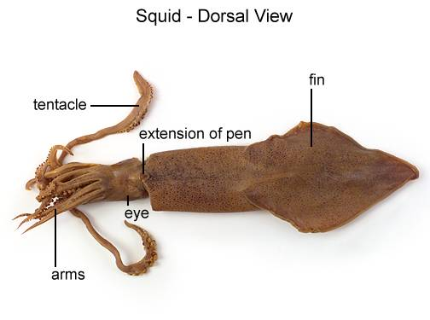

Slide 14
Internal Anatomy
Is your squid male or female?

Slide 15
Female Squid
In females,
the ovaries containing the eggs are light yellow in color; they look and feel like Jell-O.
Females also have a pair of egg shell glands called nidamental glands; they are the large, oval, white organs located at about the midpoint of the mantle cavity.
Females also have an accessory nidamental gland located near the top of the main glands. They are close to the ink sac and pinkish in color, do not confuse them with the heart.

Slide 16
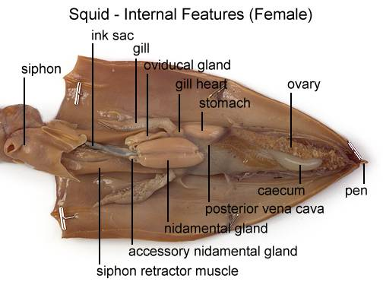

Slide 17
Male Squid
In males,
the sperm is white in color and more watery than the eggs.
The sperm pass through the small coiled tube called the vas deferens and into the spermatophoric gland which looks like a small sac with many intertwining circles within it.
This gland adds substances to the sperm to make it into a sperm packet (spermatophore).

Slide 18
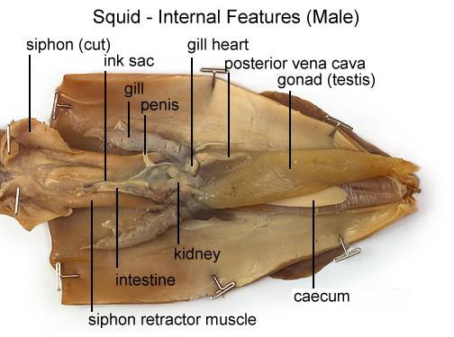

Slide 19
Internal Anatomy
The stomach is an oval structure (sometimes difficult to find) about ½ inch long hooked to the side and near the top portion of the caecum.
The caecum is located next to the gonads and both are about the same size and shape.
The stomach is the major site for digestion and the caecum increases the surface area available for digestion.

Slide 20
Internal Anatomy
The gills are 2 white feathery structures found within the mantle cavity.
Squid actually have 3 hearts!
Each of these hearts is quite small and slightly yellowish in color.
At the base of each gill is a branchial heart (also called the gill heart) which pumps blood from the body up to the gills to be oxygenated. (These are the auricles).
The third heart is larger and located between the two branchial hearts.
This is called the systemic heart and pumps oxygenated blood from the gills to the rest of the body. (This is the ventricle).

Slide 21
Internal Anatomy
The squid is supported as it speeds through the water by a chitinous structure called a pen.
This structure is the remnant shell. To locate the pen, lift up the head and place it down over the top of the organs of the body.
Underneath where the head was lying on the plate, you will now notice a pointed area touching the plate right along the midline of the body.
This is the tip of the pen. Grasp this tip and start to pull until the pen comes free of the mantle.
The pen is as long as the length of the mantle and shaped like a transparent feather.

Slide 22
Internal Anatomy
The ink sac is located on the rectum and looks much like a small silver fish or thin black line depending on how full the sac is.
The ink is the pigment melanin which artists call sepia ink.
You can dip the pen into the ink sac and right your name on a sheet of paper!

Slide 23
End of Dissection
Through out your squid in the trash.
Wash tray with water
Clean your equipment with paper towels return to front table.
Wipe off your table.
Answer end of dissection questions in your journal.

Slide 24
Squid
are invertebrates (animals without backbones)
are mollusks closely related to octopus
can change the color of their skin to camouflage and hide from predators
move through water by squirting water from the mantle through the siphon, using a type of jet propulsion
are carnivores
have 8 arms and 2 tentacles
have a beak to tear food
produce a dark ink to escape from predators
are eaten by fish, birds, marine mammals and humans
are found in So Cal during the winter months (Dec – Mar)

Slide 25
Links
Interactive Squid anatomy – colossal squid!
http://squid.tepapa.govt.nz/anatomy/interactive
Natural History museum squid dissection
http://www.nhm.org/seamobile/PDF/clasacts/sqd%20i.pdf.

