Slide 1

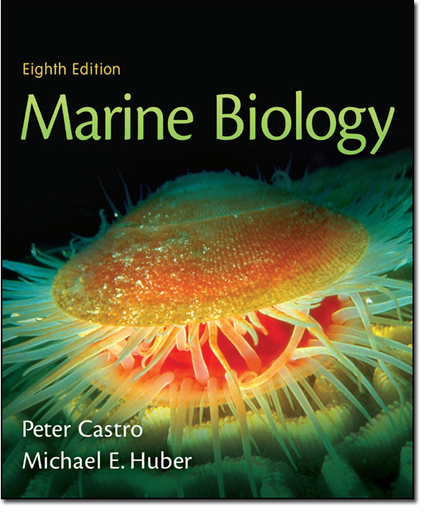
Chapter 2
Lecture
Slides
Copyright © The McGraw-Hill Companies, Inc. Permission required for reproduction or display.

Slide 2
Chapter Two
The Sea Floor

Slide 3
Geography of the Ocean Basins
The world ocean is the predominant feature on the Earth in total area.
In the Northern Hemisphere, 61% of the total area is ocean.
In the Southern Hemisphere, about 80% of the total area is ocean.
The world ocean is divided into four large basins: Pacific, Atlantic, Indian and Arctic.

Slide 4
Structure of the Earth
Some evolutionary scientists believe the earth originated 4.5 billion years ago from dust accumulated from the Big Bang
  Actual age of the earth is unknown. The Big Bang is a theory not a fact.
Earth’s location relative to the sun allows for water to stay liquid – an essential element to sustain life

Slide 5
Internal Structure of the Earth
Core – innermost layer; solid inner core and liquid outer core; iron-rich.
Mantle – middle layer; semi-plastic composition.
Crust – outermost layer; thinnest portion of the Earth.

Slide 6
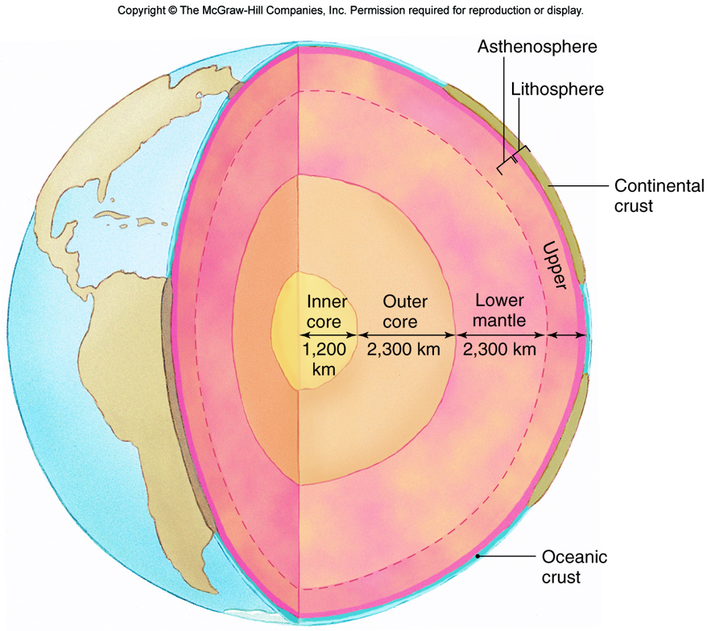

Slide 7
Continental versus Oceanic Crust
Oceanic crust – made up of dark-colored mineral, basalt; denser than continental crust.
Continental crust – light-colored granite construction mainly; less dense.

Slide 8
Continental Drift
Proposed in 1912 by Alfred Wegner
He suggested that all continents had been joined in a single supercontinent which he named Pangaea.
He proposed that Pangaea began breaking up 180 million years ago.
At the time, his proposal was not widely accepted because he could not explain HOW this occurred.

Slide 9
CONTINENTAL DRIFT
A Different Proposal
http://www.youtube.com/watch?v=sD9ZGt9UA-U

Slide 10
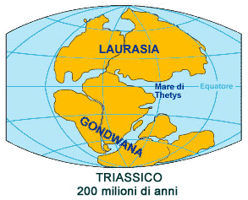

Slide 11
Plate Tectonics
Plate tectonics explains the “HOW” behind Wegner’s continental drift theory
The main features of plate tectonics are:
  The Earth’s surface is covered by a series of crustal plates
  The ocean floors are constantly moving; spreading in the center and sinking at the edges and being regenerated.
  Convection currents beneath the plates assist movement
  Heat from the mantle drives these currents

Slide 12
Evidence for Plate Tectonics
Mid-Oceanic Ridges
  The mid-oceanic ridges rise from ocean floor – a chain of submarine volcanic mountains
  at regular intervals, the ridge is displaced by faults in the Earth’s crust called transform faults
  Very little sediment is located at the bottom near these ridges; sediment gets thicker away from the ridges signifying that the crust further from the ridge is older (sediment has had time to accumulate)

Slide 13
Evidence for Plate Tectonics
Geomagnetic Anomalies:
  Occasionally, at random intervals, the Earth's magnetic field reverses. New rock formed from magma records the orientation of Earth's magnetic field at the time the magma cools.
  Studies of the sea floor revealed "stripes" of alternating magnetization parallel to the mid-oceanic ridges. This is evidence for continuous formation of new rock at these ridges. As new rock forms, older rock is pushed farther away from the ridge, producing these patterns in the rock.

Slide 14
Evidence of Plate Tectonics
Island Arcs
  Chains of islands are found throughout the oceans, especially in the western Pacific.
  These "Island arcs" are usually situated along deep sea trenches on the continental side of trenches.
  These observations, along with many other studies of our planet, support the theory that underneath the Earth's crust is a layer of heated rock driving the creation of new ocean floor.

Slide 15
Geologic History
Pangaea was surrounded by a single world ocean, Panthalassa
The Tethys Sea separated Eurasia from Africa
These were in place about 200 million years ago

Slide 16
Geologic History
About 180 million years ago, a rift began to form between North America and the combined continents of South America/Africa
This rift separated Pangaea into two large continents, Laurasia and Gondwana
This rift was the beginning on the Mid-Atlantic Ridge

Slide 17
Geologic History
Also around 180 million years ago, a rift began to split up Gondwana and the early Indian Ocean began to form
About 135 million years ago, a rift between South America and Africa began to form
This rift joined the mid-ocean ridge in the North Atlantic to form a single mid-Atlantic ridge

Slide 18
Geologic History
As the Atlantic Ocean grew (grows), the Americas were (are) carried farther from Eurasia and Africa
The Atlantic Ocean to continues to grow and the Pacific Ocean continues to shrink

Slide 19
Marine Sediments
Lithogenous sediments – derived from the break-down of rocks (weathering)
Biogenous sediments – derived from the skeletons and shells of marine organisms

Slide 20
What Can We Learn from Sediments?
Biogenous sediments (composed of microfossils) can reveal information from the past
Ocean temperature at the time the microfossils were formed can be determined by looking at the ratios of magnesium to calcium or by different ratios of oxygen isotopes

Slide 21
Continental Margins
The margins of continents are boundaries between continental crust and oceanic crust
They generally consist of:
  Continental shelf (most landward)
  Continental slope
  Continental rise (most seaward)

Slide 22
The Continental Shelf
Makes up about 8% of the ocean’s surface area
However, it is biologically the richest area of the ocean
The width varies from 1 km (0.6 mi) to 750 km (470 mi)
Shelf ends at shelf break which occurs at a depth of 120 – 400 m (300-1300 ft)

Slide 23
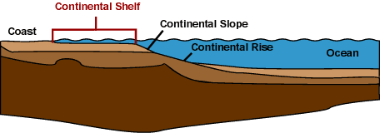

Slide 24
Continental Slope
Can be thought of as the “edge” of a continent
Begins at the shelf break and continues to deep sea floor
Much steeper than continental shelf and continental rise

Slide 26
Continental Rise
Formed by sediments that have been pushed down from continental shelf and slope
It can be thought of as an underwater river delta (the river in this case is formed of sediments)

Slide 28
Types of Margins
Passive margins:
  Relatively inactive geologically
  Characterized by flat, wide coastal plains, wide continental shelves and gradually sloping continental slopes
  Example: East Coast of US

Slide 29
Types of Margins
Active Margins:
  Sites of more intense geologic activity including earthquakes, volcanoes and trenches
  Characterized by steep, rocky shorelines, narrow continental shelves and steep continental slopes
  Example: West Coast of US
  http://www.youtube.com/watch?v=8Xpflh1187M&safe=active

