Slide 1

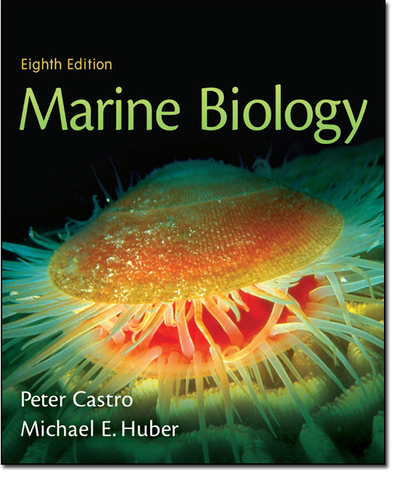
Chapter 6
Lecture
Slides
Copyright © The McGraw-Hill Companies, Inc. Permission required for reproduction or display.

Slide 2
Chapter 6
Multi-cellular Primary Producers: Seaweeds and Plants

Slide 3
Marine Algae
Marine algae are important primary producers (photosynthetic)
These algae are called by a generic term “seaweeds” or more formal term macroalgae
While some are thought to be the pre-cursors of plants, algae do not have the same advanced structures seen in plants such as roots, stems and leaves

Slide 4
Marine Algae
The body of a macroalgae is known as a thallus.
This thallus can be simple or more advanced in its structure.
In some algae, there are:
  Blades – leaf-like structures
  Stipes – stem-like structures
  Holdfast – root-like structures
  (these structures lack the advanced conducting tissues seen in true plants)

Slide 5
Marine Algae
Some algae also possess pneumatocysts, gas-filled bladders used to keep the blades near the water’s surface where more light is available for photosynthesis
The blades, stipes and pneumatocysts of the giant kelp ( a brown algae) are shown in Fig. 6.8

Slide 6
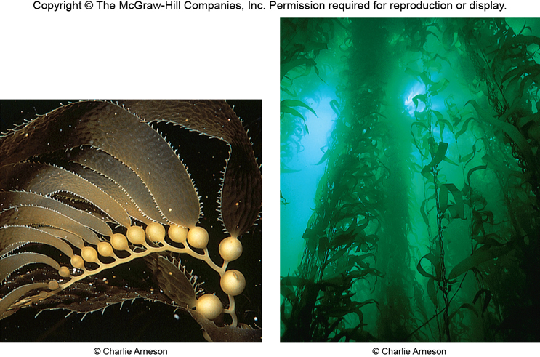

Slide 7
Marine Algae
Like plants, algae exhibit a life history marked by an alteration of generations.
To summarize, in the alternation of generations:
  A gametophyte stage produces gametes (eggs and sperm) that will fuse to become a zygote.
  This zygote then develops into a second stage, the sporophyte, that produces spores.
  These spores develop into the gametophyte stage and the cycle begins again (incidentally, plants are exhibit the same alternation of generations)
  The entire process is illustrated in Fig. 6.11, pg. 108.

Slide 8
Marine Algae
Many algae also reproduce asexually by a means called vegetative growth.
In this process, an algae reproduces new individuals that are genetically identical to the parent algae.

Slide 9
Marine Algae
Some algae are commercially important as food (ex: think of the algae used in the sushi industry)
Other algae are commercially important because of extracts that are harvested from them
For example, algin is an extract of brown algae that is used as a emulsifier in dairy products such as ice cream and cheese.

Slide 10
Marine Algae
Another example is the carrageenan harvested from red algae.
Carrageenan is also used as a thickening agent in dairy products such as yogurt, milkshakes, etc.
Agar is a second extract from red algae. Agar is used to culture microbes in the health care industry. It is also used as a thickener in foods, used as a filler in pharmaceuticals and cosmetics and to protect canned meats (ever opened a canned ham and noticed the “gel” around it? That’s agar.)

Slide 11
Types of Marine Algae
Green algae
  Thought to be ancestor of land plants
  ~ 7000 species; less than 1000 are marine
  Found worldwide in wet environments
  Microscopic to macroscopic
  Some coralline (produce calcium carbonate, Ex: Halimeda)
  Chlorophylls A and B as well as carotenoids (same as in true plants)
  Store excess energy as starch (same as in true plants)
  Cellulose in cell walls (same as in true plants)

Slide 12
Types of Marine Algae
Brown algae
  ~ 1500 species, almost all marine
  Some microscopic, most larger - to 300+ feet
  Prefer shallow, cold waters
  Contain chlorophyll A and C and fucoxanthin
  Typical body of holdfast, stipe and blades
  Source of algin
  Examples: kelp, Fucus, Sargassum

Slide 13
Types of Marine Algae
Notable brown algae:
  The kelps found in temperate and polar locations are the largest of the algaes
  In some species, like the giant kelp, each individual can be hundreds of feet in length
  This growth provides habitat for countless species of fish, marine mammals, birds and invertebrates – this community is known as the kelp forest.
  Kelp forests are among the most productive (and important) marine habitats.

Slide 14
Types of Marine Algae
Notable brown algae:
  Sargassum is a species of brown algae found in the Atlantic between North America and Europe as well as the Gulf of Mexico
  Massive floating mats of Sargassum provide habitat for countless species of fish, marine mammals, birds and invertebrates.
  This community is known as the Sargasso Sea.
  Like the kelp forests, the importance of this community cannot be overstated.

Slide 15
Types of Marine Algae
Red Algae
  ~ 4000 species, almost all marine
  Prefer deep cold waters or warm, shallow waters depending on species
  Some are corraline (produce calcium carbonate, Ex: Corallina, shown in Fig. 6.10, pg. 108)
  Mostly marine
  Contains photosynetic pigments, chlorophyll A and phycobilins

Slide 16
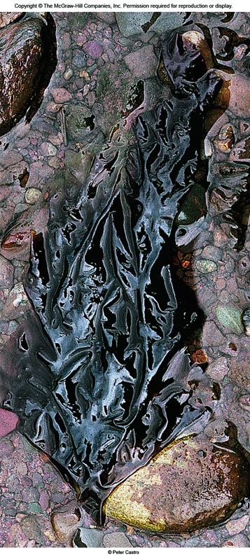

Slide 17
Advanced Primary Producers- Plants
Angiosperms are true plants.
Over 250,000 species exist worldwide, however, only a few of these exist in the marine community.
Those plants that do exist there must have mechanisms for dealing with salinity.
These plants have true leaves, stems, roots and conducting tissues.

Slide 18
Advanced Primary Producers- Plants
Seagrasses
  About 60 species exist in temperate and mainly tropical locations.
  Flowers are small and inconspicuous in most species.
  Pollen (sperm) is carried by water currents.
  Tiny seeds produce by fertilization are also carried by water currents or in the feces of animals that consume the seagrasses.

Slide 19
Advanced Primary Producers- Plants
Seagrasses
  Seagrasses are known to exhibit rapid growth and provide food to many organisms
  They also provide habitat for countless organisms that hide among the blades in seagrass beds (large collections of seagrass plants)
  Eelgrass is the most widely distributed of the seagrasses where it is widely distributed in shallow water bays and estuaries.

Slide 20
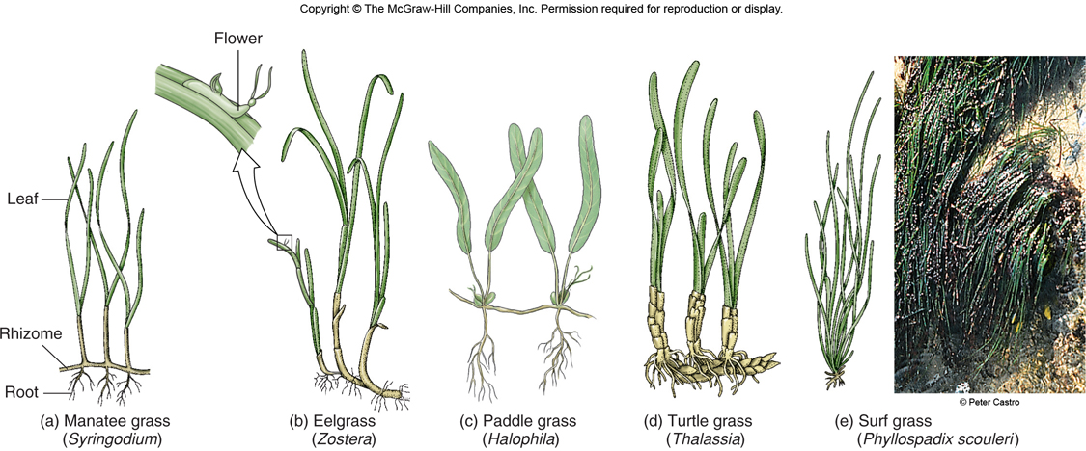

Slide 21
Advanced Primary Producers- Plants
Salt marsh Plants- plants bordering shallow bays and tidal creeks.
  Cordgrass, Spartina, the predominant salt marsh plant is in the grass family.
  Spartina is only exposed to saltwater at high tide.
  Spartina is extremely important as habitat to young marine animals such as juvenile invertebrates and fish.
  Very little Spartina is directly consumed by herbivores. Instead, its importance as a primary producer comes when plants die back in winter and bacteria and fungus break the leaves down to detritus.
  Detritus is a nutrient source for countless organisms.
  Spartina plants possess salt glands to help deal with excess salt.
  Other halophytes (salt-tolerant plants) exist in areas of higher elevation than Spartina.

Slide 22
Advanced Primary Producers- Plants
Mangrove trees
  About 80 species of mangroves exist only in tropical and subtropical areas.
  They cannot withstand freezing temperatures.
  Like Spartina, they only tolerate partial salt water submergence.
  Mangroves have a thick network of prop roots that are heavily exposed at low tide (Fig. 6.14, pg. 112 displays the roots of the red mangrove tree)

Slide 23
Advanced Primary Producers- Plants
Seeds of mangroves germinate while still attached to the parent plant and develop into elongated seedlings up to 1 foot in length before falling from the parent tree.
These seedlings drop into nearby soils or are carried by water currents to new locations (Occasionally, they are even found in NC after large storms such as hurricanes – they cannot grow here, however, due to freezing temps).

Slide 24
Advanced Primary Producers- Plants
Mangrove forests, or mangals, provide habitat for marine organisms such as invertebrates, fish, turtles, birds and marine mammals.
They can be though of as the tropical equivalent of salt marshes.

Slide 25
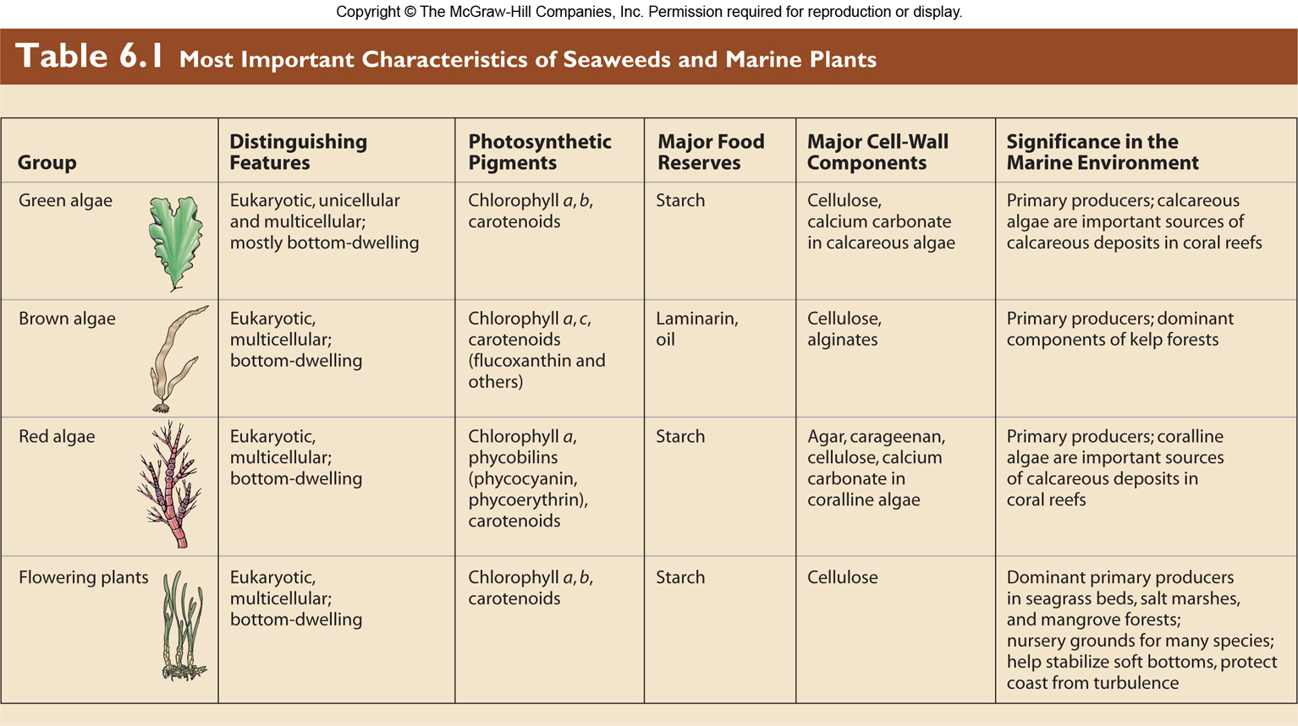
Most Important Characteristics of Seaweeds and Marine Plants

