Slide 1

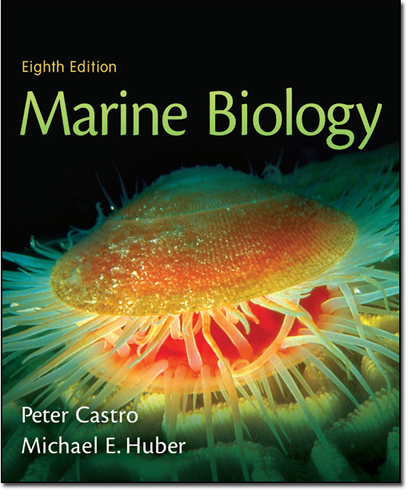
Chapter 11
Lecture
Slides
Copyright © The McGraw-Hill Companies, Inc. Permission required for reproduction or display.

Slide 2
Chapter 11
Between the Tides

Slide 3

What is the intertidal zone?
The intertidal zone is the area between the mean low tide and mean high tide.
By contrast, the subtidal zone is the area that is always submerged.
The intertidal zone, therefore, borders the subtidal zone.
The intertidal zone will be exposed during low tide.

Slide 4
Substrate
Substrate refers to the type of “bottom” that is present in a community.
In the intertidal zone, substrate types can be rocky or soft bottom.
Soft bottoms can vary from sand to silt or a mixture (mud).
Rocky substrate can vary as to the type of rock present and the degree of height/slope.

Slide 5
What type of organisms live in the intertidal zone?
Epifauna – organisms that live on the surface of the substrate (ex: mud snails on soft bottoms, barnacles on hard substrates)
Infauna – organisms that live in the substrate (ex: clams burrowed in soft bottoms)
Meiofauna – organisms that are so small that they live between the grains of soft substrate
These organisms can be sessile (attached) or motile (able to move).

Slide 6
Problems Associated with the Intertidal Zone
Due to the exposure seen in the intertidal zone, organisms face a variety of challenges, including:
  Desiccation (water loss)
  Temperature changes (can be extreme)
  Salinity changes (can be extreme)
  Interrupted feeding
  Wave action and tides
  Oxygen availability and build-up of CO₂
  Limited space

Slide 7
Dessication
When exposed, organisms must deal with potential water loss.
Water loss is more pronounced on hot, dry days or windy days.
Organisms can deal with the potential water loss by hiding or “clamming up.”

Slide 8

Desiccation
Hiding may involve moving to a tide pool or an area with more moisture (motile organisms)
Hiding may also mean that some organisms only live in areas where moisture will remain when the tide is out (such as crevices in rocks or low spots in soft bottoms)

Slide 9
Desiccation
“Clamming up” consists of closing shells or otherwise walling yourself off from the environment in an attempt to conserve moisture (such as an oyster closing its shell or a snail walling itself off using its operculum).
While moisture can be conserved in this way, there is a down side – no exchange of gases or feeding occurs.

Slide 10
Changing Temperatures
The wide variety of temperatures that must be tolerated by organisms in the intertidal can be severe.
Imagine, one morning the temperature may hover around 60 degrees with an afternoon spent in temperatures exceeding 100 degrees.
Some organisms have mechanisms to help stay cool.

Slide 11
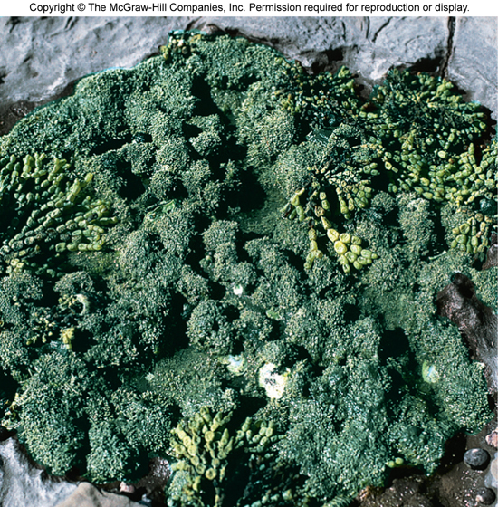

Slide 12
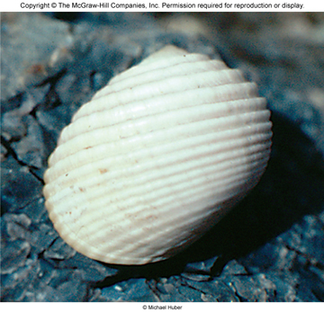

Slide 13
Changing Salinity
Salinity can change dramatically due to temperatures or weather.
Normal ocean salinity is around 33-35 ppt.
Estuarine salinity normally varies between 5 ppt and 30 ppt.
Organisms in the intertidal are normally euryhaline (can tolerate a wide variety of salinities); subtidal organisms by contrast are normally stenohaline (tolerate a very low range of salinities)

Slide 14
Changing Salinity
Salinity may begin at 20-25 ppt and climb dramatically during the day due to water loss when the intertidal is exposed.
Salinity may also drop during the day due to a sudden influx of freshwater provided by a passing thunderstorm.
Now, imagine a salinity change of possibly 20 ppt or more combined with a temperature change of 40 degrees or more. Organisms must be extremely adaptable or perish.

Slide 15
Interrupted Feeding
If an organisms “clams up,” feeding will cease.
Feeding will also cease for filter feeders when exposed to air.
A few organisms such as snails can still feed during low tide by scraping algae off surfaces.
Remember, for communities with semidiurnal tides, an organism could spend nearly half of their day un-submerged and not feeding.

Slide 16
Wave Action
Waves can be a problem for organisms that live in intertidal communities directly exposed to them. This action may dislodge organisms from their habitat.
Rocky shorelines are often exposed to significant wave action.
In soft bottomed communities, the open beach intertidal zone is exposed to significant wave action.
Marsh communities are normally not exposed to as much wave action due to their position behind the open beach.

Slide 17
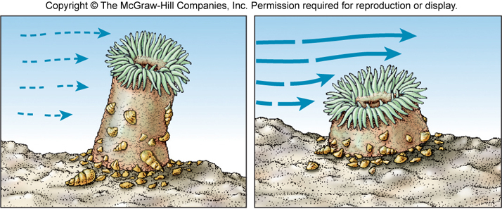

Slide 18
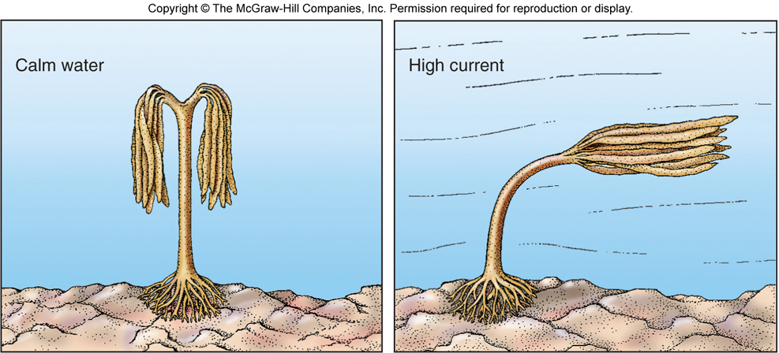

Slide 19
Oxygen Availability
Oxygen can be exhausted if an organism “clams up” during low tide.
It can also be exhausted in tidal pools if many organisms have sought refuge there.
Carbon dioxide can also build up to toxic levels when organisms are not able to exchange these gases with their environments.
Some organisms have evolved the capability to exchange gases in air and water (such as many crab species).

Slide 20
Limited Space
In some intertidal communities, proper space may be limited.
This is particularly true in rocky intertidal environments where the amount of surface area is limited.
However, space can be limited in soft bottomed communities as well. Organisms in these areas prefer hard substrate such as living on an “oyster reef” because they do not need to worry about washing away due to water action.

Slide 21

Zonation in the Intertidal
Zonation in the intertidal consists of upper intertidal (most exposed) to middle and lower intertidal (least exposed).

Slide 22
Zonation in the Intertidal
Competition will be greater in the lower intertidal because it is the least “severe” of the zones since it is exposed to a lesser degree than the upper intertidal.
The lower intertidal is always more species rich for the same reason (although species will vary greatly by location).

Slide 23

Competition
Some organisms are better competitors than others are will exclude other organisms if the community is left undisturbed.
If a habitat is disturbed, organisms move in and are later excluded in a predictable pattern known as succession.
The climax community (end result) will eventually form when the community is undisturbed for a long period of time. (Seen at right.)

Slide 24

Substrate in the Soft Bottomed Intertidal
In the soft bottomed intertidal community, grain size can vary greatly between sand, silt, clay or a mixture (mud).
The smaller the particular size, the less oxygen that can fit in those spaces.

Slide 25
Substrate in the Soft Bottomed Intertidal
The grain size is so small in most soft bottomed intertidal communities that all except the top few inches will be anoxic (without oxygen).
Therefore, meiofauna is usually restricted to the oxygenated zone.
Infauna must maintain a connection with the oxygenated zones via tubes, siphons or extended burrows if they are located in the anoxic zone.
In the anoxic zone, many anaerobic bacteria exist that break down organics.

Slide 26

Soft Bottom Intertidal Organisms
The diagram to the right shows the diversity of infauna and epifauna that may be found in this community.

Slide 27

Soft Bottom Food Webs
Detritus (broken down organic particles) and producers such as photoautotrophs and chemoautotrophs form the basis for the food web in this community.

Slide 28

Rocky Intertidal Food Webs
The food web in the rocky intertidal is based on autotrophs such as seagrasses, algae and diatoms.
Top carnivores in any community that have the ability to change community composition significantly are known as keystone predators.

